Slide 1
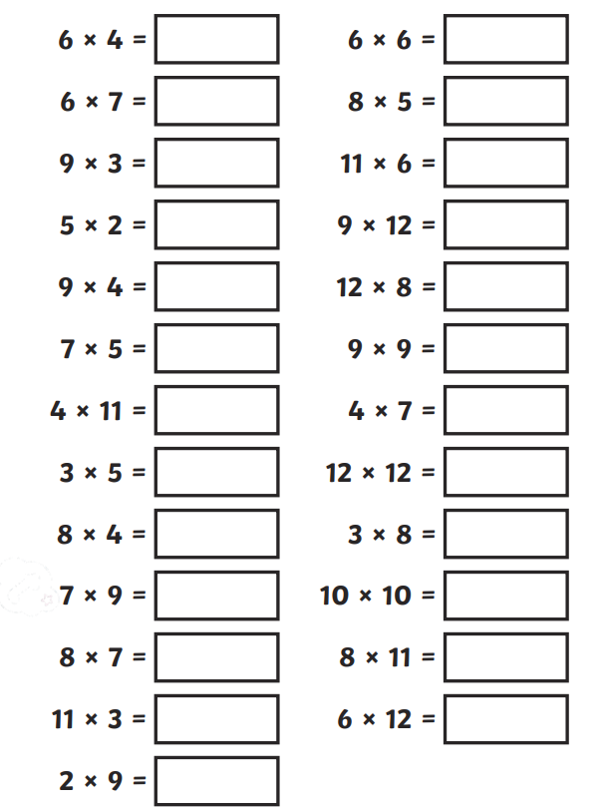
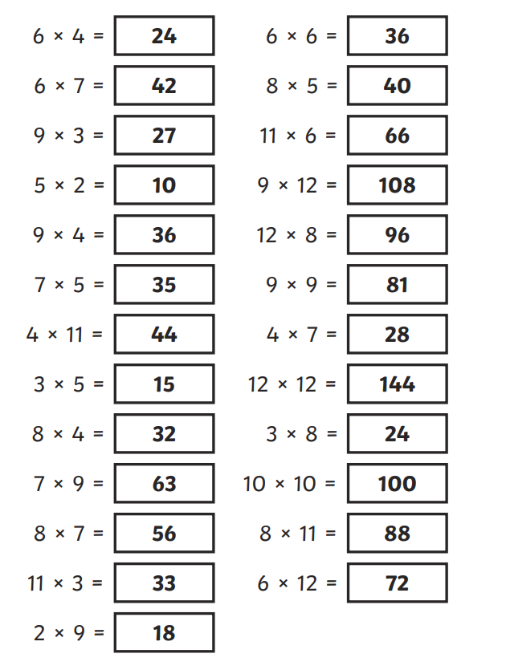
Thursday 9th May Morning challenge
Check your answers:
Is it your day for TTRS?

Slide 2
Thursday 9th May OUT THERE – EAST NORFOLK TRIP

Slide 3
Thursday 9th May TBAT: spell words with the prefix 'non'.
Dictation

Slide 4
Thursday 9th May TBAT: spell words with the prefix 'non'.
Dictation
The teacher was reading the non-fiction book to the class.
The children were talking a lot of nonsense during breaktime.
The traffic was non-stop but the woman wanted to get to the non-profit shop.
Challenge
Write your own sentence using at least two of our spelling words from this week (they must be in the same sentence).

Slide 5
Thursday 9th May TBAT: know fires can be started and how to be protected from a fire at school. What do you already know about fires? What is needed to start a fire? Explain why we need to take precautions in buildings to prevent fires.

Slide 6
Thursday 9th May TBAT: know fires can be started and how to be protected from a fire at school.

Slide 7
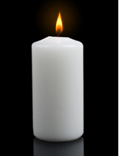
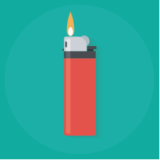
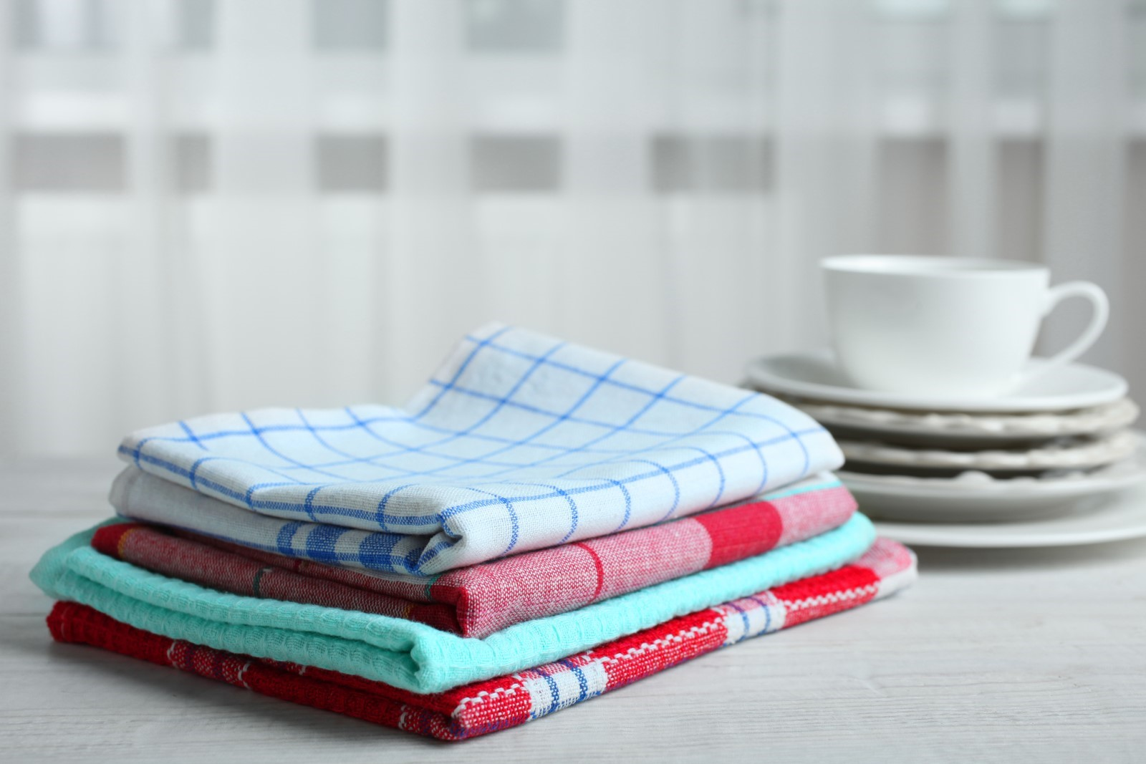
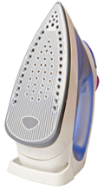
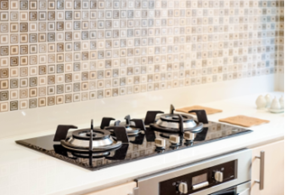
Thursday 9th May TBAT: know fires can be started and how to be protected from a fire at school.
Which element of the fire does each picture relate to?

Slide 8
Thursday 9th May TBAT: know fires can be started and how to be protected from a fire at school. Where are the dangers in the following slide?

Slide 9
Home safety challenge
Notes:
Ask pupils to play ‘Spot the dangers’ game. They should identify the possible fire hazards within the home. This might include: overloaded sockets, a burner left on, the iron plugged in on the ironing board and left on a piece of clothing, tea towel left above hob, towel on radiator.

Slide 10
Thursday 9th May TBAT: know fires can be started and how to be protected from a fire at school. Think about how we keep safe at school. Write down which precautions we take to keep ourselves safe and draw a picture to go with this. What could happen if precautions aren't followed?

