Slide 1
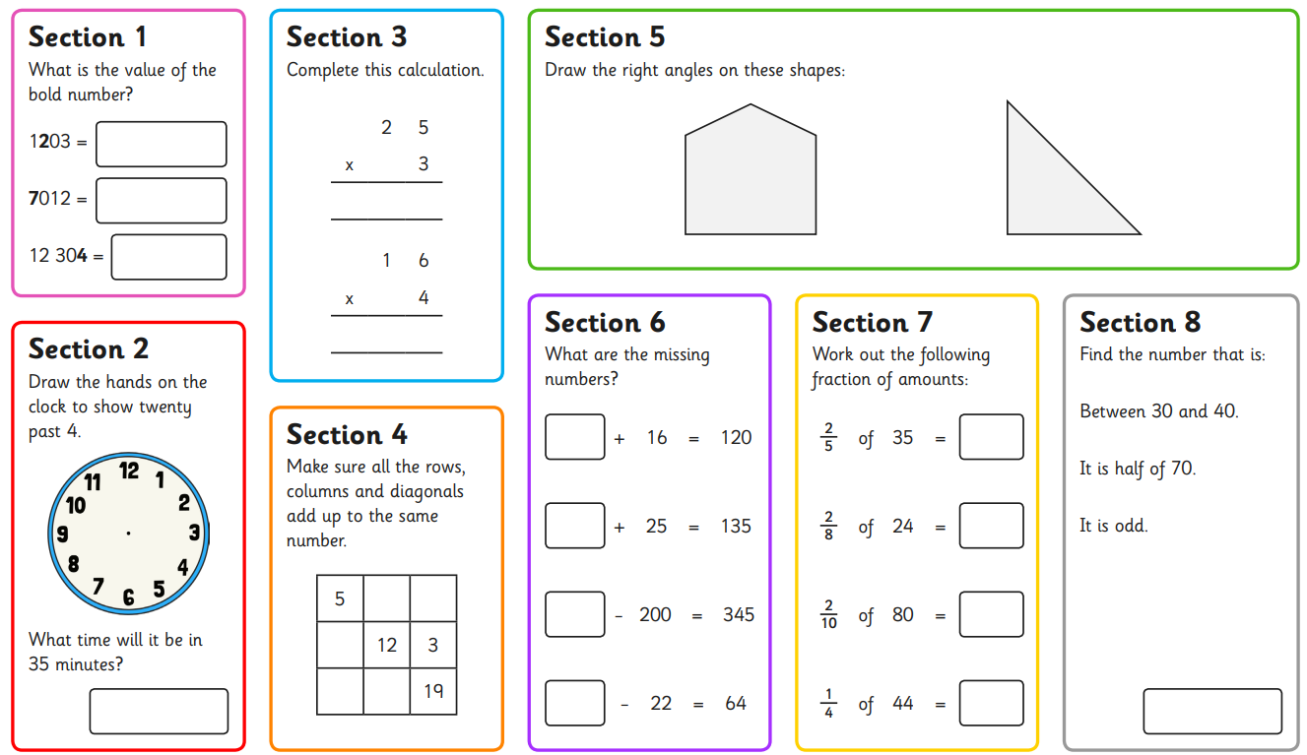
Wednesday 8th May
Morning Challenge

Slide 2
Cleopatra was born in 69 bce in the city of Alexandria in Egypt. Her family originally came from Macedonia in Europe, but it had ruled Egypt for more than 200 years. Cleopatra and her brother, Ptolemy XIII, became rulers together after their father died in 51 bce. However, her brother had followers who soon drove Cleopatra from power.
Tutankhamun or “King Tut” is probably the most well-known Egyptian pharaoh. One of the reasons is that his burial tomb is one of the few that was discovered with everything still in it.
It was common for tomb raiders to steal all of the treasures that were buried with the pharaohs and so very little has ever been found.
The tomb raiders didn’t locate King Tut’s tomb and we can use the contents of the tomb to learn about the culture and people of ancient Egypt.
King Tut lived from around 1341 to 1323 BC, and because he was only ten years old when he became a pharaoh, he was called the ‘boy king’. King Tut’s father was the pharaoh Akhenaten.
Ramses II was an Egyptian pharaoh. He ruled ancient Egypt from 1279 to 1213 bce. His reign was the second longest in ancient Egyptian history.
Ramses II was also known as Ramses the Great. He was given this name because he was known as a great military leader. He also built many temples and buildings throughout ancient Egypt. Massive statues of him can be found all over Egypt.

Slide 3
Trip to East Norfolk Sixth Form

Slide 4
Wednesday 8th May 2024
8.05.23
TBAT: realise why you shouldn't make assumptions.
Partner Talk
What is a stereotype?
How would you describe to someone who doesn't know what a stereotype is?

Slide 5
Wednesday 8th May 2024
8.05.23
TBAT: realise why you shouldn't make assumptions.
Today we are going to look at a made up land of Grinadod.
In this land they are certain there prejudices are correct.
What is a prejudice?

Slide 6
That’s stereotyping!
Welcome to the Land of Grinadod!
People here have strong opinions!
Notes:
Ask pupils to briefly imagine this land.

Slide 7
That’s stereotyping!
To find out what they think of you here, decide whether you are left- or right-handed and what colour your eyes and hair are.
Notes:
Help pupils to be clear!

Slide 8
That’s stereotyping!
This is what they think in Grinadod.
If you are left-handed, you don’t like animals.
If you are right-handed, you are a very quiet person.

Slide 9
That’s stereotyping!
This is what they think about you in Grinadod, based on your hair colour:
Hair colour | What you think
Blonde | You wish you could go to school at the weekends because it’s so much fun!
Brown | You think PE should be banned.
Black | You wish you could do spelling tests every day at school.
Red | You fall asleep at school every day.
Other | You wish school was a place where talking wasn’t allowed!

Slide 10
That’s stereotyping!
This is what they think about you in Grinadod, based on your eye colour:
Eye colour | What you are like
Blue | Really secretive
Hazel | Really good at music and singing
Brown | Really good at building
Green | Really religious
Grey | Really bad at running
Other | Really mean

Slide 11
Imagine you are from the land of Grinadod!
Wednesday 8th May 2024
8.05.23
TBAT: realise why you shouldn't make assumptions.
You must now assume something that the people from Grinadod would assume if they had never met you before.

Slide 12
Wednesday 8th May 2024
8.05.23
TBAT: realise why you shouldn't make assumptions.
Finish these sentences
It is unkind to assume things about people because...
People may feel ____________ if you assume things about them.

Slide 13
Wednesday 8th May 2024
08.05.23
Wayfarers
Computing
TBAT: identify input and output devices
Blue
What is an input?
Green
What is a process?
Challenge
Why is the output different to the input?

Slide 14
Digital devices must have an input, a process, and an output
Introduction
Process
Input
Output
When ‘H’ key pressed, display ‘H’
When ‘e’ key pressed,
display ‘e’
When...
Hello world
You press a button on the keyboard
The computer follows a program that tells it what to do when you press a button
You see the letter on the screen that matches the button that you pressed
Notes:
Image sources:
https://pixabay.com/photos/computer-keyboard-typing-1869236/
https://pixabay.com/illustrations/monitor-isolated-display-white-313011/

Slide 15
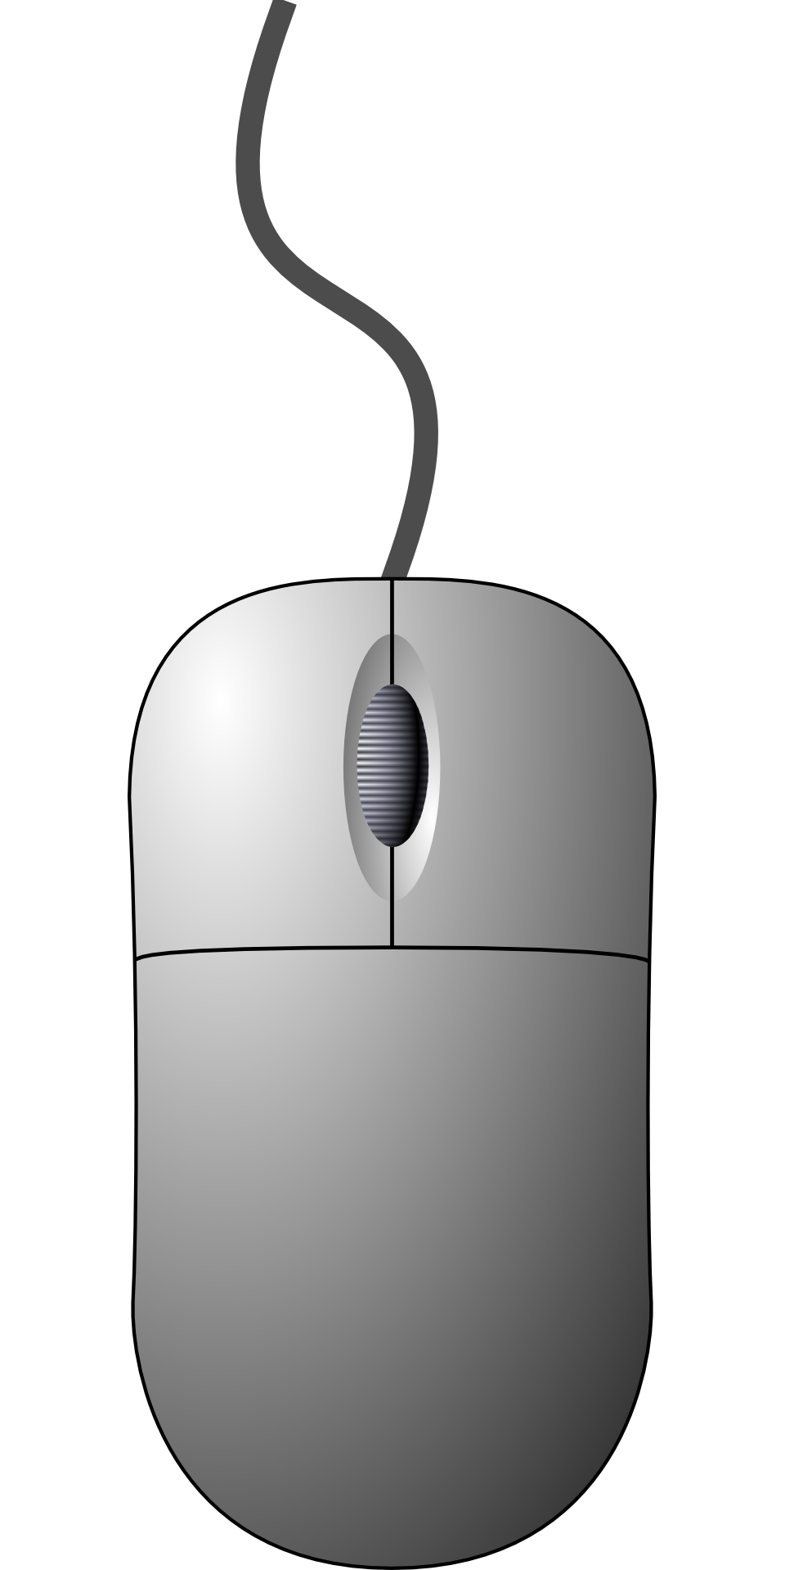
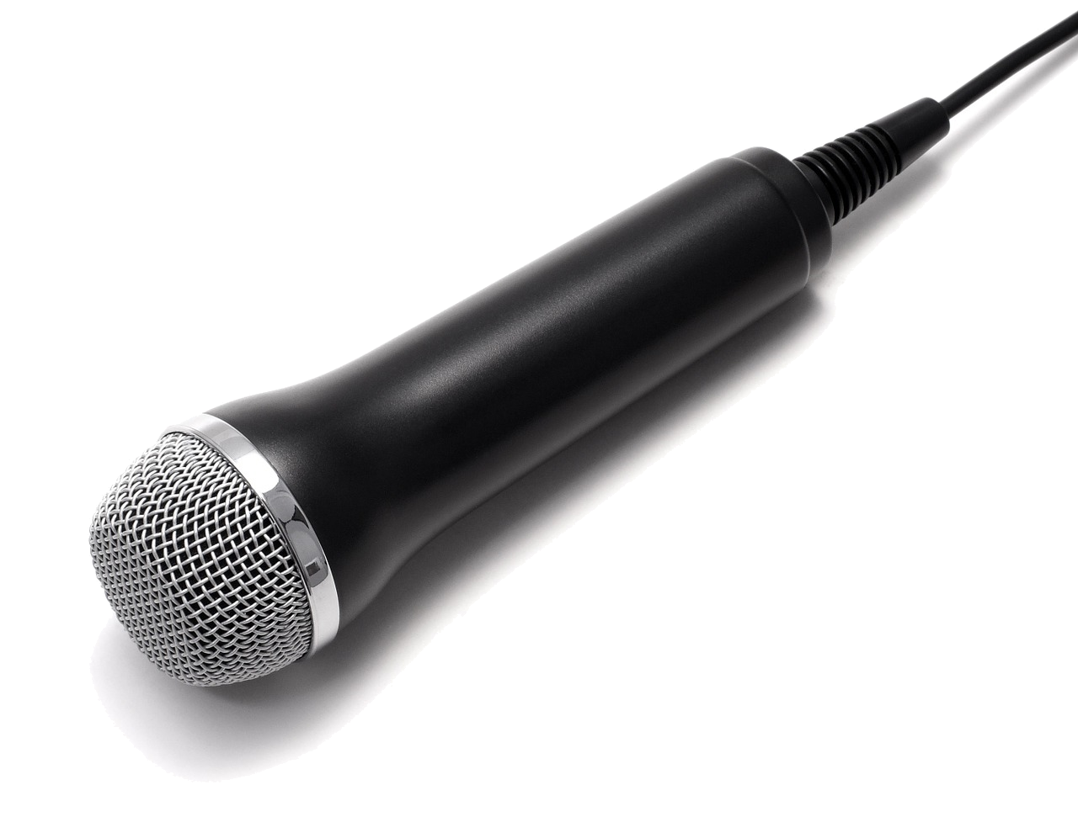
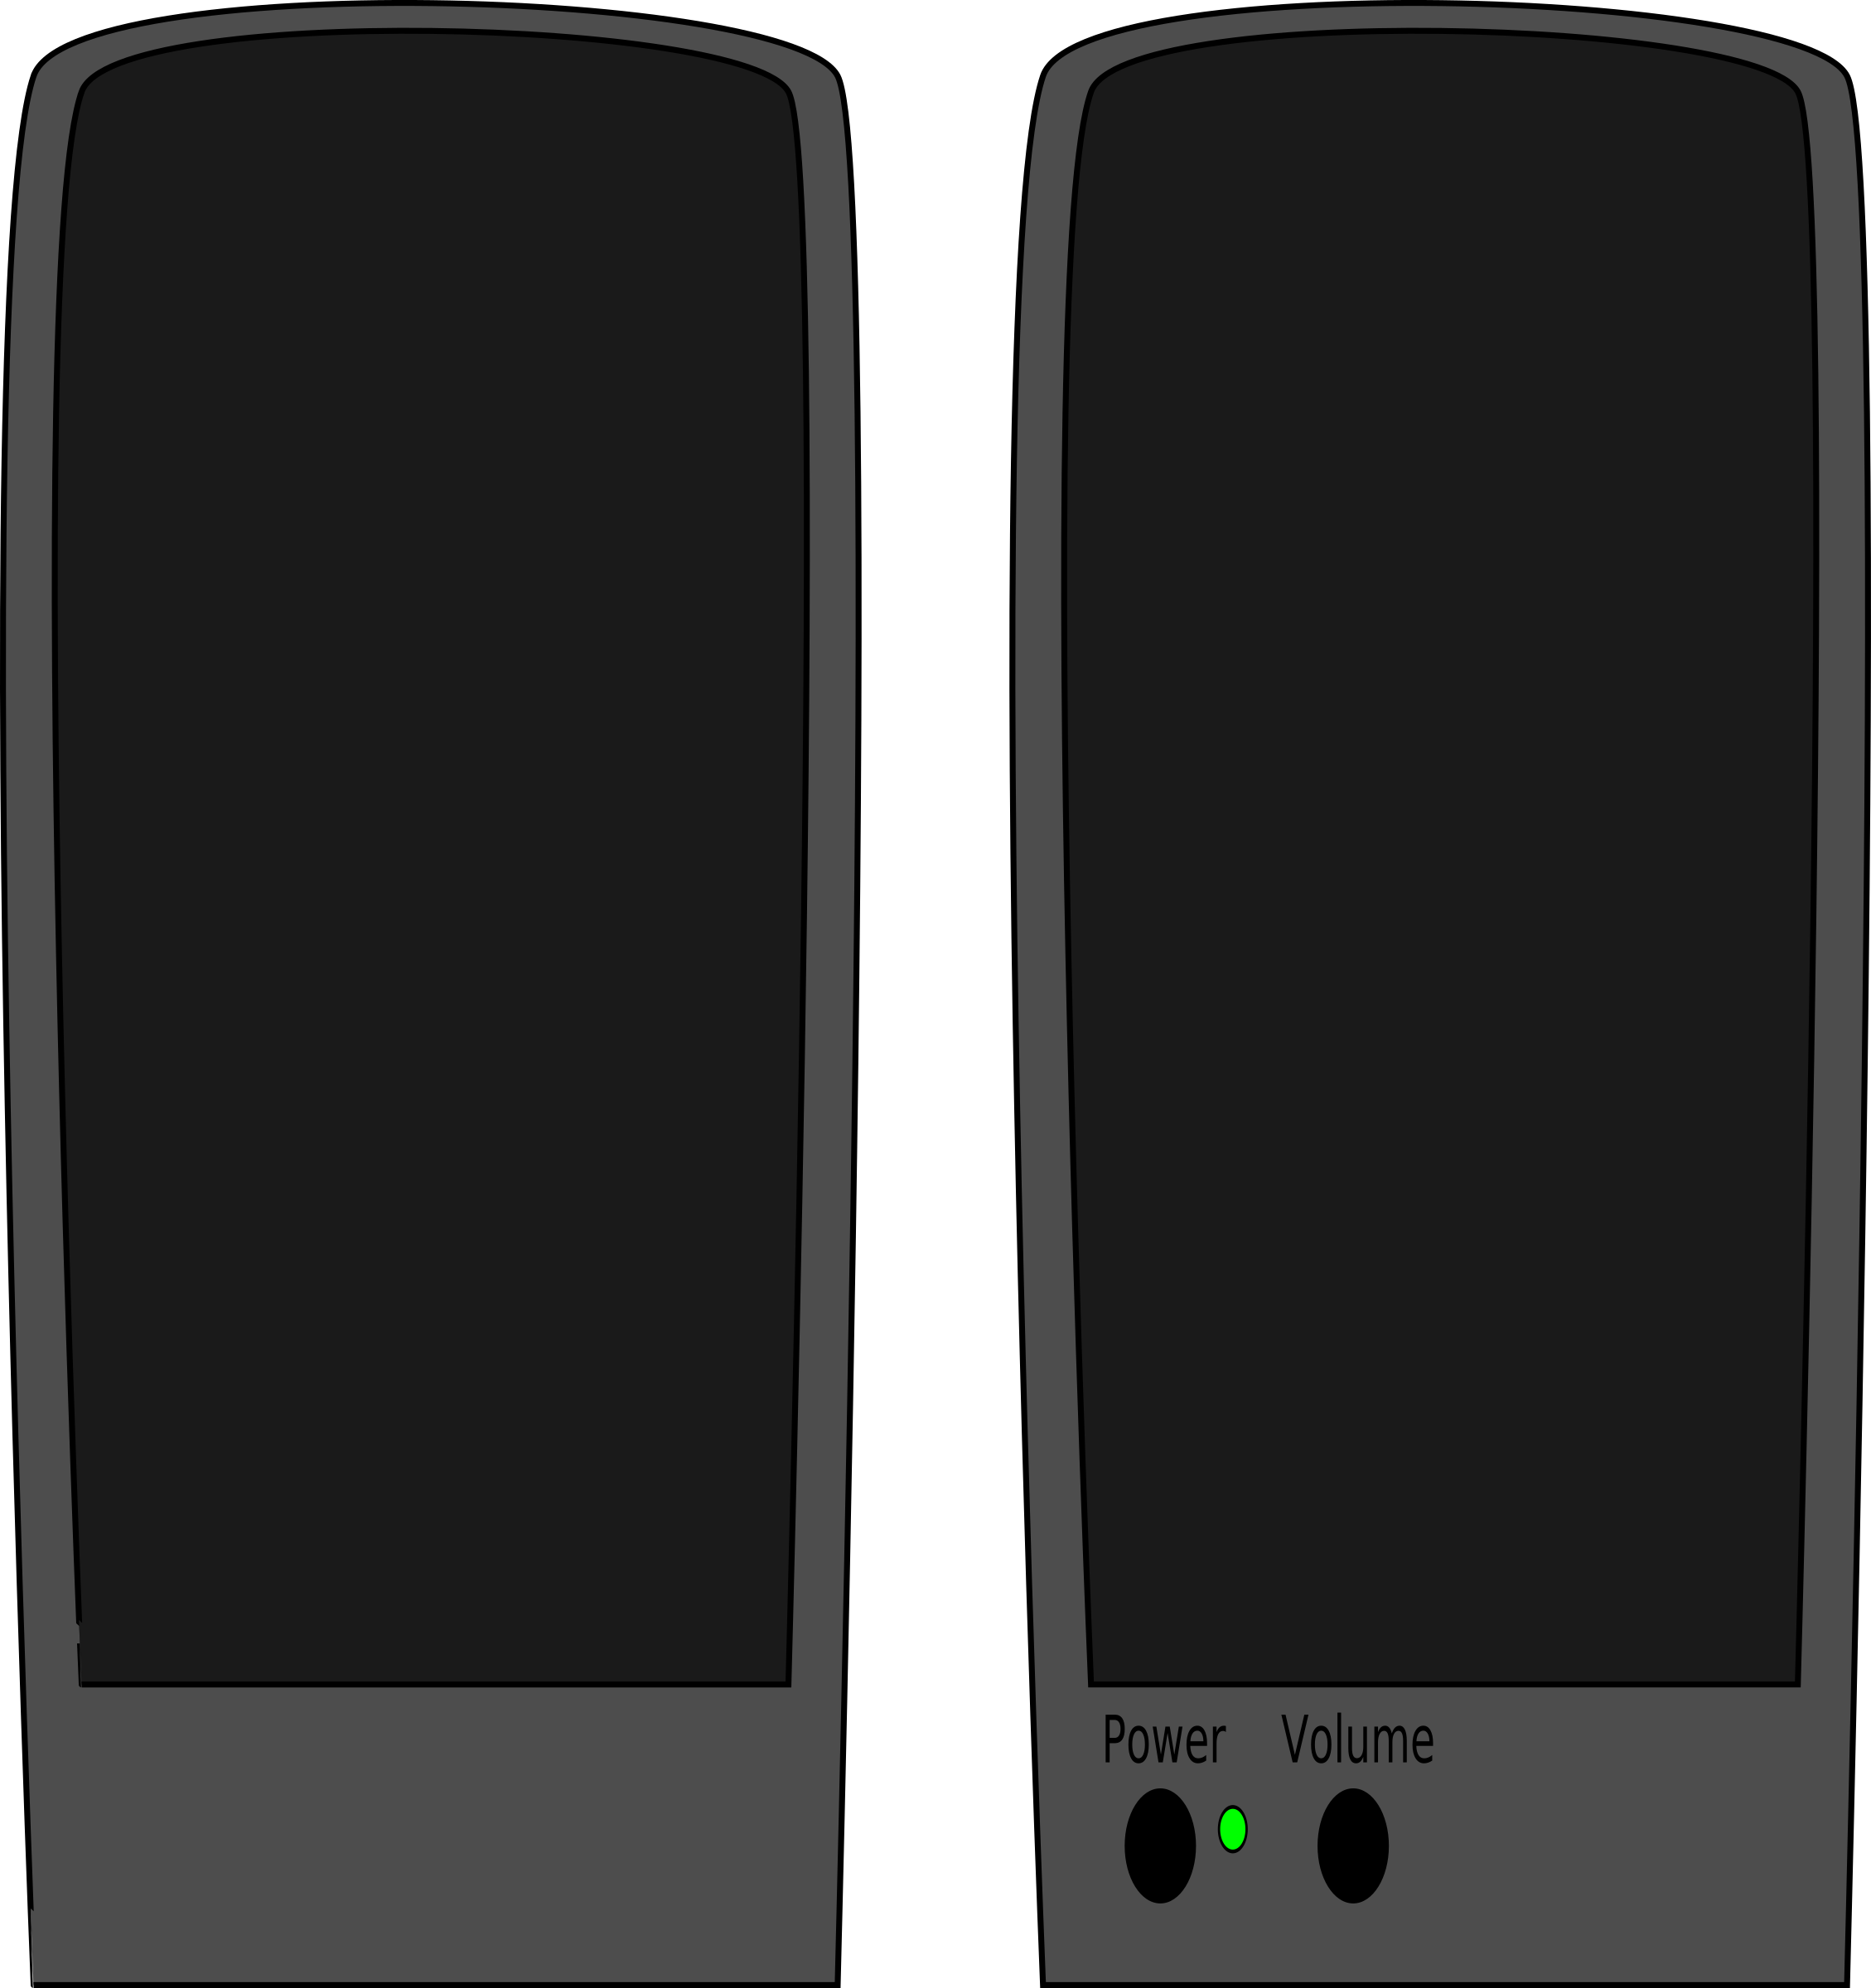
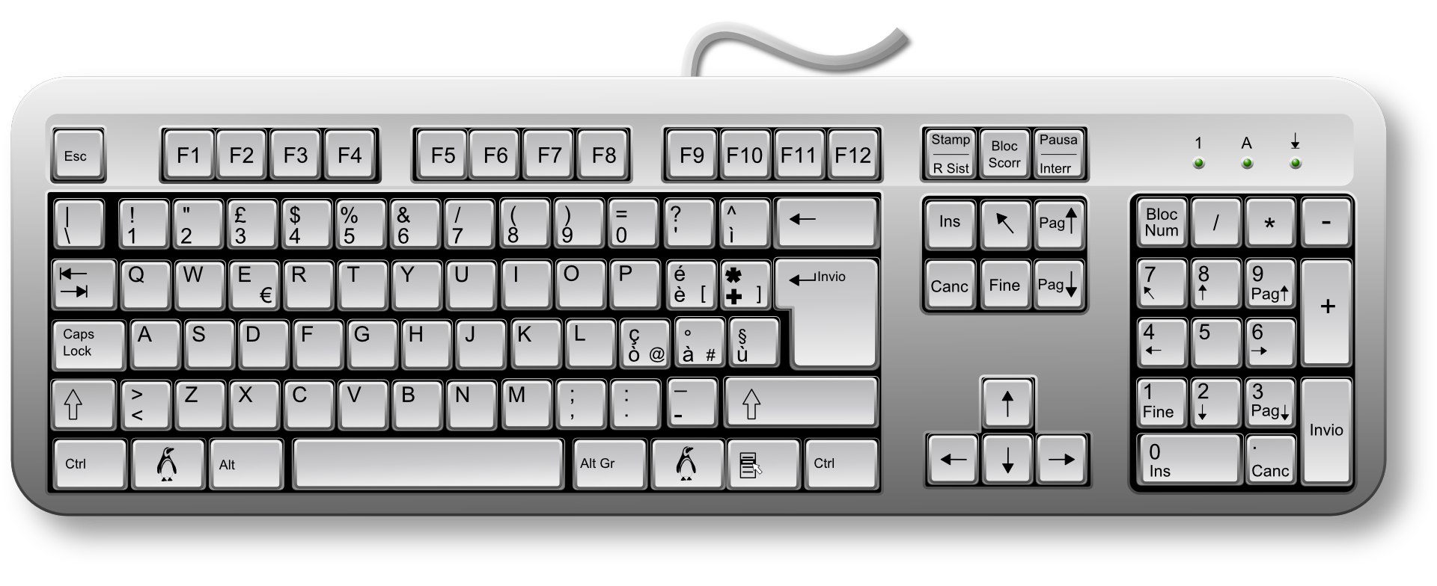
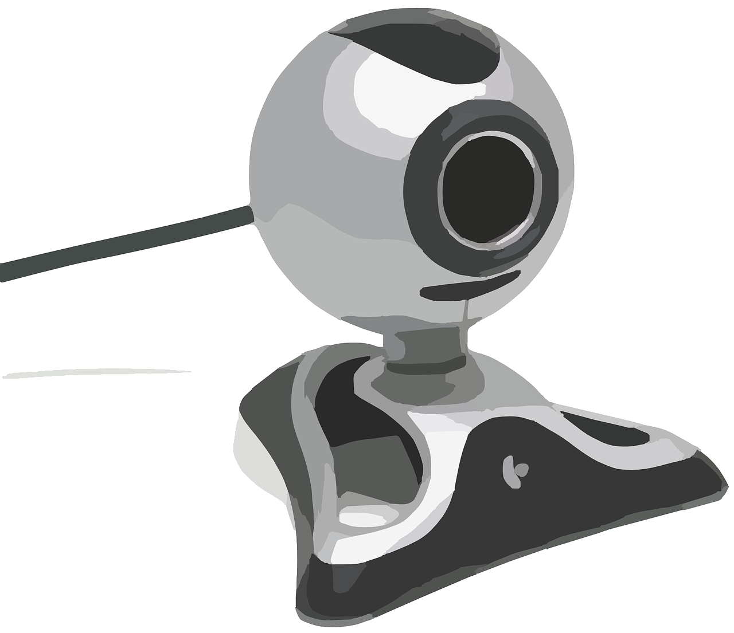
Input or output?
Activity 1
keyboard
printer
webcam
cable
microphone
monitor
input
mouse
output
touchscreen
speakers
Notes:
Image sources:
https://pixabay.com/vectors/mouse-computer-technology-internet-34688/
https://pixabay.com/vectors/loudspeakers-speakers-music-sound-29634/
https://pixabay.com/vectors/keyboard-keys-computer-hardware-162134/
https://pixabay.com/photos/micro-usb-microphone-1335142/
https://pixabay.com/vectors/monitor-display-computer-screen-309582/
https://pixabay.com/vectors/african-african-american-black-2029825/
https://pixabay.com/vectors/usb-cable-cable-connect-mini-usb-154767/
https://pixabay.com/vectors/printer-copier-modern-office-1293116/
https://pixabay.com/vectors/webcam-video-camera-movie-record-295440/

Slide 16
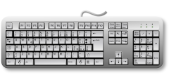
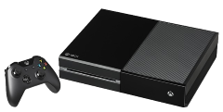
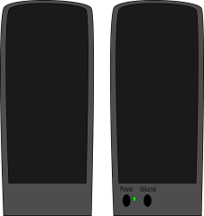
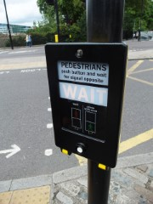
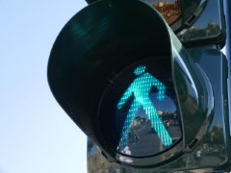
Year 3 – Connecting computers Lesson 2 – What parts make up a digital device? | Learner activity sheet
Match input, device, output
Task 1 – Match the Inputs, devices and outputs.
Input device
Digital device
Output device
Keyboard
Touchscreen
Games controller
Button
Laptop
Games console
Tablet
Pedestrian crossing
button
Printer
Screen
Speaker
Pedestrian crossing lights
Resources are updated regularly — the latest version is available at: ncce.io/tcc.
This resource is licensed under the Open Government Licence, version 3. For more information on this licence, see ncce.io/ogl.
Notes:
Last updated: 02-07-21
Image sources:
https://pixabay.com/vectors/keyboard-keys-computer-hardware-162134/
https://pixabay.com/vectors/african-african-american-black-2029825/
https://pixabay.com/vectors/video-game-controller-game-computer-147039/
https://pixabay.com/vectors/help-button-red-emergency-support-153094/
https://pixabay.com/vectors/laptop-notebook-mobile-computer-154091/
https://pixabay.com/photos/video-game-console-video-game-play-2202666/
https://pixabay.com/photos/ipad-tab-tablet-3d-2462599/
https://pixabay.com/photos/london-united-kingdom-678711/
https://pixabay.com/vectors/printer-copier-modern-office-1293116/
https://pixabay.com/vectors/monitor-display-computer-screen-309582/
https://pixabay.com/vectors/loudspeakers-speakers-music-sound-29634/
https://pixabay.com/photos/traffic-light-green-light-1024768/

Slide 17
Design a digital device
Activity 3
Can you design a machine that uses inputs and produces an output?
Your task
Can you describe how its processing works?
What does it do?
How does it work?
Some ideas
A device that:
Makes lights flash to music
Tells jokes
Takes a picture and changes it
Records a voice and changes it
Makes music

Slide 18
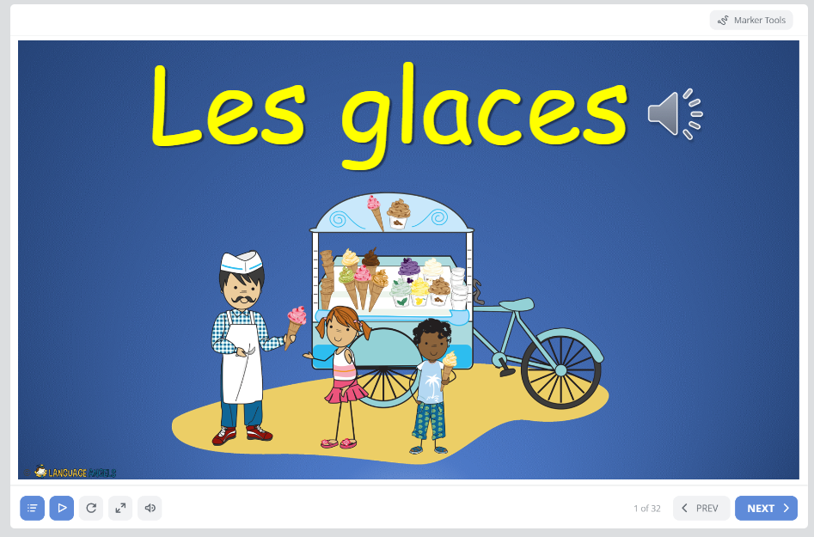
Mardi 8 Mai
TBAT: explain if you’d like a cone or a tub
Home (languageangels.com)
Unit – Ice Creams

Slide 19
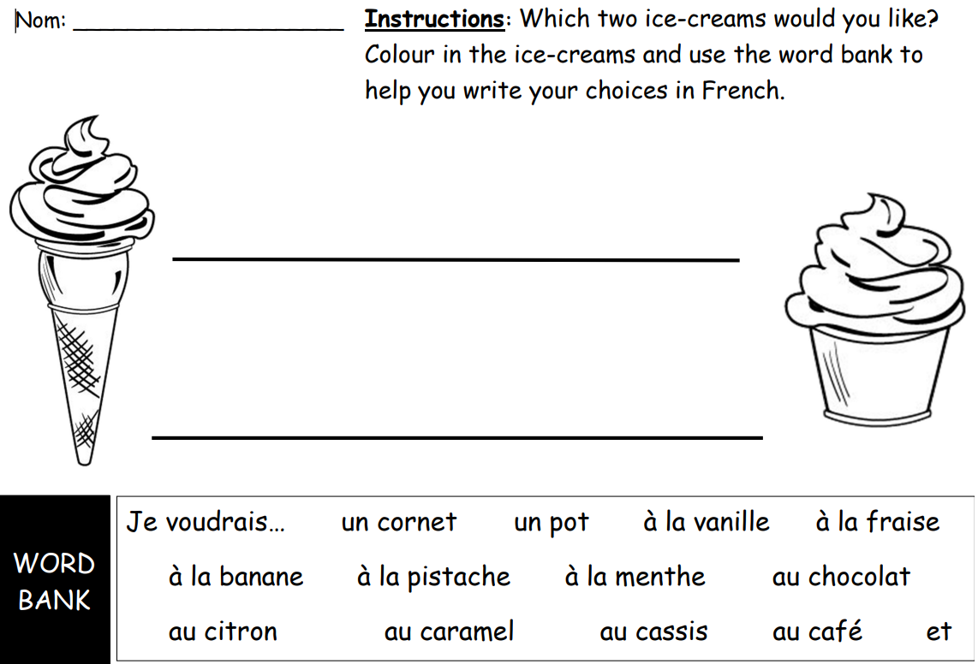
Mardi 8 Mai
TBAT: apply knowledge of 10 different ice cream flavours

Slide 20
TBAT: apply sending and receiving skills in games.
This half term in P.E will be Cricket and Balls Skills
- Changing for PE - Rules and expectations moving to PE - Move to the downstairs hall or outside Get Set 4 PE - KS2 OAA (getset4education.co.uk)

