Slide 1
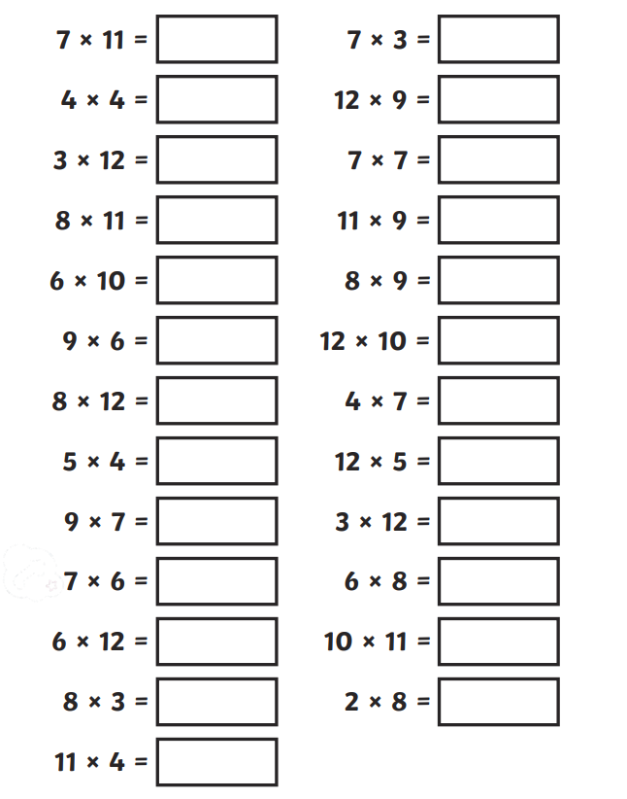
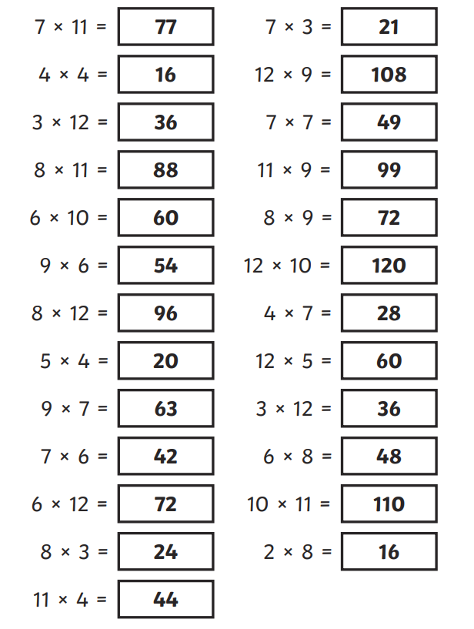
Wednesday 8th May Morning challenge
Check your answers:
Is it your day for TTRS?

Slide 2
Wednesday 8th May Music TBAT: Understand that melodies have phrases and explore layers and layering. What is a melody? What is the difference between a chorus and a verse? The Collins Hub Educator > Library Year 4 – Ancient Worlds – Lesson 1 – Amazing Egyptians

Slide 3
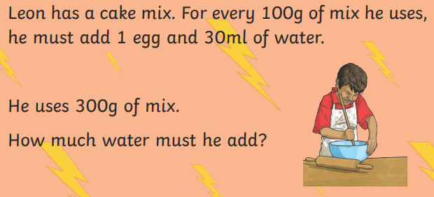
08.05.24 TBAT: add and subtract 0·1 and 0·01.
3 in 3
1. 5,132 + 2, 314 =
2. 308 – 10 =
3. 297 x 5 =

Slide 4
08.05.24 TBAT: add and subtract 0·1 and 0·01.

Slide 5
08.05.24 TBAT: add and subtract 0·1 and 0·01.
3.9 + 0.1 =
5 – 0.1 =

Slide 6
08.05.24 TBAT: add and subtract 0·1 and 0·01.
6.74 - 0.01 =
9.75 – 0.01 =
8.01 - 0.1 =

Slide 7
08.05.24 TBAT: add and subtract 0·1 and 0·01.
 | One tenth more
3.7
8.11
 |  | 9.2
12.9
 |  | 10

Slide 8
08.05.24 TBAT: add and subtract 0·1 and 0·01.
What is one tenth more than 8.79?
What is one tenth less than 4.51?
What is one hundredth more than 8.79?
What is one hundredth less than 4.51?
Isabella is thinking of a number.
She adds one tenth.
She subtracts one hundredth.
She ends with 3.09.
What number did she start with?

Slide 9
08.05.24 TBAT: add and subtract 0·1 and 0·01.
Challenge -
Write the next three numbers in these decimal sequences.
1. 3.7, 3.8, 3.9, ____, ____, ____.
2. 5.84, 5.83, 5.82, ____, ____, ____.
3. 1.12, 1.23, 1.34, ____, ____, ____.
Mastery Challenge -
Write your answer as a decimal and a fraction.
1. 5.67 + 1/10 =
2. 8.74 + 1/100 =
3. 1/10 + 1/100 + 0.99 =
Mastery Challenge with Greater Depth -
Ella is thinking of a number.
She adds one tenth.
She subtracts one hundredth.
She adds 0.3.
She doubles it.
She ends with 7. What number did she start with?
1. 6·9 + 0·1 =
2. 9·17 – 0·01 =
3. ___ = 2·39 + 0·01
4. 8 – 0·01 =
5. ____ = 8·7 – 0·1
6. 12·4 + 0·1 =
7. ____ = 8 – 0·1

Slide 10
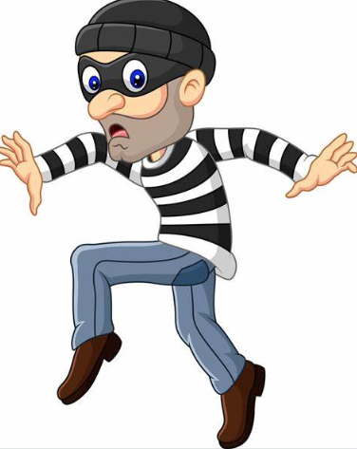
Wednesday 8th May TBAT: spell words with the prefix 'non'.
The spelling thief has taken away some of the letters from our spellings. Fill in the missing letters to complete the words.
__on – __tic__
N__nse__s__
N__n –__to__
__ __n – st__rt__r
__on – __el__ev__r
Challenge: Unjumble the words to create some of our spelling words. Once unjumbled, use the words in a sentence.
Onn – tionfic nno - toiftpr

Slide 11
Wednesday 8th May TBAT: write a balanced argument.
3 in 3 Should children be allowed to eat chocolate for breakfast?
Breakfast is known as the most important meal of the day; it gives you energy and fuel and therefore powers you for the morning. A decent breakfast should allow you to wake up properly and allow you to function fully in the morning. In supermarkets these days, there are many different options for breakfast. Cereal, toast, yogurts, fruit- all of these items are popular choices for children to start the day with. Having said this, there are some children who would choose a less conventional start to their day- a bar of chocolate. There are arguments for and against the eating of chocolate for breakfast and this balanced argument will examine the opinions for both sides.
1. What is this balanced argument about? 2. Name three alternative options for breakfast instead of chocolate. 3. Find and copy a word which means traditional.

Slide 12
Wednesday 8th May TBAT: write a balanced argument.
Partner talk: Read your paragraph from last week – does it make sense? What could you improve on?
What are you proud of? Can you spot a subordinate clause?

Slide 13
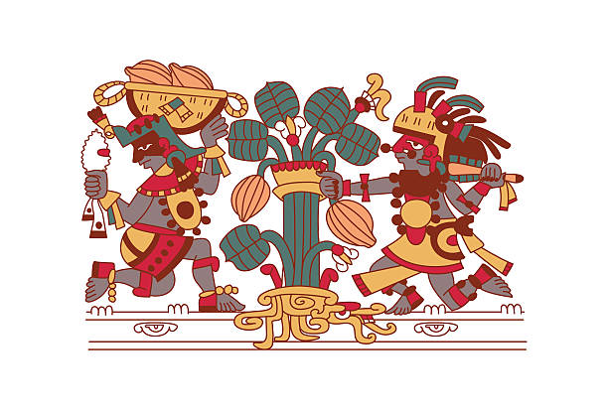
Wednesday 8th May TBAT: write a balanced argument.
SHOULD THE MAYAN GODS GIVE THEIR PEOPLE CHOCOLATE?

Slide 14
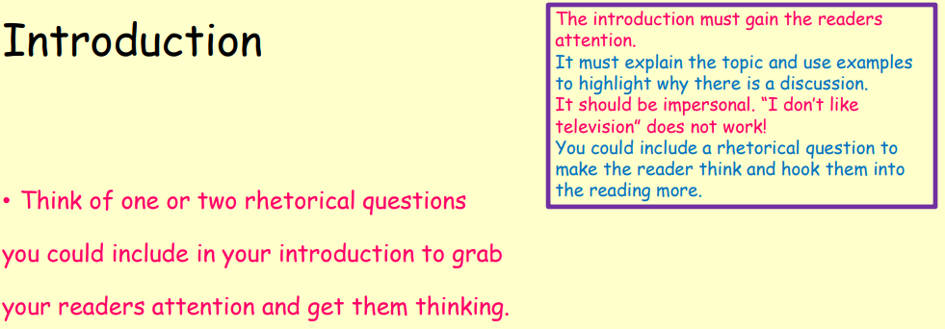
Wednesday 8th May TBAT: write a balanced argument.
SHOULD THE MAYAN GODS GIVE THEIR PEOPLE CHOCOLATE? Today, you are going to write your introduction and first paragraph (which you can use from Friday)
In the realm of the Mayan gods, a debate rages over whether the divine gift of chocolate should be given to their people. On one hand, chocolate is a delectable delight, capable of bringing joy and sweetness to the lives of the Mayan people. However, on the other hand, there are concerns about the potential consequences of introducing such a tempting treat into their society. In this balanced argument, we will explore both sides of the debate to determine whether the Mayan gods should indeed share their sacred chocolate with their people. By weighing the benefits and drawbacks of this decision, we can uncover the best course of action for the divine guardians of the Mayan civilization.

Slide 15
Wednesday 8th May TBAT: write a balanced argument.
SHOULD THE MAYAN GODS GIVE THEIR PEOPLE CHOCOLATE? Should the Mayan gods bestow the gift of chocolate upon their people? Yes, indeed! Chocolate, with its rich and delicious flavour, has been cherished by civilizations throughout history, and the Mayan people would surely benefit from its divine taste. Firstly, chocolate is not just a delightful treat, but it also holds cultural significance for the Mayans, who have long revered cacao as a sacred symbol of wealth and prosperity. By sharing chocolate with their people, the Mayan gods would honour this tradition and strengthen the bond between the divine and the mortal realm. Moreover, chocolate is known to have various health benefits, such as improving mood and boosting energy levels, which could enhance the well-being of the Mayan people. With its heavenly taste and positive effects, chocolate would undoubtedly be a welcome addition to the lives of the Mayan people, making it a gift worth giving. While the idea of the Mayan gods giving chocolate to their people may sound appealing, there are reasons to argue against it, especially considering the gifts and blessings the gods have already bestowed upon the Mayan civilization. Throughout history, the Mayan gods have provided their people with abundant resources, fertile lands, and spiritual guidance, nurturing a thriving and prosperous society. In light of these generous gifts, some may argue that the addition of chocolate is unnecessary and potentially frivolous. Instead of asking for more, perhaps the Mayan people should focus on appreciating and making the most of the blessings they have already received. Moreover, introducing chocolate could potentially disrupt the delicate balance of the Mayan way of life and lead to unforeseen consequences. By maintaining gratitude for the gifts they have already received, the Mayan people can continue to thrive and honour the legacy of their gods without the need for additional indulgences like chocolate.

Slide 16
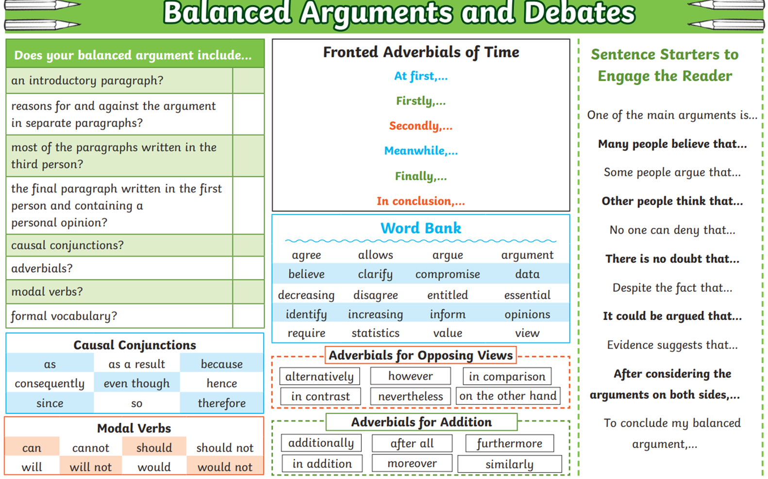
Wednesday 8th May TBAT: write a balanced argument.

Slide 17
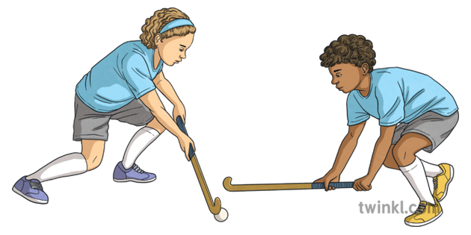
Wednesday 8th May TBAT: develop the attacking skill of dribbling. Get Set 4 PE - Lesson Plan -2 for Year 3/4 Hockey (getset4education.co.uk) Partner talk: What do you know about the sport: Hockey?

Slide 18
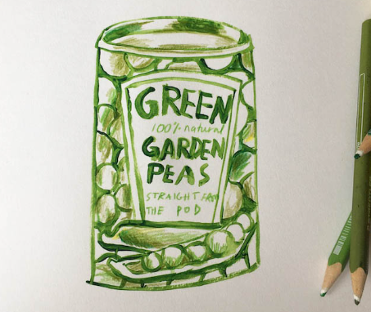
Wednesday 8th May
TBAT: create a simple 3D sculpture

Slide 19
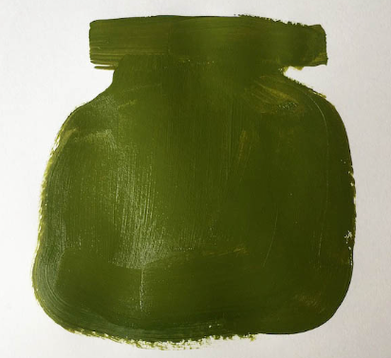
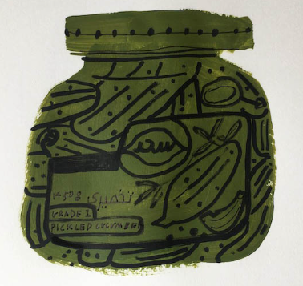
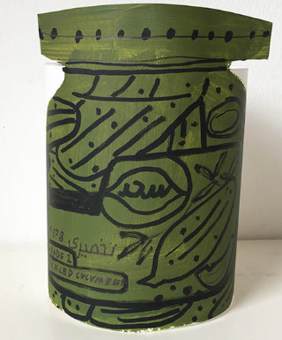
Option 1 – Block colour painting
Pay close attention to the silhouette of the jar. The paint will need to dry before you can add detail. Use a colour that features heavily on the tin. You may want to draw an outline of the silhouette first before painting if you like.
Once the paint has dried, take a thick felt tip or marker pen to draw in the detail of the jar, remembering to include the food within the jar if you can see it. Use a handwriting pen/fine liner to create smaller detail like text.
Draw four straight lines coming out from the top and bottom on each side of the drawing (without interrupting the painting). These lines will make the flaps that will make the tin stand. Cut along the lines. Try and keep your cutting as straight as possible so that the tin won’t be standing at an angle. Make sure that you cut around the top of the tin/jar lid to give it some depth.

Slide 20
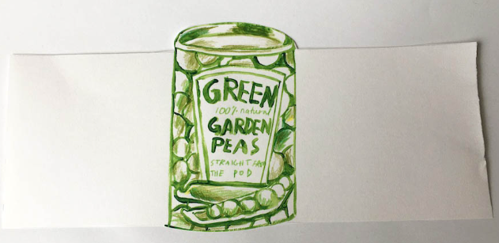
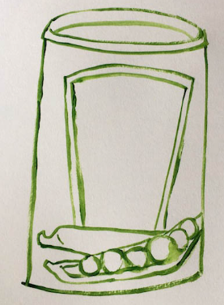
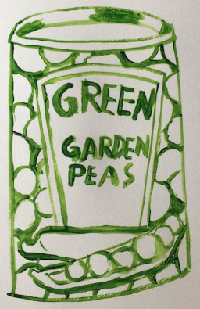
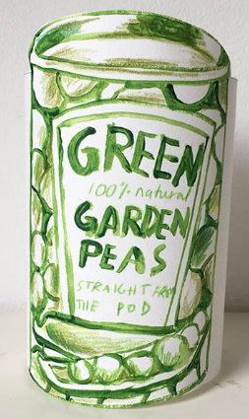
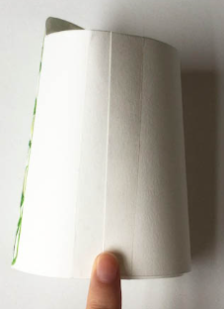
Option 2 – Outline painting
Create a simple line painting, thinking about the outline of the object and focussing on the main bits of detail. Include text and the main areas of detail. Use some coloured pencil crayons and start thinking about darker areas and lighter areas of the tin. Draw four straight lines coming out from the top and bottom on each side of the drawing. These lines will make the flaps that will make the tin stand. Curl the flaps together so that when they look at the front of their object as little white can be seen as possible.

Slide 21
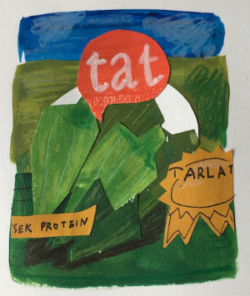
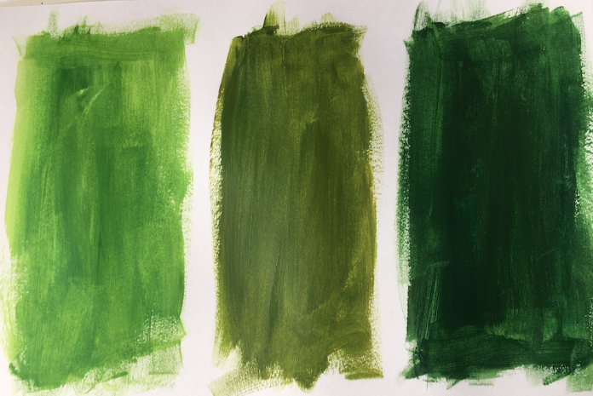
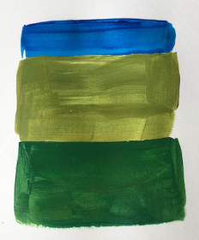
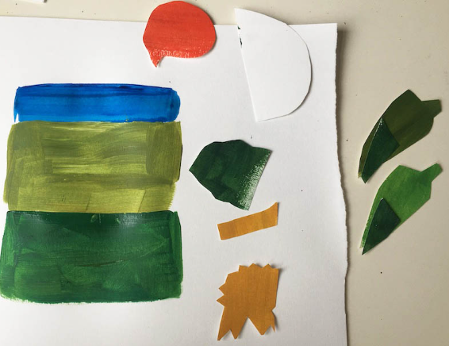
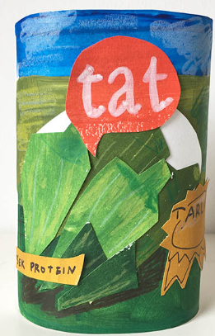
Option 3 – Collaging
Paint block colours within the background of your selected tin/jar. Next you will need to pick out bits of detail and cut shapes out of the painted sheets of paper. These will be used to create the detail within the tin or jar. Arrange your cut out bits until you are happy. Once you are happy with your composition you can glue all the pieces into place. Make sure that the glue reaches the edges so that bits don’t peel up. Add detail with pencil crayons and pens. Create the 2 large flaps either side of the tin, bend round and fasten with tape.

Slide 22
