Slide 1
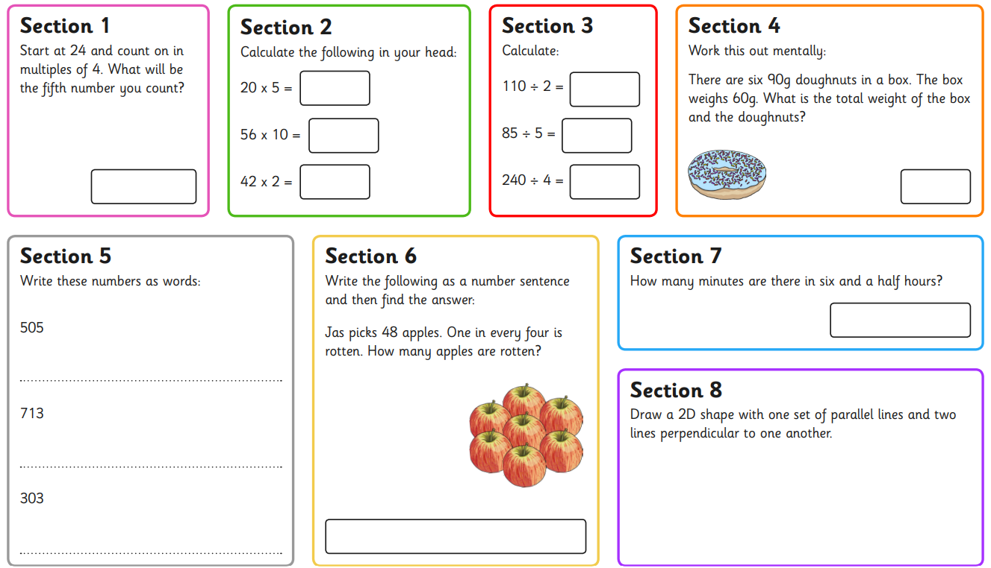
Tuesday 7th May
Morning Challenge

Slide 2
Tuesday 7th May 2024
07.05.24
TBAT: divide with remainders
Daily 10 - Mental Maths Challenge - Topmarks
Key Vocabulary
Divide Inverse Number line Remainder

Slide 3
Tuesday 7th May 2024
07.05.24
TBAT: divide with remainders

Slide 4
Tuesday 7th May 2024
07.05.24
TBAT: divide with remainders
Partner Talk
Discuss how you would solve the following questions.
72 shared by 5 =
41 shared by 3 =
46 shared by 4 =

Slide 5
Tuesday 7th May 2024
07.05.24
TBAT: divide with remainders
Solve the following division calculation.
Blue Green
92 shared by 5 =
62 shared by 5 =
Challenge: to share equally by 5, you will always need the number to end in a 0 or 5. True or false? Explain your answer.

Slide 6
Tuesday 7th May 2024
07.05.24
TBAT: divide with remainders
ndependent - use the number line method to solve the following questions.
1. 35 shared by 3 =
2. 53 shared by 4 =
3. 63 shared by 5 =
4. 82 shared by 8 =
5. 92 shared by 3 =
RP: There are 21 fish in a fishbowl. If they get split into 4 bowls, there will be equal amounts in each. True or false? Explain your answer.

Slide 7
Tuesday 7th May 2024
07.05.24
Mastery Challenge
Use a number line to solve the following questions. Which one is the odd one out? Why?

Slide 8
Tuesday 7th May
TBAT: Spell words ending in –ture.
What's the same and what's different with the following words? Creature Measure What other ways could you spell the 'ture' sound? Think about the phonemes you can hear.

Slide 9
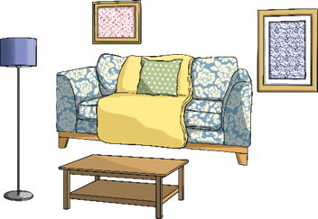
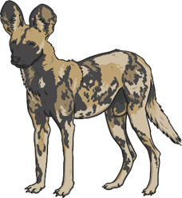
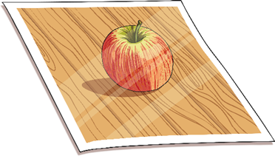
Match the pictures or the explanations to each of these ‘ture’ words.
picture
gesture
structure
creature
furniture
picture
furniture
creature
The movement of a body part, often the hand or head to show a feeling or instruction.
The arrangement of parts put together, like in a building.
gesture
structure
Notes:
Click the spelling words at the top to match the correct image or definition ☺

Slide 10
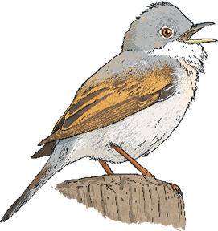
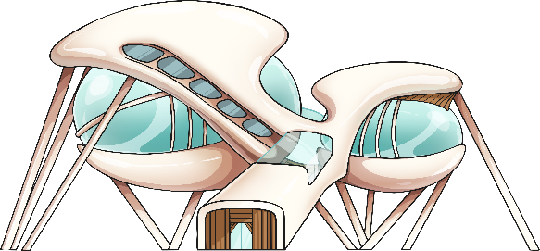
Match the pictures or the explanations to each of these ‘ture’ words.
moisture
capture
nature
future
culture
future
moisture
nature
A verb meaning to take control or get something by force.
The ideas, customs and behaviour of a group of people or society; the arts.
capture
culture

Slide 11
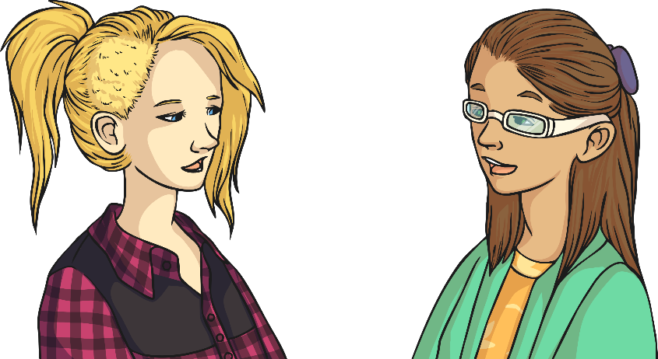
Each of these sentences contain one of the ten ‘ture’ words and a preposition. Can you find them?
“Help! There is a weird looking creature under my bed,” the boy shrieked.
creature
The bananas in the cake are what give it its moisture.
moisture
Coventry will become the Uk’s City of Culture in 2012 following on from Hull.
Notes:
Click each sentence to reveal the ‘ture’ words.

Slide 12
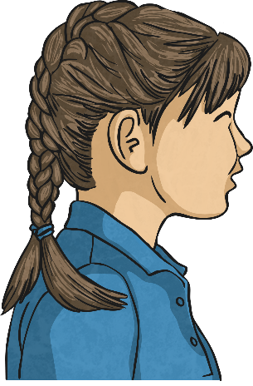
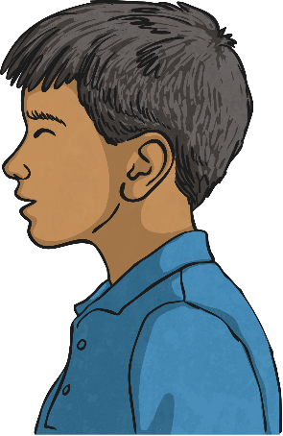
Each of these sentences contain one of the ten ‘ture’ words and a preposition. Can you find them?
Astonishingly, the artist’s exquisite furniture is all made out of cardboard.
furniture
The dynamic photograph manages to capture the dangers of rock climbing.
capture
The doctor’s mind-boggling time machine is designed to catapult you into the future.
future
Notes:
Click each sentence to reveal the ‘ture’ words.

Slide 13
Each of these sentences contain one of the ten ‘ture’ words and a preposition. Can you find them?
The children have worked collaboratively on the picture on their school.
picture
The architect has designed a magnificent structure for the new building.
structure
Many children’s television programmes have demonstrated how to appreciate nature and look after the plants and animals around us.
nature
Notes:
Click each sentence to reveal the ‘ture’ words.

Slide 14
Tuesday 7th May
TBAT: spell words ending in ture. What do you notice about the following words? Creature Furniture Picture Nature Adventure Challenge – Can you use these words in a sentence with a fronted adverbial?

Slide 15
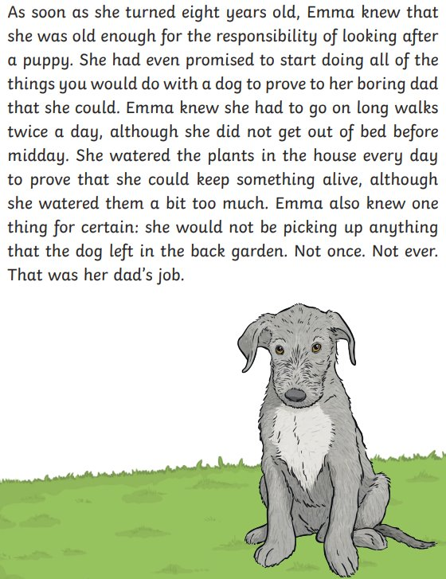
Tuesday 7th May
TBAT: write the beginning and build up
of my narrative.
3 in 3
1. Who is stopping Emma from getting a puppy? 2. Why do you think that the author describes dad as ‘boring’? 3. What makes you think that Emma is not ready to get a puppy? Use evidence from the text.

Slide 16
Tuesday 7th May
TBAT: write the beginning and build up
of my narrative. B/G partner Share your plan from yesterday. Who is your main character? Where is your story set? What is happening at the beginning of the story?

Slide 17
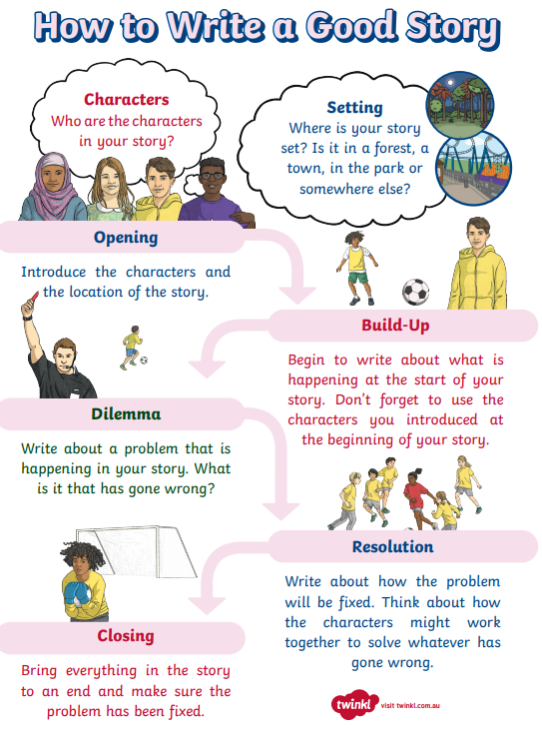
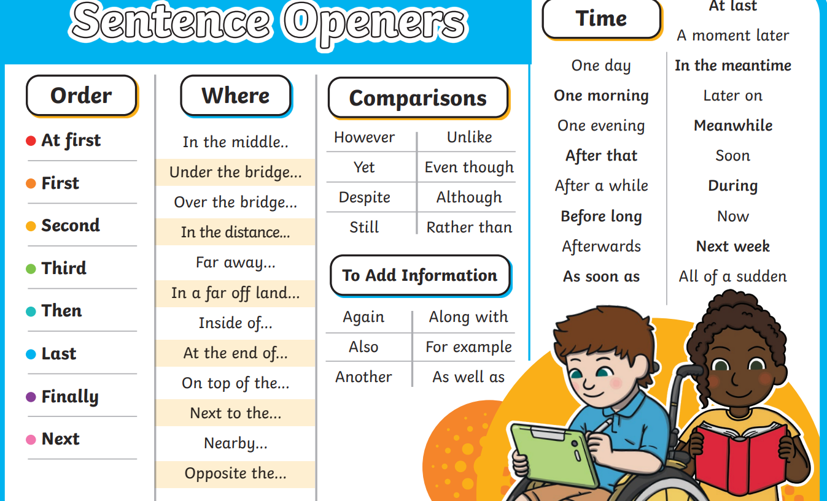
Tuesday 7th May
TBAT: write the beginning and build up
of my narrative. In your opening, you want to grab the reader's attention.

Slide 18
Tuesday 7th May
TBAT: write the beginning and build up
of my narrative. -Pick an opener. -Describe your setting using adjectives. Can you add an expanded noun phrase? -Do not use speech in the first paragraph.

Slide 19
Example Beginning: Stanley (I) Inside the dark pyramids. Hieroglyphs on the towering walls. Feeling nervous about finding the scrolls. Build Up: Exited the tomb telling Sir Hawara I found the scrolls! Amisi told me I have been working for thieves. She felt betrayed. I felt confused. Problem: I overhear Sir Hawara's plan to leave me inside the tomb. He is a nasty thief! I feel lonely and disappointed. Resolution: I go along with the plan, but I lead the thieves in the wrong direction. I feel smug to have pulled it off! Sir Hawara is arrested. Ending: I travel home to see my family. I feel emotional to see everyone.

Slide 20
Tuesday 7th May
TBAT: write the beginning and build up of my narrative.
Think about the setting – paint a picture in the reader's mind. In the darkness, I stood silently. With only narrow rays of sunlight shining through the cracks of the towering pyramid walls, looking around for the scrolls was a difficult job. I kept thinking about Sir Hawara waiting outside of the pyramid for me. Nervously, I wandered round in the dusty pyramid before I finally found the scrolls!
As I exited the pyramid, I could see Sir Hawara waiting impatiently.
"WELL... have you found them?!" he questioned.
I was excited to tell him exactly where the scrolls were. His eyes lit up as I told him the news. After I had spoken to Sir Hawara, I turned to see Amisi. She had a look of disappointment on her face as she told me I had been working for thieves. I tried to question her, feeling confused with what she had told me, but she walked off without looking back.
Include fronted adverbials to show manner.

Slide 21
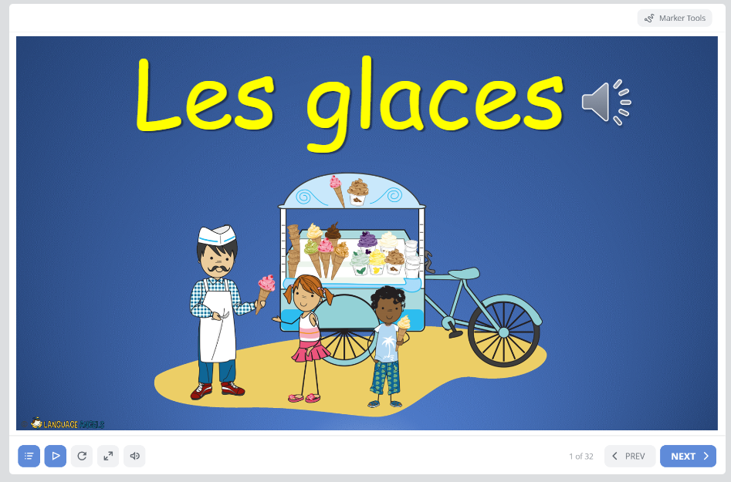
Lundi 7 Mai
TBAT: explain if you’d like a cone or a tub
Home (languageangels.com)
Unit – Ice Creams

Slide 22
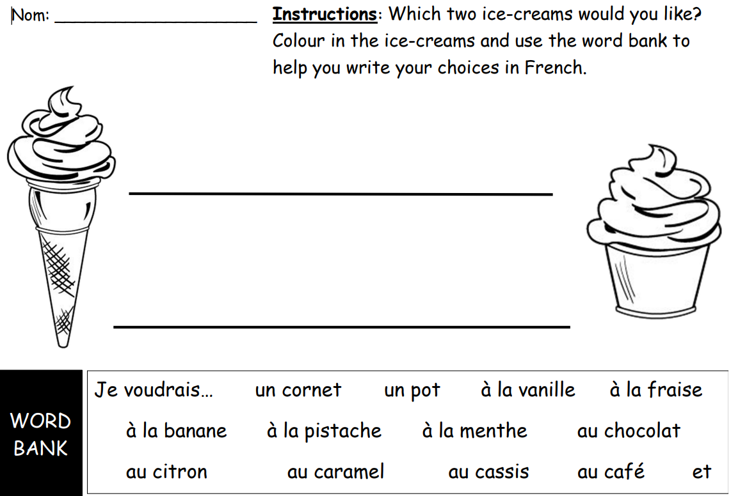
Lundi 7 Mai
TBAT: explain if you’d like a cone or a tub

Slide 23
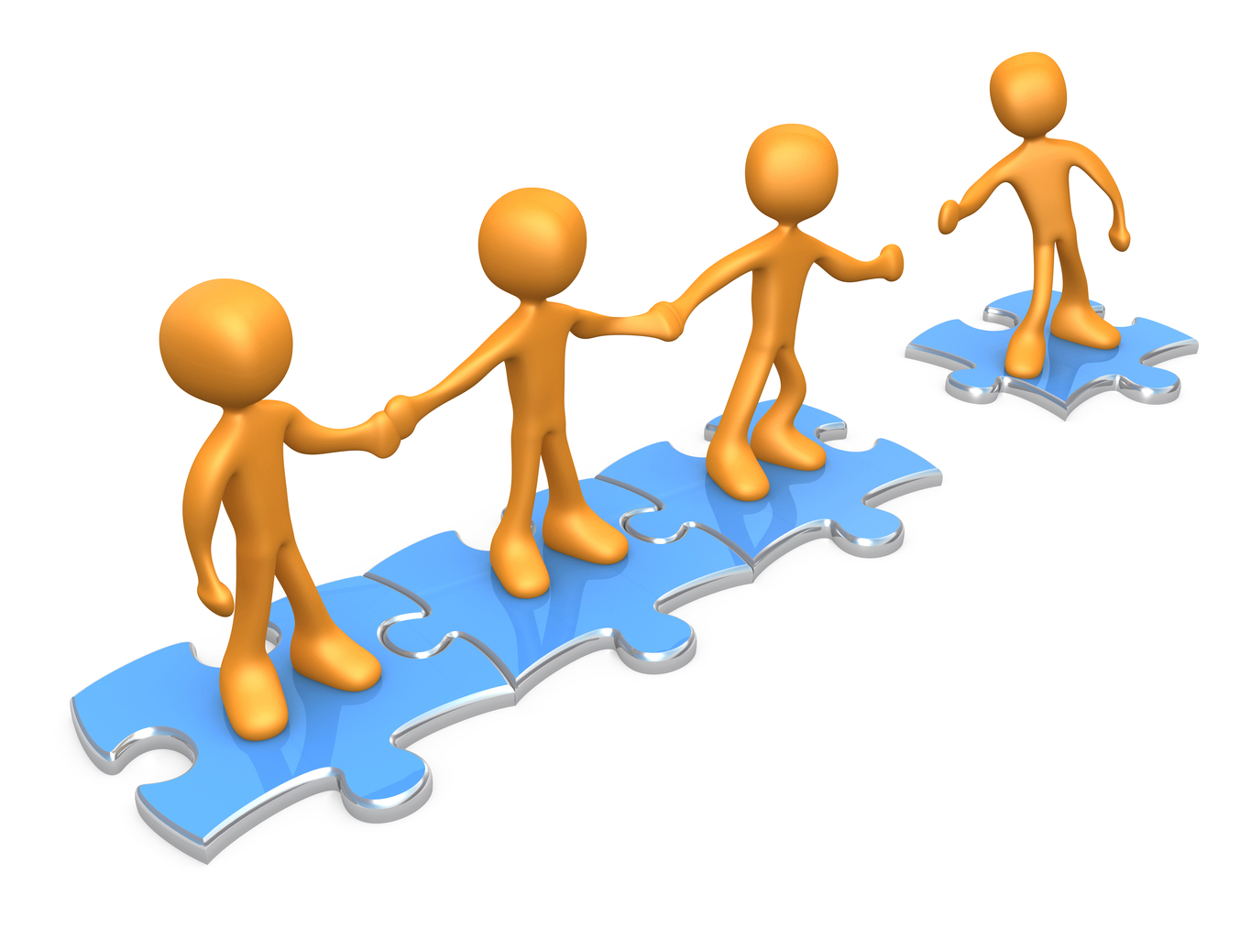
TBAT: apply sending and receiving skills in games.
This half term in P.E will be Cricket and Balls Skills
- Changing for PE - Rules and expectations moving to PE - Move to the downstairs hall or outside Get Set 4 PE - KS2 OAA (getset4education.co.uk)

Slide 24
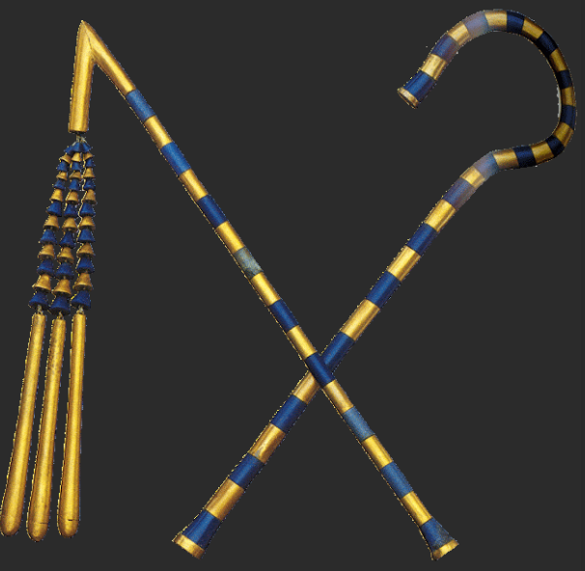
Tuesday 7th May
Q. Who ruled Ancient Egypt?
Key vocabulary
Pharaoh – a ruler of Ancient Egypt, a bit like a king or a queen.
Crook – a long staff curved at one end. It became a sign of kingship.
Dynasty – a series of rulers sharing a common origin.
Flail – a symbol of power.

Slide 25
Tuesday 7th May
Q. Who ruled Ancient Egypt?
3 in 3
1.Most people in Ancient Egypt lived…
in the desert along the river in big cities
2.The River Nile was an important source of what?
fresh water stone precious metals salt
3.What were irrigation channels used for?
transporting goods watering crops feeding animals

Slide 26
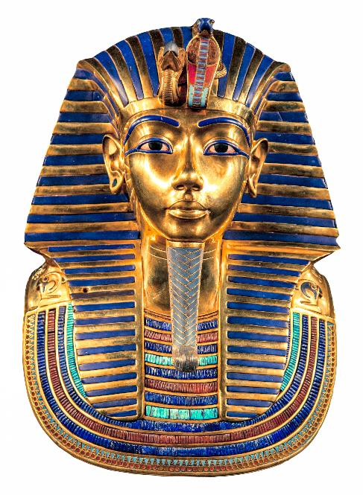
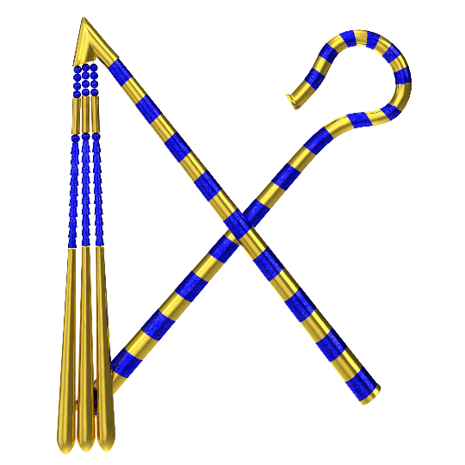
Who were the pharaohs?
Lesson 3:
Ancient Egyptian rulers were called pharaohs, which means ‘great house’. They made all laws and rules for the people. They were responsible for keeping the people safe and making sure the crops grew. The pharaoh would also lead the Egyptian army to war if needed.
The symbols of the pharaohs were the crook and flail. They are often shown wearing a crown or headdress. Pharaohs also wore a false beard to show their importance.
Notes:
Read: Who were the pharaohs? Introduce the word ‘pharaoh’ and encourage pupils to draw parallels. These parallels could be with modern rulers, such as royalty or the Prime Minister, or with the kings and queens they may have studied in Year 2. Draw attention to the picture as you read through the text. Pupils will need to use it for the next activity.

Slide 27
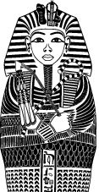
Label this image using the words in the box.
Lesson 3:
crook
flail
false beard
headdress
Notes:
Retrieval: Pupils label the crook, flail, false beard, and headdress shown in the illustration. Answers are provided on the next slide.

Slide 28
Label this image using the words in the box.
Lesson 3:
headdress
false beard
flail
crook

Slide 29
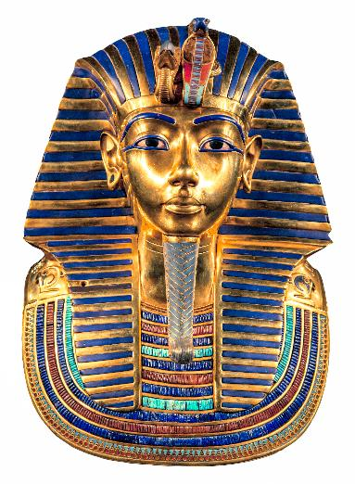
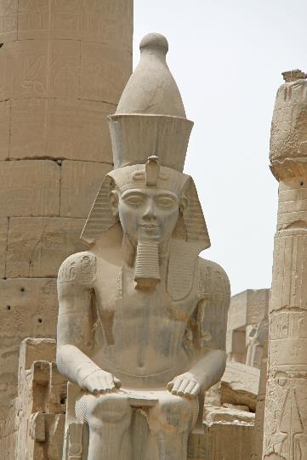
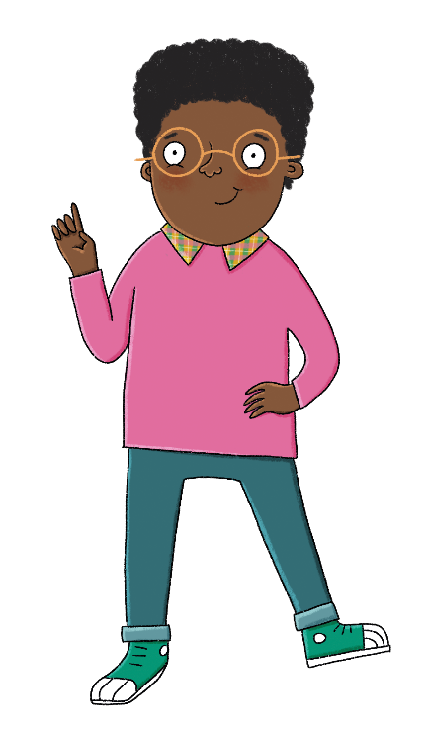
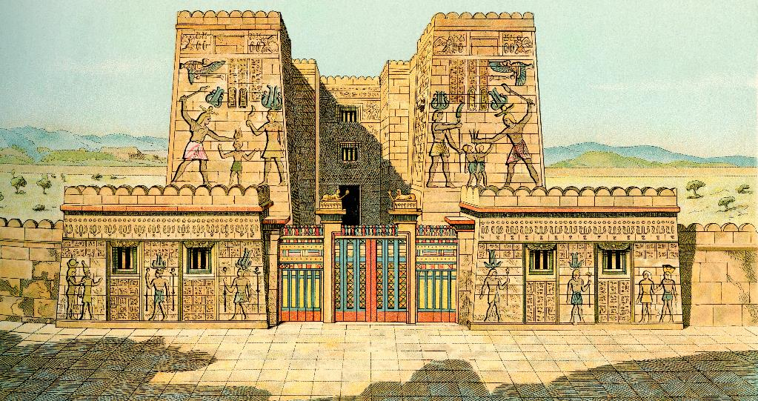
Lesson 3:
Why was ‘great house’ a good name for the pharaohs?
Notes:
Talk task: Pupils can discuss why ‘great house’ was a good name for the pharaohs. They might come up with suggestions about royal palaces or family lines, given what they have learned about the dynastic nature of the pharaohs. Pupils might have the misconception that ‘great’ just relates to the size of a house, and this is therefore an opportunity to address this.

Slide 30
What is a dynasty?
Lesson 3:
A dynasty is a line of rulers from the same family. When a pharaoh died, their eldest son would usually become pharaoh. However, if a pharaoh died without having any children, there were arguments over who would become the next pharaoh. Sometimes these arguments ended in murder or war!
Over 3,000 years, 30 different dynasties ruled Ancient Egypt. Menes was the first pharaoh. Let’s look at some other famous pharaohs.

Slide 31
Tutankhamun
Lesson 3:
Tutankhamun became pharaoh in around 1332bce, when he was just nine years old. He only ruled for ten years, as he died aged 19. We don’t know how he died.
Thousands of years later, the treasures that were buried with him have helped archaeologists learn a lot about Ancient Egypt.

Slide 32
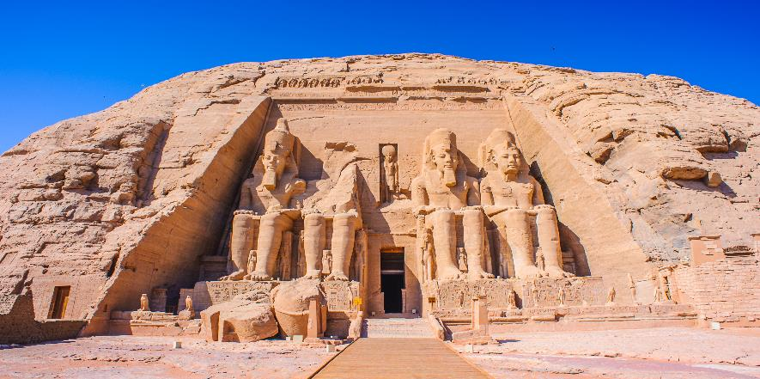
Ramesses II
Lesson 3:
Ramesses II became pharaoh in 1279bce and ruled for 66 years. He is called Ramesses the Great because he built more statues and monuments than any other pharaoh.
This statue of Ramesses II is at a temple in Luxor. It is over 10 metres tall!
This is the Great Temple at Abu Simbel, built by Ramesses II. You will learn more about it in Lesson 7.

Slide 33
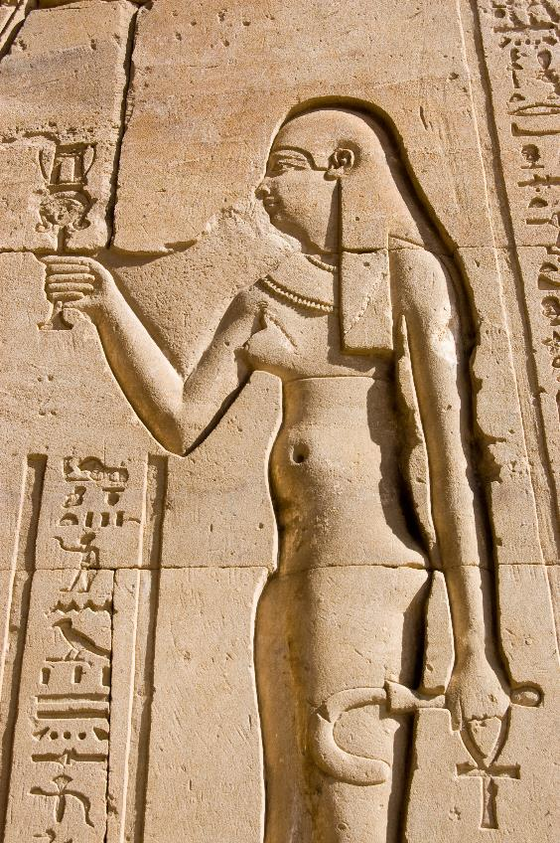
Cleopatra
Lesson 3:
Cleopatra was born around 70bce. She ruled Egypt for around 30 years jointly with one of her younger brothers, then another. She was very clever and spoke many languages. She is also famous as the last pharaoh of Ancient Egypt before the civilisation ended.

Slide 34
Tuesday 7th May
Q. Who ruled Ancient Egypt?
Choose one of the following and create a fact file.
Cleopatra
Tutankhamun
Ramessess II
Include fronted adverbials to add to the main clause.

