Slide 1
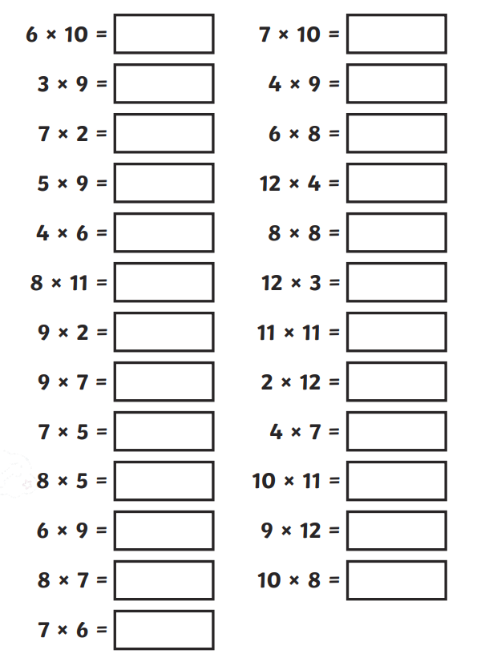
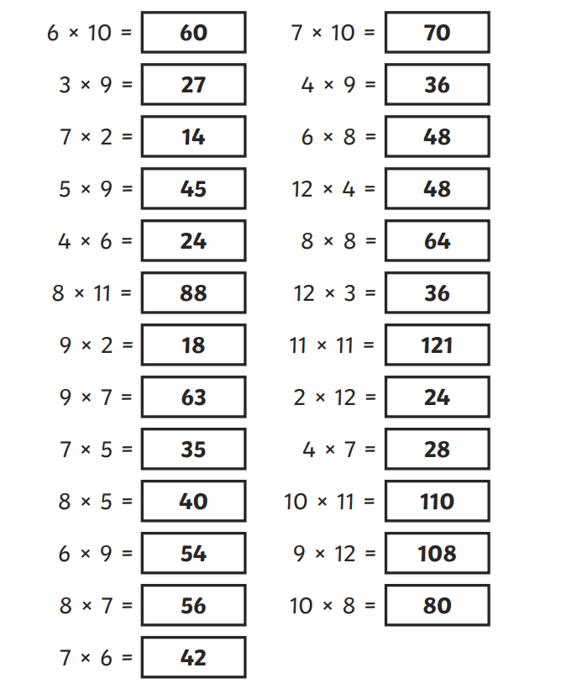
Tuesday 7th May Morning challenge
Check your answers:
Is it your day for TTRS?

Slide 2
Tuesday 7th May Class assembly Being a good friend: What does it mean to be a good friend?

Slide 3
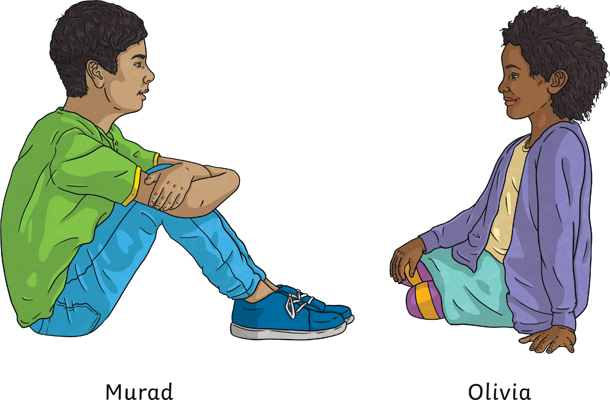
Friends…
Play with us. Share with us.
Choose to be our partners.
Compliment us.
Listen to us.
Make us laugh.

Slide 4
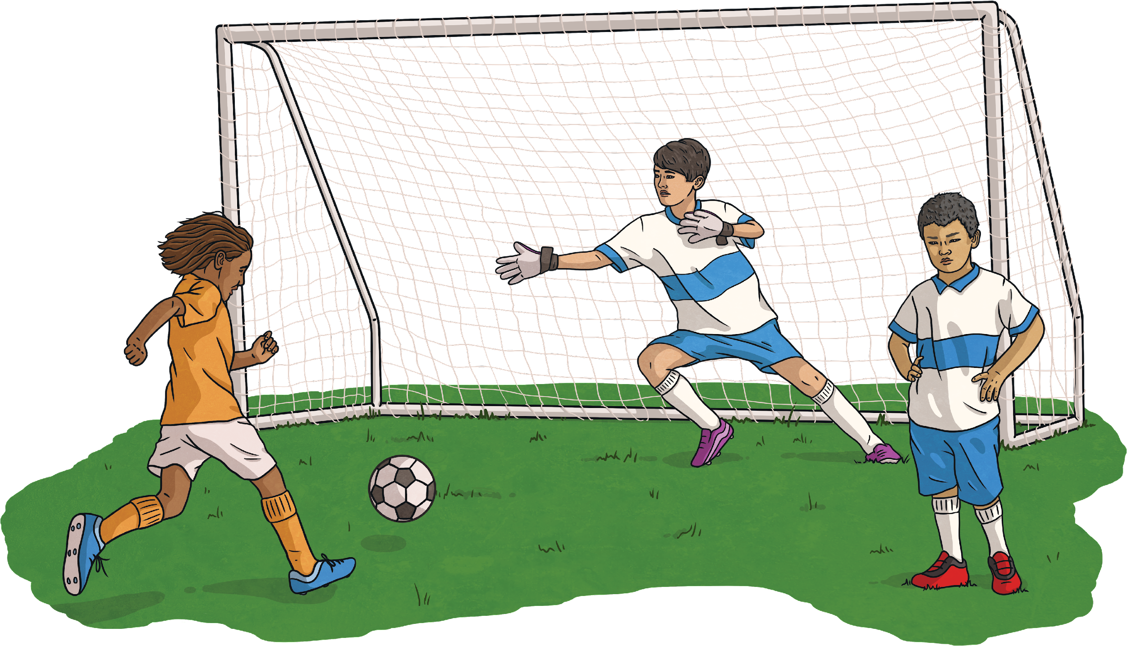
Friends
What do you like to do with your friends?

Slide 5
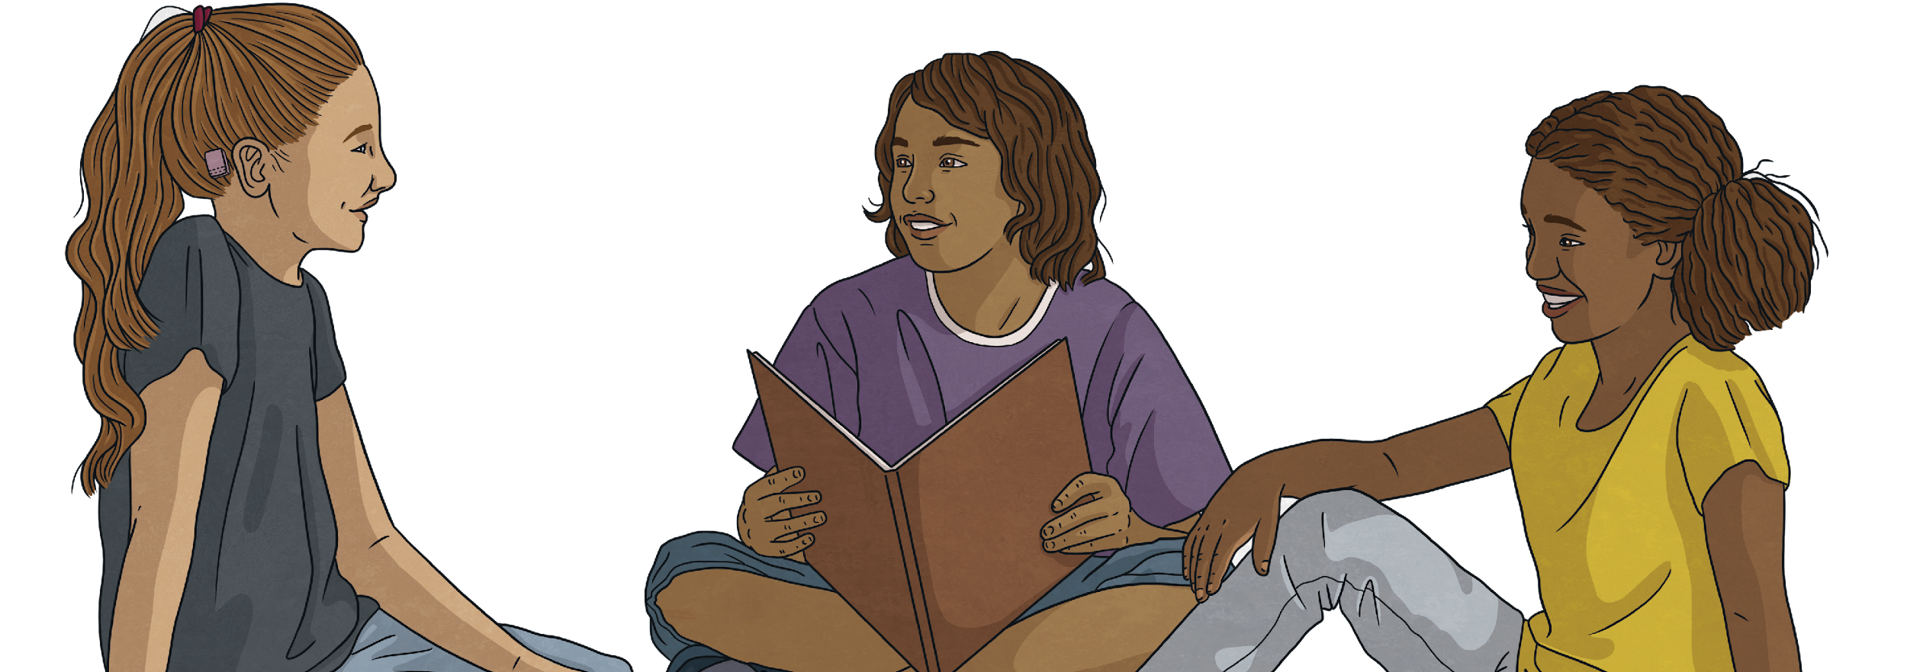
How to be a good listener for your friend
Allow them time to talk.
Ask positive and encouraging questions.
Nod and be interested.

Slide 6
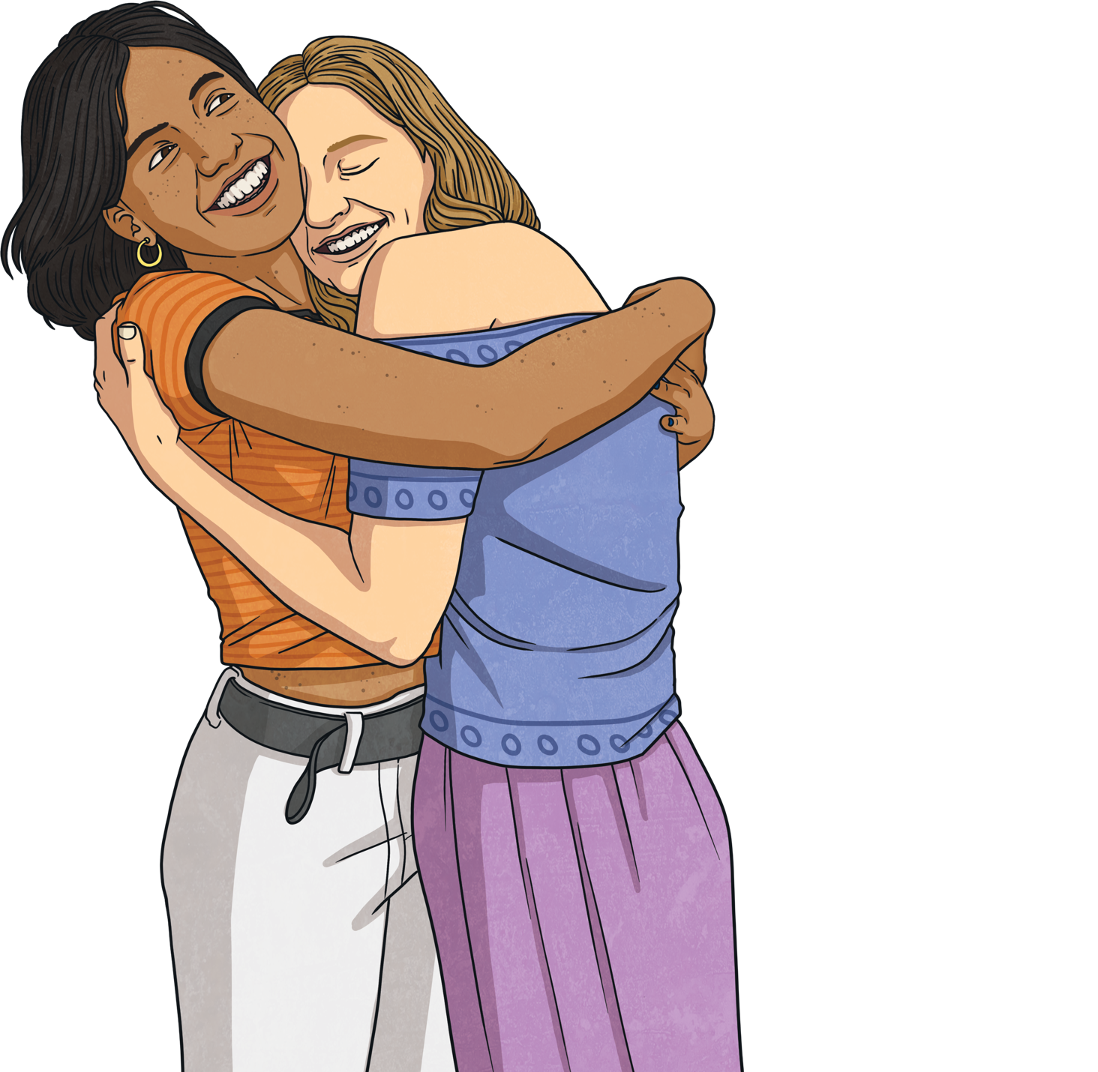
Friends
How do you feel when your friend compliments you?
How do you feel when you give someone a compliment?

Slide 7
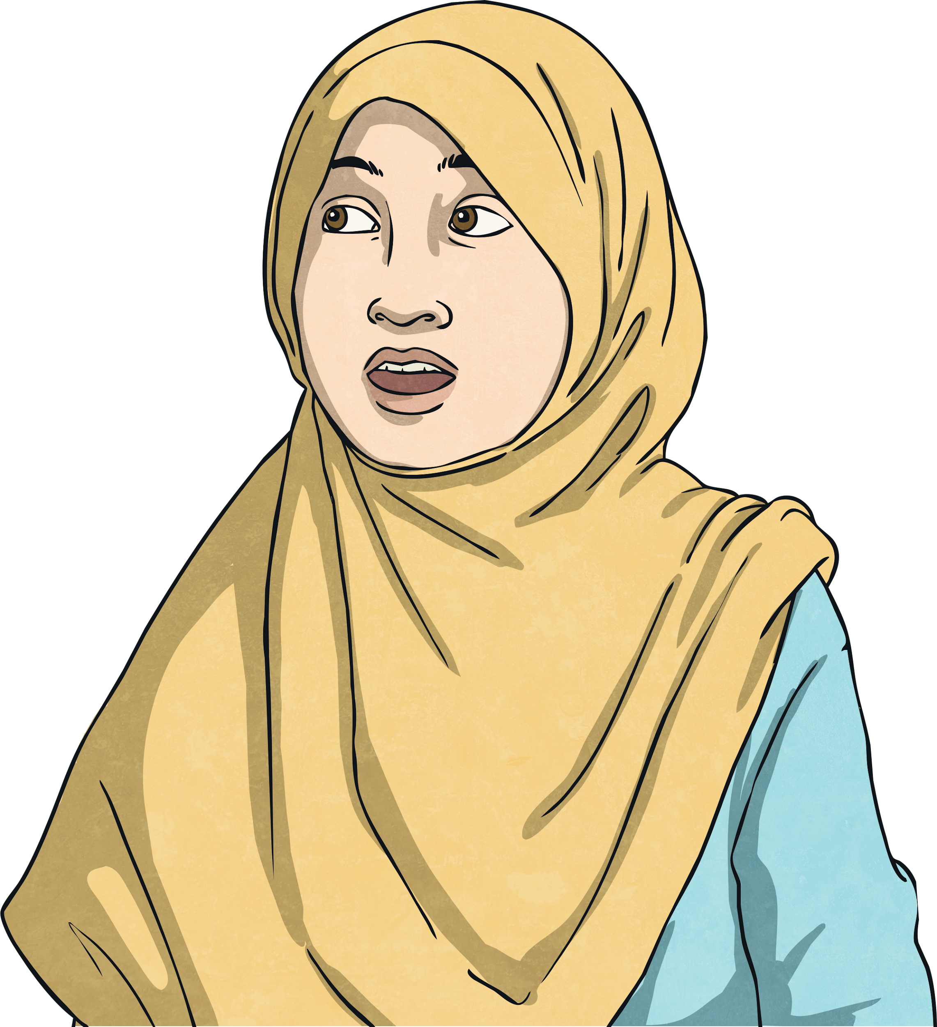
Compliments
Pay your friend a compliment if they are feeling down. It could even cheer them up!
It is a good idea to say ‘thank you’ when someone pays you a compliment.
Make sure what you say is nice and genuine.

Slide 8
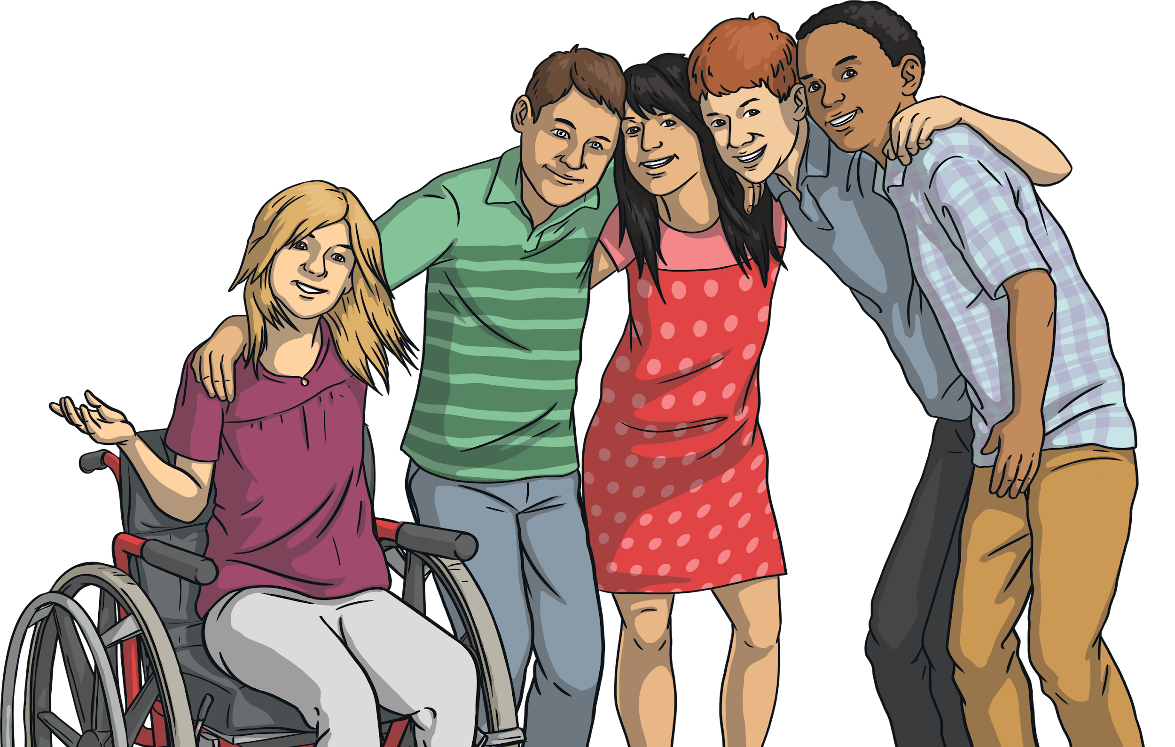
Friends
Do you think that all friends last forever?
Can everyone be a friend?
Can we be friends with someone all the time?
Could you be friends with someone after you have had a falling out?

Slide 9
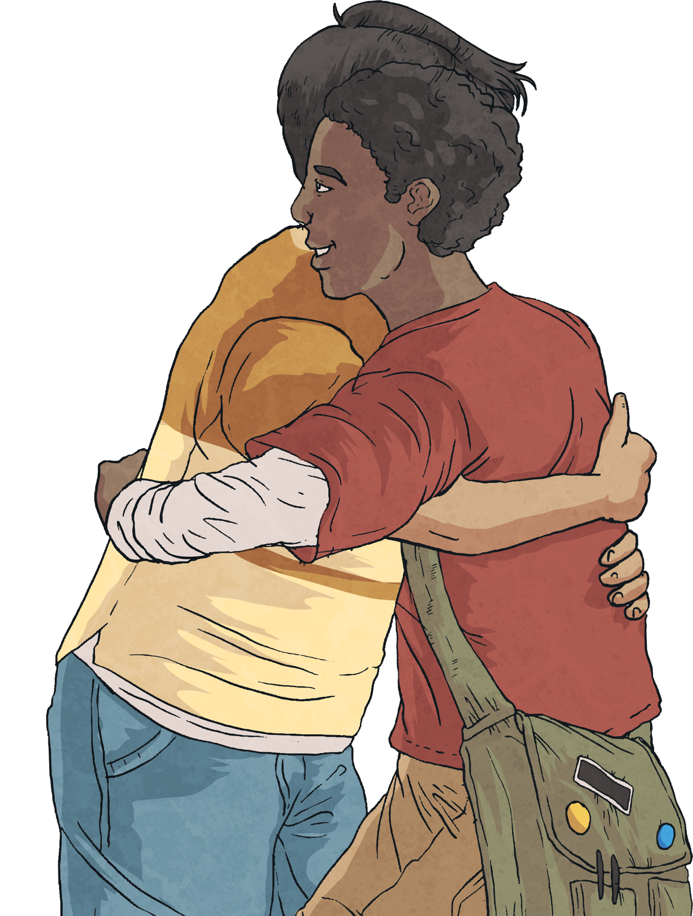
Friends
Try and remember how to be a good one!

Slide 10
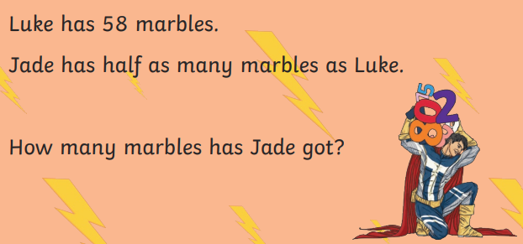
07.05.24 TBAT: compare 2-place decimals in the context of lengths.
3 in 3
1. 134 ÷ 100 =
2. 1/3 of 18 =
3. 179 x 6 =

Slide 11
07.05.24 TBAT: compare 2-place decimals in the context of lengths.

Slide 12
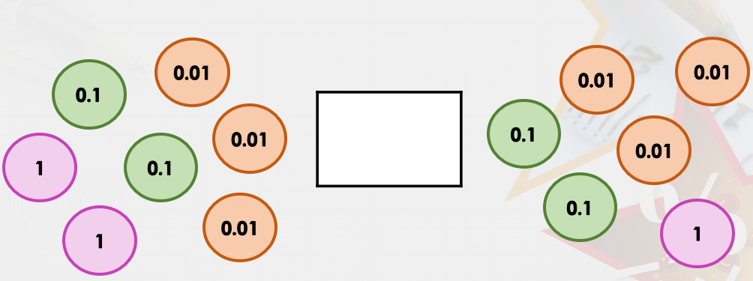
07.05.24 TBAT: compare 2-place decimals in the context of lengths.
Write down and compare these decimal numbers using >, < or =.

Slide 13
07.05.24 TBAT: compare 2-place decimals in the context of lengths.
Compare these decimal numbers using >, < or =.

Slide 14
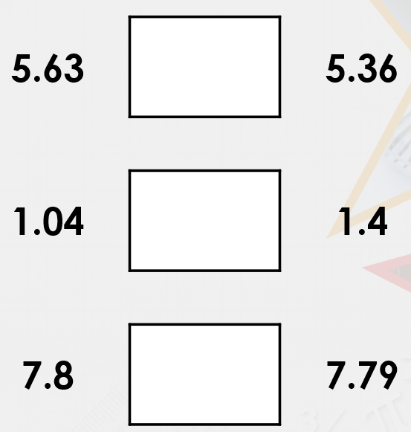
07.05.24 TBAT: compare 2-place decimals in the context of lengths.
Compare these decimal numbers using >, < or =.

Slide 15
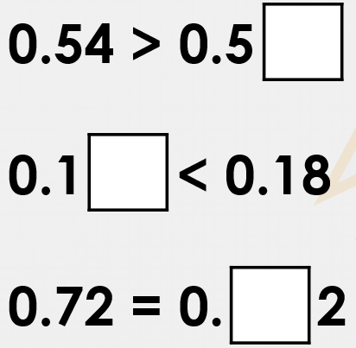
07.05.24 TBAT: compare 2-place decimals in the context of lengths.
Using digits from 1 to 9, make these statements correct.

Slide 16
07.05.24 TBAT: compare 2-place decimals in the context of lengths.

Slide 17
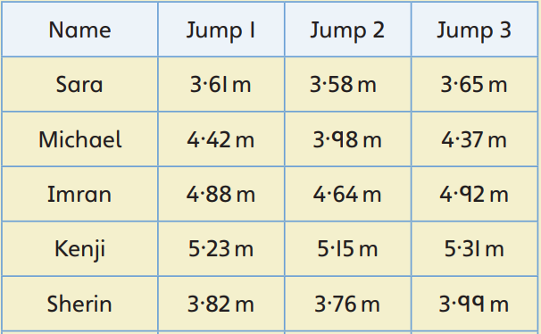
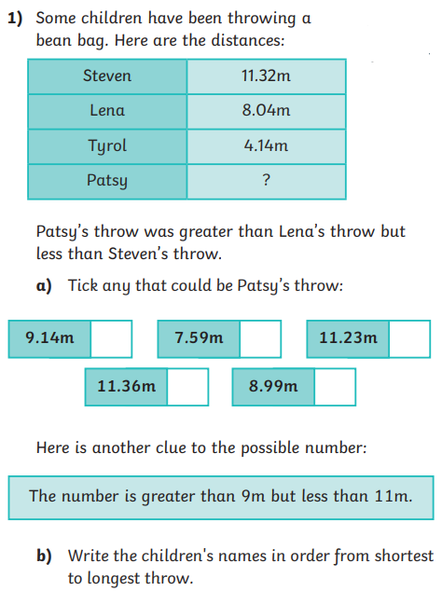
07.05.24 TBAT: compare 2-place decimals in the context of lengths.
Mastery -
Mastery with Greater Depth -
Write each child's jumps in ascending order.
Challenge - Ben thinks that 3·4 m is a shorter length than 3·04 m. Is he correct? Explain your reasoning.

Slide 18
Tuesday 7th May TBAT: use horizontal and diagonal joins.
Non-stick
Non-stop
Non-starter
Nonsense
Non-fiction
Non-believer
Non-profit
Can you find the definition of these words in the dictionary?

Slide 19
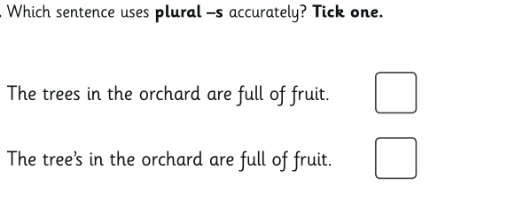
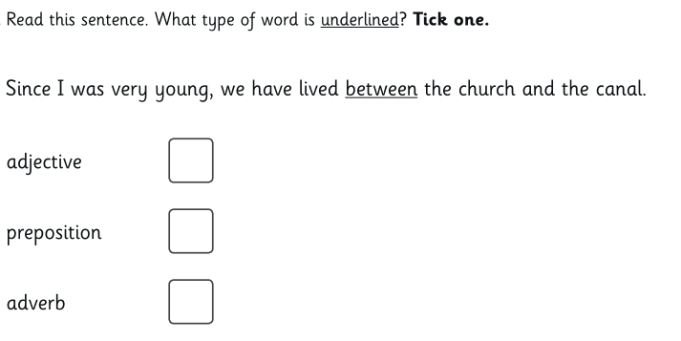
Tuesday 7th May TBAT: use subordinating clauses correctly. 3 in 3

Slide 20
Tuesday 7th May TBAT: use subordinating clauses correctly. What is a coordinating conjunction? Give an example. What is a subordinating conjunction? Give an example. Explain why the sentence below is incorrect: After, they played football it was time for art.

Slide 21
Tuesday 7th May TBAT: use subordinating clauses correctly.

Slide 22
Tuesday 7th May TBAT: use subordinating clauses correctly.

Slide 23
Tuesday 7th May TBAT: use subordinating clauses correctly.

Slide 24
Tuesday 7th May TBAT: use subordinating clauses correctly.

Slide 25
Tuesday 7th May TBAT: use subordinating clauses correctly.
Last week, we began to plan a balanced argument: Should the Mayan Gods give their people chocolate? Using the ideas you generated last week (see flip chart For and Against) and come up with three sentences using subordinating clauses. E.g Although the Maya people work hard, the Gods deserve to keep chocolate as their own luxury.

Slide 26
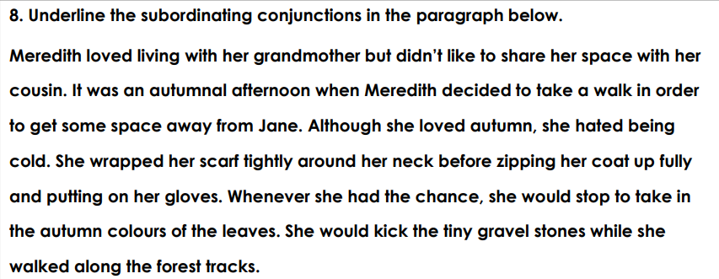
Tuesday 7th May TBAT: use subordinating clauses correctly.
Challenge:

Slide 27
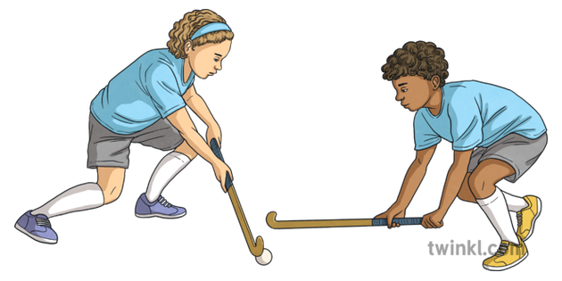
Tuesday 7th May TBAT: develop sending and receiving the ball with accuracy and control. Get Set 4 PE - Lesson Plan -1 for Year 3/4 Hockey (getset4education.co.uk) Partner talk: What do you know about the sport: Hockey?

Slide 28
Tuesday 7th May
TBAT: describe how content can be added and accessed on the WWW
What does WWW stand for?
Name something you can share on the internet?
What does .com stand for?

Slide 29
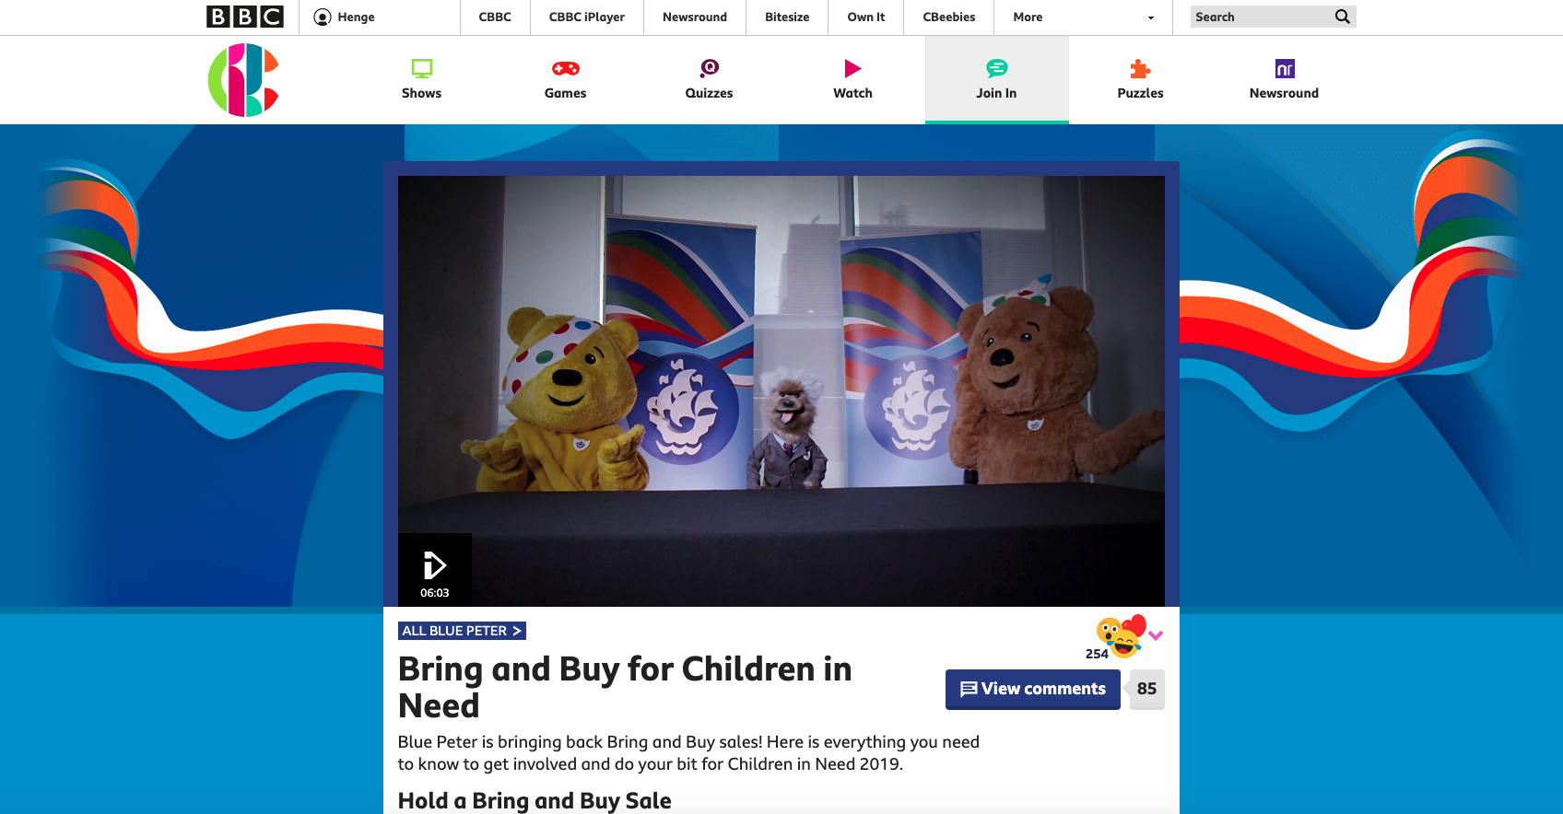
What’s on a website?
Introduction
Have a look at this website. What can you see on it?
Notes:
Website image: www.bbc.co.uk/cbbc/joinin/bp-children-in-need-bring-and-buy-sales

Slide 30
What’s on a website?
Introduction
Here are some common parts of a website:
Links
Logo
Video
Text
Notes:
Website image: www.bbc.co.uk/cbbc/joinin/bp-children-in-need-bring-and-buy-sales

Slide 31
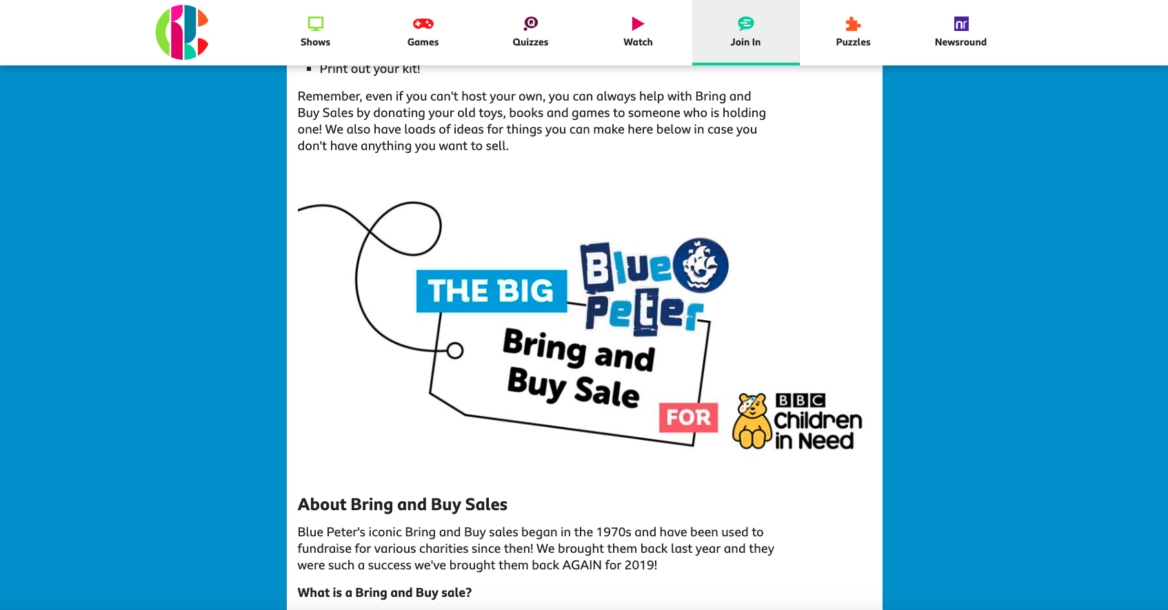
What’s on a website?
Introduction
Image
Notes:
Website image: www.bbc.co.uk/cbbc/joinin/bp-children-in-need-bring-and-buy-sales

Slide 32
Features of websites
Activity 1
Which feature is most important in these types of websites?
Logo or title
Links to other websites/pages
Videos
Pictures
Text
Shopping
Information
News

Slide 33
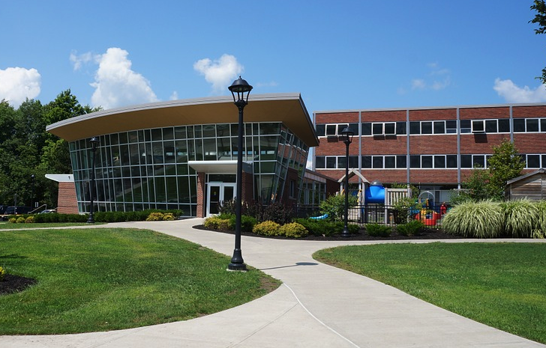
Adding content to the World Wide Web
Activity 2
Could you add a picture of your school to your school’s website?
Who could do this?
Where does the picture go?
Who could see the picture?
Notes:
Image source: https://pixabay.com/photos/college-campus-building-university-75535/ (cropped)

Slide 34
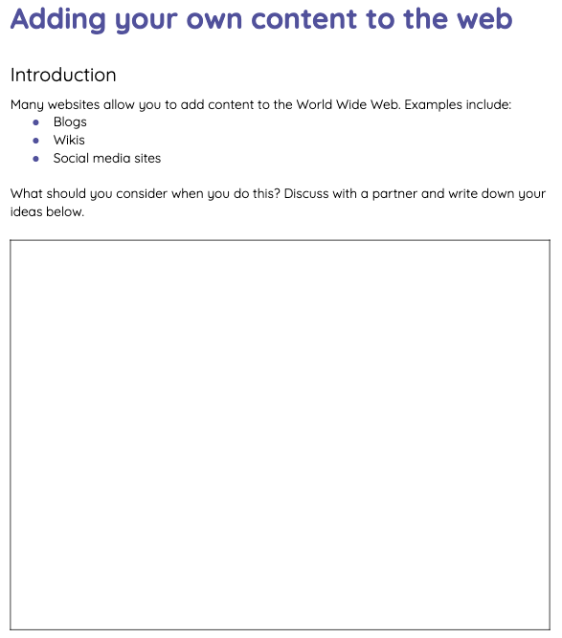
Adding content to the Web
Activity 2
What should you consider when adding content to the web?
Think/pair/share
Write down your ideas

Slide 35
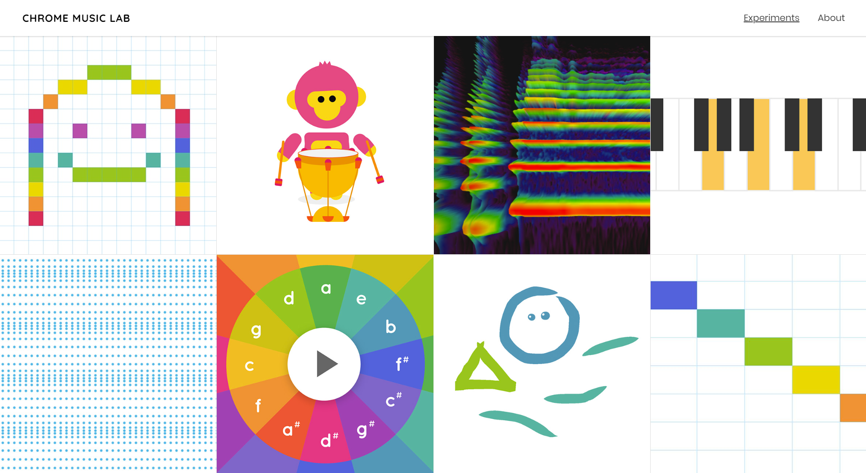
Chrome Music Lab: making music with drawings
Activity 3
Go to Chrome Music Lab and click on the drawing.
Notes:
You can access Chrome Music Lab: Kandinsky at musiclab.chromeexperiments.com/Kandinsky.

Slide 36
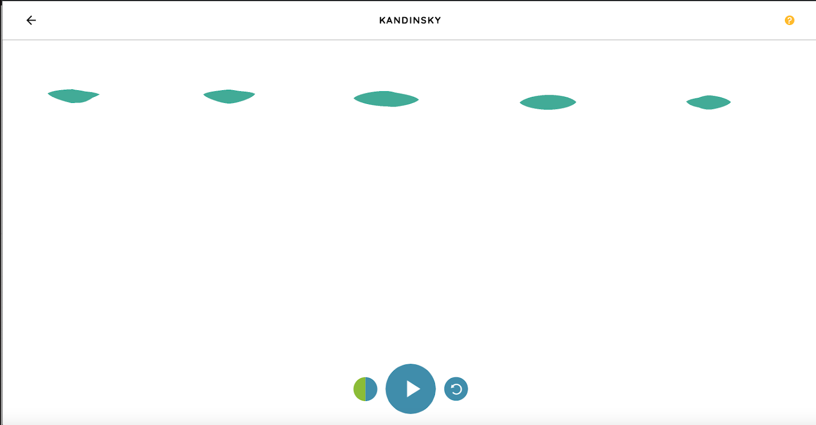
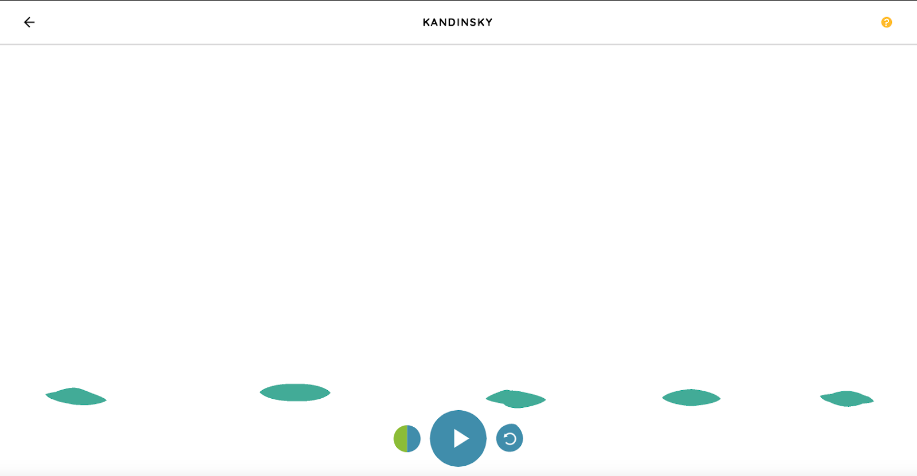
Making sounds with drawing: pitch
Activity 3
Try drawing lines at the top of the screen.
Try drawing lines at the bottom of the screen.
What is this website enabling you to do?
Notes:
Website images: musiclab.chromeexperiments.com/Kandinsky

Slide 37
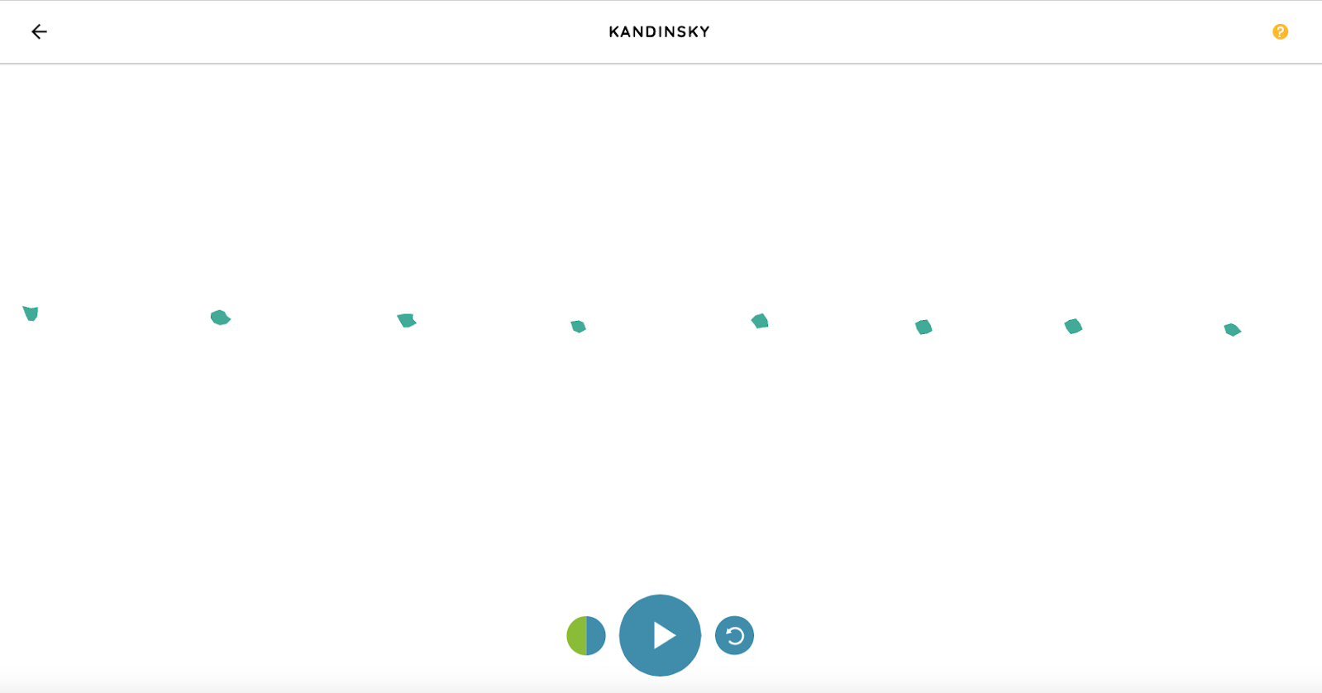
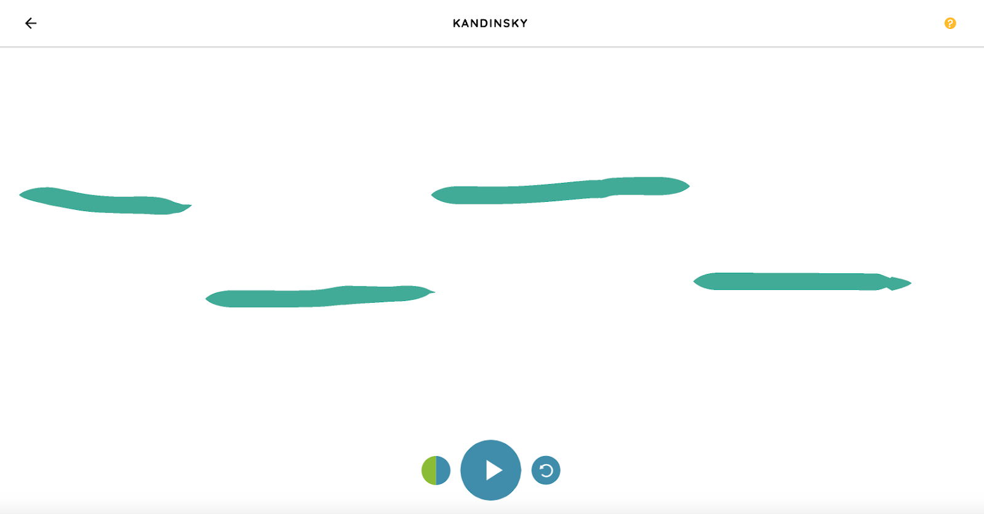
Making sounds with drawing: duration
Activity 3
Try drawing short lines.
Try drawing long lines.
Can you think of any other websites where you can create your own content?
Notes:
Website images: musiclab.chromeexperiments.com/Kandinsky

Slide 38
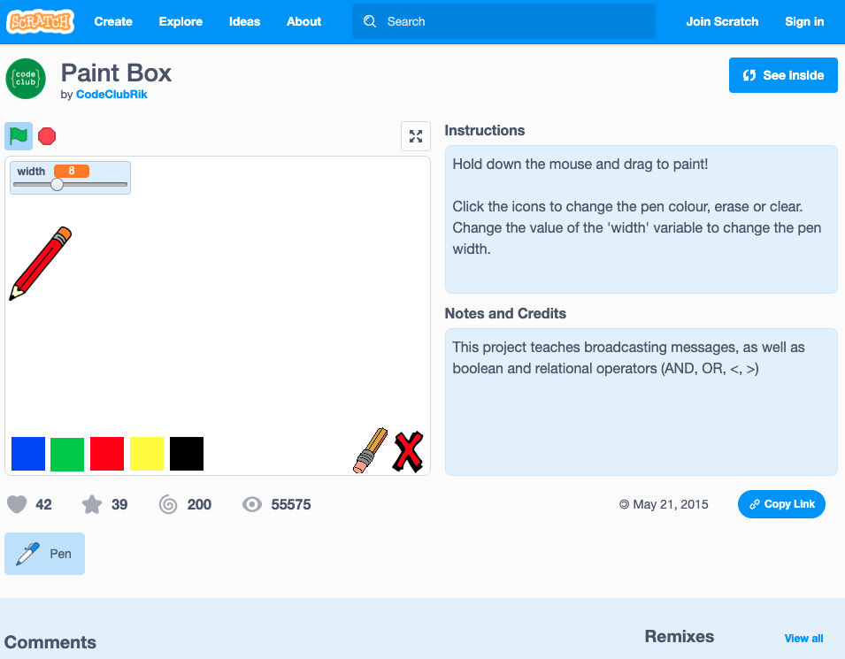
How is the content on this page generated?
Plenary
ncce.io/paintbox
Links
Project window
Comments

