Slide 1
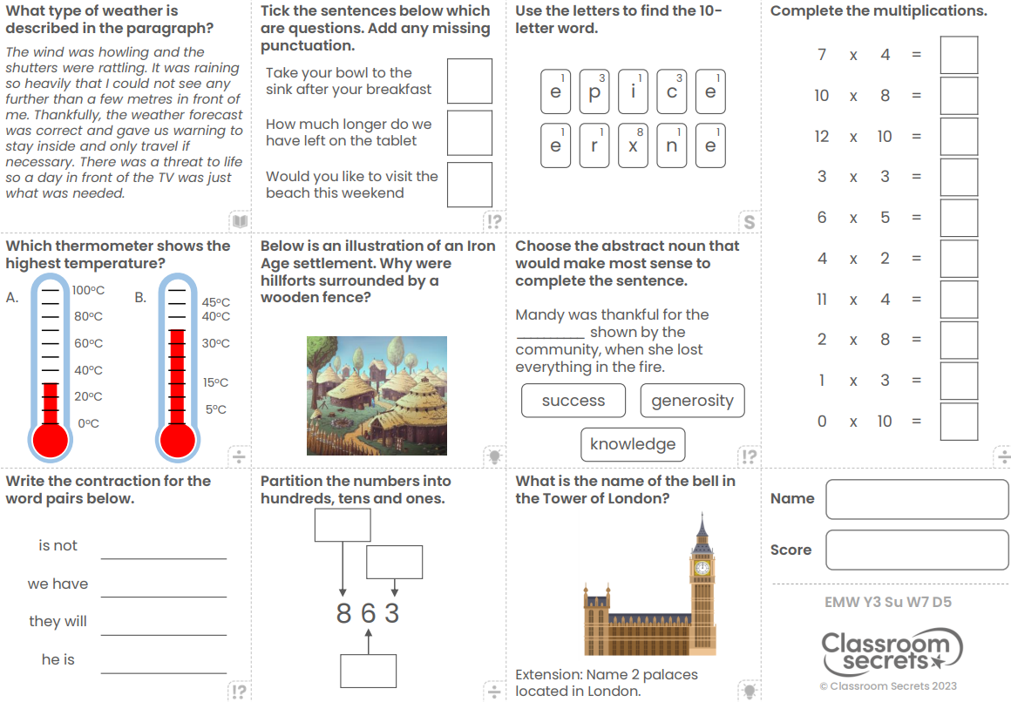
Friday 3rd May
Morning Challenge

Slide 2
Friday 3rd May
TBAT: know why Islamic art never shows Allah.

Slide 3
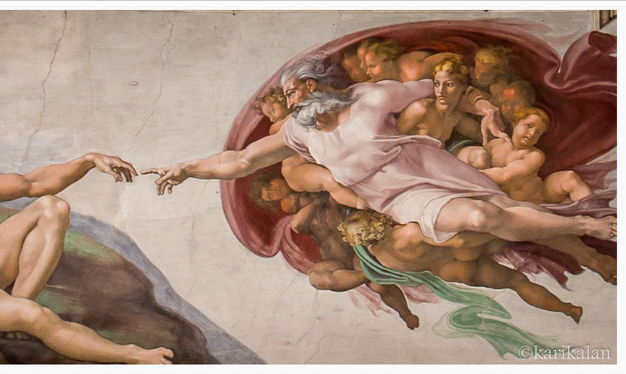
This is a Christian painting showing God.
It was painted by Michelangelo and is called the Creation of Adam.
The Christian God is shown as looking like a human being.
Muslims would never show Allah looking like this.

Slide 4
Allah ….
has always existed.
knows everything that can be known.
can do anything.
has no shape or form.
Think back to lesson one when we talked about why it might be difficult to draw Allah.

Slide 5
It is impossible for a Muslim to draw Allah because they have no form or shape.
They are too big and impressive for human beings to imagine.

Slide 6
We have already looked at three different ways Muslims use art to show what Allah is like.
Can you remember what they are?

Slide 7
Repeating tiles show Muslims that Allah is infinite (goes on forever)
The beautifully decorated Qur’ans reflect the beauty of Allah’s creation
The Arabic calligraphy allows Muslims to include Allah in their art without drawing them.

Slide 8
03.05.24
TBAT: begin to divide with remainders
Daily 10 - Mental Maths Challenge - Topmarks
Key Vocabulary
Divide Inverse Number line Remainder

Slide 9
03.05.24
TBAT: begin to divide with remainders

Slide 10
03.05.24
TBAT: begin to divide with remainders
Class Talk
Discuss how you would solve the following questions on a number line
110 shared by 5 =

Slide 11
03.05.24
TBAT: begin to divide with remainders
Class Talk
Discuss how you would solve the following questions on a number line
What may we do differently?
What is left?
Can you share the rest equally?
112 shared by 5 =

Slide 12
03.05.24
TBAT: begin to divide with remainders
Partner Talk
Discuss how you would solve the following questions.
94 shared by 10 =
43 shared by 2 =
Challenge: 115 can be shared by 5 to give a remainder of 1.
True or false? Explain your answer.

Slide 13
03.05.24
TBAT: begin to divide with remainders
Solve the following division calculation.
Blue Green
62 shared by 4 =
54 shared by 4 =
Challenge: 64 can be shared by 3 with no remainders.
True or false? Prove it.

Slide 14
03.05.24
TBAT: begin to divide with remainders
Independent – use the number line method to solve the following questions.
1. 42 shared by 4 =
2. 58 shared by 3 =
3. 61 shared by 5 =
4. 17 shared by 8 =
5. 84 shared by 5 =
RP: At breakfast club, 92 slices of bread were shared equally between 3 plates. The children think there will be 30 slices on each plate. Is this true? Show your working out.

Slide 15
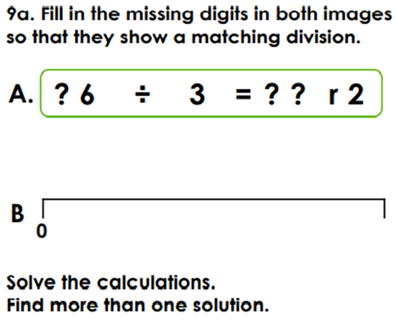
03.05.24
TBAT: begin to divide with remainders
Mastery Challenge

Slide 16
Friday 3rd May
Spellings 1. treasure
2. measure
3. pleasure
4. closure
5. enclosure
6. leisure
7. pressure
8. composure
9. exposure
10. reassure

Slide 17
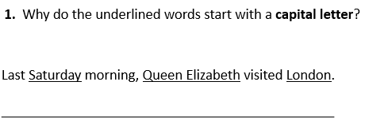
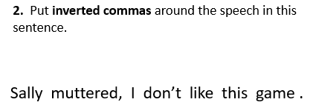
Friday 3rd May TBAT: plan a narrative. 3 in 3

Slide 18
Friday 3rd May TBAT: plan a narrative. Talk partners Which features are needed in a narrative?

Slide 19
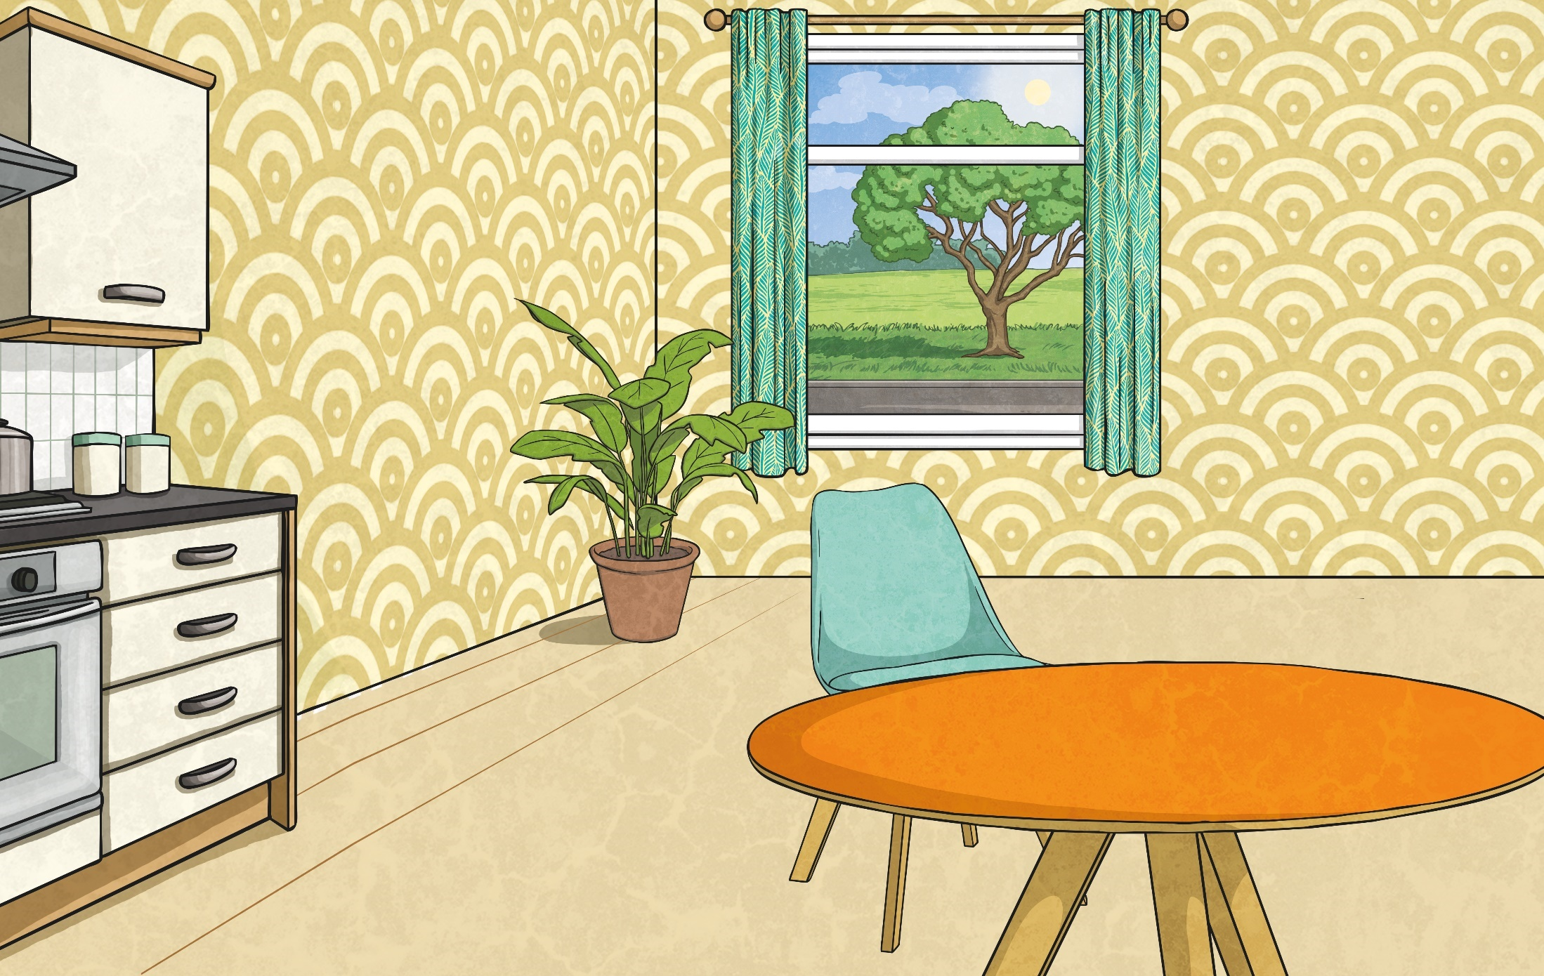
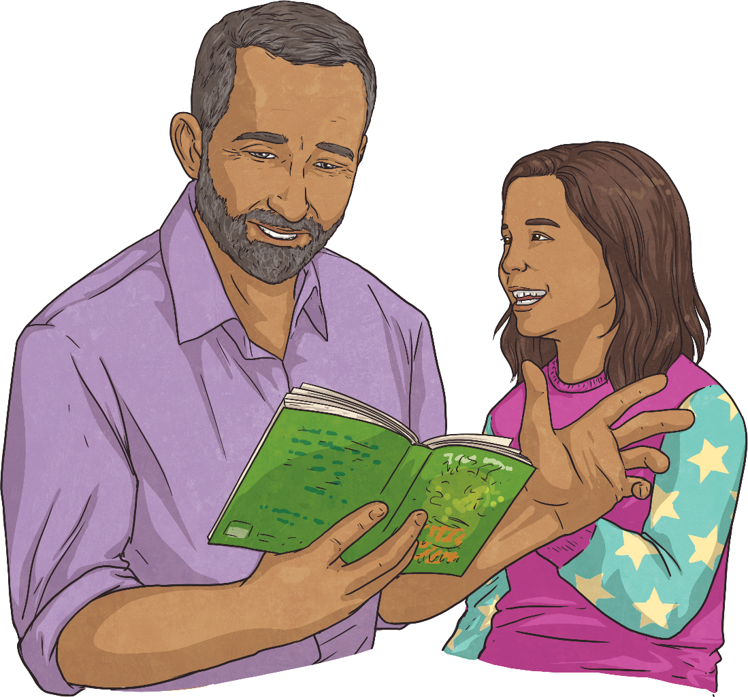
What is Narrative Writing?
Narrative writing is generally thought of as story writing. The main purpose of a narrative text is to entertain the reader, viewer or listener. Sometimes narratives can also be used to inform or teach too.
Usually, a narrative will follow a very specific structure including a beginning, middle and end. It will often be written using chronological events and set in the past present or future.

Slide 20
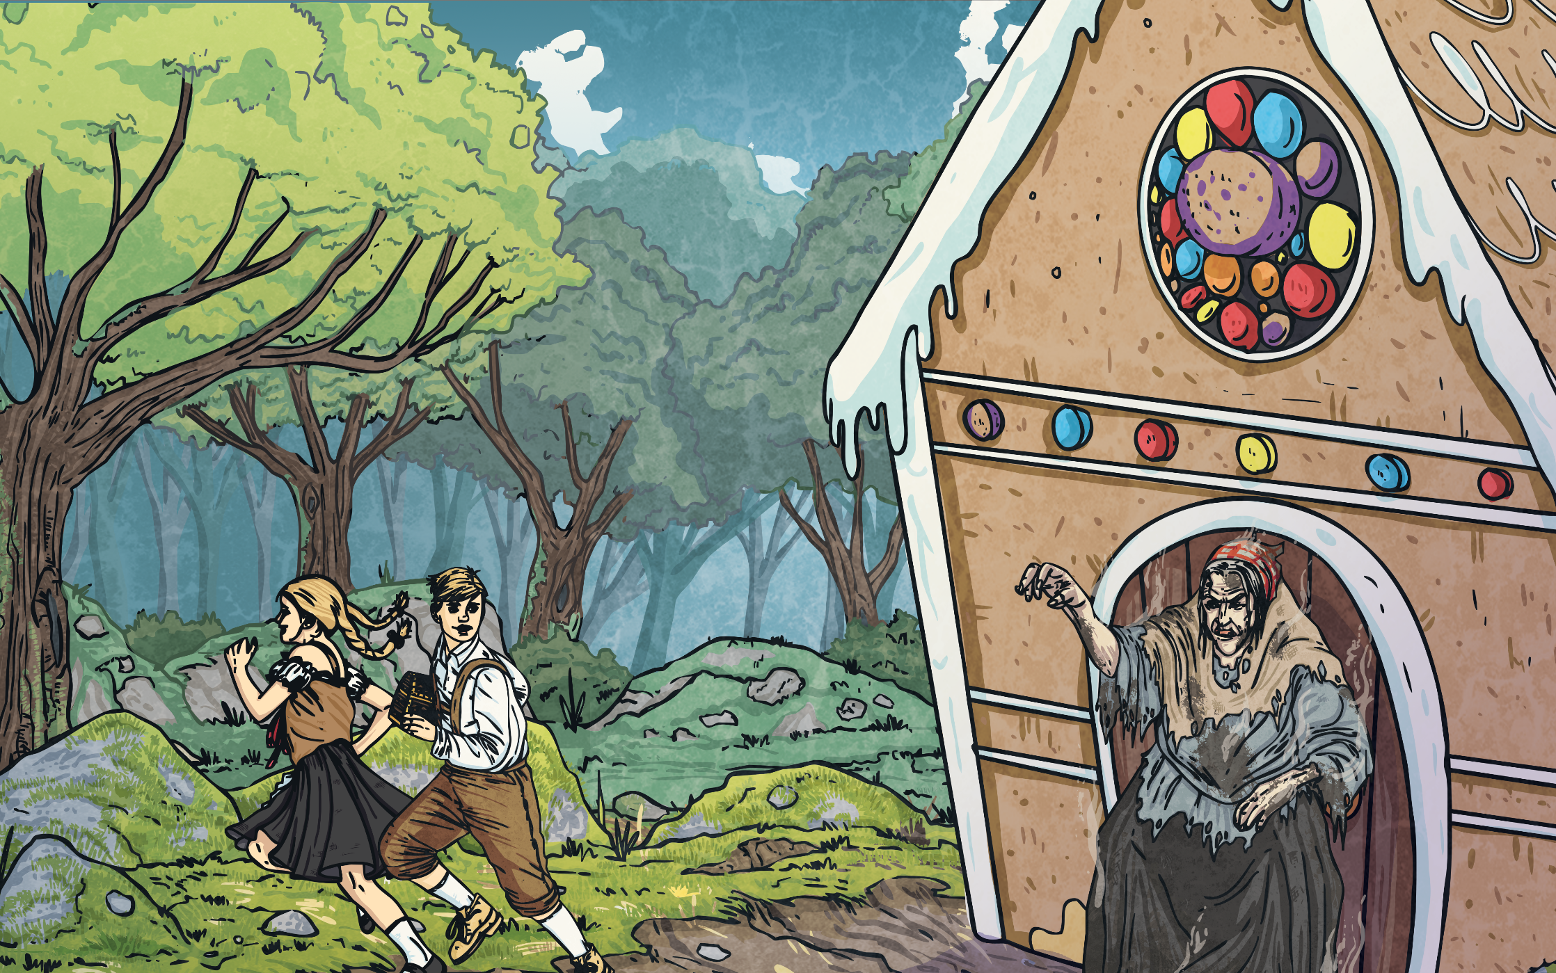
Features of a Narrative Text
A narrative text…
tells a story, usually in chronological order;
begins with an orientation, to introduce the characters and setting of the story;
involves a problem or complication of some sort;
includes a series of events;
ends with a resolution.

Slide 21
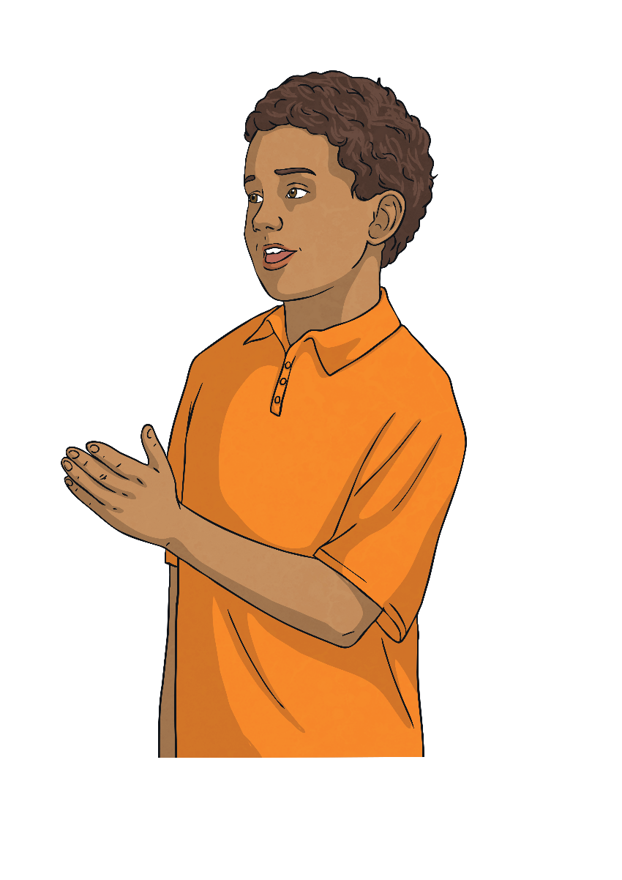
Language Used in Narratives
The language used to write a narrative should include…
past tense (often but not always)
character names
story specific vocabulary
dialogue between characters
descriptive language to “show not tell” the story
chronological sequencing words

Slide 22
Friday 3rd May TBAT: plan a narrative. Think about what has happened in chapter six of Flat Stanley. We are going to plan our narrative as if we are writing from Stanley's point of view.

Slide 23
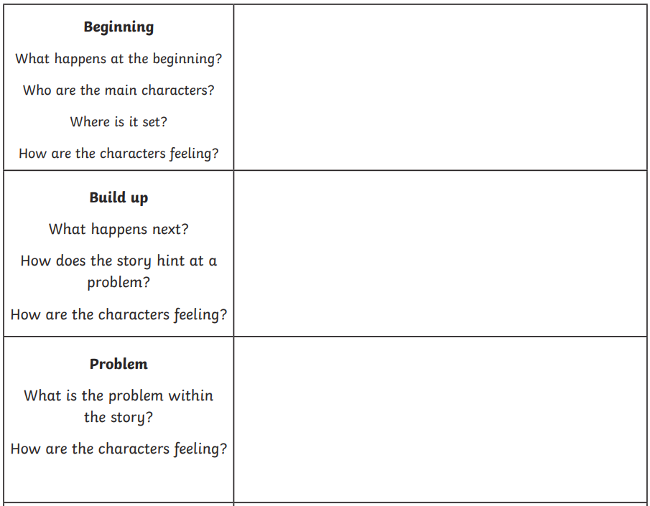
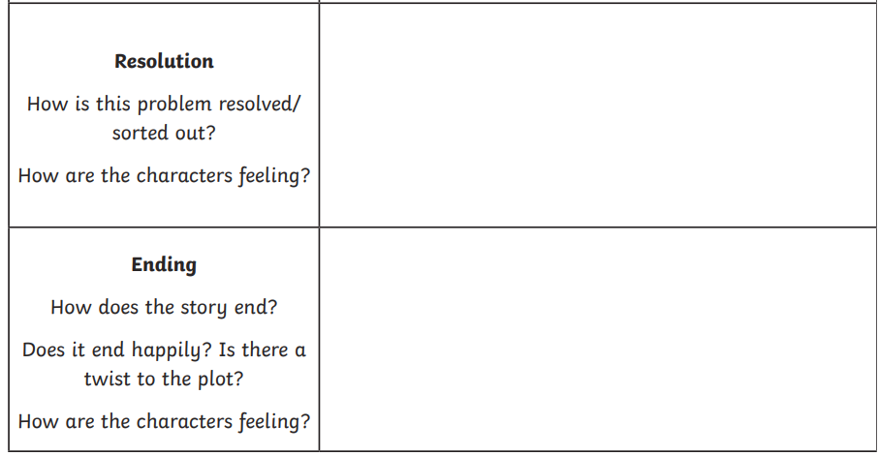
Friday 3rd May TBAT: plan a narrative.

Slide 24
Friday 3rd May TBAT: plan a narrative. Example Beginning: Stanley (I) Inside the dark pyramids. Hieroglyphs on the towering walls. Feeling nervous about finding the scrolls. Build Up: Exited the tomb telling Sir Hawara I found the scrolls! Amisi told me I have been working for thieves. She felt betrayed. I felt confused. Problem: I overhear Sir Hawara's plan to leave me inside the tomb. He is a nasty thief! I feel lonely and disappointed. Resolution: Stanley (I) go along with the plan, but I lead the thieves in the wrong direction. I feel smug to have pulled it off! Sir Hawara is arrested. Ending: I travel home to see my family. I feel emotional to see everyone. Plan a bank of fronted adverbials to use in your narrative.

