Slide 1
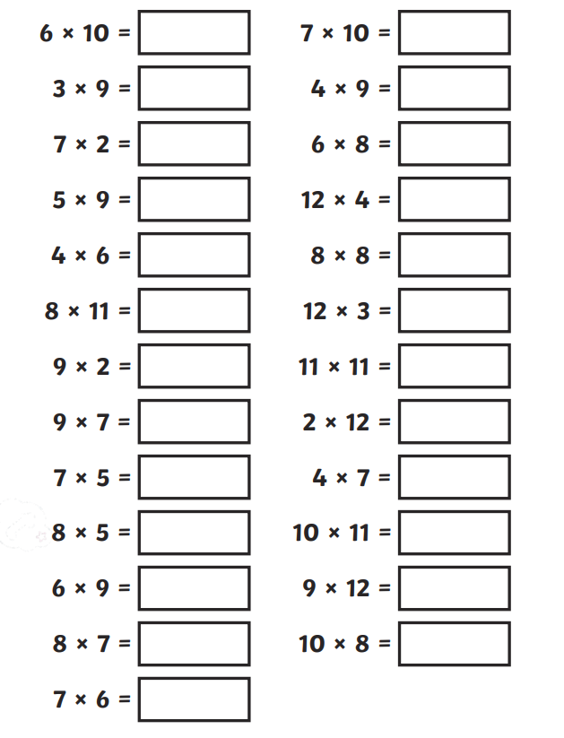
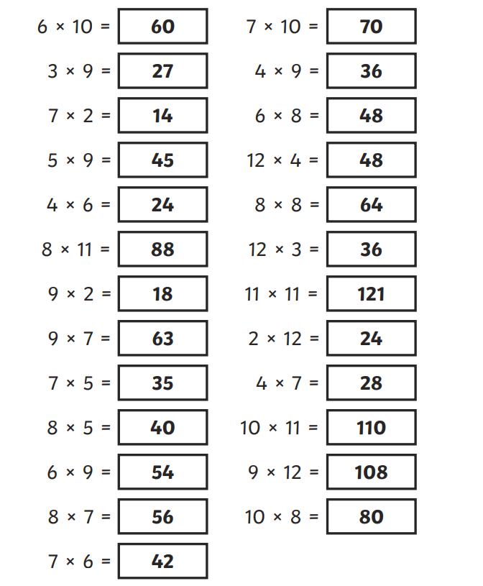
Friday 3rd May Morning challenge
Check your answers:
Is it your day for TTRS?

Slide 2
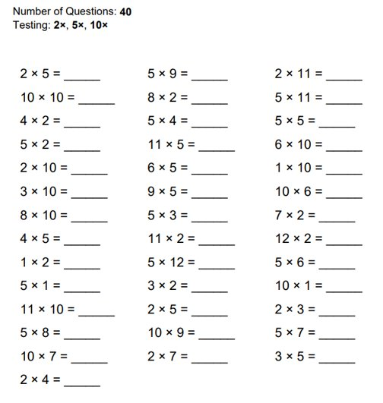
03.05.24 TIMES TABLES OLYMPICS.
-4 minutes to complete -Some are on 2s,5s and 10s. -Some are moving on to 3s and 6s.
-Some are moving on to 4s and 8s.
-Some are moving on to 7s and 9s. -Please collect scores

Slide 3
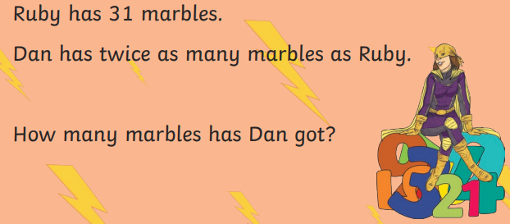
03.05.24 TBAT: Identify 3D shapes and sort based on their properties.
3 in 3
1. 7.2 X 100 =
2. 296 ÷ 8 =
3. Round this number to the nearest 100 - 2733

Slide 4
03.05.24 TBAT: Identify 3D shapes and sort based on their properties.

Slide 5
03.05.24 TBAT: Identify 3D shapes and sort based on their properties.
Match the key vocabulary to its definition.
Edges
Vertices
Faces
a flat surface on a 3D shape. For example a cube has 6.
where two faces meet. For example a cube has 12.
a corner where edges meet (the plural is vertices). For example a cube has 8.

Slide 6
03.05.24 TBAT: Identify 3D shapes and sort based on their properties.
Identify three real-life objects that are cylinder-shaped.
Identify 2 real-life objects that are cone-shaped.

Slide 7
03.05.24 TBAT: Identify 3D shapes and sort based on their properties.
What shape am I?
2 faces
1 edge
1 vertex
1 face
1 edge
0 vertices
6 faces
12 edges
8 vertices

Slide 8
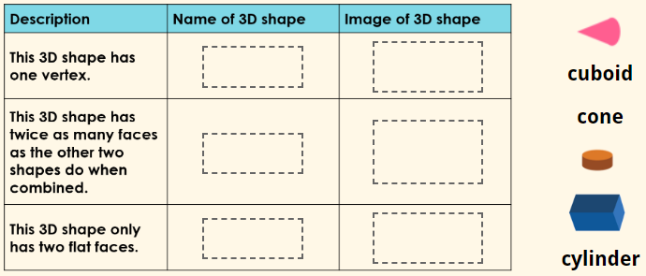
03.05.24 TBAT: Identify 3D shapes and sort based on their properties.
Sorting 3D Shapes on a Venn Diagram - Mathsframe

Slide 9
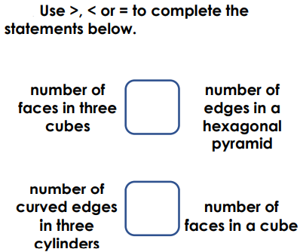
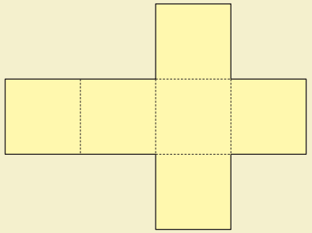
03.05.24 TBAT: Identify 3D shapes and sort based on their properties.
Which 3D shapes can you place on this Carroll diagram?
Challenge - Here is the net of a cube. Draw the net of a square-based pyramid.
Mastery -
Mastery with Greater Depth -
Create a Carroll diagram using your own criteria to sort 3D shapes.
 | Even number of faces | Odd number of faces
Curved face(s)
No curved faces

Slide 10
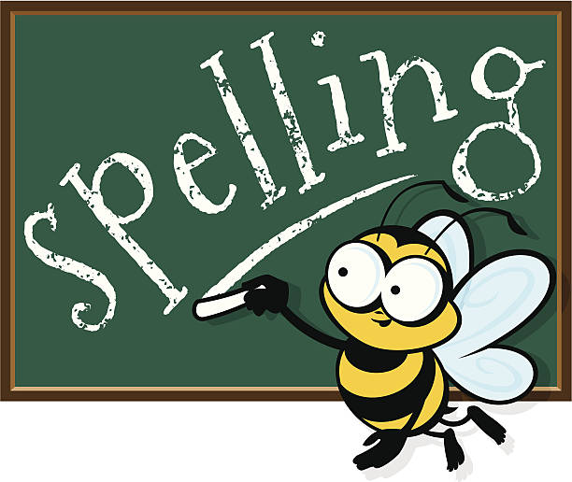
Friday 3rd May Spelling Test 1. exit 2. extend 3. explode 4. excursion 5. exchange 6. exclaim 7. expel 8. external 9. Exterior 10. Export

Slide 11
Friday 3rd May TBAT: write a paragraph of a balanced argument. 3 in 3 Imagine a world where the Mayan gods ponder whether to bestow upon their people the divine gift of chocolate. On one hand, chocolate is a delicious and cherished treat, bringing joy and pleasure to those who indulge in its sweet embrace. However, on the other hand, there are concerns about the potential health risks and societal implications of granting access to this decadent delicacy. In this balanced argument, we will explore both sides of the debate to determine whether the Mayan gods should indeed share their sacred chocolate with their people. 1. Find and copy a word which means indulgent. 2. Find one reason for giving the Mayan people chocolate. 3. Find one reason against giving the Mayan people chocolate.

Slide 12
Friday 3rd May TBAT: write a paragraph of a balanced argument. Tell your partner as many reasons as you can remember FOR the Mayan people receiving chocolate from their Gods. Tell your partner as many reasons as you can remember AGAINST the Mayan people receiving chocolate from their Gods. Explain the purpose of a balanced argument.

Slide 13
Friday 3rd May TBAT: write a paragraph of a balanced argument. Today, we are going to write one paragraph based on what we practised orally yesterday. You are going to write one paragraph for or one paragraph against. SHOULD THE MAYAN GODS GIVE THEIR PEOPLE CHOCOLATE? For Against Recap your words from yesterday (you each spoke for 30 seconds)

Slide 14
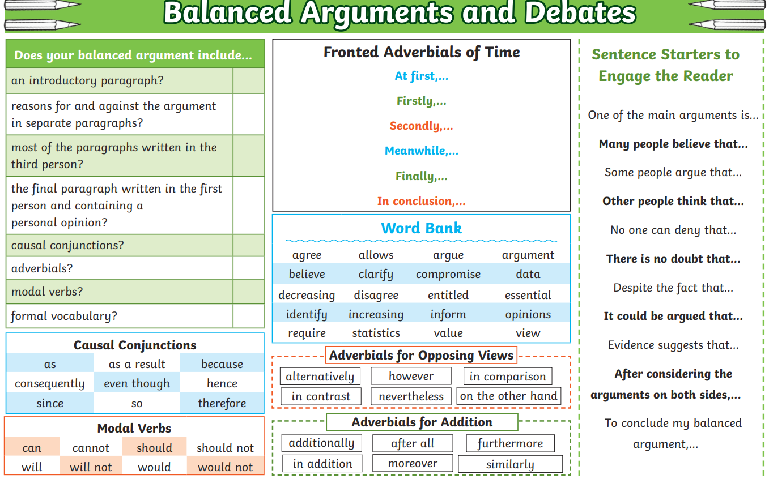
Friday 3rd May TBAT: write a paragraph of a balanced argument. Share write Can you include features from this knowledge organiser?

Slide 15
Friday 3rd May TBAT: write a paragraph of a balanced argument. Should the Mayan gods bestow the gift of chocolate upon their people? Yes, indeed! Chocolate, with its rich and delicious flavour, has been cherished by civilizations throughout history, and the Mayan people would surely benefit from its divine taste. Firstly, chocolate is not just a delightful treat, but it also holds cultural significance for the Mayans, who have long revered cacao as a sacred symbol of wealth and prosperity. By sharing chocolate with their people, the Mayan gods would honour this tradition and strengthen the bond between the divine and the mortal realm. Moreover, chocolate is known to have various health benefits, such as improving mood and boosting energy levels, which could enhance the well-being of the Mayan people. With its heavenly taste and positive effects, chocolate would undoubtedly be a welcome addition to the lives of the Mayan people, making it a gift worth giving. While the idea of the Mayan gods giving chocolate to their people may sound appealing, there are reasons to argue against it, especially considering the gifts and blessings the gods have already bestowed upon the Mayan civilization. Throughout history, the Mayan gods have provided their people with abundant resources, fertile lands, and spiritual guidance, nurturing a thriving and prosperous society. In light of these generous gifts, some may argue that the addition of chocolate is unnecessary and potentially frivolous. Instead of asking for more, perhaps the Mayan people should focus on appreciating and making the most of the blessings they have already received. Moreover, introducing chocolate could potentially disrupt the delicate balance of the Mayan way of life and lead to unforeseen consequences. By maintaining gratitude for the gifts they have already received, the Mayan people can continue to thrive and honour the legacy of their gods without the need for additional indulgences like chocolate.

