Slide 1
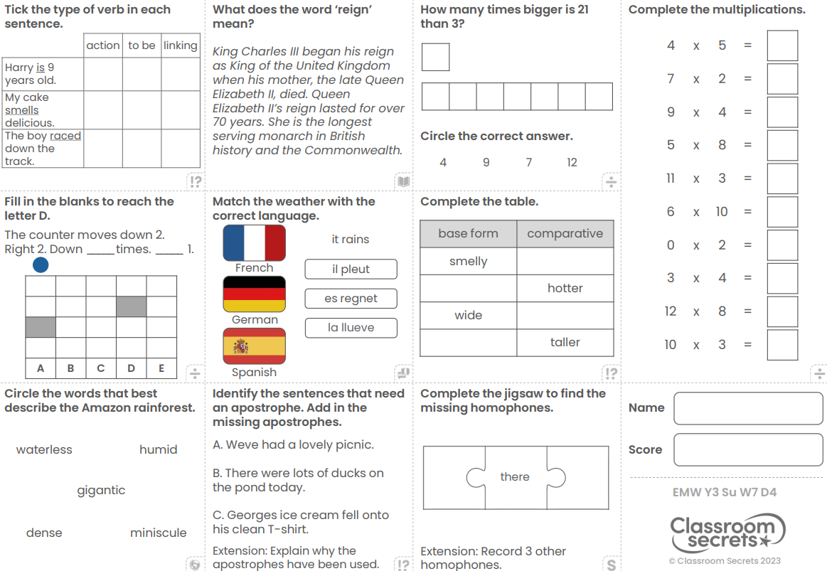
Thursday 2nd May
Morning Challenge

Slide 2
Thursday 2nd May
TBAT: know why Islamic art never shows Allah.

Slide 3
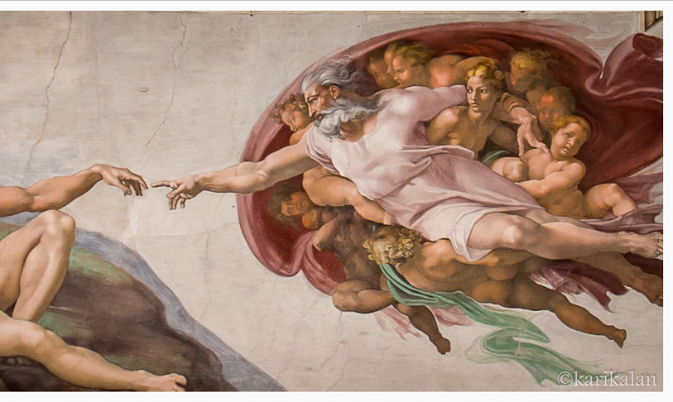
This is a Christian painting showing God.
It was painted by Michelangelo and is called the Creation of Adam.
The Christian God is shown as looking like a human being.
Muslims would never show Allah looking like this.

Slide 4
Allah ….
has always existed.
knows everything that can be known.
can do anything.
has no shape or form.
Think back to lesson one when we talked about why it might be difficult to draw Allah.

Slide 5
It is impossible for a Muslim to draw Allah because they have no form or shape.
They are too big and impressive for human beings to imagine.

Slide 6
We have already looked at three different ways Muslims use art to show what Allah is like.
Can you remember what they are?

Slide 7
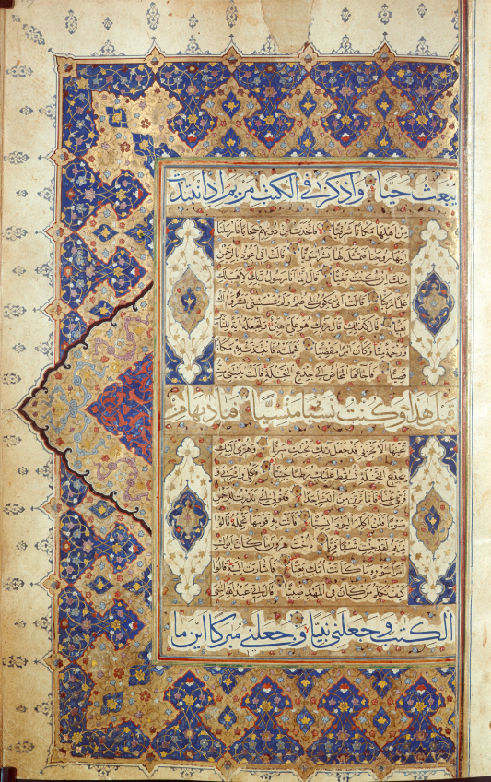


Repeating tiles show Muslims that Allah is infinite (goes on forever)
The beautifully decorated Qur’ans reflect the beauty of Allah’s creation
The Arabic calligraphy allows Muslims to include Allah in their art without drawing them.

Slide 8

02.05.24
TBAT: use a number line to divide
Daily 10 - Mental Maths Challenge - Topmarks
Key Vocabulary
Divide
Inverse
Number line
Remainder

Slide 9
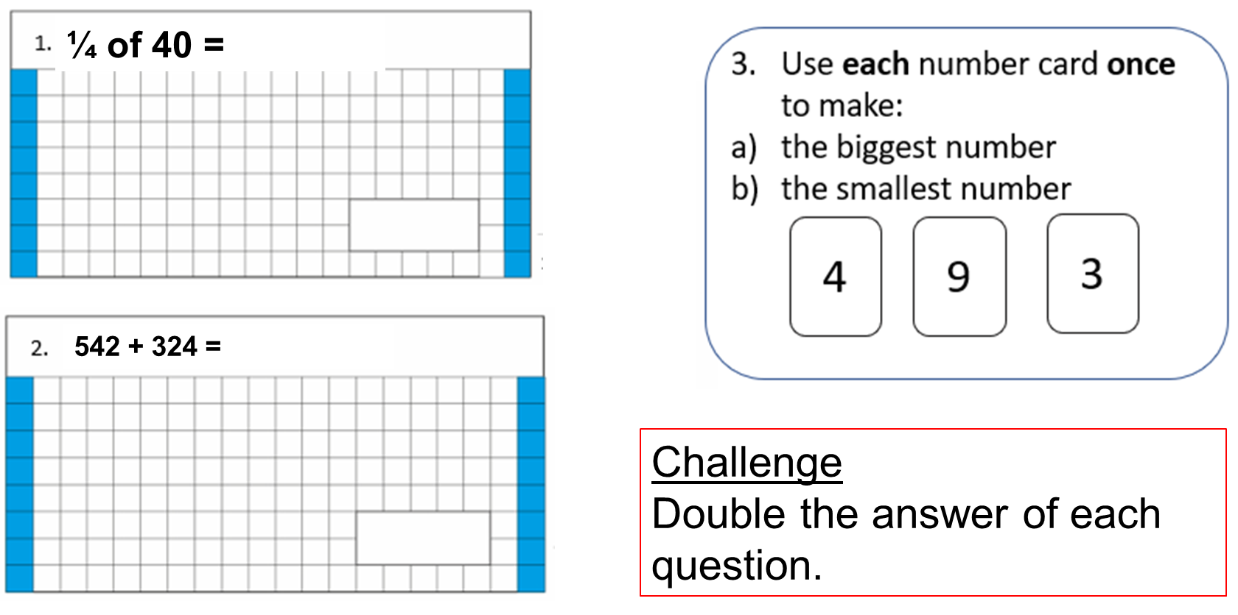
02.05.24
TBAT: use a number line to divide

Slide 10
02.05.24
TBAT: use a number line to divide
Partner Talk
Discuss how you would solve the following questions.
152 shared by 8 =
150 shared by 5 =
90 shared by 6 =

Slide 11
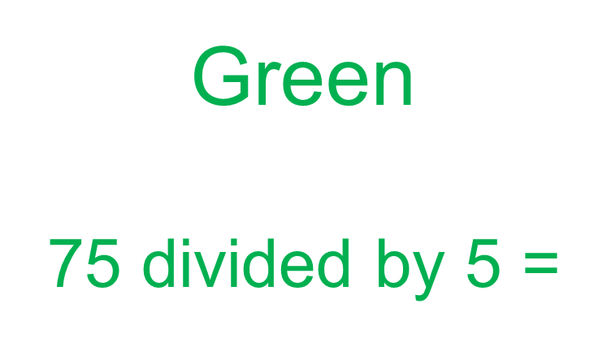
02.05.24
TBAT: use a number line to divide
Blue
85 divided by 5 =

Slide 12
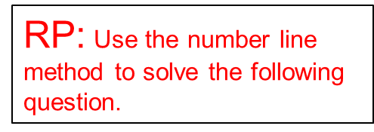
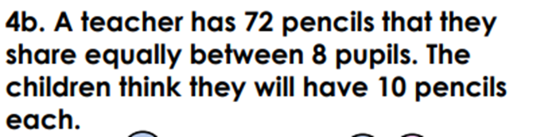
02.05.24
TBAT: use a number line to divide
Independent
1. 54 shared by 3 =
2. 48 shared by 3 =
3. 65 shared by 5 =
4. 108 shared by 4 =

Slide 13
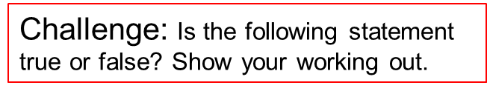
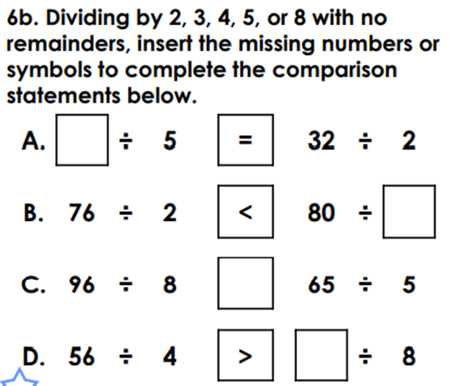
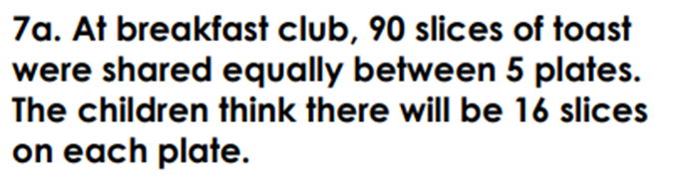
02.05.24
TBAT: use a number line to divide
Mastery Challenge

Slide 14
Thursday 2nd May
TBAT: Spell words ending in –sure.
Dictation
The lion enclosure was the most popular place at the zoo.
In maths, we use a scale to measure mass.
Pirates are often on a quest for treasure.
Forces work by applying pressure by pushing.

Slide 15
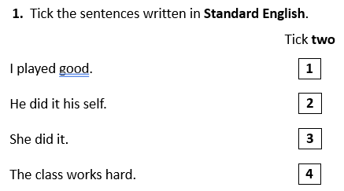
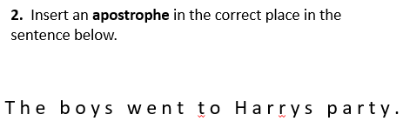
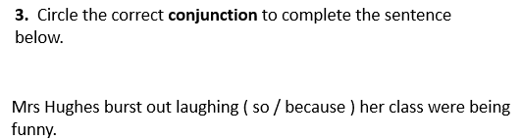
Thursday 2nd May
TBAT: use vocabulary and body language effectively to communicate meaning.
3 in 3

Slide 16
Thursday 2nd May
TBAT: use vocabulary and body language effectively to communicate meaning.
Read through chapter six again.
Talk partners
How do you think Stanley felt as he found the scrolls?
How do you think he felt when he exited the tomb?
How did Amisi feel when she found out who Stanley was working for?

Slide 17
Thursday 2nd May
TBAT: use vocabulary and body language effectively to communicate meaning.
With your partner imagine that you are Stanley and Amisi.
Have a conversation in character about what has happened.
How did Stanley's emotions change throughout the chapter?
How did Amisi feel when she found out what Stanley was doing?

Slide 18
Thursday 2nd May
TBAT: use vocabulary and body language effectively to communicate meaning.
In groups, make 4 freeze frames to summarise the chapter.
What are the 4 most important points?
What do you need to include?
Take pictures of freeze frames and explain under each scene.

Slide 19
02.05.24
TBAT: think of an opposite to traditional stereotypes
Blue
What is a stereotype?
Green
Give an example of a way that someone can break a stereotype
Challenge
Explain why you should not assume what people enjoy.

Slide 20
02.05.24
TBAT: : think of an opposite to traditional stereotypes
In your books make a list in the characters column of the fairy tales you can see on the board.
We will then make a class list and think about a typical adjective which is often given to one of your characters.
Challenge
Have a think about how these adjectives can create a stereotype and are they unfair?

Slide 21
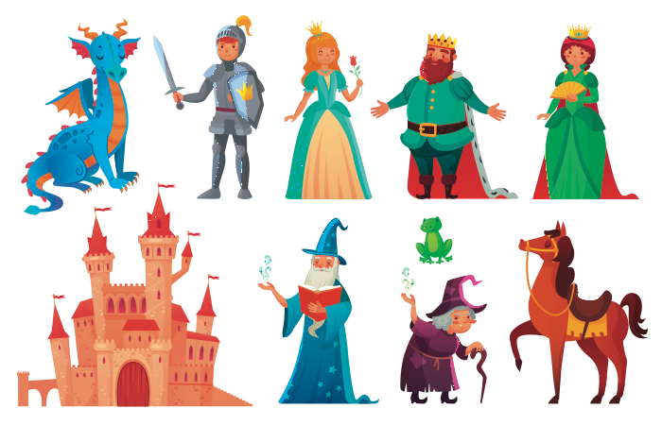
Fairy tales with a difference!
Notes:
Ask pupils to guess the traditional tales which have these characters and animals in them. Ask them to name the fairy tales and make a list. On this slide they may mention: ‘Sleeping Beauty’, ‘The Princess and the Rose’, ‘The Frog Prince’, ‘Hansel and Gretel’ or ‘The Princess and the Dragon’.

Slide 22
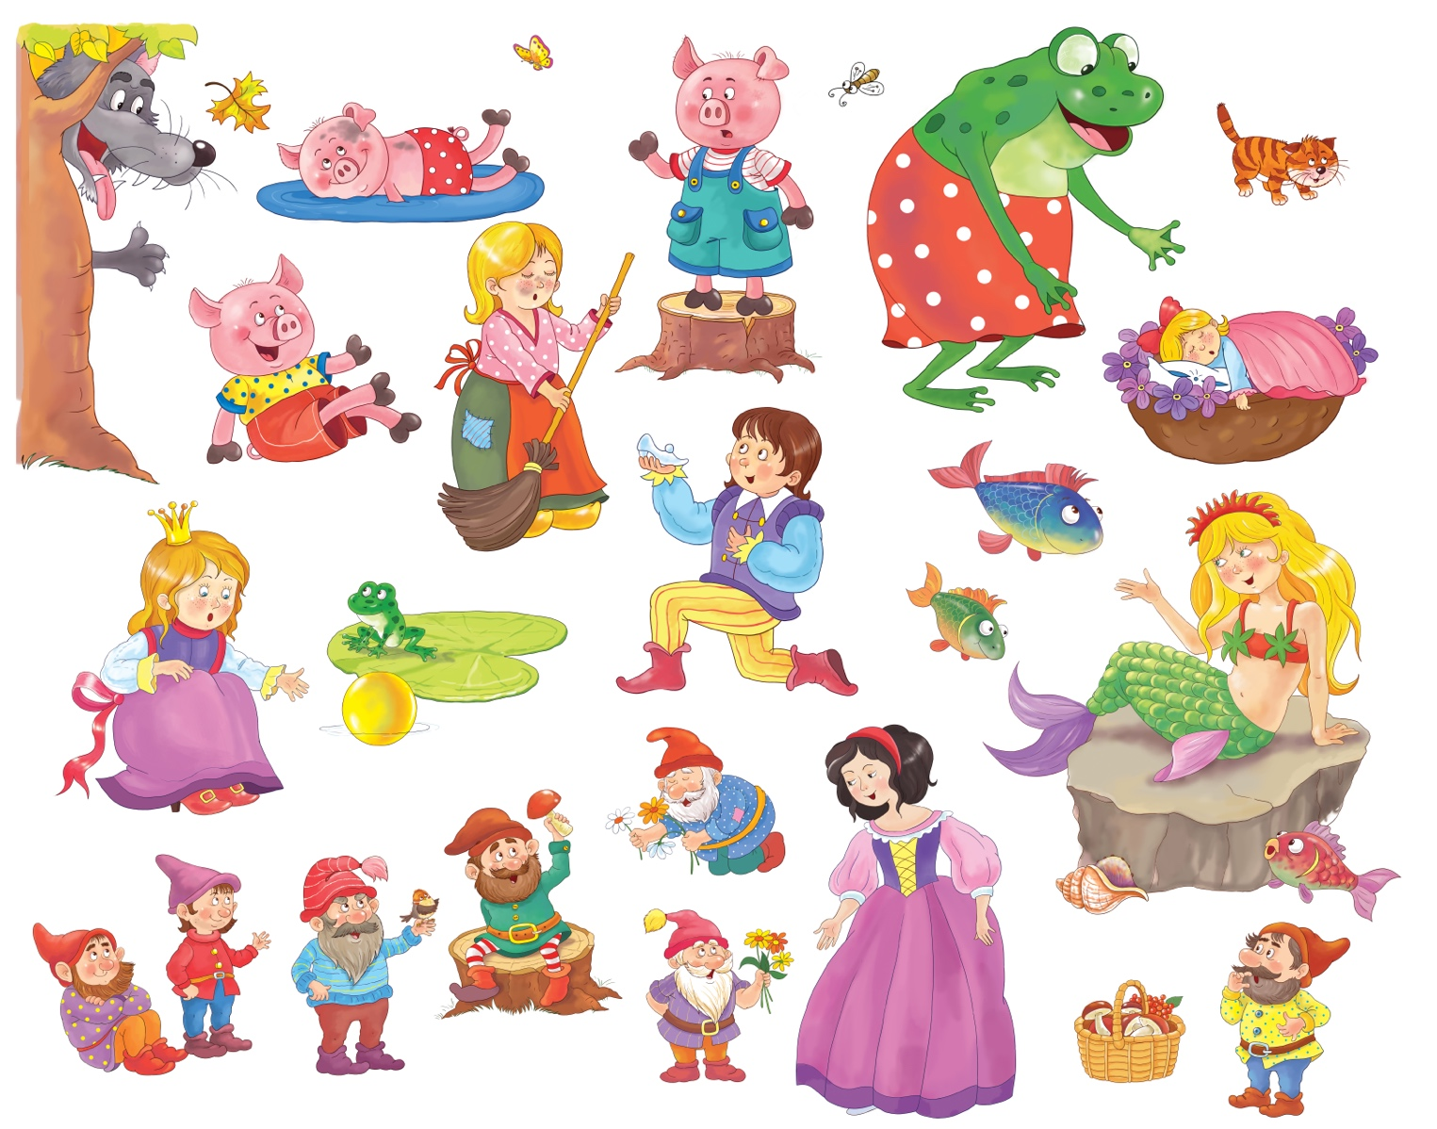
Fairy tales with a difference!
Notes:
Ask pupils to guess the traditional tales which have these characters and animals in them. Ask them to name the fairy tales. On this slide they may mention: ‘The Three Little Pigs’, ‘Snow White’, ‘Cinderella’, ‘The Frog Prince’ or ‘The Little Mermaid’. Ask pupils about any fairy tales which are not shown on these slides. They may mention ‘Jack and the Beanstalk’ or ‘Rapunzel’.
Talk with pupils about characters in all these traditional tales and make a list. Add a typical adjective which is often given to such characters, to create examples like: handsome prince, lazy cat, wise owl, helpless princess, wicked stepmother, mean wolf, cunning fox, poor boy, kind fairy godmother, brave knight, foolish boy, etc. Talk with the class about how stereotypes in stories can be unfair, negative or destructive. Not all stepmothers are cruel, and not all boys are foolish!

Slide 23
02.05.24
TBAT: : think of an opposite to traditional stereotypes
Character | Adjective | Opposite Adjective | Character | Adjective | Opposite Adjective
Sleeping Beauty |  |  | Cinderella
The princess and the Frog |  |  | The Frog Prince
Hansel and Gretel |  |  | The Little Mermaid
The princess and the dragon |  |  | Jack and the beanstalk
The three Little Pigs |  |  | Rapunzel
Snow White

Slide 24
Fairy tales with a difference!
With your partner, think about the characters in fairy tales and other traditional stories. Add a different adjective to make new characters which challenge stereotypes.
What will your new characters be called? Draw and label them.
Describe how they might act.
Remember to break a stereotype

Slide 25
02.05.24
TBAT: : think of an opposite to traditional stereotypes
Character | Adjective | Opposite Adjective | Character | Adjective | Opposite Adjective
Sleeping Beauty |  |  | Cinderella
The princess and the Frog |  |  | The Frog Prince
Hansel and Gretel |  |  | The Little Mermaid
The princess and the dragon |  |  | Jack and the beanstalk
The three Little Pigs |  |  | Rapnunzel
Snow White

Slide 26

TBAT: track a ball that is not sent directly to me.
This half term in P.E will be Cricket and Balls Skills
- Changing for PE
- Rules and expectations moving to PE
- Move to the downstairs hall or outside
Get Set 4 PE - KS2 OAA (getset4education.co.uk)

Slide 27
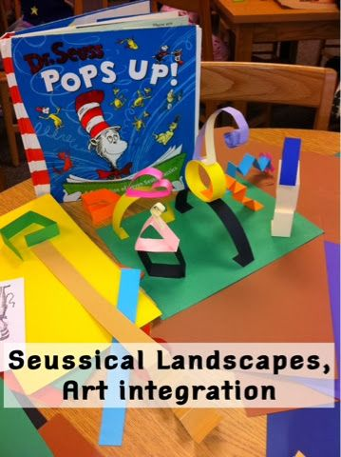
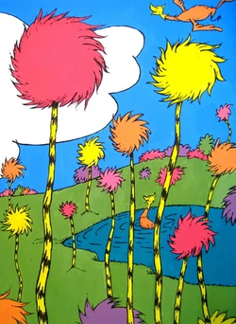
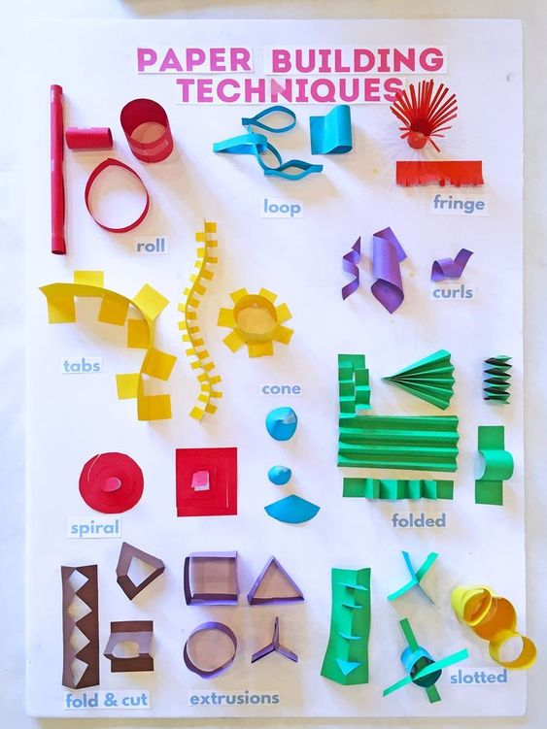
Thursday 2nd May
TBAT: create a story setting through pop up art.
Today we are going to take inspiration from The Lorax and use the image of the setting to create our own pop-up images:

