Slide 1
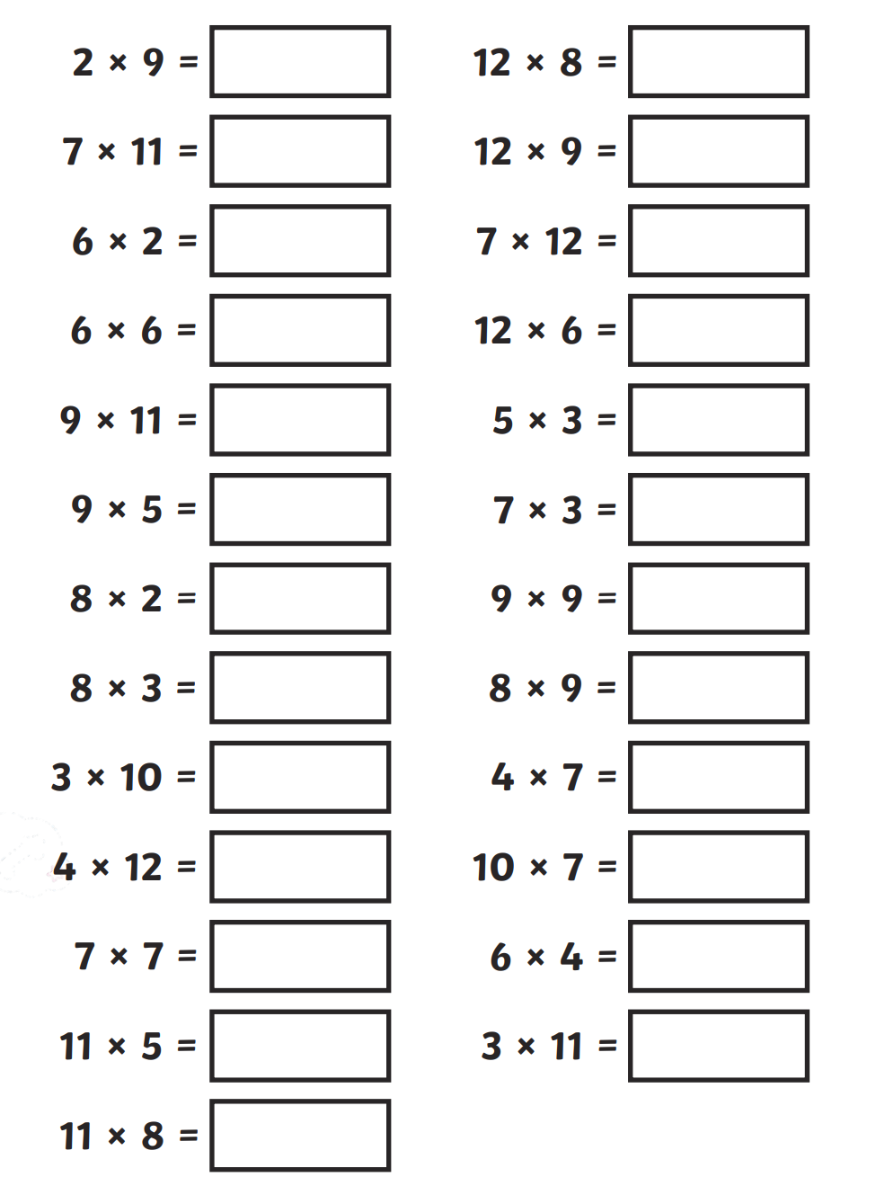
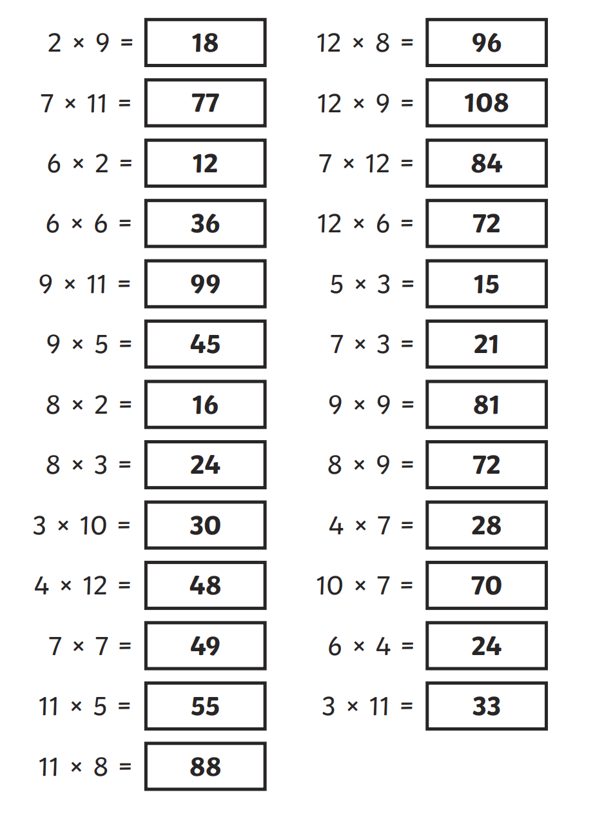
Thursday 2nd May Morning challenge
Check your answers:
Is it your day for TTRS?

Slide 2
Thursday 2nd May
TBAT: understand what sawm and zakat are. What do the five pillars of Islam represent? What language are the pillars written in? When do Muslims pray?

Slide 3
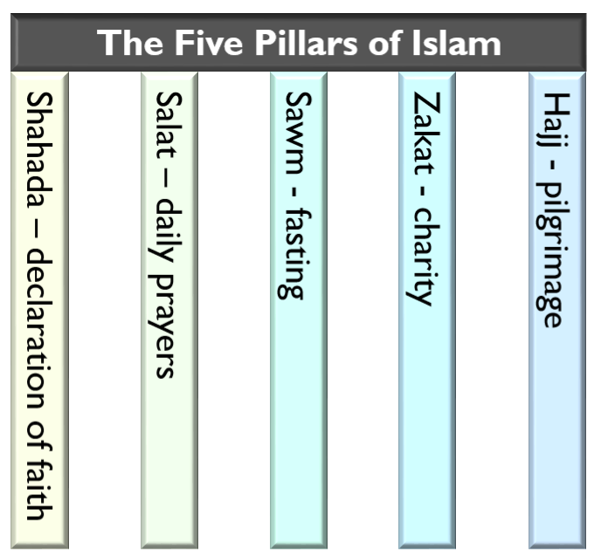
Thursday 2nd May
TBAT: understand what sawm and zakat are.
Remember, this half-term we are looking at the Five Pillars of Islam.
Five beliefs and practices that support Muslims’ faith.
Today we are looking at sawm and zakat – fasting and giving to charity

Slide 4
Thursday 2nd May
TBAT: understand what sawm and zakat are.
Sawm is the Arabic word for fasting.
Fasting is the act of not eating or drinking for a set period of time.
Muslims fast at different times for different reasons. It could be for a day or, in the case of Ramadan, the fasting could be for a much longer period.

Slide 5
Thursday 2nd May
TBAT: understand what sawm and zakat are.
Why is this such an important part of Islam?
Some other religions do encourage fasting but it is one of the five most important practices in Islam.
Think about how you would feel if you didn’t eat or drink all day from sunrise until sunset.
Why might a Muslim choose to do this as part of their religion?

Slide 6
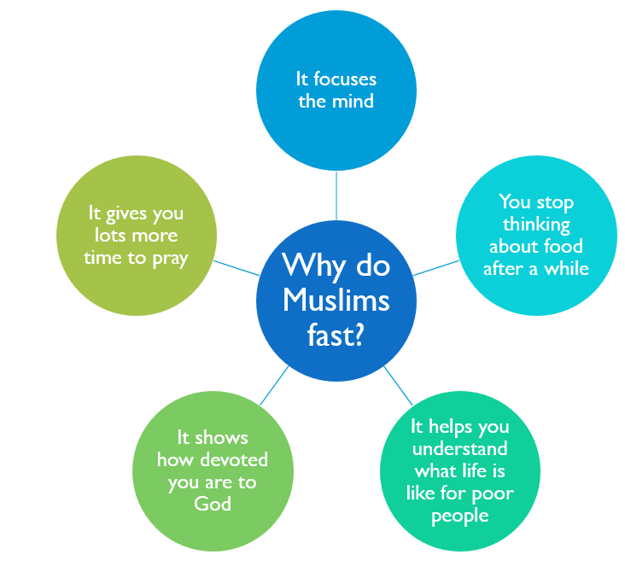

Slide 7
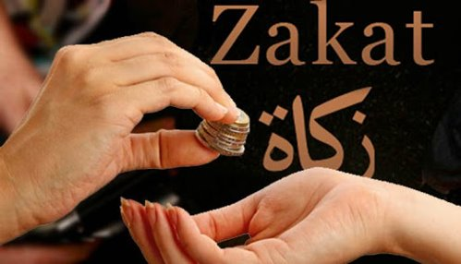
A big part of sawm is giving something up to show how seriously you take your religion. This is called ‘making a sacrifice’.
Zakat is another form of sacrifice.
Zakat is the requirement for all Muslims to give some of their income to charity every year.

Slide 8
Thursday 2nd May
TBAT: understand what sawm and zakat are.
This helps to create a sense of community because everyone helps those in need.
It also makes sure the poorest and neediest in society don’t get forgotten.
For Muslims it shows they care for all of God’s creation – that could be their neighbours or people in need on the other side of the world.

Slide 9
Thursday 2nd May
TBAT: understand what sawm and zakat are.
Talk about these in pairs before writing them in your book.
Muslims fast because …
Muslims fast so …
Muslims give zakat because …
Muslims give zakat so …

Slide 10
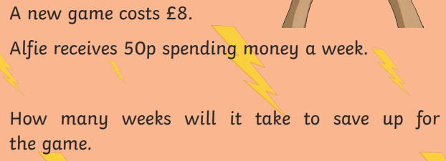
02.05.24 TBAT: sort 2D shapes according to properties including types of quadrilaterals and triangles.
3 in 3
1. ____= 4,580 + 1,000
2. 3/5 of 55 =
3. Round these decimals to the nearest whole number.
3.1
1.5
4.8
6.2

Slide 11
02.05.24 TBAT: sort 2D shapes according to properties including types of quadrilaterals and triangles.

Slide 12
02.05.24 TBAT: sort 2D shapes according to properties including types of quadrilaterals and triangles .
Which matches the description?
• More than 3 sides
• 2 lines of symmetry
• 2 acute and 2 obtuse angles
Which shape matches the description?
• More than 4 sides
• 5 lines of symmetry
• All obtuse angles

Slide 13
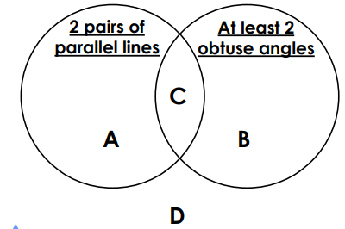
02.05.24 TBAT: sort 2D shapes according to properties including types of quadrilaterals and triangles .
Which shapes could the letters represent in the Venn diagram?

Slide 14
02.05.24 TBAT: sort 2D shapes according to properties including types of quadrilaterals and triangles .

Slide 15
02.05.24 TBAT: sort 2D shapes according to properties including types of quadrilaterals and triangles .

Slide 16
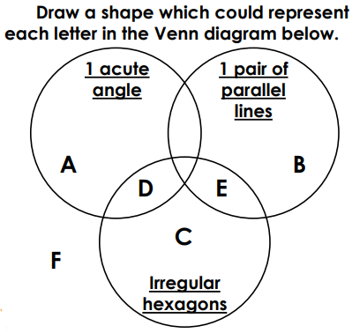
02.05.24 TBAT: sort 2D shapes according to properties including types of quadrilaterals and triangles .
Which 2D shapes can you sort into the Carroll diagram?
Write the names of the shapes.
Challenge - Always, sometimes, never? Quadrilaterals have 2 pairs of parallel lines. Explain your answer and draw shapes to prove it.
Mastery Challenge -
Mastery Challenge with Greater Depth – Create a Carroll diagram using your own criteria.
 | Regular | Irregular
Quadrilateral
Not a quadrilateral
Square
Rhombus
Kite
Right-angled triangle
Isosceles triangle
Equilateral triangle
pentagon

Slide 17
Thursday 2nd May TBAT: spell words with the prefix 'ex'.
Dictation

Slide 18
Thursday 2nd May TBAT: spell words with the prefix 'ex'.
Dictation
The children went on an excursion and wanted to extend their trip. They had to exchange some pounds for dollars.
The headteacher had to tell a child to exit the hall.
The external building was yellow.
Challenge
Write your own sentence using at least two of our spelling words from this week (they must be in the same sentence).

Slide 19
Thursday 2nd May TBAT: participate in a debate. 3 in 3 1. What is the argument in this text? 2. What are the reasons against? 3. What are the reasons for? CH: What side would you be on? Why?

Slide 20
Thursday 2nd May TBAT: participate in a debate. What is a balanced argument? True or false – You should give your own opinion before the conclusion of a balanced argument. Explain the purpose of a balanced argument.

Slide 21
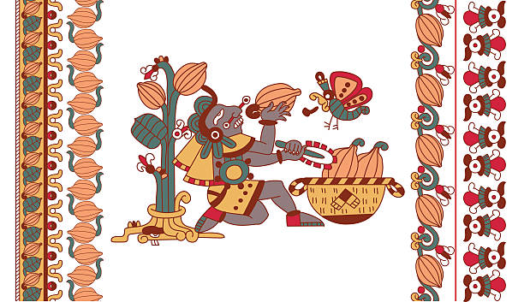
Thursday 2nd May TBAT: participate in a debate. SHOULD THE MAYAN GODS GIVE THEIR PEOPLE CHOCOLATE?

Slide 22
Thursday 2nd May TBAT: participate in a debate. SHOULD THE MAYAN GODS GIVE THEIR PEOPLE CHOCOLATE? For Against

Slide 23
Thursday 2nd May TBAT: participate in a debate. SHOULD THE MAYAN GODS GIVE THEIR PEOPLE CHOCOLATE? For Against Stand in two lines facing each other (different partner to your B/G partner) and tell them your reason.

Slide 24
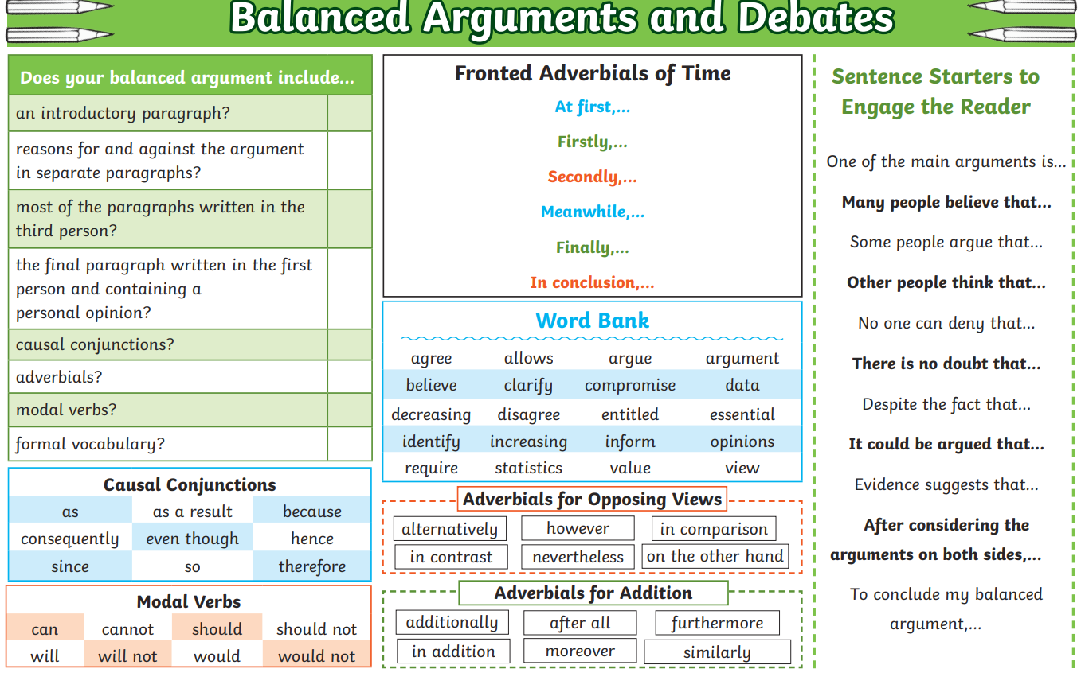
Thursday 2nd May TBAT: participate in a debate.
In your pairs, you are going to take it turns to argue your reason. Can you use the sentence starters on the board? Be prepared to share. Share write an example together: No one can deny that the Gods were good to the Mayan people, but do they really deserve chocolate? Perhaps the Gods want to keep some luxury for themselves.

Slide 25
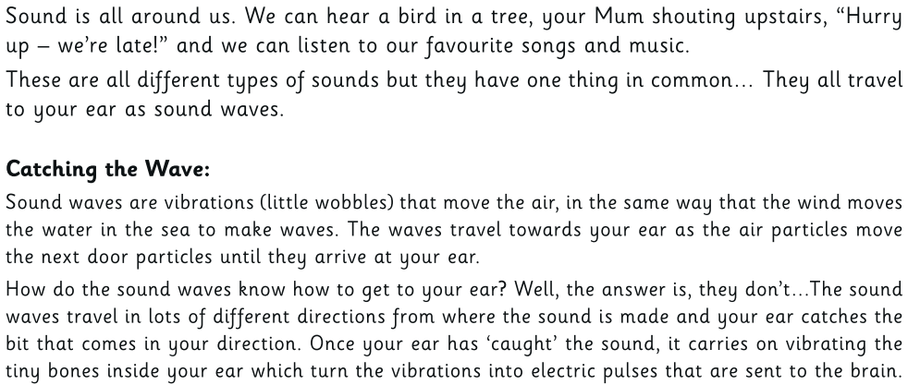
Thursday 2nd May
Q: How are sounds made?
What vibrates inside your ear to send the sound signals into your body?
What do all sounds have in common?
What are sound waves?

Slide 29
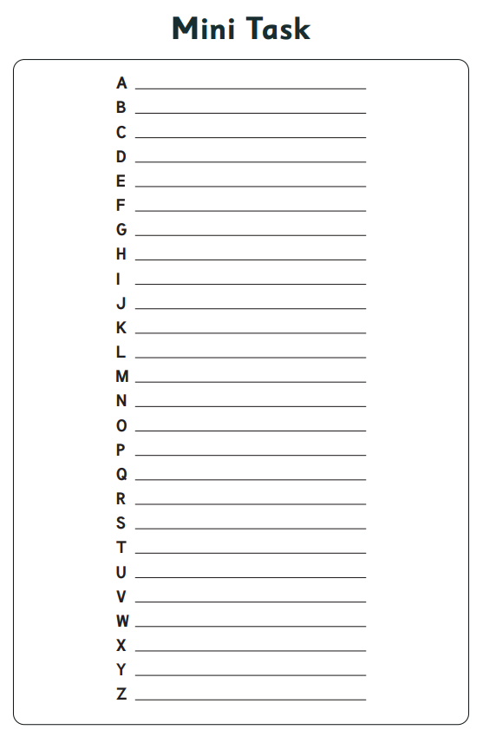

Slide 31
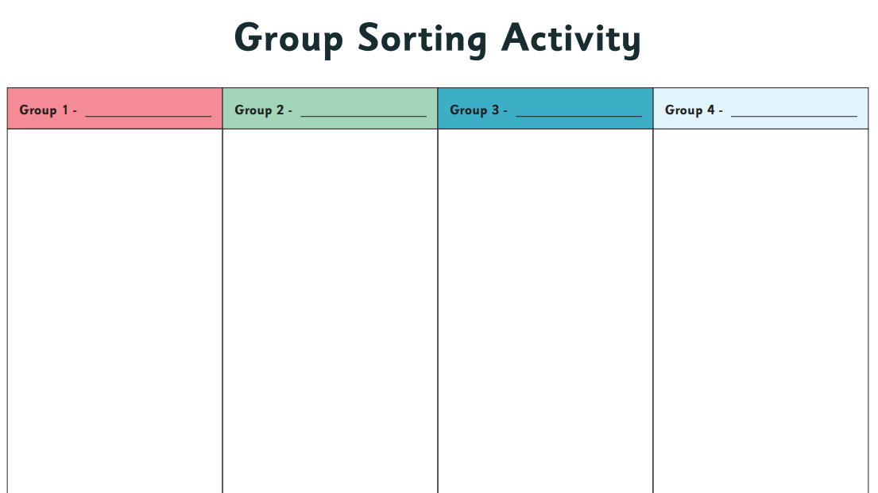

Slide 33
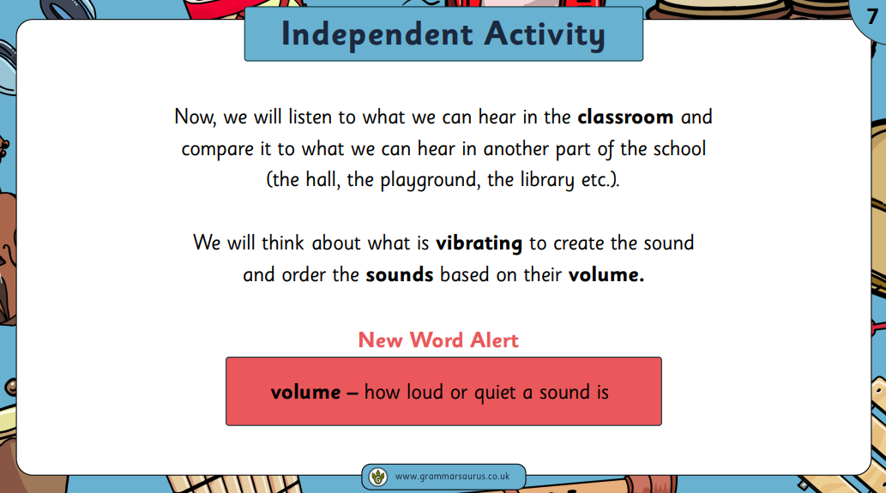

Slide 34
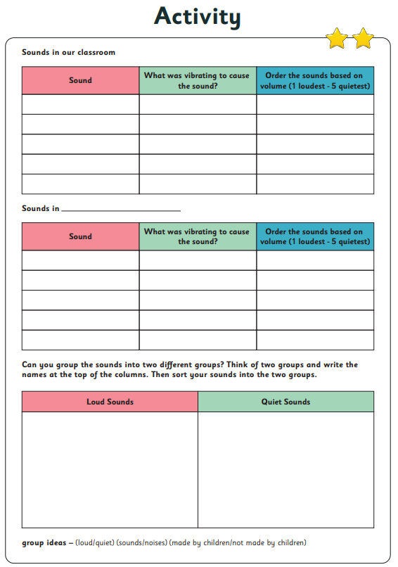

Slide 39
Thursday 2nd May TBAT: know how to put somebody in the recovery position and understand CPR. How can you treat somebody with burns or scalds? How can you treat somebody with a head injury? Explain what you would need to do if the first aid becomes an emergency. Why?

Slide 40
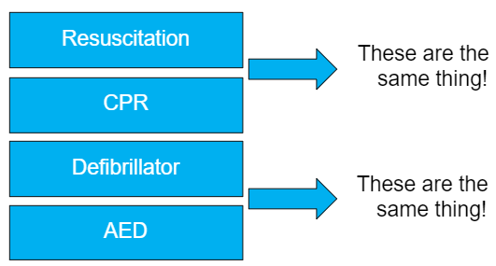
Thursday 2nd May TBAT: know how to put somebody in the recovery position and understand CPR. Do you know the meaning of any of these words or do you know what these things are and what they do?

Slide 41
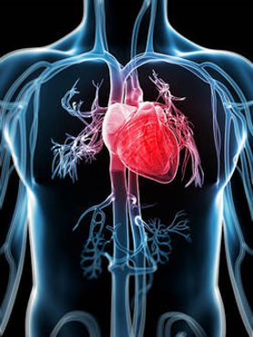
Thursday 2nd May TBAT: know how to put somebody in the recovery position and understand CPR. Resuscitation can save someone life!
If someone goes into cardiac arrest this means that their heart has stopped beating and oxygen can’t get around their body.
Resuscitation or CPR is used to help them.
A defibrillator, which is also known as an AED is a special machine that can get a heart pumping again.

Slide 42
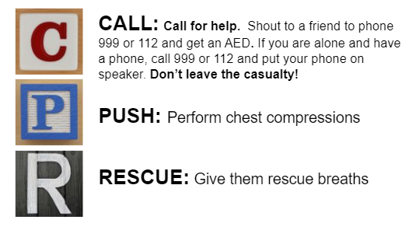
Thursday 2nd May TBAT: know how to put somebody in the recovery position and understand CPR. The official meaning of CPR is cardiopulmonary resuscitation. But, there is an easier way to remember it:

Slide 43
Thursday 2nd May TBAT: know how to put somebody in the recovery position and understand CPR. Watch the video below on how to perform CPR. How to administer CPR - BBC Teach

Slide 44
Thursday 2nd May TBAT: know how to put somebody in the recovery position and understand CPR. How to use a defibrillator: https://youtu.be/UFvL7wTFzl0
Things we still need to remember if we need to use a defibrillator.
Do I still need to do CPR if I use a defibrillator?
Yes. The defibrillator will indicate when to start and stop CPR, and guide you through how to do CPR.
Important: do not touch the casualty when the defibrillator administers a shock.
Do you have to be trained to use a defibrillator?
No – the defibrillator will guide you through what to do with simple voice instructions and visual prompts. However, we would encourage everyone to take defibrillator training to ensure they are familiar with the device and ready to act confidently in an emergency.
Anyone can safely use a defibrillator. Do not wait for the emergency services to arrive to start treating the casualty.
Can you hurt someone by using a defibrillator?
No. If a person is not in cardiac arrest the device will not administer a shock, even if you press the button, as it has detected a heartbeat.
By using a defibrillator, you increase their chances of survival.
Who can you use a defibrillator on?
Yes, standard defibrillator pads are suitable for use on children over the age of eight.
For children aged between one and eight years, use a paediatric defibrillator or standard defibrillator with paediatric pads. The paediatric pads adjust the current delivered during defibrillation. In an emergency, if a defibrillator with adult pads is the only device available, then it can be used.

Slide 45
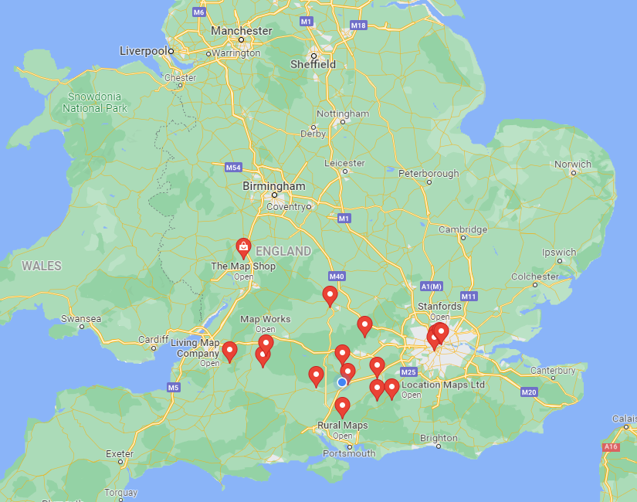
Where are the AEDs in my local area?
Find out where your nearest defibrillators are.
Once you have found them, mark them onto the map.
Visit AED Defibrillator UK Locations | Find an AED / Defibrillator (heartsafe.org.uk)
Challenge – If you are at Gorleston beach, where is your nearest defibrillator?
Notes:
Get the pupils to visit AED Defibrillator UK Locations | Find an AED / Defibrillator (heartsafe.org.uk)
This has a map with defibrillator locations across the UK.

Slide 46
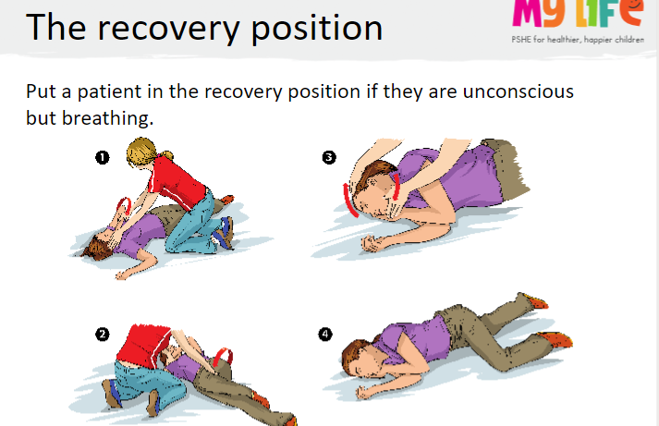
Thursday 2nd May TBAT: know how to put somebody in the recovery position and understand CPR.
Talk partners
What does the word unconscious’ mean?
With your partner, you will put each other into the recovery position.
As I read the instructions of putting someone into the recovery position, you will follow the steps. Let me demonstrate with one of you first.
When you have completed it, you should check your partner looks like the person in the picture. Then swap and let your partner have a go.
Notes:
The instructions are:
1. With the patient lying on their back, place the nearest arm to you at a right angle to their body.
2. Move the other arm across the chest with the back of the hand underneath the patient’s cheek.
3. Bend the leg furthest away to you until the foot is flat on the floor.
4. Holding the bent leg and with your hand underneath the patient’s cheek, roll the patient onto their side.
5. Tilt their head back to open their airways.

