Slide 1
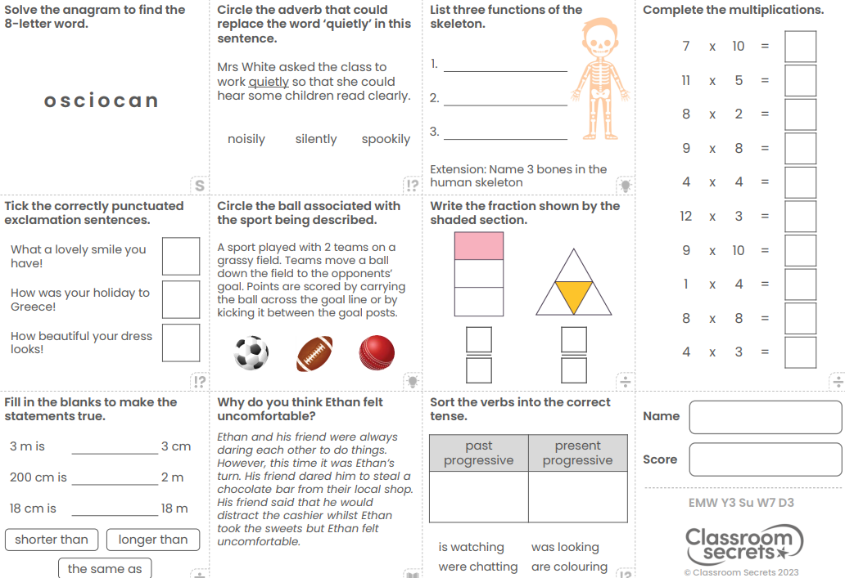
Wednesday 1st May
Morning Challenge

Slide 2
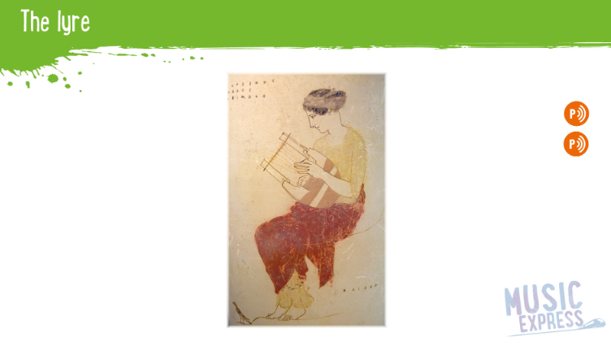
Wednesday 1st May
TBAT: perform a round in three parts.
Collins Connect
Ancient Worlds – Story songs – Activity 3

Slide 3

01.05.24
TBAT: divide by 2,3,4 and 5
Daily 10 - Mental Maths Challenge - Topmarks
Key Vocabulary
Divide
Inverse
Number line
Remainder

Slide 4
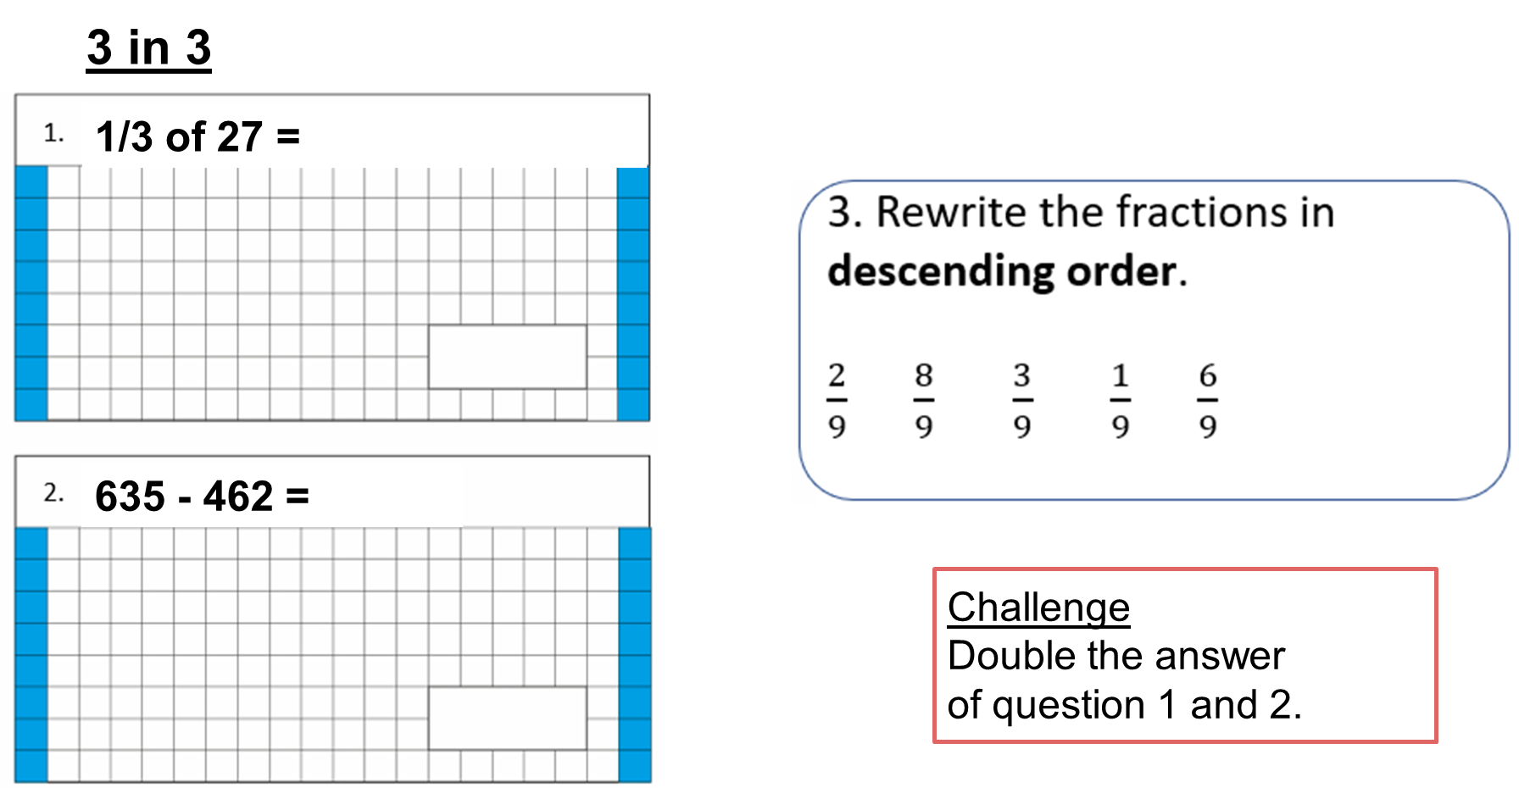
01.05.24
TBAT: divide by 2,3,4 and 5

Slide 5
01.05.24
TBAT: divide by 2,3,4 and 5
Class Talk
Discuss how you would solve the following questions.
We need to use a number line to work this out
90 shared by 3 =

Slide 6
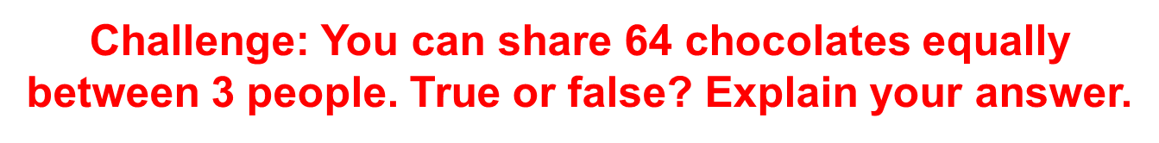
01.05.24
TBAT: divide by 2,3,4 and 5
Partner Talk
Discuss how you would solve the following questions.
65 shared by 5 =
16 shared by 4 =

Slide 7


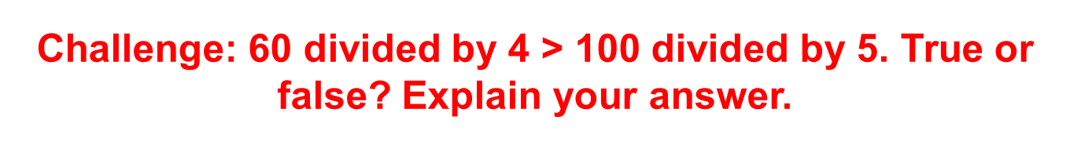
01.05.24
TBAT: divide by 2,3,4 and 5
Solve the following division calculation.
Blue Green

Slide 8
01.05.24
TBAT: divide by 2,3,4 and 5
Independent - Use a number line to solve the following questions.
1. 21 shared by 3 =
2. 44 shared by 4 =
3. 75 shared by 5 =
4. 60 shared by 2 =
5. 52 shared by 4 =
6. 100 shared by 5 =
RP: A baker bakes 132 cupcakes. She sends them to 3 different supermarkets. Does each supermarket receive an equal amount? Prove it.
RP: A football team score 125 goals in 5 games. How many did they score in 1 game?

Slide 9
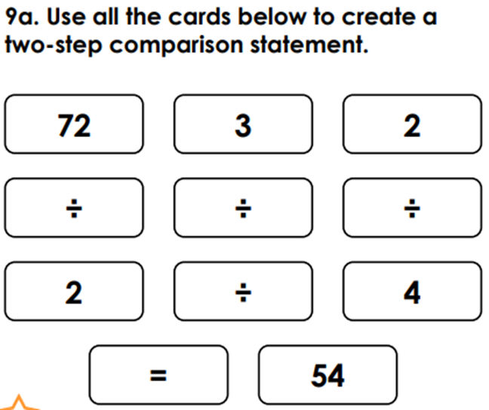
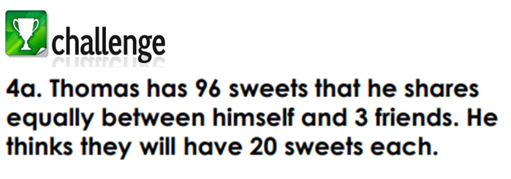
01.05.24
TBAT: divide by 2,3,4 and 5
Mastery Challenge

Slide 10
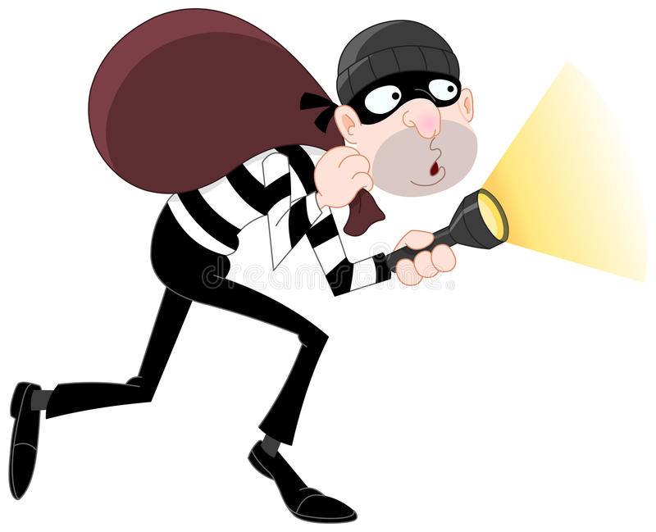
Wednesday 1st May
TBAT: Spell words ending in –sure.
Spelling thief
m_as_r_
tre_s_r_
l_i_u_e
en_lo_u_e
pl_a_u_e
Challenge – Rewrite the sentences below and correct the spellings:
The preshure was too much for the manager. So he took himself to the zoo and visited the zebra encloushure. He took great pleshure in seeing the zebras running freely.

Slide 11
Wednesday 1st May
TBAT: identify the features of a narrative.
3 in 3
Troy sat on the wall outside the corner shop. Inside, his friends were enjoying the thrill of choosing their sweets. Having only three pence to his name, he knew that there would be nothing that he could afford, so there was no point in even looking. He reached into his pocket and pulled out his feeble collection of coins. Why did they even bother making them if they couldn’t be used to buy anything? He rubbed his thumb over the two pence piece, as if cleaning it up would somehow increase its value. But then something happened that made him rub his own eyes instead.
1. What was Troy sitting on?
2. What were Troy’s friends doing?
3. How much money did Troy have?

Slide 12
Wednesday 1st May
TBAT: identify the features of a narrative.
What could we write a narrative about?
What are the features needed in a narrative?

Slide 13
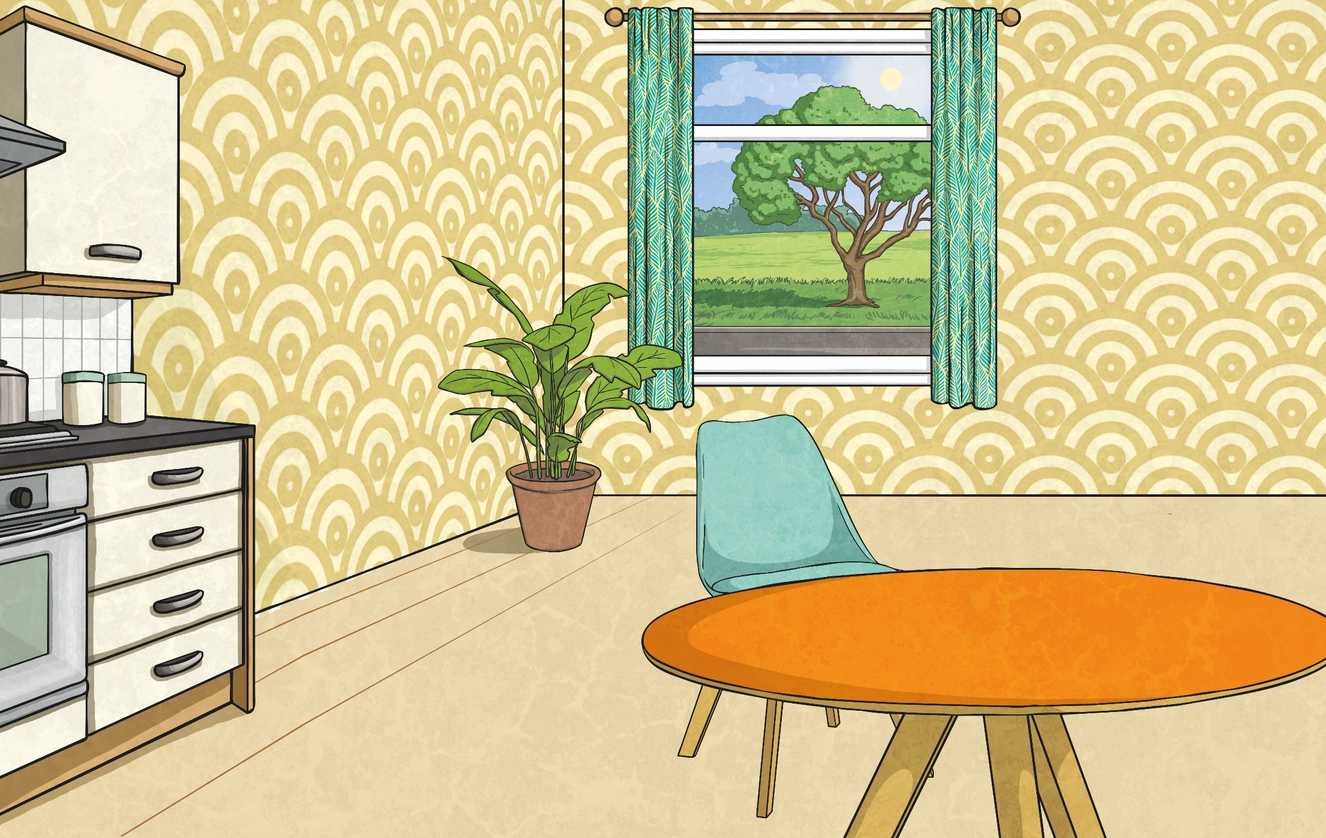
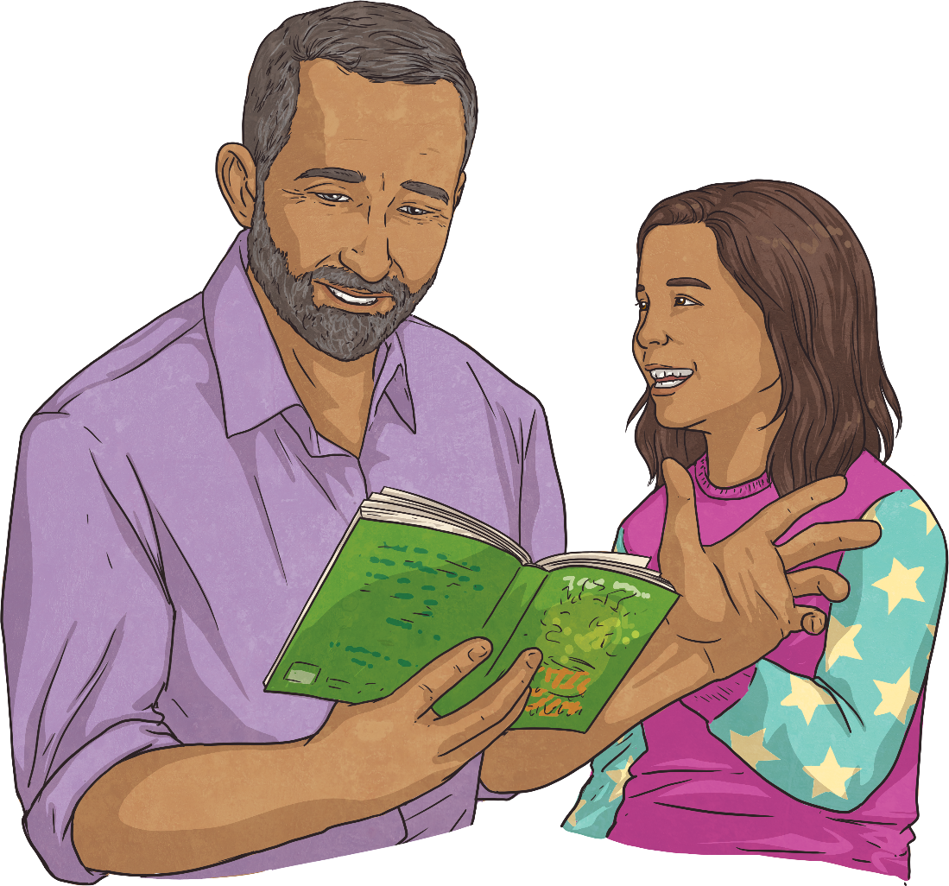
What is Narrative Writing?
Narrative writing is generally thought of as story writing. The main purpose of a narrative text is to entertain the reader, viewer or listener. Sometimes narratives can also be used to inform or teach too.
Usually, a narrative will follow a very specific structure including a beginning, middle and end. It will often be written using chronological events and set in the past present or future.

Slide 14
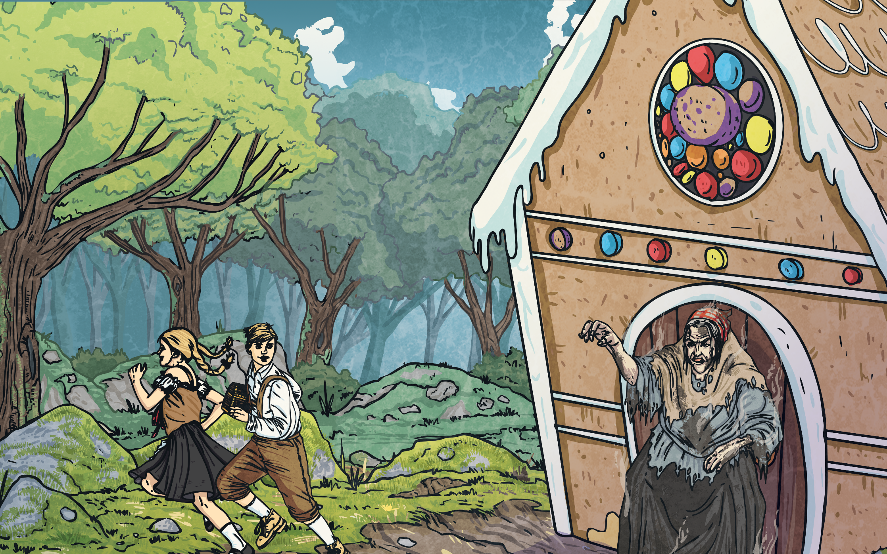
Features of a Narrative Text
A narrative text…
tells a story, usually in chronological order;
begins with an orientation, to introduce the characters and setting of the story;
involves a problem or complication of some sort;
includes a series of events;
ends with a resolution.

Slide 15

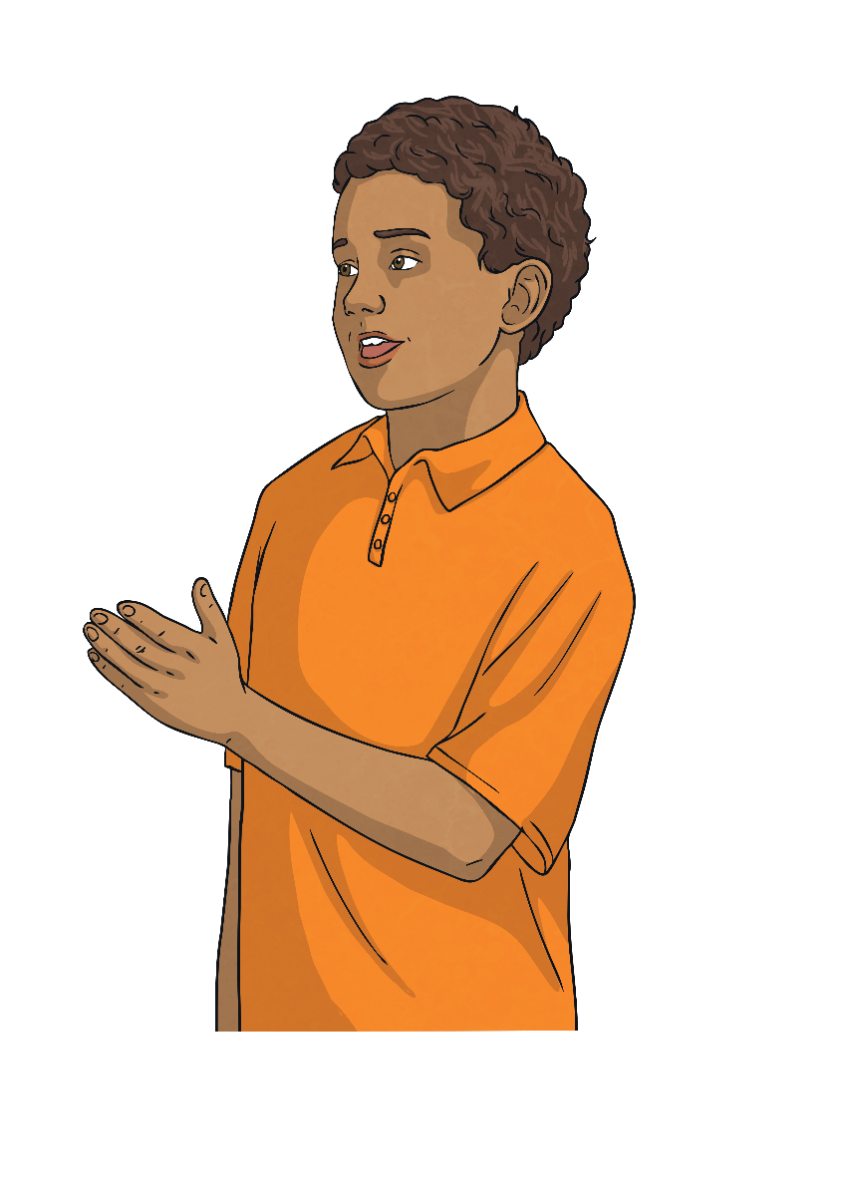
Language Used in Narratives
The language used to write a narrative should include…
past tense (often but not always)
character names
story specific vocabulary
dialogue between characters
descriptive language to “show not tell” the story
chronological sequencing words

Slide 16
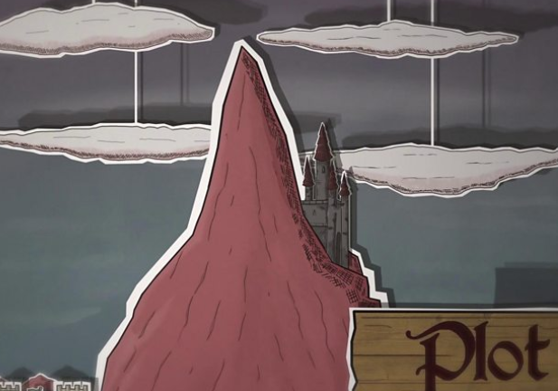
Wednesday 1st May
TBAT: identify the features of a narrative.
How is a story structured? - BBC Bitesize

Slide 17
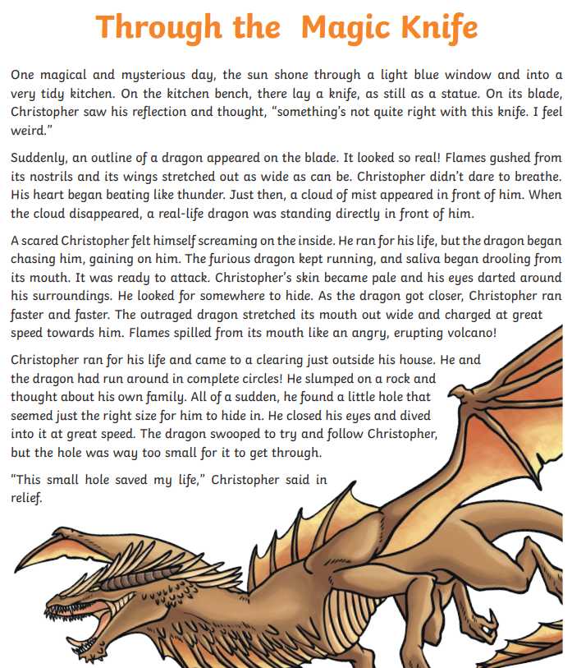
Wednesday 1st May
TBAT: identify the features of a narrative.
Using the example, highlight and create a key for the features needed in a narrative.

Slide 18
01.05.24
TBAT: recognise how digital devices can change the way we work
Blue
What is an input?
Green
What is an output?
Challenge
What do we call the action that happens?

Slide 19
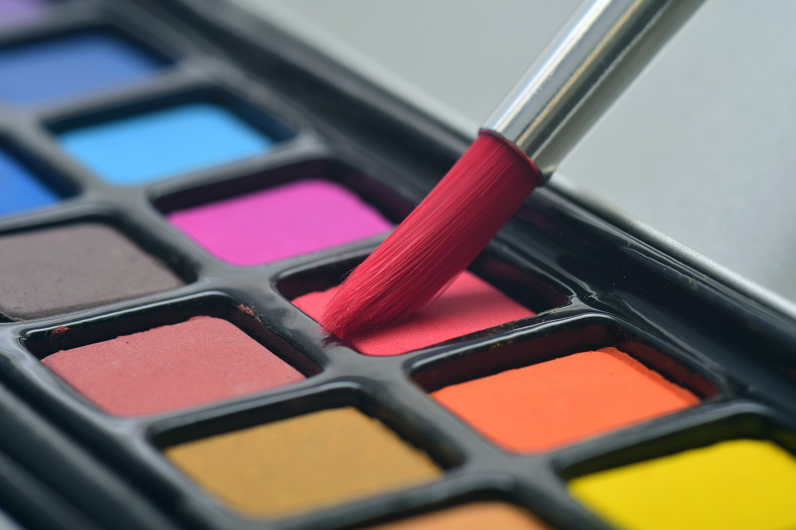

Can you think of a digital version of these two things?
Introduction
Notes:
Image sources:
https://pixabay.com/photos/brush-watercolor-paint-art-color-3445376/
https://pixabay.com/photos/paper-table-record-notebook-2541687/

Slide 20
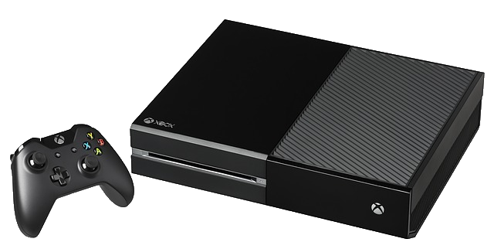


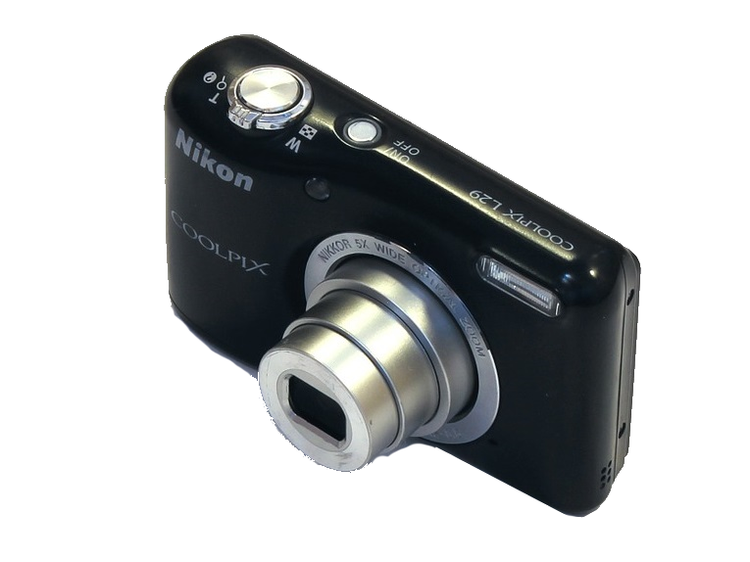
What can you use a digital device for?
Activity 1
Notes:
Image sources:
https://pixabay.com/photos/video-game-console-video-game-play-2202666/
https://pixabay.com/vectors/laptop-notebook-mobile-computer-154091/
https://pixabay.com/vectors/android-nexus-5-phone-smart-phone-1294370/
https://pixabay.com/photos/nikon-l29-digital-camera-compact-1502599/

Slide 21
Activity 1
 | Digital camera | Laptop computer | Games console | Smartphone
Take pictures
Write a story
Play a game
Make a phone call
Send a message
Notes:
Image sources:
https://pixabay.com/photos/nikon-l29-digital-camera-compact-1502599/
https://pixabay.com/vectors/laptop-notebook-mobile-computer-154091/
https://pixabay.com/photos/video-game-console-video-game-play-2202666/
https://pixabay.com/vectors/android-nexus-5-phone-smart-phone-1294370/

Slide 22
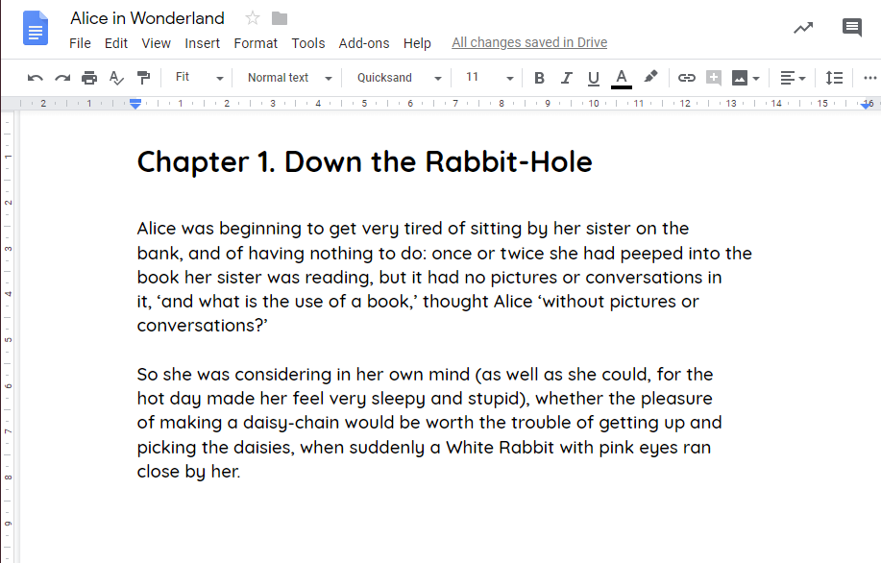

How is writing similar and different on a digital device?
Plenary
I use a ________ to ___________ so that I can ________________.
This is different to __________ because I can ___________.
Are there times when it’s better to use a non-digital tool rather than a digital device?
Notes:
Image sources:
Screenshot of Google Docs, with text from: https://www.gutenberg.org/files/11/11-h/11-h.htm
https://pixabay.com/photos/writing-write-fountain-pen-ink-1209121/

Slide 23
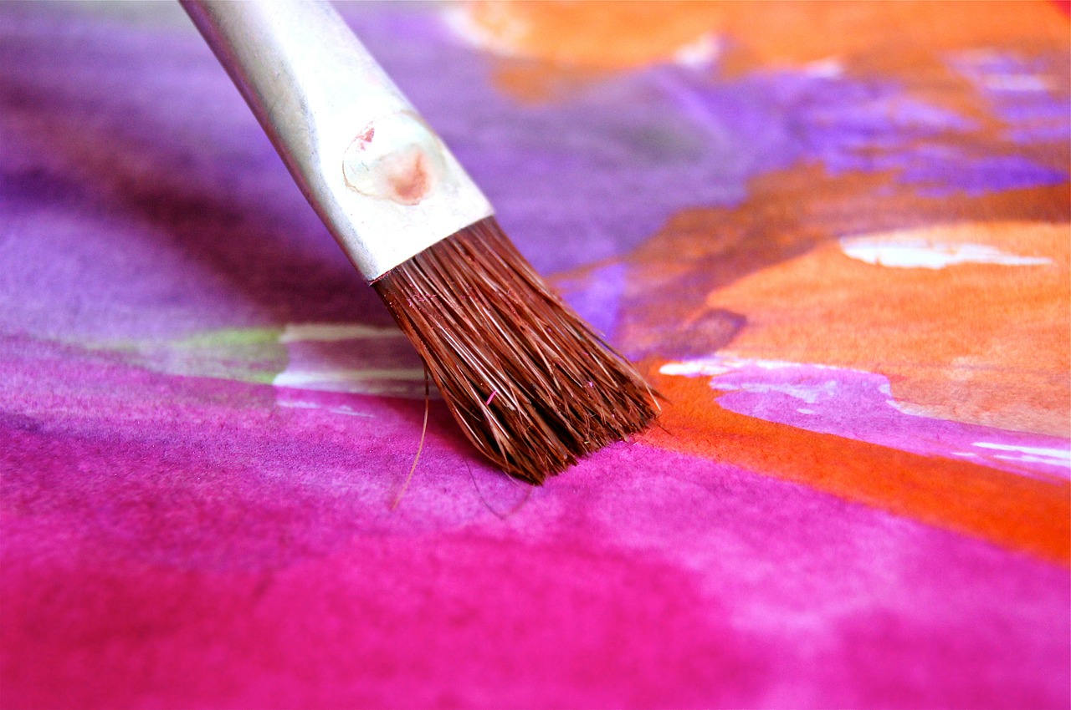
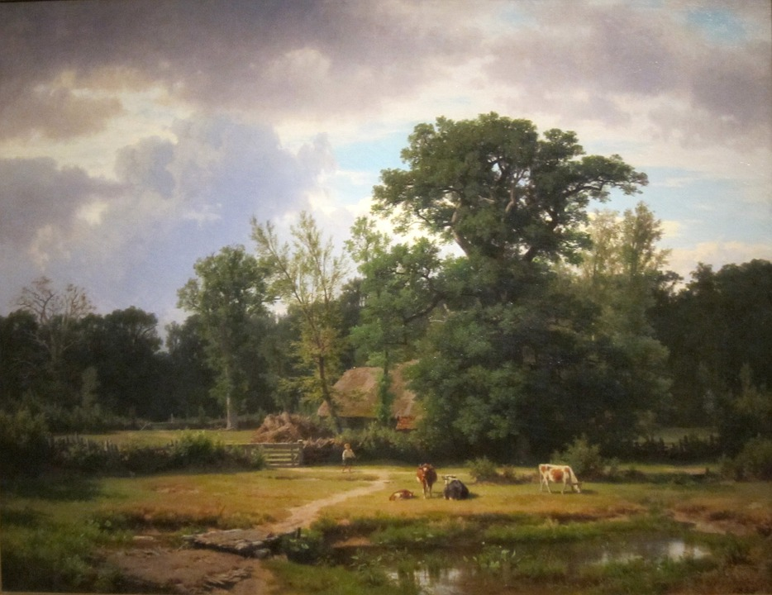
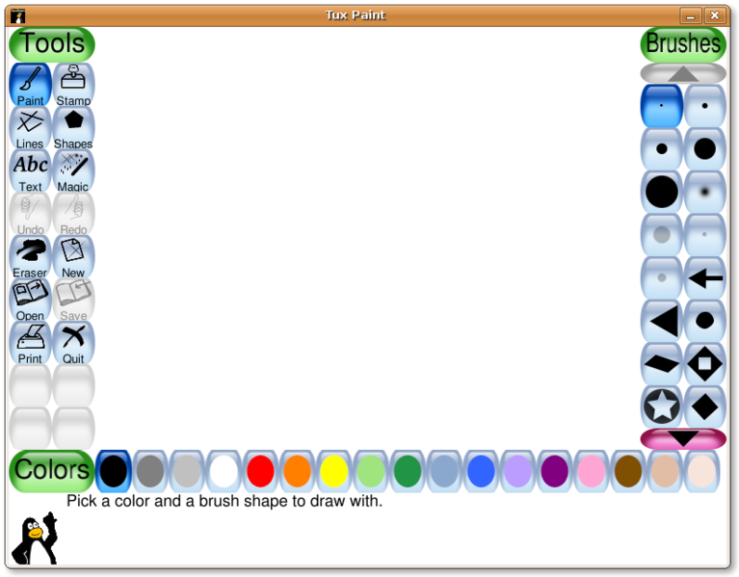
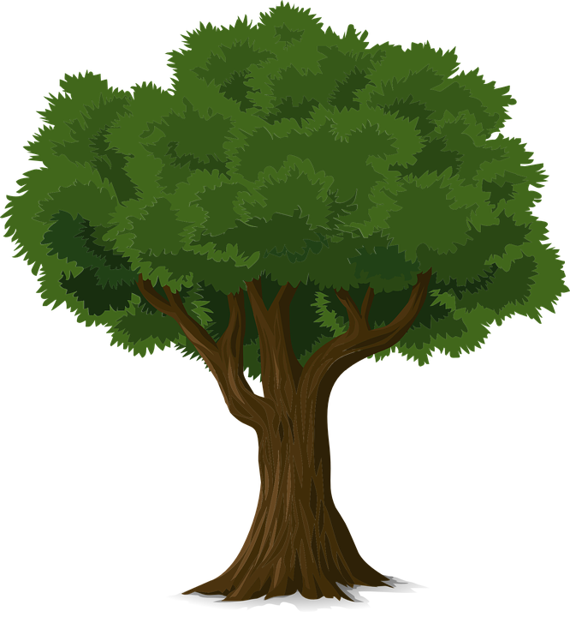
Painting or digital painting?
Activity 2
Notes:
Image sources:
https://pixabay.com/photos/brush-color-paint-play-watercolor-96240/
https://pixabay.com/illustrations/painting-art-artistic-artistry-81177/
Screenshot from Tux Paint
https://pixabay.com/vectors/tree-forest-trunk-nature-leaves-576847/

Slide 24
Questions
Activity 3
How did you feel about doing these activities?
Which method would you prefer?
How did you fix mistakes in digital painting?
What input devices could you use?
Do you think all artists would use a computer if they had access to one?
Do you need to be good at using a computer in order to produce good art?

Slide 25
02.05.24
TBAT: think of an opposite to traditional stereotypes
Blue
What is a stereotype?
Green
Give an example of a way that someone can break a stereotype
Challenge
Explain why you should not assume what people enjoy.

Slide 26
02.05.24
TBAT: : think of an opposite to traditional stereotypes
In your books make a list in the characters column of the fairy tales you can see on the board.
We will then make a class list and think about a typical adjective which is often given to one of your characters.
Challenge
Have a think about how these adjectives can create a stereotype and are they unfair?

Slide 27
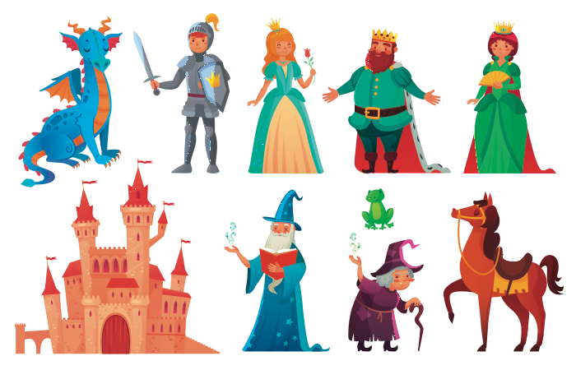
Fairy tales with a difference!
Notes:
Ask pupils to guess the traditional tales which have these characters and animals in them. Ask them to name the fairy tales and make a list. On this slide they may mention: ‘Sleeping Beauty’, ‘The Princess and the Rose’, ‘The Frog Prince’, ‘Hansel and Gretel’ or ‘The Princess and the Dragon’.

Slide 28
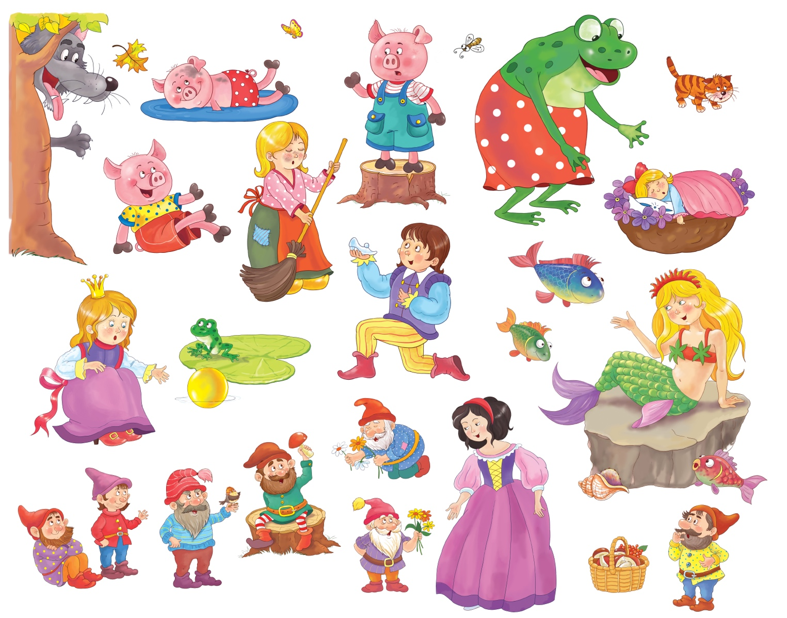
Fairy tales with a difference!
Notes:
Ask pupils to guess the traditional tales which have these characters and animals in them. Ask them to name the fairy tales. On this slide they may mention: ‘The Three Little Pigs’, ‘Snow White’, ‘Cinderella’, ‘The Frog Prince’ or ‘The Little Mermaid’. Ask pupils about any fairy tales which are not shown on these slides. They may mention ‘Jack and the Beanstalk’ or ‘Rapunzel’.
Talk with pupils about characters in all these traditional tales and make a list. Add a typical adjective which is often given to such characters, to create examples like: handsome prince, lazy cat, wise owl, helpless princess, wicked stepmother, mean wolf, cunning fox, poor boy, kind fairy godmother, brave knight, foolish boy, etc. Talk with the class about how stereotypes in stories can be unfair, negative or destructive. Not all stepmothers are cruel, and not all boys are foolish!

Slide 29
02.05.24
TBAT: : think of an opposite to traditional stereotypes
Character | Adjective | Opposite Adjective | Character | Adjective | Opposite Adjective
Sleeping Beauty |  |  | Cinderella
The princess and the Frog |  |  | The Frog Prince
Hansel and Gretel |  |  | The Little Mermaid
The princess and the dragon |  |  | Jack and the beanstalk
The three Little Pigs |  |  | Rapunzel
Snow White

Slide 30
Fairy tales with a difference!
With your partner, think about the characters in fairy tales and other traditional stories. Add a different adjective to make new characters which challenge stereotypes.
What will your new characters be called? Draw and label them.
Describe how they might act.
Remember to break a stereotype

Slide 31
02.05.24
TBAT: : think of an opposite to traditional stereotypes
Character | Adjective | Opposite Adjective | Character | Adjective | Opposite Adjective
Sleeping Beauty |  |  | Cinderella
The princess and the Frog |  |  | The Frog Prince
Hansel and Gretel |  |  | The Little Mermaid
The princess and the dragon |  |  | Jack and the beanstalk
The three Little Pigs |  |  | Rapnunzel
Snow White

Slide 32
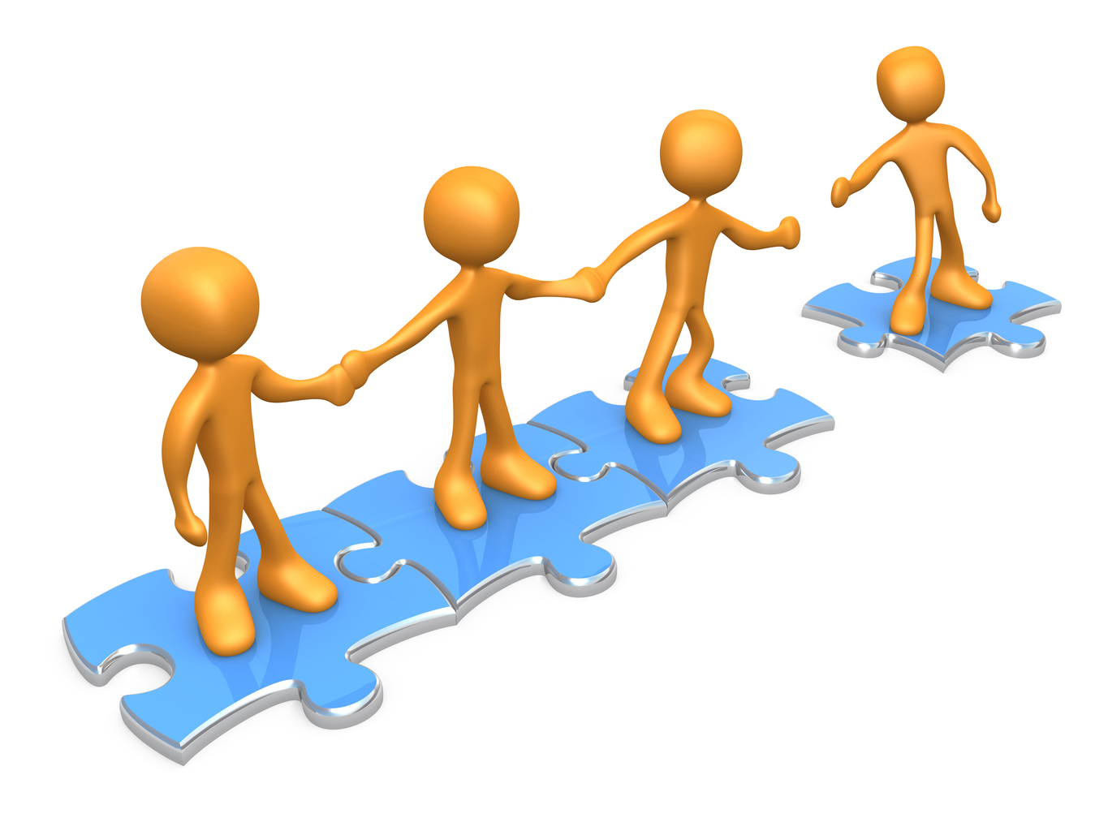
TBAT: track a ball that is not sent directly to me.
This half term in P.E will be Cricket and Balls Skills
- Changing for PE
- Rules and expectations moving to PE
- Move to the downstairs hall or outside
Get Set 4 PE - KS2 OAA (getset4education.co.uk)

