Slide 1
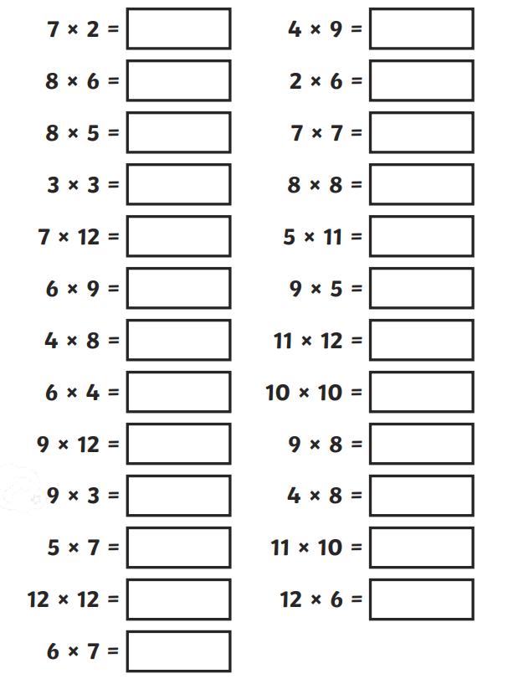
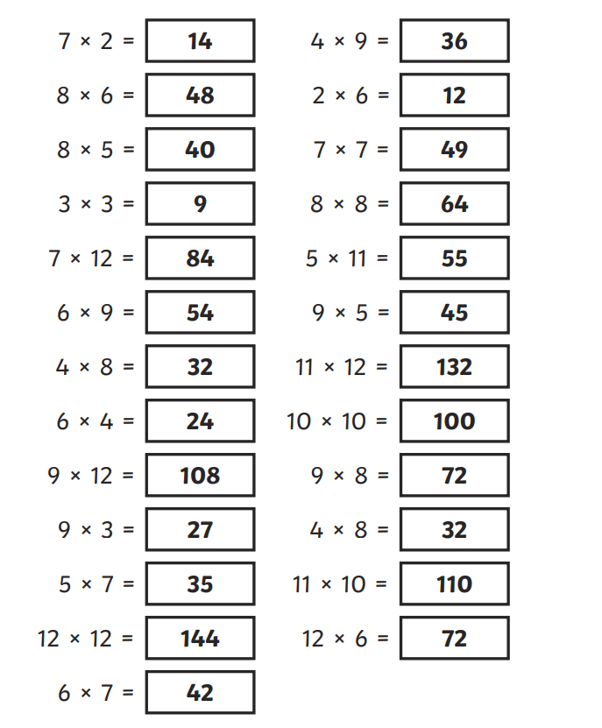
Wednesday 1st May Morning challenge
Check your answers:
Is it your day for TTRS?

Slide 2
Wednesday 1st May TBAT: Perform repeating patterns. What does the word repeat mean? What is a pattern? Can you create your own clapping pattern to share with the class. The Collins Hub Educator > Library Recycling Bhangra

Slide 3
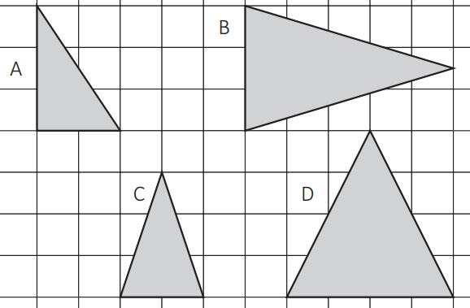
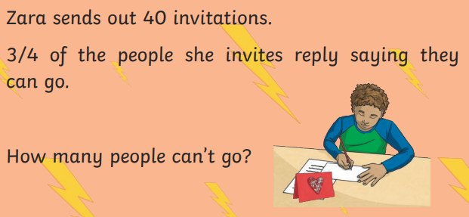
01.05.24 TBAT: recognise, name and classify 2D shapes identifying regular and irregular polygons.
3 in 3
1. 1/9 of 108 =
2. 8 ÷ 100 =
3. Identify the right-angled triangle.

Slide 4
01.05.24 TBAT: recognise, name and classify 2D shapes identifying regular and irregular polygons.

Slide 5
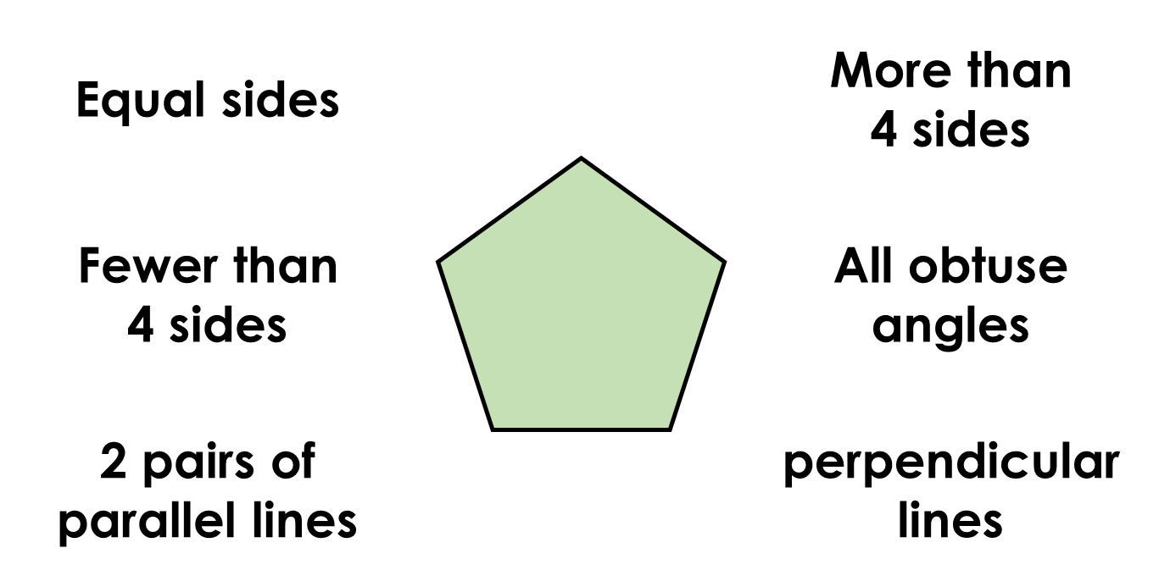
01.05.24 TBAT: recognise, name and classify 2D shapes identifying regular and irregular polygons.
Which descriptions match the shape below?

Slide 6
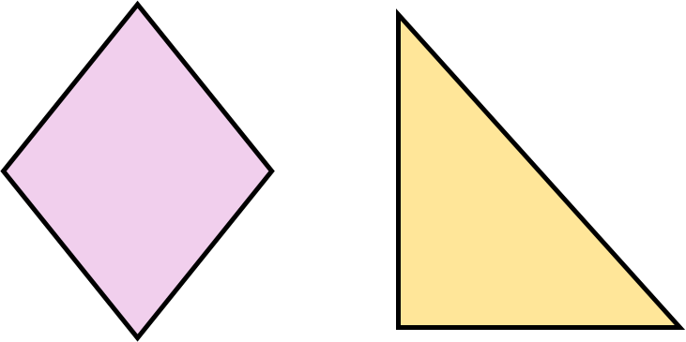
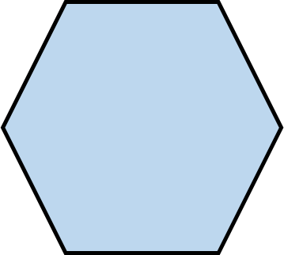
01.05.24 TBAT: recognise, name and classify 2D shapes identifying regular and irregular polygons.
Can you name the 2D shapes?

Slide 7
01.05.24 TBAT: recognise, name and classify 2D shapes identifying regular and irregular polygons.
Which shape matches the description below?
•Fewer sides than a pentagon.
•1 line of symmetry.
•No acute angles.

Slide 8
01.05.24 TBAT: recognise, name and classify 2D shapes identifying regular and irregular polygons.
I have no parallel lines.
I have more than 4 sides.
I am a regular polygon.
I have 5 lines of symmetry.
I am a _____________ .
I have no parallel lines.
I have less than 4 sides.
I am an irregular polygon.
I have 1 line of symmetry.
I am a _____________ .
What is the difference between a regular polygon and an irregular polygon?

Slide 9
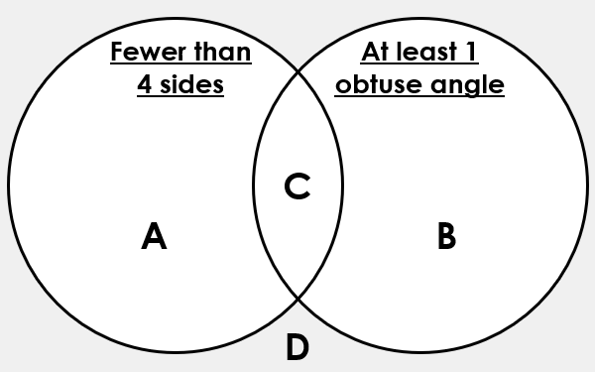
01.05.24 TBAT: recognise, name and classify 2D shapes identifying regular and irregular polygons.
Which shape could represent each letter in the Venn diagram?

Slide 10
01.05.24 TBAT: recognise, name and classify 2D shapes identifying regular and irregular polygons.
Sort the shapes into the Carroll diagram.
 | Regular Polygon | Irregular polygon
Odd number of sides
Even number of sides

Slide 11
01.05.24 TBAT: recognise, name and classify 2D shapes identifying regular and irregular polygons.
Challenge
Mastery
Mastery with greater depth

Slide 12
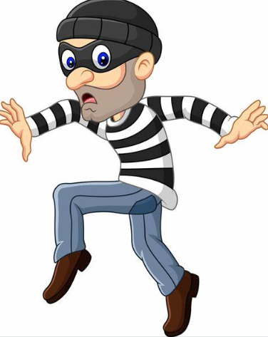
Wednesday 1st May TBAT: spell words with the prefix 'ex'.
The spelling thief has taken away some of the letters from our spellings. Fill in the missing letters to complete the words.
__xi__
Ex__en__
E__plo__e
E__po__t
__xpe__
Challenge: Unjumble the words to create some of our spelling words. Once unjumbled, use the words in a sentence.
riorexte terexnal curexsion

Slide 13
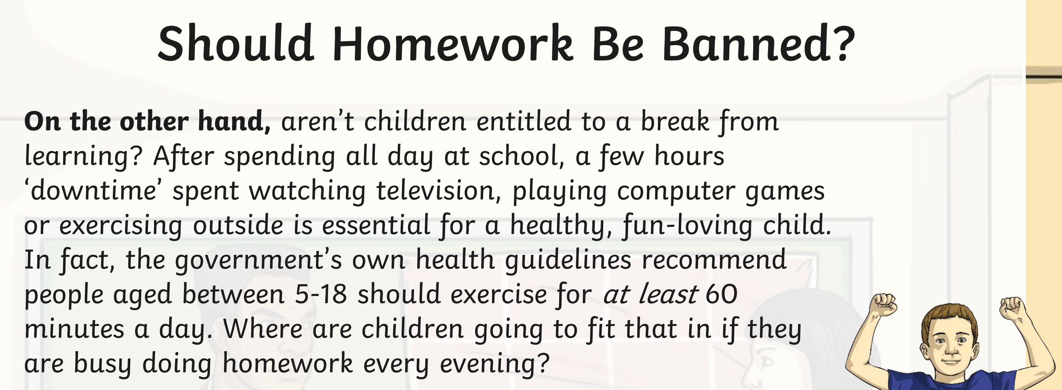
Wednesday 1st May TBAT: Know the features of a balanced argument.
3 in 3 1. Find and copy a subordinating conjunction in the text. 2. How long should people between the ages of 5 and 18 be exercising for each day? 3. Summarise this paragraph. Is it for or against the banning of homework?

Slide 14
Wednesday 1st May TBAT: Know the features of a balanced argument.
What are the four purposes for writing?
What is the purpose of writing a balanced argument?
Explain what is meant by a balanced argument.

Slide 15
Wednesday 1st May TBAT: Know the features of a balanced argument.

Slide 16
Wednesday 1st May TBAT: Know the features of a balanced argument.

Slide 17
Wednesday 1st May TBAT: Know the features of a balanced argument.

Slide 18
Wednesday 1st May TBAT: Know the features of a balanced argument.

Slide 19
Wednesday 1st May TBAT: Know the features of a balanced argument.

Slide 20
Wednesday 1st May TBAT: Know the features of a balanced argument.

Slide 21
Wednesday 1st May TBAT: Know the features of a balanced argument.

Slide 22
Wednesday 1st May TBAT: Know the features of a balanced argument.
Look at the example you have been given. Can you find these features?

Slide 23
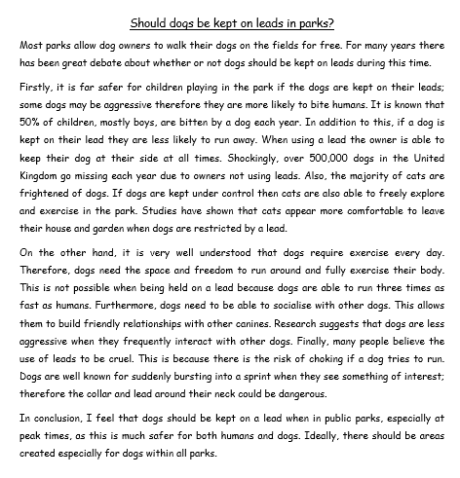
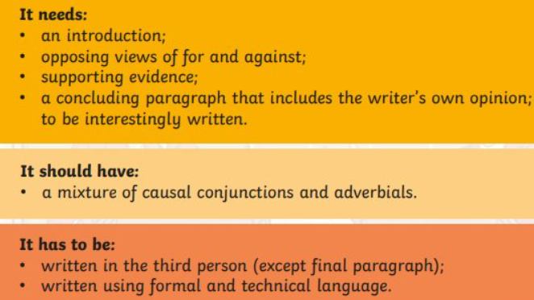
Wednesday 1st May TBAT: Know the features of a balanced argument.

Slide 24
Wednesday 1st May TBAT: Know the features of a balanced argument.
Independent Think of your own argument – remember it must be balanced! Then think of 3 positives and 3 negatives (for and against) to support your argument. Challenge: Can you write a sentence to support your argument using a subordinating conjunction?

Slide 25
Wednesday 1st May
TBAT: apply skills and knowledge to compete in a tournament.
What is the role of a fielder? What are some of the rules in rounders? Explain why it is important to watch the person in front of you. Get Set 4 PE - Lesson Plan -6 for Year 3/4 Rounders (getset4education.co.uk)

Slide 26
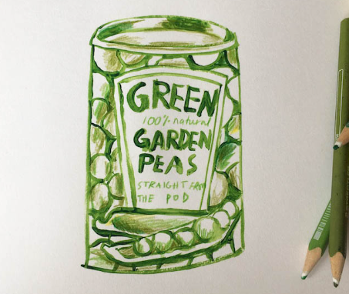
Wednesday 1st May
TBAT: create a simple 3D sculpture

Slide 27
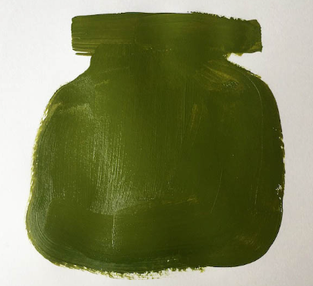
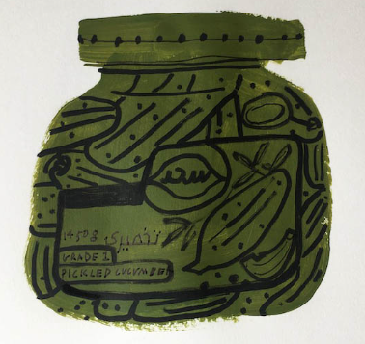
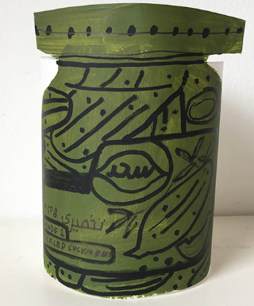
Option 1 – Block colour painting
Pay close attention to the silhouette of the jar. The paint will need to dry before you can add detail. Use a colour that features heavily on the tin. You may want to draw an outline of the silhouette first before painting if you like.
Once the paint has dried, take a thick felt tip or marker pen to draw in the detail of the jar, remembering to include the food within the jar if you can see it. Use a handwriting pen/fine liner to create smaller detail like text.
Draw four straight lines coming out from the top and bottom on each side of the drawing (without interrupting the painting). These lines will make the flaps that will make the tin stand. Cut along the lines. Try and keep your cutting as straight as possible so that the tin won’t be standing at an angle. Make sure that you cut around the top of the tin/jar lid to give it some depth.

Slide 28
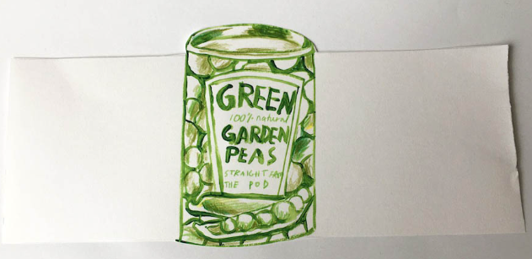
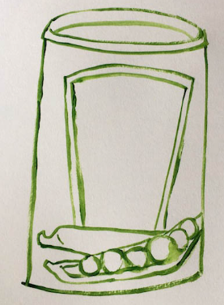
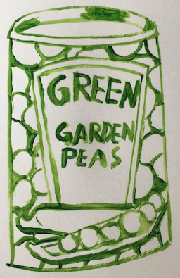
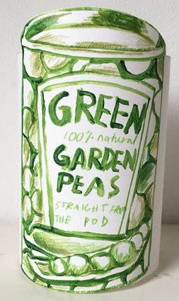
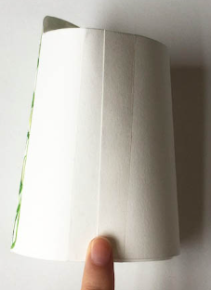
Option 2 – Outline painting
Create a simple line painting, thinking about the outline of the object and focussing on the main bits of detail. Include text and the main areas of detail. Use some coloured pencil crayons and start thinking about darker areas and lighter areas of the tin. Draw four straight lines coming out from the top and bottom on each side of the drawing. These lines will make the flaps that will make the tin stand. Curl the flaps together so that when they look at the front of their object as little white can be seen as possible.

Slide 29
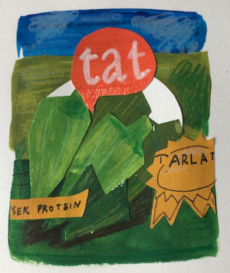
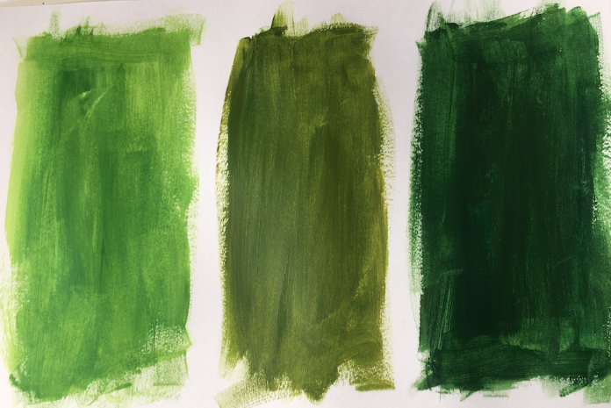
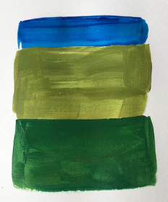
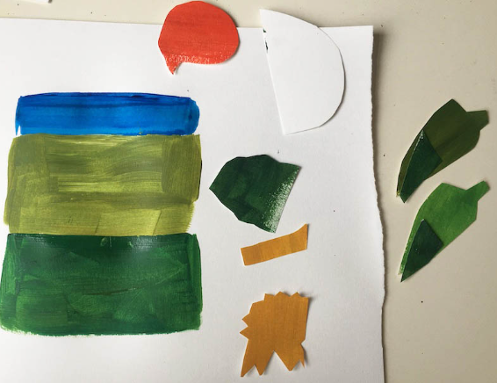
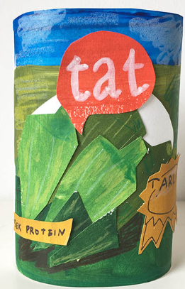
Option 3 – Collaging
Paint block colours within the background of your selected tin/jar. Next you will need to pick out bits of detail and cut shapes out of the painted sheets of paper. These will be used to create the detail within the tin or jar. Arrange your cut out bits until you are happy. Once you are happy with your composition you can glue all the pieces into place. Make sure that the glue reaches the edges so that bits don’t peel up. Add detail with pencil crayons and pens. Create the 2 large flaps either side of the tin, bend round and fasten with tape.

