Slide 1
Tuesday 30th April 2024
30/4/24

Slide 2
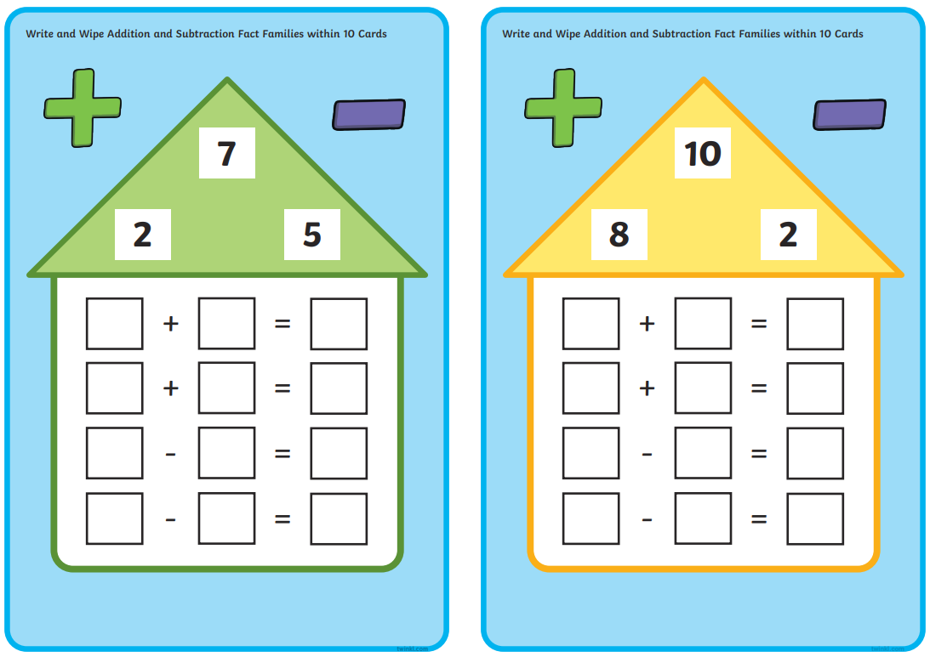
Morning Challenges
Name writing practise.
Fact Families activity.
Read a book.

Slide 3
Revisit and review
Today's Grapheme
oa/oe/ow/o-e

Slide 4
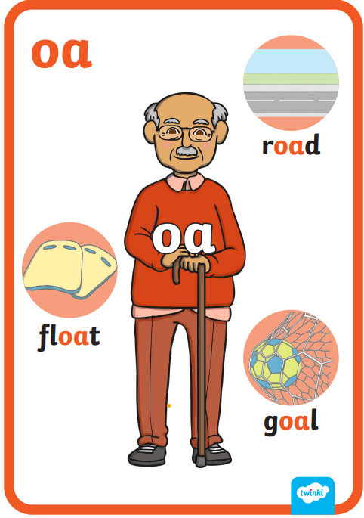
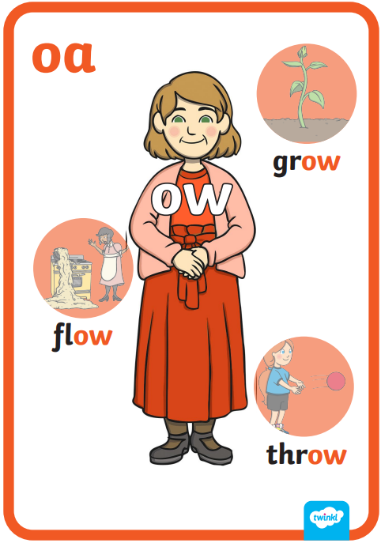
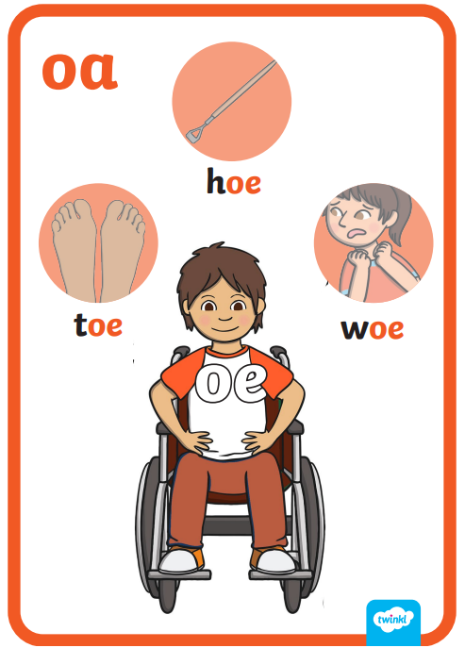
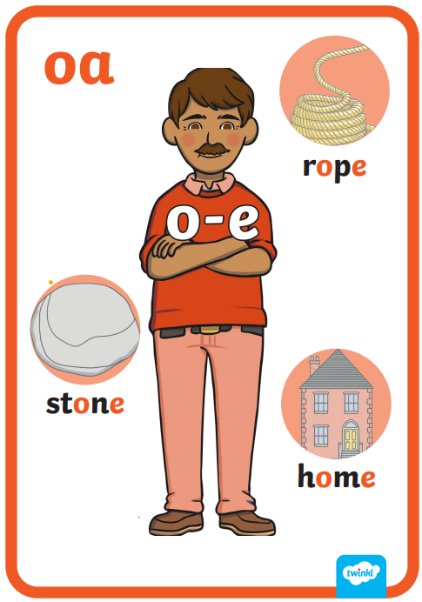
Revisit and review
The 'oa' family

Slide 5
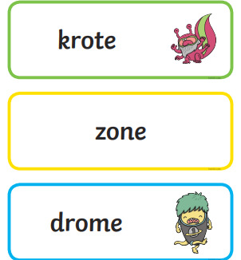
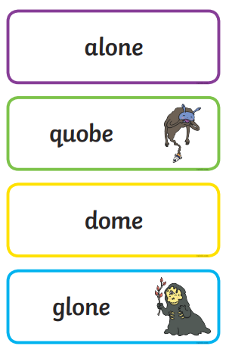
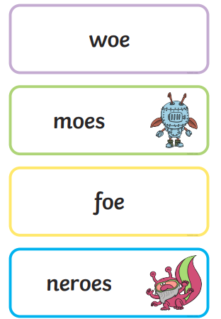
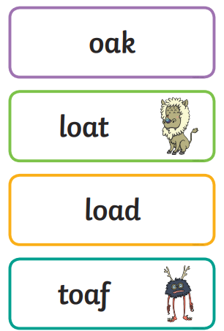
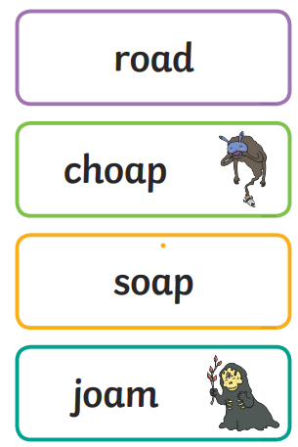
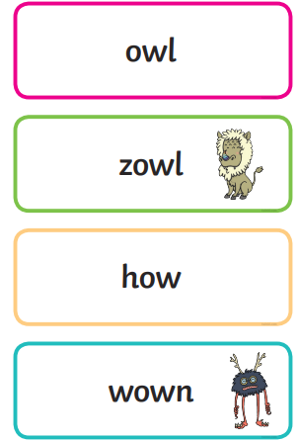
Real or Nonsense words? Read the words and underline the 'oa' phonemes
CHALLENGE
Write the real words in a sentence

Slide 6
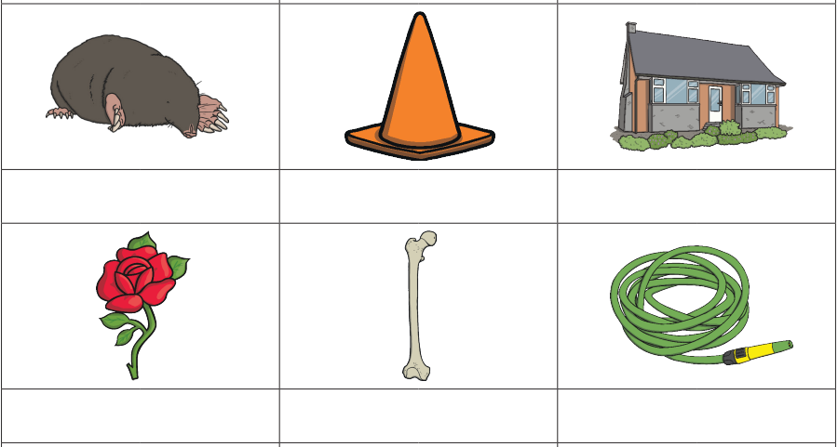
mole
hose
rose
bone
cone
home
CHALLENGE
Write the real words in a sentence

Slide 7
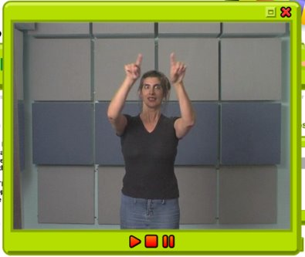
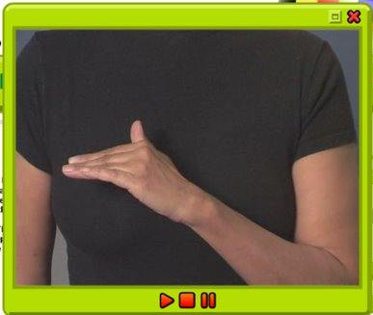
TBAT: practise a diagonal join with no ascender /ime/ /ine/
Tuesday 30th April 2024
30/4/24
Warm up
Gross- Spirals in the air
Fine- Hand bend

Slide 8
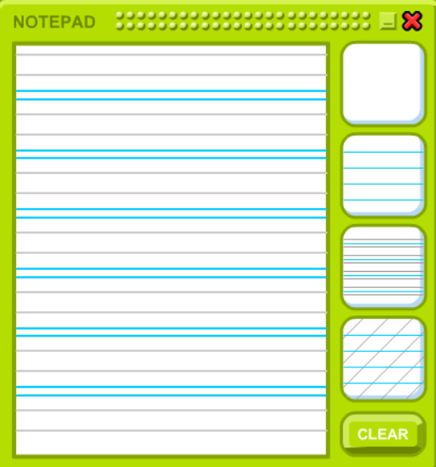
TBAT: practise a diagonal join with no ascender /ime/ /ine/
Tuesday 30th April 2024
30/4/24

Slide 9
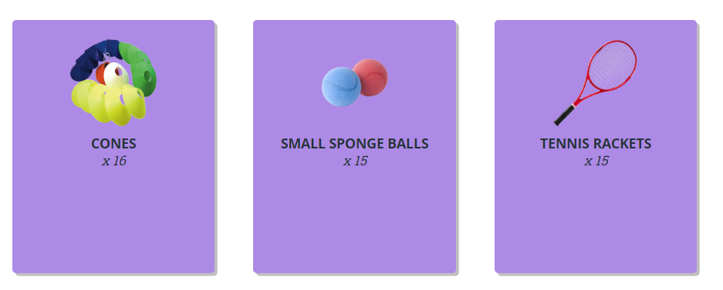
TBAT – develop hitting a ball
2 in 2
Name 1 way of throwing
How can we warm up our body?

Slide 10
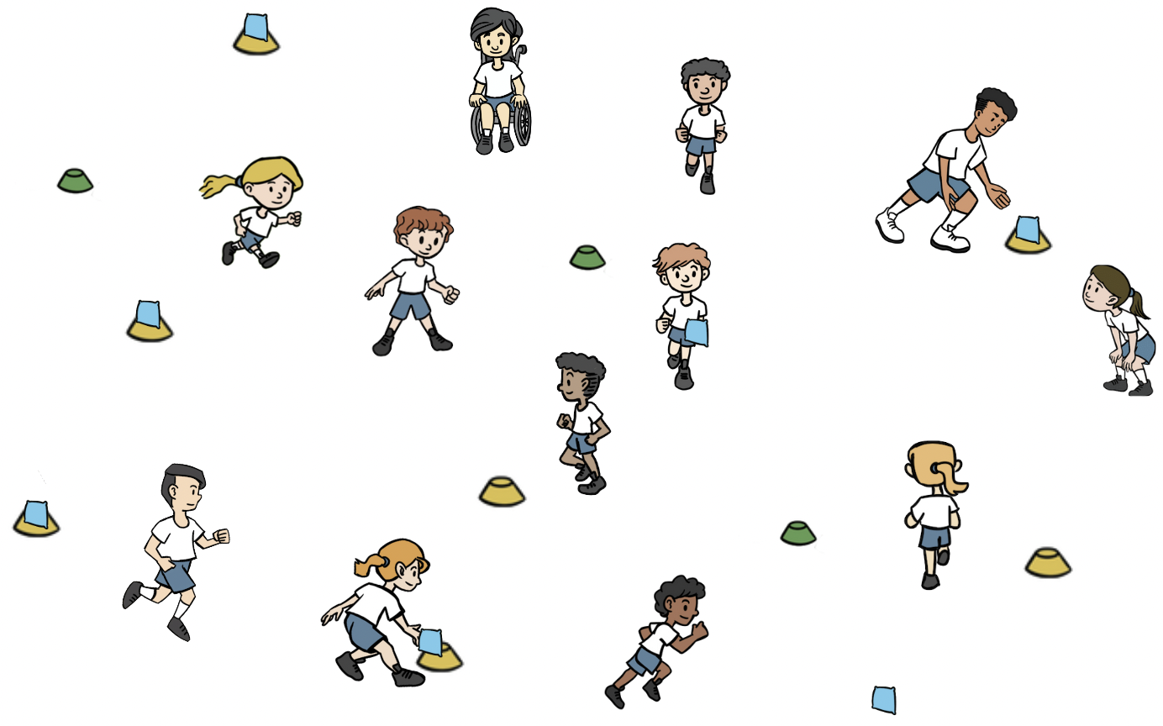
TBAT – develop hitting a ball
Warm-up
Split the class into two teams, a 'batting' and a 'fielding' team. Batting team have a cone and beanbag that they place in space (beanbag on top of cone).
Batters move from cone to cone, throwing the beanbags off the cones.
Fielders retrieve the beanbags and place them back on the cones.
Use underarm and overarm throwing.

Slide 11
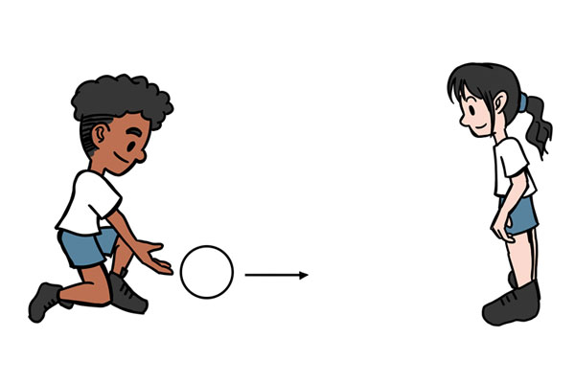
TBAT – develop hitting a ball
Skill development
Striking the ball
In pairs with one ball. Pupils begin standing opposite each other. They take turns to hit the ball to their partner.
Standing opposite each other. One pupil underarm throws the ball to their partner so that it bounces once. After one bounce, the other pupil tries to hit it with their hand.

Slide 12
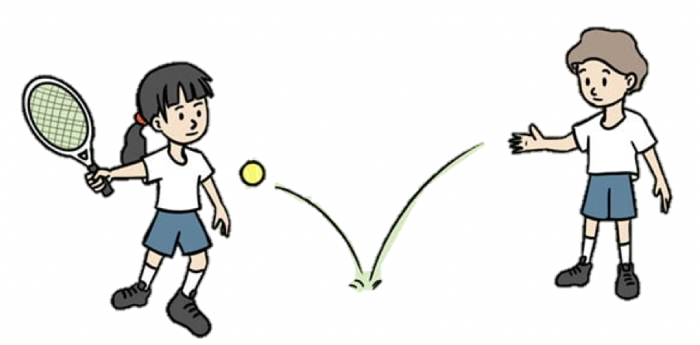
TBAT – develop hitting a ball
Skill development
Using a racket
In pairs with one racket and a sponge ball between them. Pupil A begins with the racket and ball. They drop the ball on the floor and hit it after one bounce. Pupils B runs to collect and return it. Have four turns then change over.
Watch the ball and let it bounce once. Hit the ball using the centre of the racket. Hold the racket towards the bottom of the handle.
This time, pupil A underarm throws the ball for pupil B to hit. Pupil A collects the ball and they change roles.
Stand sideways on to your partner. Watch the ball as it comes towards you. Hit after one bounce.

Slide 13
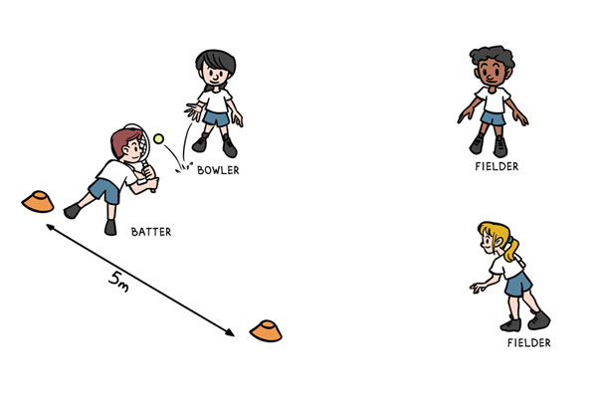
TBAT – develop hitting a ball
Skill development
Strike and field
Groups of four you need one tennis racket, one ball and two cones.
One pupil is the batter, they begin with the tennis racket, at one of the cones.
The other cone is placed 5m away.
The other three pupils are on the same team. Two of them are fielders and the other pupil is the bowler.
The bowler underarm throws the ball to the batter, who attempts to hit it with the racket.
The batter then runs between the two cones, scoring a point each time they reach a cone.
The fielders must collect the ball and return it to the bowler, who shouts 'stop' to stop the batter scoring.

Slide 14
TBAT – develop hitting a ball
Plenary
When batting, I should hit towards the fielders.
The bowler is on the fielding team.
Hitting the ball softly will make it go further.
Watching the ball as it comes towards me will help me to hit it.
My job as a fielder is to stop the batter scoring.

Slide 15
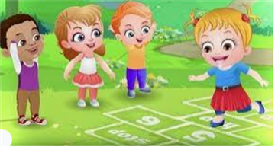
Break

Slide 16
Quick recall: write all the number bonds for …
5
6
7
8
9
10
5
5
0
5 + 0 = 5
Notes:
Do Now: Speed number bonds
Pupils each have a mini whiteboard and pen. They write all the number bonds they can think of for five, six, and seven.
Have you found all possibilities? How do you know you’ve found them all?

Slide 17
To add ones to a 2-digit number
tens
add
ones
subtract
Dienes
number bond

Slide 18
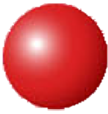
If I know … then I know …
I know that 5 + 3 = 8.
This helps me to calculate 45 + 3 really quickly!
45 + 3 = ______
5
45
3
3
Notes:
New Learning: Applying knowledge of number bonds within ten
Show pupils the slide and have them discuss the child’s statement.
What do you think this child means? Can you explain using a representation?
After some paired discussion, see if any pupils can offer an explanation. Then model on a bead string, first showing a group of five and a group of three being combined to make eight. Complete the first part-whole model on the slide. Then show 45 and draw pupils’ attention to the group of five, and how adding a group of three to this makes 48. The manipulative is used to make the structure clear, rather than to ‘calculate’. Complete the second part-whole model.
Ask a pupil to come to the front and make five on a bead string. Then another pupil with a separate bead string makes 15, another makes 25, another 35, etc.
How could we use 5 + 3 = 8 to help us add three to each of these numbers?
They all have a group of five. When we add three, it will become a group of eight.
Add three to each and have pupils say the full equation each time:
15 plus three is equal to 18. 25 plus three is equal to 28. 35 plus three is equal to 38, etc.
Introduce the language structure:
If I know [5 + 3 = 8], then I know [15 + 3 = 18].
The next slide presents one equation already discussed and three other equations of the structure ‘tens and three, plus five’. Can pupils explain the connection?

Slide 19
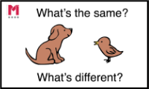
What’s the same? What’s different?
______ = 25 + 3
33 + 5 = ______
63 + 5 = ______
______ = 53 + 5
Notes:
New Learning: Applying knowledge of number bonds within ten
Show pupils the slide and have them discuss the child’s statement.
What do you think this child means? Can you explain using a representation?
After some paired discussion, see if any pupils can offer an explanation. Then model on a bead string, first showing a group of five and a group of three being combined to make eight. Complete the first part-whole model on the slide. Then show 45 and draw pupils’ attention to the group of five, and how adding a group of three to this makes 48. The manipulative is used to make the structure clear, rather than to ‘calculate’. Complete the second part-whole model.
Ask a pupil to come to the front and make five on a bead string. Then another pupil with a separate bead string makes 15, another makes 25, another 35, etc.
How could we use 5 + 3 = 8 to help us add three to each of these numbers?
They all have a group of five. When we add three, it will become a group of eight.
Add three to each and have pupils say the full equation each time:
15 plus three is equal to 18. 25 plus three is equal to 28. 35 plus three is equal to 38, etc.
Introduce the language structure:
If I know [5 + 3 = 8], then I know [15 + 3 = 18].
The next slide presents one equation already discussed and three other equations of the structure ‘tens and three, plus five’. Can pupils explain the connection?

Slide 20
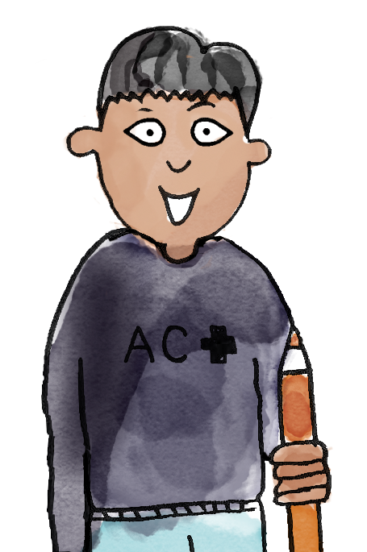
56 is five tens and six ones.
Six ones plus two ones is eight ones. The parts are 56 and two.
The whole is 58.
22
28
6
2
58
The parts are 22 and six.
22 is two tens and two ones.
Two ones plus six ones is eight ones.
22 plus six is equal to 28.
56
add subtract tens ones number bond Dienes
Notes:
Talk Task: Applying knowledge of number bonds within ten
Pupils have the Task Sheet cut into four horizontal strips and a bead string each. They select a strip. Pupil A looks at their part-whole model and represents the greater part on their bead string, then uses the sentence structure on the slide to describe the addition. Pupil B does the same with their part-whole model, which uses the same number bond. They discuss the similarities and differences between the pairs.

Slide 21
What mental strategy can we use to solve this?
56 + 3 = ______
Which number bond is helpful?
Notes:
Develop Learning: Add a 2-digit number and ones using Dienes on a part-whole model
Take feedback on the Talk Task to see whether pupils noticed that, in each pair of part-whole models, the same number bond within ten could be used to add the two parts.
Now move on to representing the same concept using Dienes on a part-whole model. The slide shows the calculation 56 + 3. As in the New Learning, the intention is for pupils to become aware of the usefulness of 6 + 3 = 9 in solving this. The Dienes representation is to emphasise the structure (if the number of tens changed but the six and three ones stayed the same, the sum would always have nine ones).
Which number bond helps us solve this equation?
Can you think of any other equations that could be solved using the same number bond?

Slide 22
How can we show this on a part-whole model?
56 + 3 = ______
Notes:
Develop Learning: Add a 2-digit number and ones using Dienes on a part-whole model
Take feedback on the Talk Task to see whether pupils noticed that, in each pair of part-whole models, the same number bond within ten could be used to add the two parts.
Now move on to representing the same concept using Dienes on a part-whole model. The slide shows the calculation 56 + 3. As in the New Learning, the intention is for pupils to become aware of the usefulness of 6 + 3 = 9 in solving this. The Dienes representation is to emphasise the structure (if the number of tens changed but the six and three ones stayed the same, the sum would always have nine ones).
Which number bond helps us solve this equation?
Can you think of any other equations that could be solved using the same number bond?

Slide 23
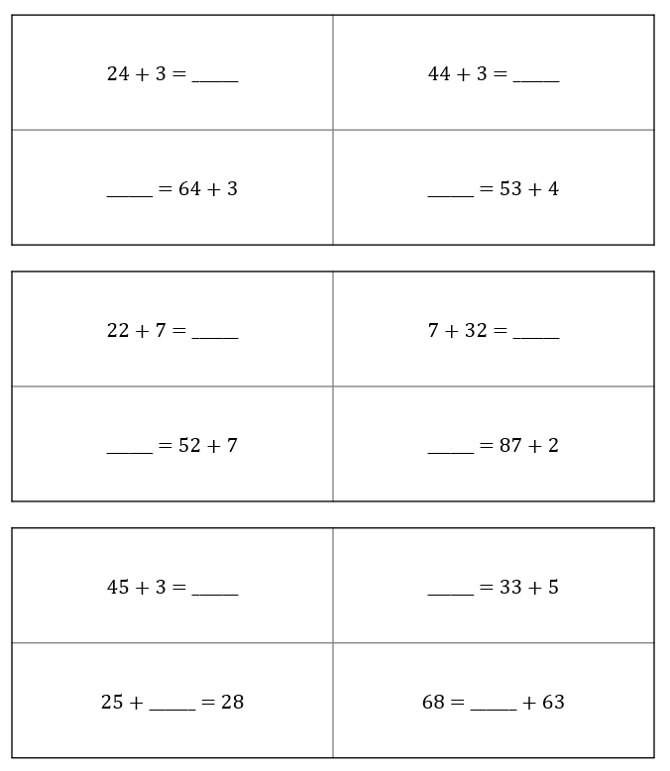
To add ones to a 2-digit number
Represent the equations using Dienes on a part whole model.
Find the missing numbers.
Notes:
Independent Task: Solving missing number equations
Pupils have the Task Sheet, a large part-whole model and Dienes. They place the Dienes on the part-whole model to find the missing numbers in the equations. They talk about the similarities in the sets of calculations.
Possible adaptations:
Pupils could use a bead string instead of Dienes to represent the equations. The representation should draw attention to the structure of the ones addition across the sets of four calculations.
Pupils could be challenged to add their own calculations to each set.

Slide 24
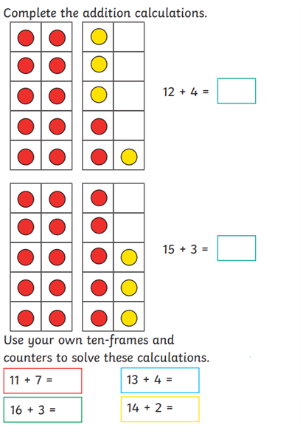
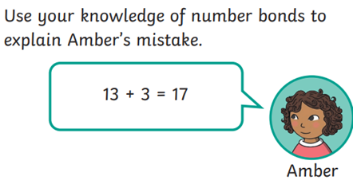
To add ones to a 2-digit number
Challenge:
RP:
Notes:
Independent Task: Solving missing number equations
Pupils have the Task Sheet, a large part-whole model and Dienes. They place the Dienes on the part-whole model to find the missing numbers in the equations. They talk about the similarities in the sets of calculations.
Possible adaptations:
Pupils could use a bead string instead of Dienes to represent the equations. The representation should draw attention to the structure of the ones addition across the sets of four calculations.
Pupils could be challenged to add their own calculations to each set.

Slide 25
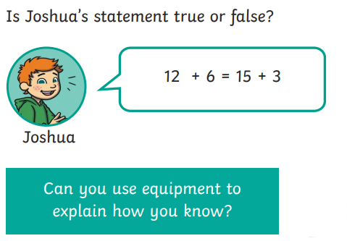
To add ones to a 2-digit number
Mastery:
Notes:
Independent Task: Solving missing number equations
Pupils have the Task Sheet, a large part-whole model and Dienes. They place the Dienes on the part-whole model to find the missing numbers in the equations. They talk about the similarities in the sets of calculations.
Possible adaptations:
Pupils could use a bead string instead of Dienes to represent the equations. The representation should draw attention to the structure of the ones addition across the sets of four calculations.
Pupils could be challenged to add their own calculations to each set.

Slide 26
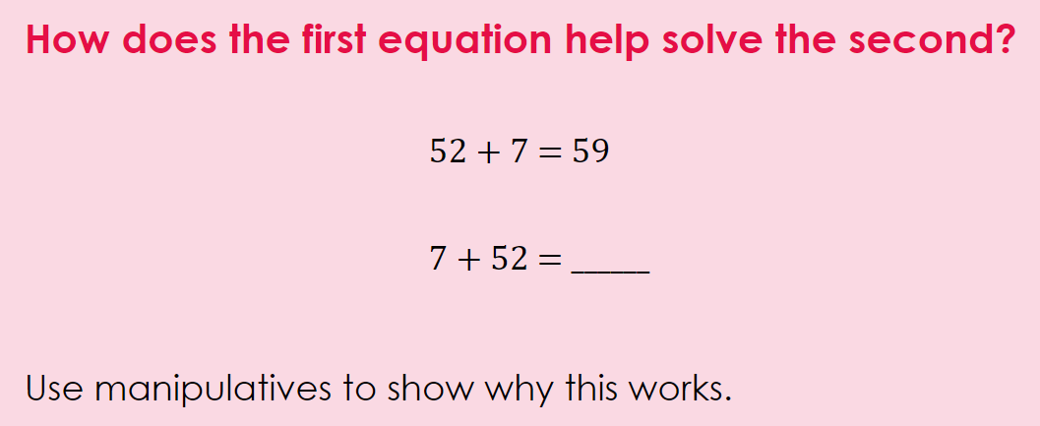
To add ones to a 2-digit number
Mastery with greater depth:
Notes:
Independent Task: Solving missing number equations
Pupils have the Task Sheet, a large part-whole model and Dienes. They place the Dienes on the part-whole model to find the missing numbers in the equations. They talk about the similarities in the sets of calculations.
Possible adaptations:
Pupils could use a bead string instead of Dienes to represent the equations. The representation should draw attention to the structure of the ones addition across the sets of four calculations.
Pupils could be challenged to add their own calculations to each set.

Slide 27
Lunch

Slide 28
TBAT: sequence events from a story.
Tuesday 30th April 2024
3 in 3

Slide 29
TBAT: sequence events from a story.
Tuesday 30th April 2024
Blue/ Green
What do you think this story will be about?
Who do you think is the main character?

Slide 30
TBAT: sequence events from a story.
Tuesday 30th April 2024
Words you will come across in the text:
Snarled- say something in an angry, bad-tempered voice.
gnashed- grind teeth together when angry.
slunk- move smoothly and quietly with gliding steps.
grinned- smile broadly.
The Paper Dolls by Julia Donaldson - a read-aloud read along audiobook by Tippy Toes Nook (youtube.com)

Slide 31
TBAT: sequence events from a story.
Tuesday 30th April 2024
Can you summarise what happened at the beginning of the story?
Can you summarise what happened in the middle of the story?
Can you summarise what happened at the end of the story?

Slide 32
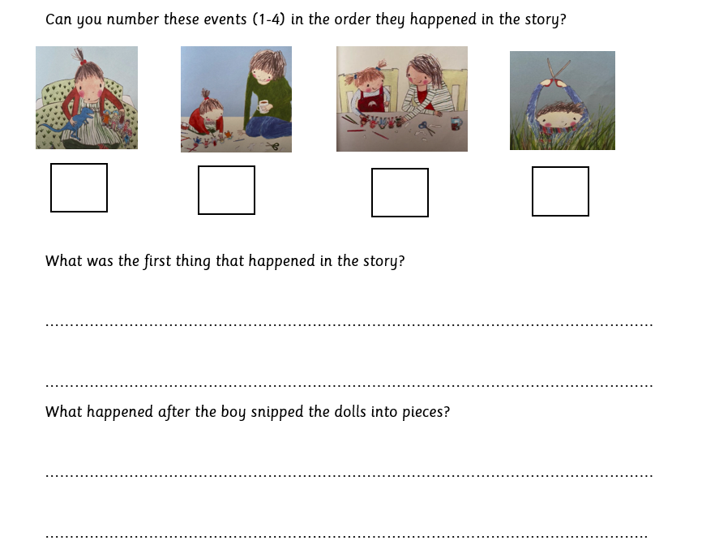
TBAT: sequence events from a story.
Tuesday 30th April 2024
Independent:
Challenge:
What do you think would happen if the story continued?

Slide 33
Lesson 3 What do Muslims do on Hajj?
Tuesday 30th April 2024

Slide 34
Blue/ Green
Key Question: What do Muslims do on Hajj?
Tuesday 30th April 2024
What is the Hajj?
Where does the Hajj take place?

Slide 35
Key Question: What do Muslims do on Hajj?
Tuesday 30th April 2024
A pilgrimage is a special religious journey that people make.
The Hajj is a Muslim pilgrimage to a city called Mecca.

Slide 36
Key Question: What do Muslims do on Hajj?
Tuesday 30th April 2024
Muslims believe that God told a man called Abraham that Mecca would be a very special city that Muslims should visit.
When they get there they have to complete some tasks as part of the Hajj.

Slide 37
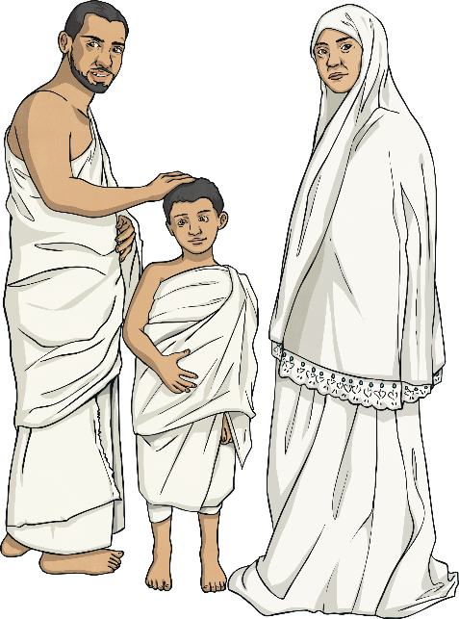
Key Question: What do Muslims do on Hajj?
Tuesday 30th April 2024
Muslims wear special clothes to do the Hajj pilgrimage.
This helps them all look the same so people don’t look rich or poor.

Slide 38
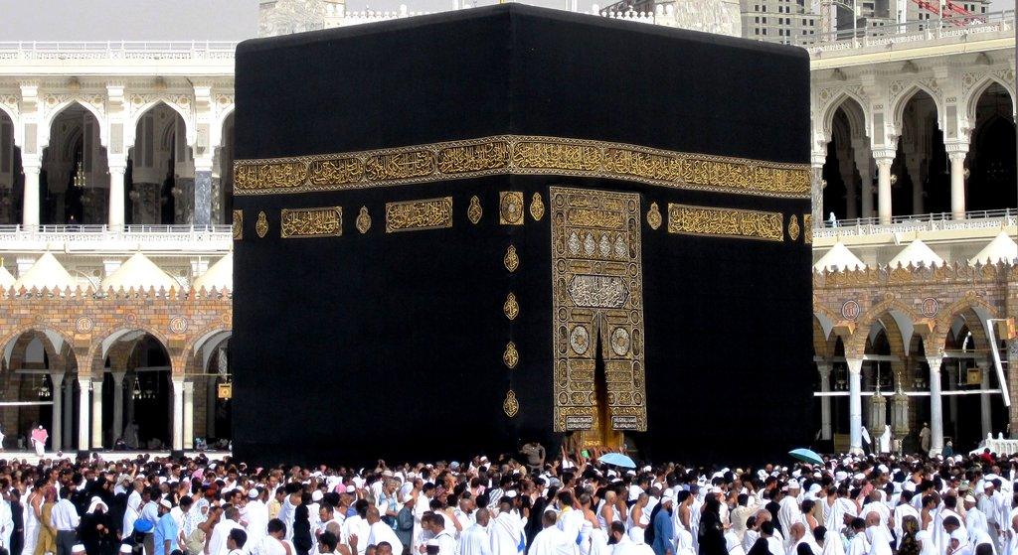
This is the Ka’bah. Muslims believe it was built by Abraham 4,000 years ago!

Slide 39
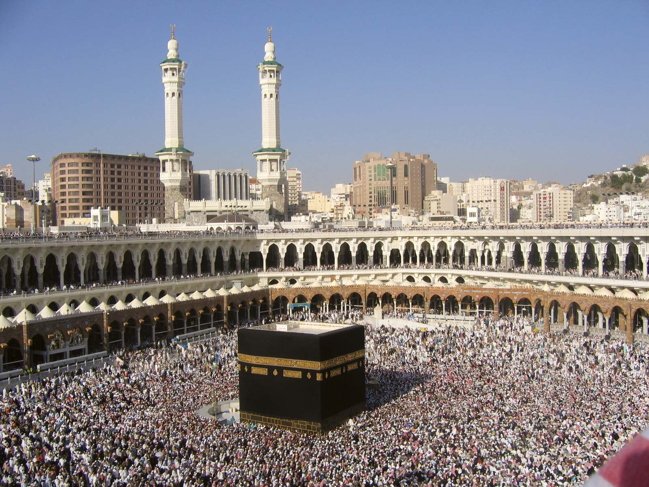
Muslims walk around the Ka’bah seven times

Slide 40
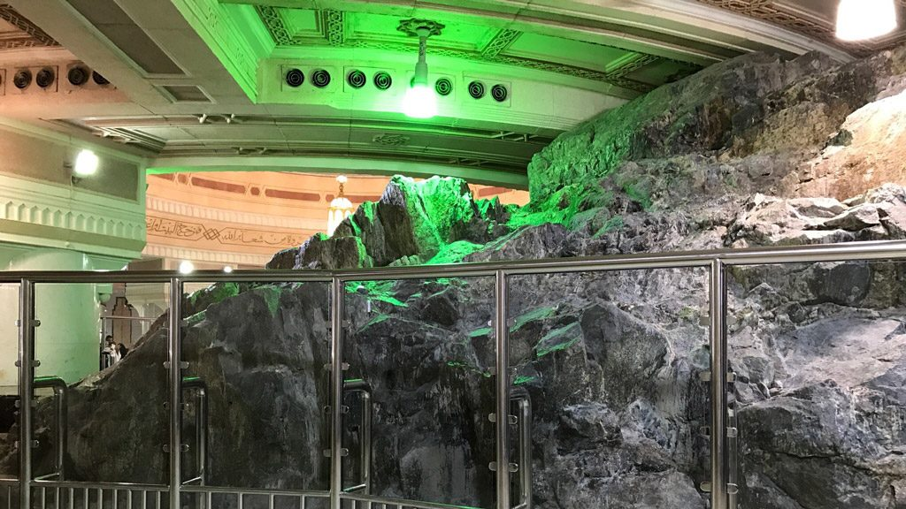
Next they have to visit the two hills of Safa and Marwah

Slide 41
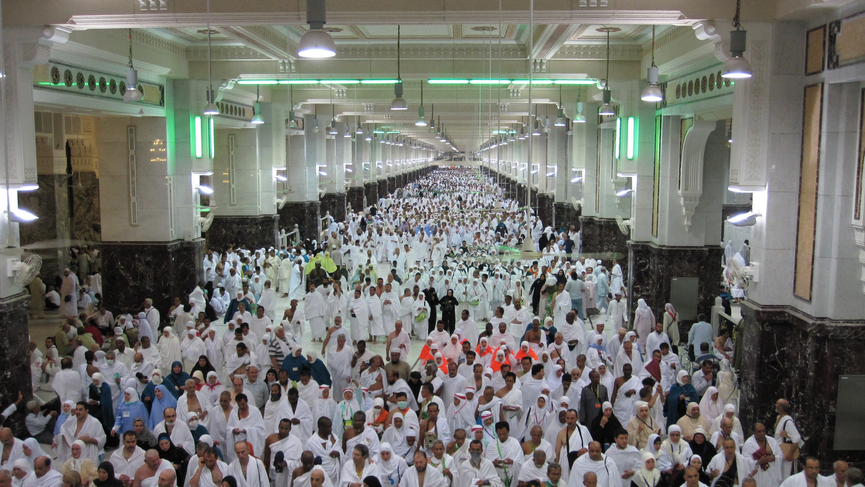
They have to walk between them seven times

Slide 42
Key Question: What do Muslims do on Hajj?
Tuesday 30th April 2024
They do this to remember the struggle of Hagar, Abraham’s wife, to find water in the desert.
She travelled back and forth between the hills before God gave Abraham a spring of water under his feet in Mecca.

Slide 43
TBAT –
TBAT – Relate pitch changes to graphic symbols and perform pitch changes vocally
Key vocabulary
Pitch – high/low higher/lower step/leap/slide
2 in 2
Using your voice can you show 3 levels of volume?
Can you use your hands to show these levels?

Slide 44
Warm up!
TBAT –
TBAT – Relate pitch changes to graphic symbols and perform pitch changes vocally
Collins Connect

Slide 45
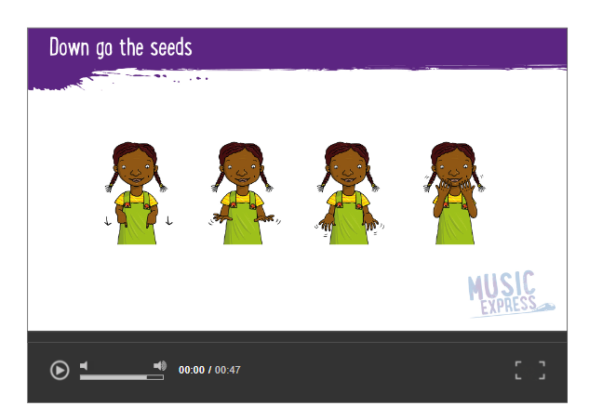
Down go the seeds
TBAT –
TBAT – Relate pitch changes to graphic symbols and perform pitch changes vocally
CHALLENGE
Can you change the actions?

Slide 46
DOWN GO THE SEEDS
TBAT – Relate pitch changes to graphic symbols and perform pitch changes vocally
PARTNER WORK
How could you improve your peformance?
(clearer pitch changes – movements)

Slide 47
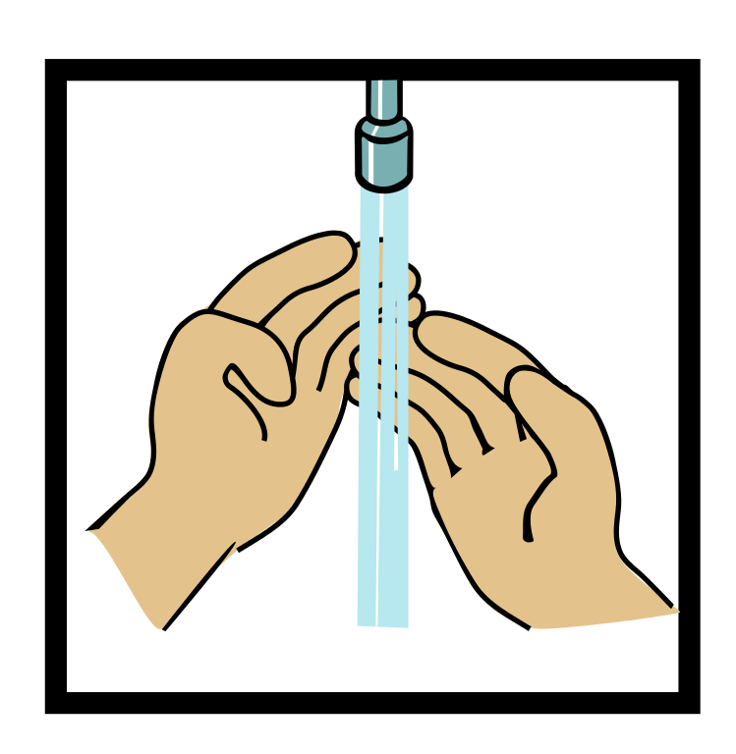
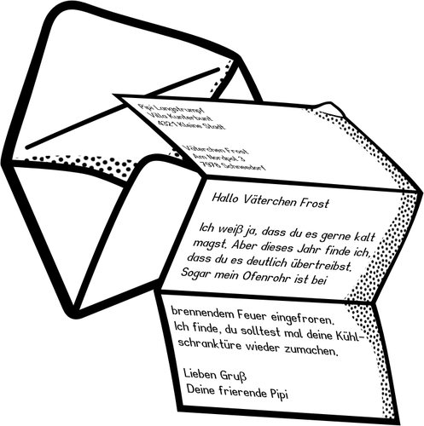
Home time
1.
2.
3.
4.
Wash hands
Collect bags , lunch boxes and water bottles.
Collect jumpers
Collect any letters/ reading books from the teachers.
Line up at the door.

