Slide 1
Monday 29th April 2024
29/04/24

Slide 2
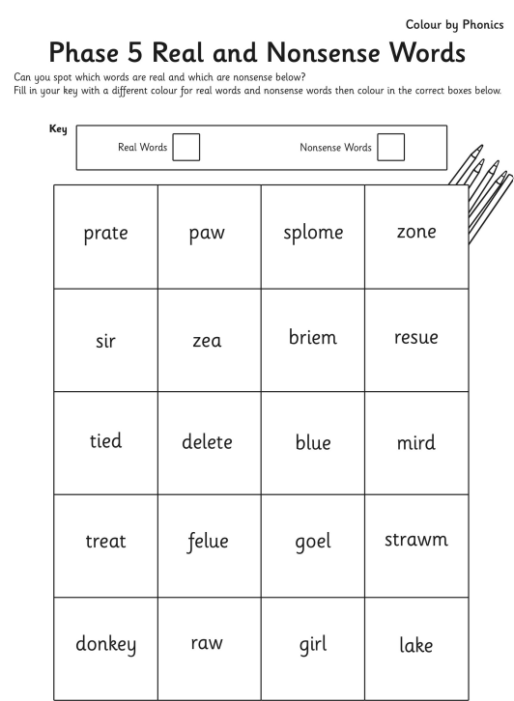
Morning Challenges
Name writing practise.
Read a book.

Slide 3
Revisit and review
Today's Grapheme
oa/oe/o-e/ow

Slide 4
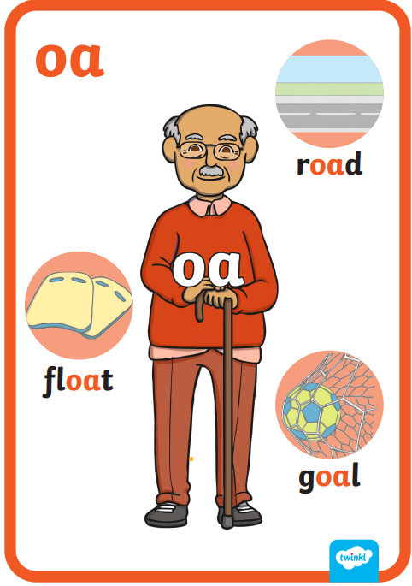
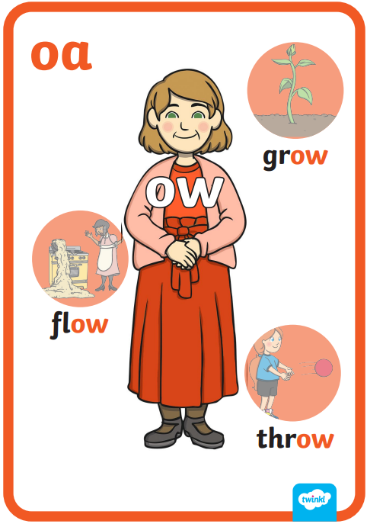
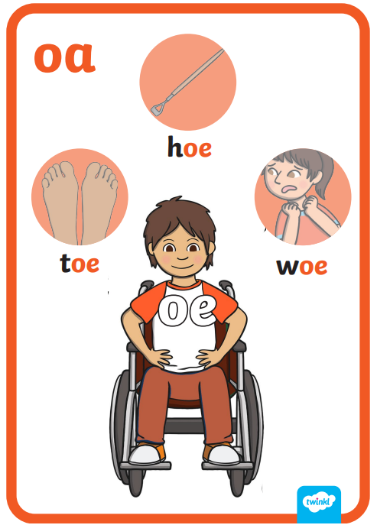
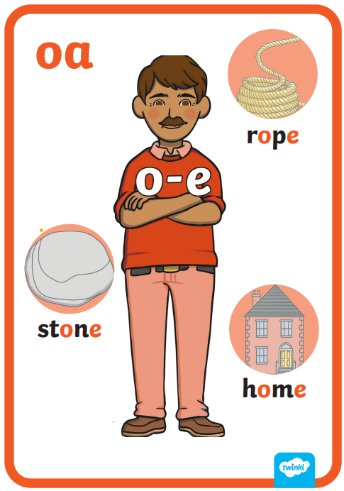
Revisit and review
The 'oa' family

Slide 5
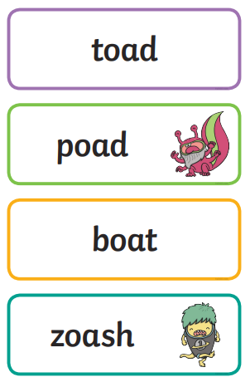
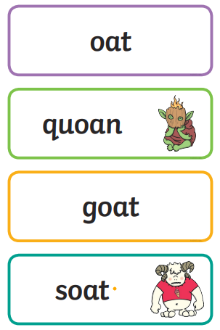
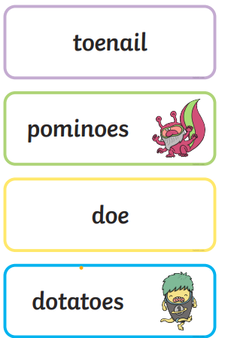
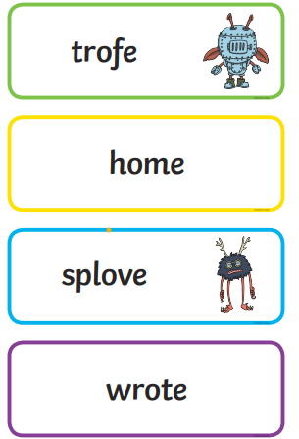
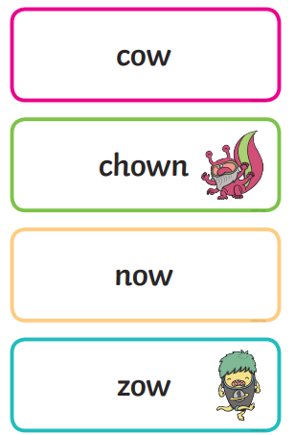
Real or Nonsense words? Read the words and underline the 'oa' phonemes
CHALLENGE
Write the real words in a sentence

Slide 6
The 'oa' family
toep bone cobe boat coat code hoe moat load
woke goat toad blow crow toe toav low lower
Challenge
Can you write these words in a sentence?

Slide 7
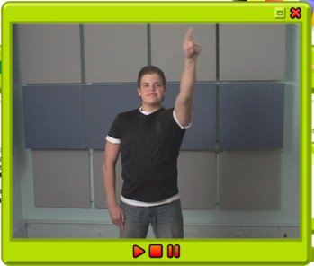
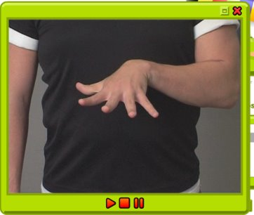
TBAT: practise a diagonal join with no ascender /ime/ /ine/
Monday 29th April 2024
29/04/24
Warm up
Gross- Big hoops
Fine- Finger stretch

Slide 8
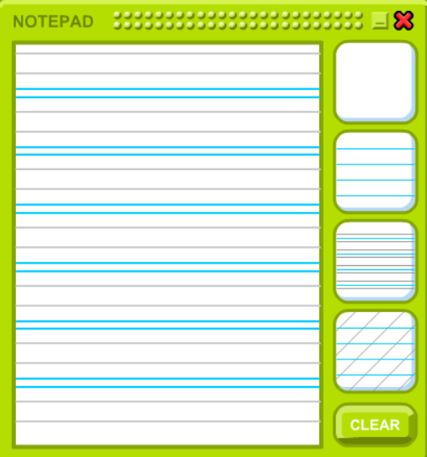
TBAT: practise a diagonal join with no ascender /ime/ /ine/
Monday 29th April 2024
29/04/24

Slide 9
Little Wandle Guided Reading

Slide 10
Assembly

Slide 11
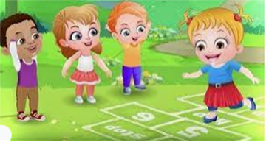
Break

Slide 12
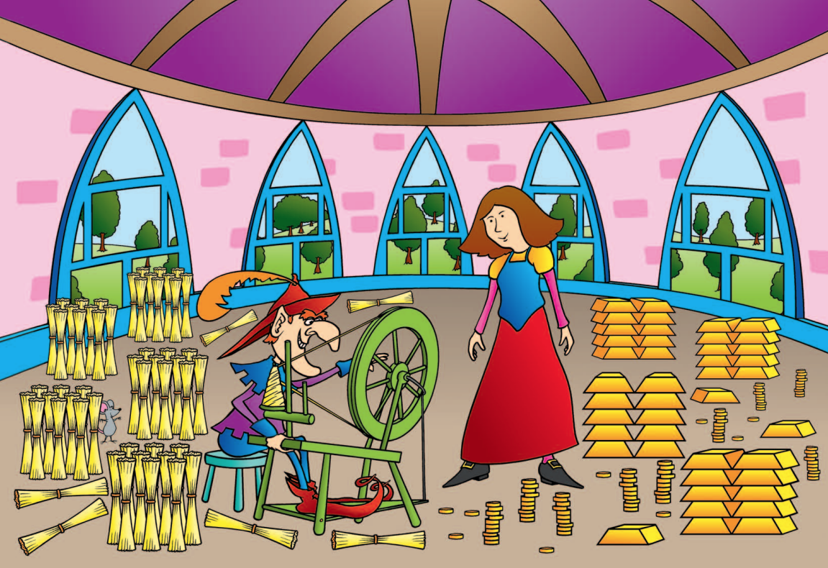
3 in 3
How many bars of gold can you see? How did you count them?
How many bundles of straw can you see? How did you count them?
Are there more bars of gold or bundles of straw? How do you know?

Slide 13
To apply knowledge of number bonds within 20
add
part
subtract
whole

Slide 14
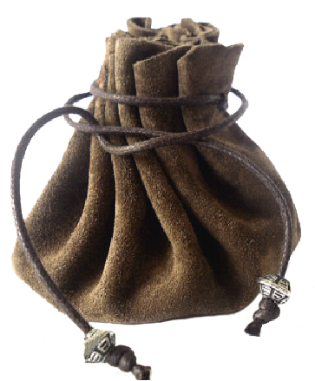
Rumpelstiltskin has 20 gold coins
He has put them into two money bags.
How many coins could be in each bag?
Notes:
New Learning: Investigating number bonds within 20
Introduce the problem – Rumpelstiltskin has 20 gold coins and he splits them between two bags. Show pupils two opaque bags.
How many gold coins could be in each money bag?
Give pupils a chance to discuss and take feedback.
Use two hoops to represent the two bags and 20 large counters or cubes to represent the coins. Share the ‘coins’ between the two hoops using a pupil’s suggestion, e.g. ten coins in each hoop. Record this on a part-whole model. Have pupils repeat key sentences:
The whole is 20. One part is ten and the other part is ten. Ten plus ten is equal to twenty. Twenty subtract ten is equal to ten.
Write the corresponding equation.
Now move one coin from one hoop to the other. Without counting the coins again, can pupils say how many coins are in each bag? Record on a part-whole model. Model the sentences:
This part has decreased by one; it now has nine coins. This part has increased by one; it now has 11 coins. The whole has stayed the same; the whole is 20. Nine plus 11 is equal to 20. 20 subtract nine is equal to 11.
Write the corresponding equation.
Continue modelling working systematically, moving one coin at a time, to find other possibilities, with pupils describing the part-whole relationship each time.

Slide 15
How many coins could be in each bag?
20
One part is ____.
The other part is ____.
The whole is 20.
Notes:
New Learning: Investigating number bonds within 20
Introduce the problem – Rumpelstiltskin has 20 gold coins and he splits them between two bags. Show pupils two opaque bags.
How many gold coins could be in each money bag?
Give pupils a chance to discuss and take feedback.
Use two hoops to represent the two bags and 20 large counters or cubes to represent the coins. Share the ‘coins’ between the two hoops using a pupil’s suggestion, e.g. ten coins in each hoop. Record this on a part-whole model. Have pupils repeat key sentences:
The whole is 20. One part is ten and the other part is ten. Ten plus ten is equal to twenty. Twenty subtract ten is equal to ten.
Write the corresponding equation.
Now move one coin from one hoop to the other. Without counting the coins again, can pupils say how many coins are in each bag? Record on a part-whole model. Model the sentences:
This part has decreased by one; it now has nine coins. This part has increased by one; it now has 11 coins. The whole has stayed the same; the whole is 20. Nine plus 11 is equal to 20. 20 subtract nine is equal to 11.
Write the corresponding equation.
Continue modelling working systematically, moving one coin at a time, to find other possibilities, with pupils describing the part-whole relationship each time.

Slide 16
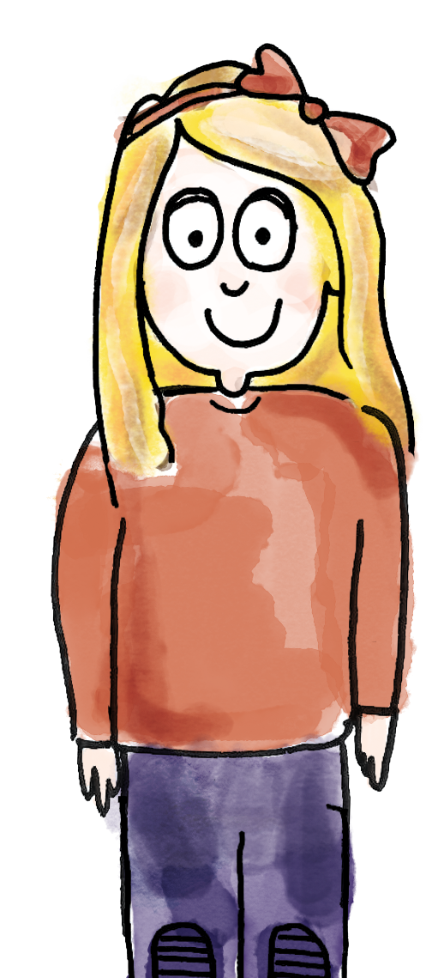
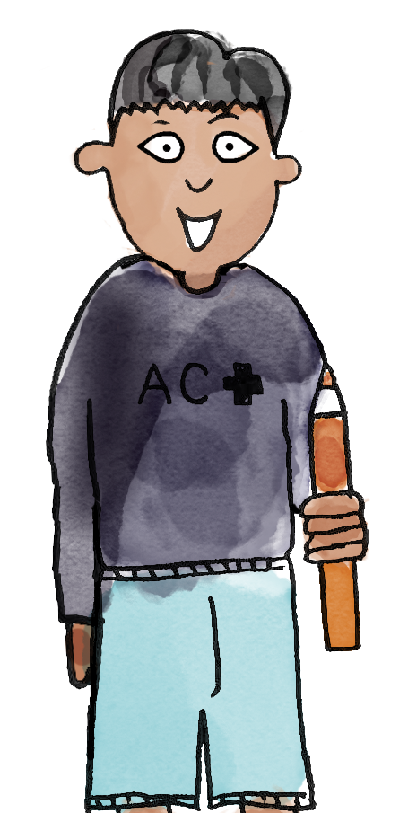
Rumpelstiltskin has split 15 coins into two bags
The whole is 15.
The parts are 0 and 15.
B/G
Zero plus 15 is equal to 15. 15 subtract zero is 15.
15
add subtract part whole
Notes:
Talk Task: Investigating number bonds to 15
Each pair of pupils has the Task Sheet and 15 counters or cubes. Explain that now Rumpelstiltskin has split 15 coins between two bags. How many coins might be in each bag?
Pupil A partitions the 15 counters into two parts, placing them on the part-whole model on the Task Sheet. They say what the whole and the parts are. Pupil B states two corresponding equations: one addition and one subtraction. Pupils swap roles and repeat, finding as many different ways of partitioning 15 coins as possible.

Slide 17
The bag contains 12 gold and silver coins
How many could be gold?
How many silver?
gold
12
silver
Notes:
Develop Learning: Addition and subtraction within 20
Show pupils an opaque bag and explain that it contains 12 gold and silver coins.
How many gold coins could be in the bag? How many silver coins could be in the bag?
Allow pupils time for discussion then take feedback.
Then tell pupils that we now know there are nine gold coins. Write ‘9’ in one part of the part-whole model on the slide.
There are 12 coins altogether. Nine are gold. How many are silver?
Discuss the two ways of thinking about this – either as 12 subtract nine, or as ‘what do I add to nine to make 12?’
Then use the next slide to prepare pupils for the Independent Task, where they must select from given numbers of gold and silver coins to make a total.

Slide 18
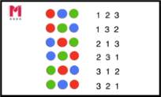
Find combinations that make 12
Choose from the possibilities shown here.
Is there more than one answer?
gold
gold
7
11
9
1
12
silver
silver
6
3
2
5
Notes:
Develop Learning: Addition and subtraction within 20
Show pupils an opaque bag and explain that it contains 12 gold and silver coins.
How many gold coins could be in the bag? How many silver coins could be in the bag?
Allow pupils time for discussion then take feedback.
Then tell pupils that we now know there are nine gold coins. Write ‘9’ in one part of the part-whole model on the slide.
There are 12 coins altogether. Nine are gold. How many are silver?
Discuss the two ways of thinking about this – either as 12 subtract nine, or as ‘what do I add to nine to make 12?’
Then use the next slide to prepare pupils for the Independent Task, where they must select from given numbers of gold and silver coins to make a total.

Slide 19
To apply knowledge of number bonds within 20
For each bag, find combinations that make the total.
Choose from the possibilities shown.
gold coins
silver coins
10
4
5
15
18
20
11
13
7
9
11
10
8
3
Notes:
Independent Task: Addition and subtraction within 20
Pupils have the Task Sheet, a large part-whole model and 20 counters or cubes to represent coins. For each bag, they explore which combinations of the given gold and silver coin quantities could make the total. Is there more than one possibility for each?
Possible adaptations:
Pupils could be given additional clues, e.g. in one bag there are eight gold coins.
Pupils could be challenged to convince you that they have found all the possibilities.

Slide 20
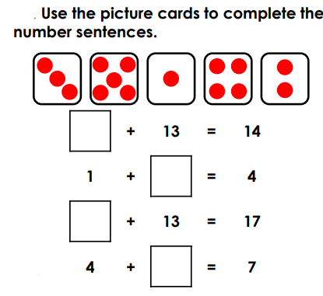
To apply knowledge of number bonds within 20
RP: Challenge
Notes:
Independent Task: Addition and subtraction within 20
Pupils have the Task Sheet, a large part-whole model and 20 counters or cubes to represent coins. For each bag, they explore which combinations of the given gold and silver coin quantities could make the total. Is there more than one possibility for each?
Possible adaptations:
Pupils could be given additional clues, e.g. in one bag there are eight gold coins.
Pupils could be challenged to convince you that they have found all the possibilities.

Slide 21
To apply knowledge of number bonds within 20
Mastery:
Notes:
Independent Task: Addition and subtraction within 20
Pupils have the Task Sheet, a large part-whole model and 20 counters or cubes to represent coins. For each bag, they explore which combinations of the given gold and silver coin quantities could make the total. Is there more than one possibility for each?
Possible adaptations:
Pupils could be given additional clues, e.g. in one bag there are eight gold coins.
Pupils could be challenged to convince you that they have found all the possibilities.

Slide 22
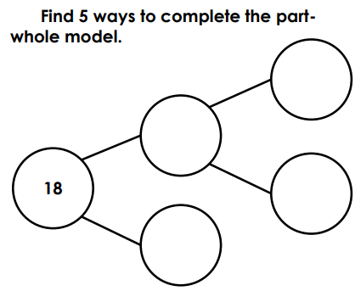
To apply knowledge of number bonds within 20
Mastery with greater depth:
Notes:
Independent Task: Addition and subtraction within 20
Pupils have the Task Sheet, a large part-whole model and 20 counters or cubes to represent coins. For each bag, they explore which combinations of the given gold and silver coin quantities could make the total. Is there more than one possibility for each?
Possible adaptations:
Pupils could be given additional clues, e.g. in one bag there are eight gold coins.
Pupils could be challenged to convince you that they have found all the possibilities.

Slide 23
Lunch

Slide 24
Plants
Key Question
Do plants grow?

Slide 25
Key Question – Do plants grow?
Key vocabulary
Plant – a living organism
Flower – the seed baring part of the plant that is usually surrounded by brightly coloured petals
Roots – the part of the plant that attaches from the ground for support and nutrient collection
Stem – the main stalk of the plant
Leaf – part of a plant that is typically flat or hangs off the stem

Slide 26
Key Question - Do plants grow?
B/G
Name 5 parts of a plant
How to wild plants grow?

Slide 27
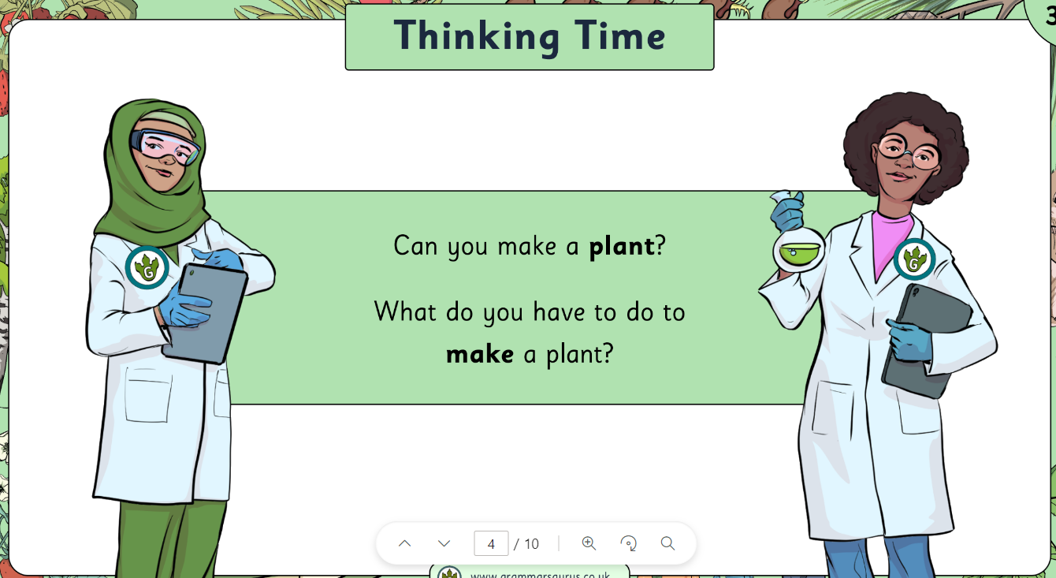
Key Question - Do plants grow?
7
Find these parts on a plant in your classroom
CHALLENGE

Slide 28
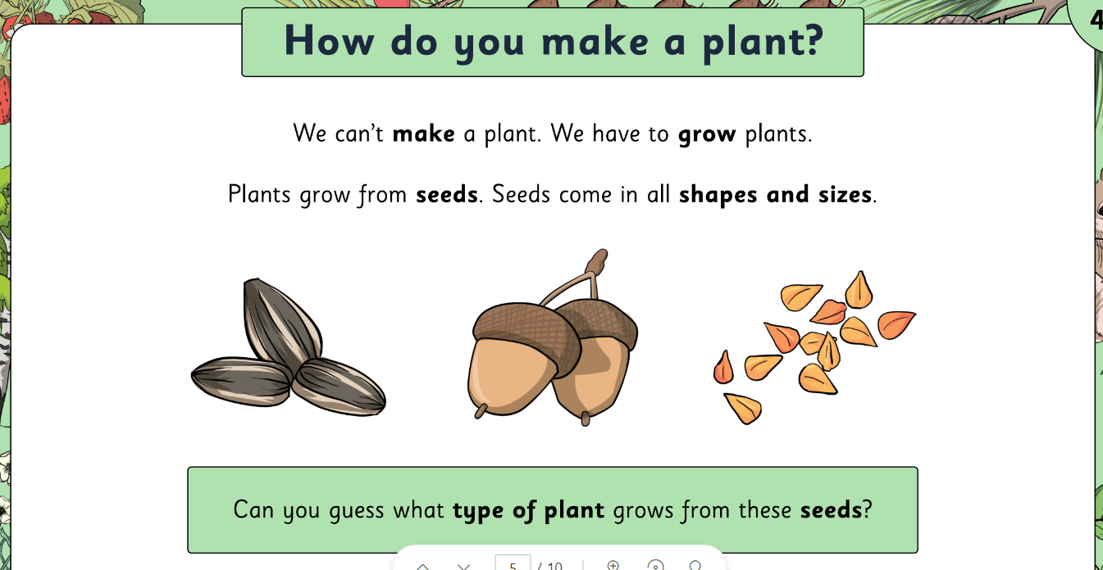
Key Question - Do plants grow?
7

Slide 29
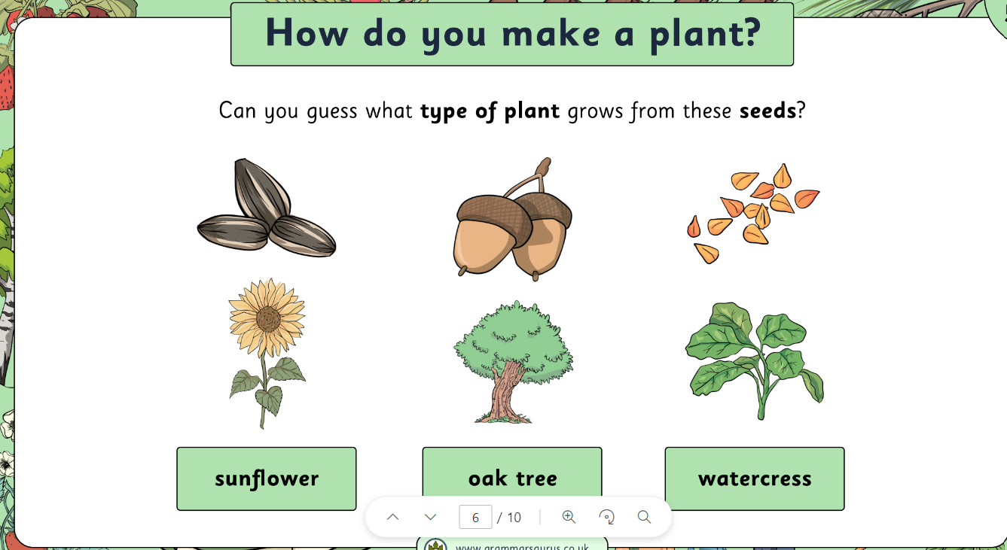
Key Question - Do plants grow?
7

Slide 30
Key Question - Do plants grow?
7
How do you grow a plant?
What do you need?
PARTNER WORK

Slide 31
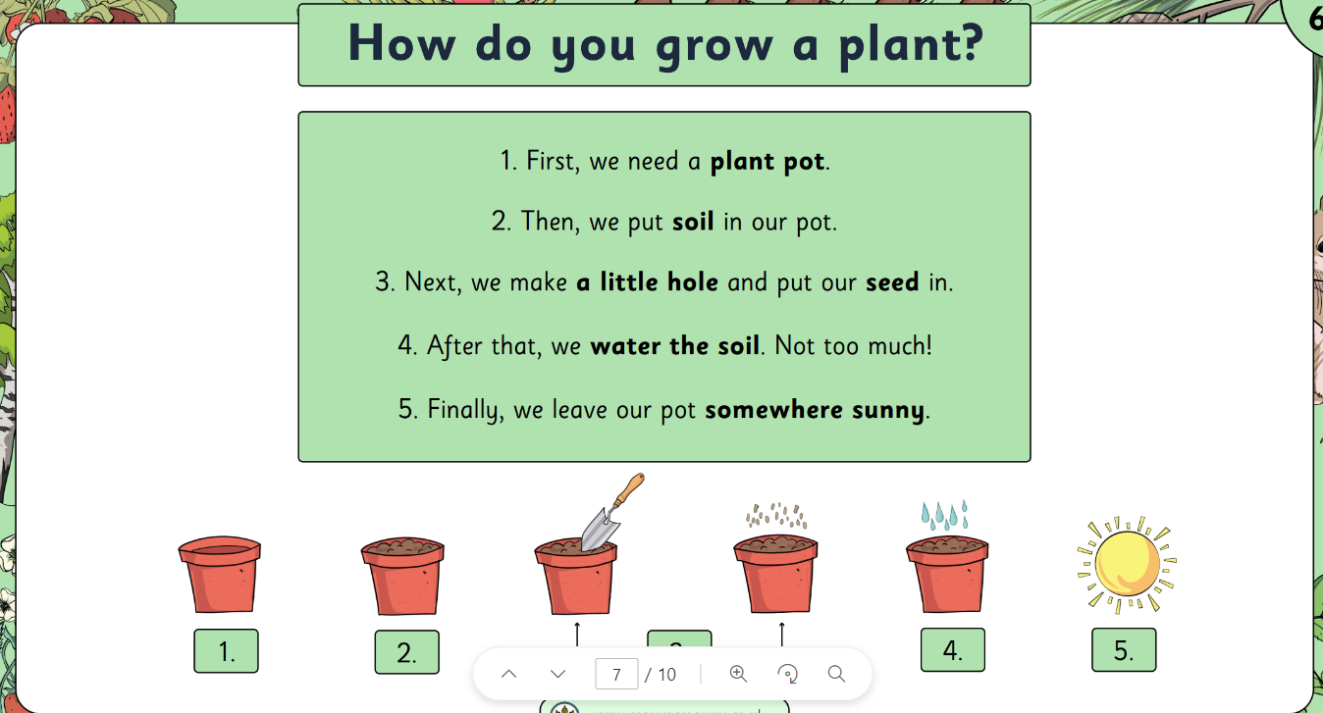
Key Question - Do plants grow?
7

Slide 32
Key Question - Do plants grow?
7
What do plants need to grow?
PARTNER WORK

Slide 33
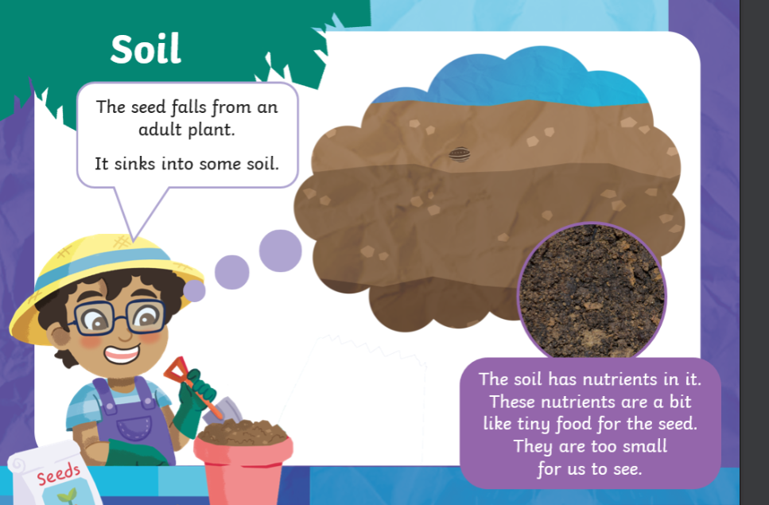
Key Question - Do plants grow?
7

Slide 34
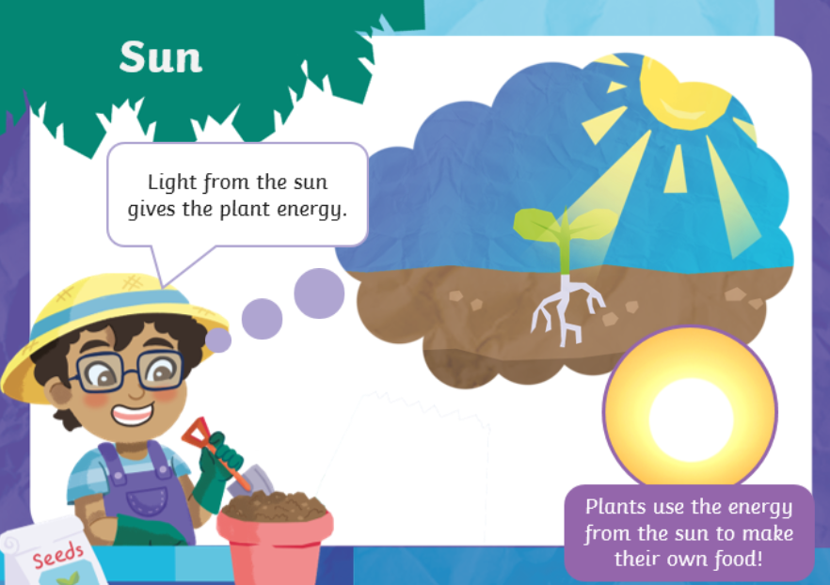
Key Question - Do plants grow?
7

Slide 35
Key Question - Do plants grow?
7

Slide 36
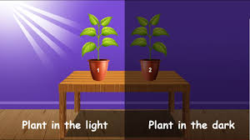
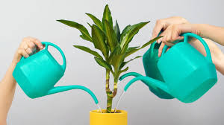
Key Question - Do plants grow?
7
TIME TO EXPERIMENT!
Will a plant grow over 2 weeks? ..... WHAT IS OUR PREDICTION?
with sunlight? In darkness? with water? with no water?

Slide 37
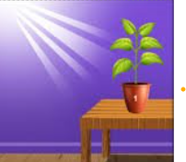
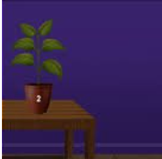
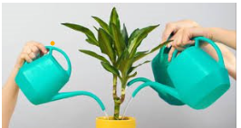
Key Question - Do plants grow? Monday 29th April 2024
7
Have the plants grown?
With sunlight
No sunlight
With water
No water

Slide 38
Key Question: How can we reduce rubbish?
Monday 29th April 2024
Blue/ Green
Name as many objects or items that get recycled.
Notes:
Explain to pupils that there are three ways we can all help to have less rubbish in our world and they are reducing, reusing and recycling. Ask pupils if they have heard of these words and what they mean. Explain that reusing and recycling are about using things again instead of throwing them away – maybe using them in a different way. Tell pupils that if you reduce something you make it smaller or less, and reducing rubbish is making less rubbish.

Slide 39
Key Question: How can we reduce rubbish?
Monday 29th April 2024
Reducing for the planet
Reduce means ‘to make something smaller so there is less of it’.
Notes:
Explain to pupils that there are three ways we can all help to have less rubbish in our world and they are reducing, reusing and recycling. Ask pupils if they have heard of these words and what they mean. Explain that reusing and recycling are about using things again instead of throwing them away – maybe using them in a different way. Tell pupils that if you reduce something you make it smaller or less, and reducing rubbish is making less rubbish.

Slide 40
Key Question: How can we reduce rubbish?
Monday 29th April 2024
Reducing for the planet
I reduce packaging by buying loose fruit and vegetables at the supermarket.
I reduce plastic bags by bringing my own shopping bags to the supermarket.
Notes:
Tell pupils that Mr and Mrs Patel try to reduce their rubbish. Here, they are describing the things that they do. Explain that taking your own reusable shopping bag means that you are not using a plastic bag which is not biodegradable. Talk with pupils about the packaging of fruits and vegetables and how wasteful it is, as it just gets thrown away. Help pupils to see that it can be reduced.

Slide 41
Key Question: How can we reduce rubbish?
Monday 29th April 2024
Reducing for the planet
I reduce plastic by using a refillable water bottle.
I reduce waste by repairing old clothes and by donating them to charity instead of throwing them away.
Notes:
Remind pupils that plastic bottles are not biodegradable and take hundreds of years to begin to break up. Even though clothes are biodegradable, some materials take longer to rot. Explain that Mr Patel repairs clothes by sewing up holes and sewing on new buttons and zips. If he really doesn’t want clothes any more, he gives them to charity so they are not thrown away. Explain that even torn, faded clothing which is beyond repair can be taken to charity shops. It can be sold on as rags to be used as furniture filling.

Slide 42
Key Question: How can we reduce rubbish?
Monday 29th April 2024
Reducing for the planet
I reduce plastic by packing my lunch in a reusable container.
I reduce paper by reading the news on my laptop.
Notes:
Explain that many sandwiches bought in a supermarket have a lot of packaging which gets thrown away. Mrs Patel doesn’t waste the plastic and cardboard because she makes her own sandwiches and stores them in her reusable sandwich box. Mr Patel doesn’t waste paper because he reads the newspaper on his laptop.

Slide 43
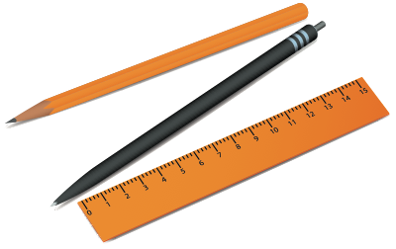
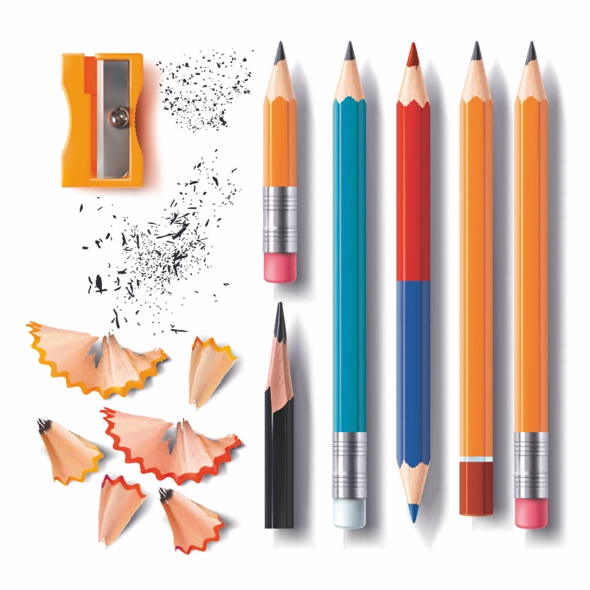
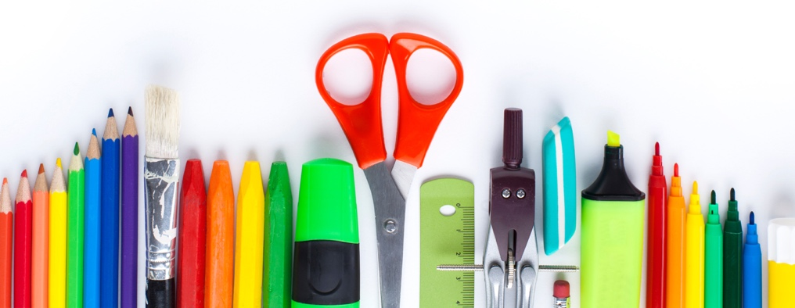
Key Question: How can we reduce rubbish?
Monday 29th April 2024
Reducing for the planet
Notes:
Tell pupils that the classroom cleaner has said that every day she has to throw away lots of school resources. She says that children waste a lot of paper and that there are often pencils, rubbers, sharpeners and other stationery on the floor and in the bins. Lots of pens have missing tops and pencils are thrown away because they are blunt. She says that there are plastic sandwich bags and carrier bags in the bin. She adds that it makes her very sad.
Ask pupils if they can think of any ways that the class can stop wasting things and reduce rubbish. Here are some ideas:
Using the front and the back of paper
Not scribbling on paper or wasting it
Putting lids on pens and felt tips so that they don’t dry out
Naming stationery so that it can be returned to its owner
Having a pencil case or box and packing things away carefully at the end of the lesson
Not sharpening pencils too much
Having a place for rulers and scissors and putting them away
Reusing boxes for parts of their lunch so they don’t waste plastic and packaging

Slide 44
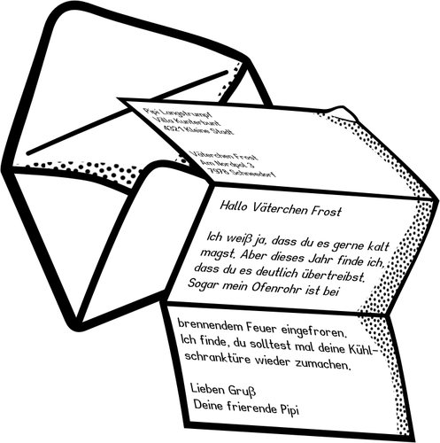
Home time
1.
2.
3.
4.
Wash hands
Collect bags , lunch boxes and water bottles.
Collect jumpers
Collect any letters/ reading books from the teachers.
Line up at the door.

