Slide 1
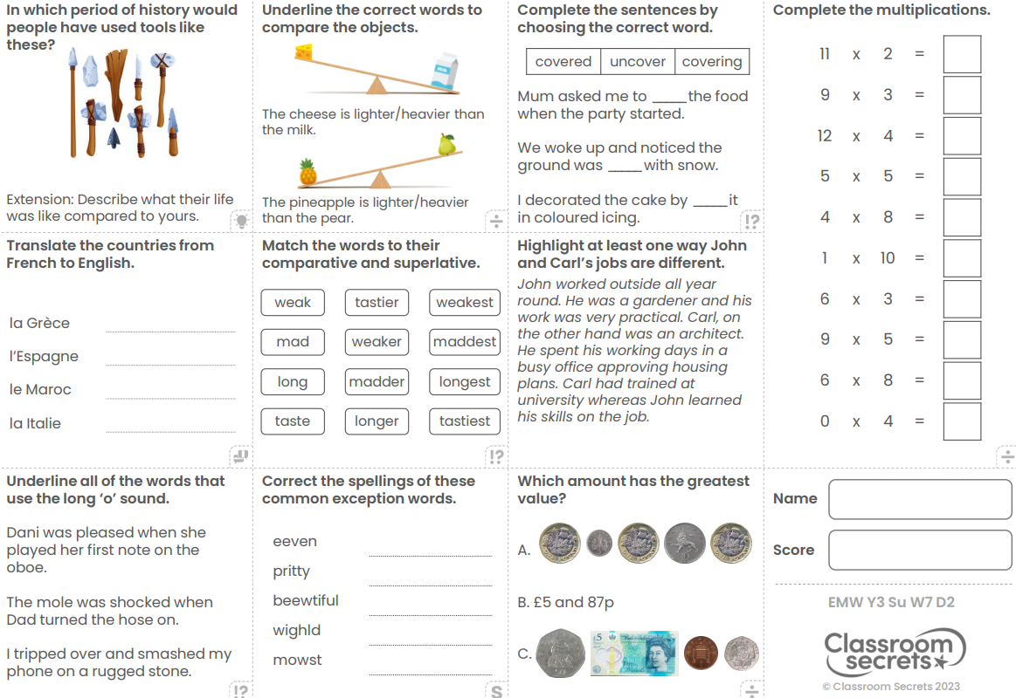
Tuesday 30th April
Morning Challenge

Slide 2
30.04.24
TBAT: understand scaling when dividing.
Daily 10 - Mental Maths Challenge - Topmarks
Key Vocabulary
Multiple Multiply Hundreds Tens Ones

Slide 3
30.04.24
TBAT: understand scaling when dividing.
542 – 316 =
24 x 3 =

Slide 4
30.04.24
TBAT: understand scaling when dividing
Partner Talk

Slide 5
30.04.24
TBAT: understand scaling when dividing.
Partner Talk

Slide 6
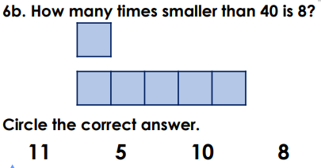
30.04.24
TBAT: understand scaling when dividing.
Blue
Green
Challenge: Which of these numbers can you double and half? Explain your answer

Slide 7
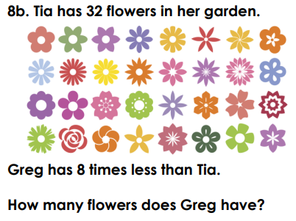
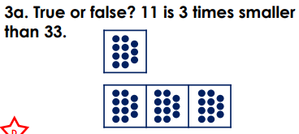
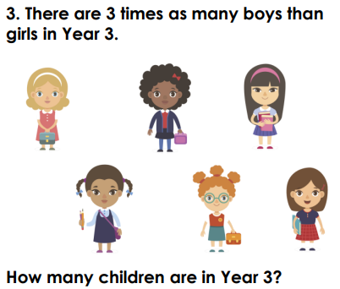
30.04.24
TBAT: understand scaling when dividing.
Independent -
1)
3)
2)
4)

Slide 8
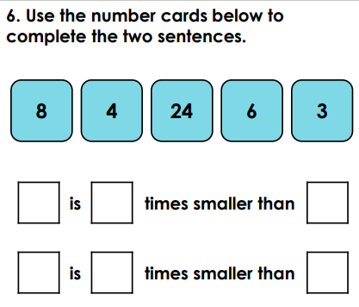
30.04.24
TBAT: understand scaling when dividing.
Mastery Challenge
Challenge:

Slide 9
30.04.24
TBAT: understand scaling when dividing.
Greater Depth:

Slide 10
TBAT: understand scaling when dividing
30.04.24

Slide 11
Tuesday 16th May 2023
16.05.23
TBAT: Spell words ending in –sure. Read the following sentence to your partner: The girl wasn't sure about the question. They had to measure the amount of water in the container. What do you notice about the 'sure' sounds in each sentence? On the next few slides, can you click on the rocks to spell out the correct –sure words. Click start to begin.

Slide 12
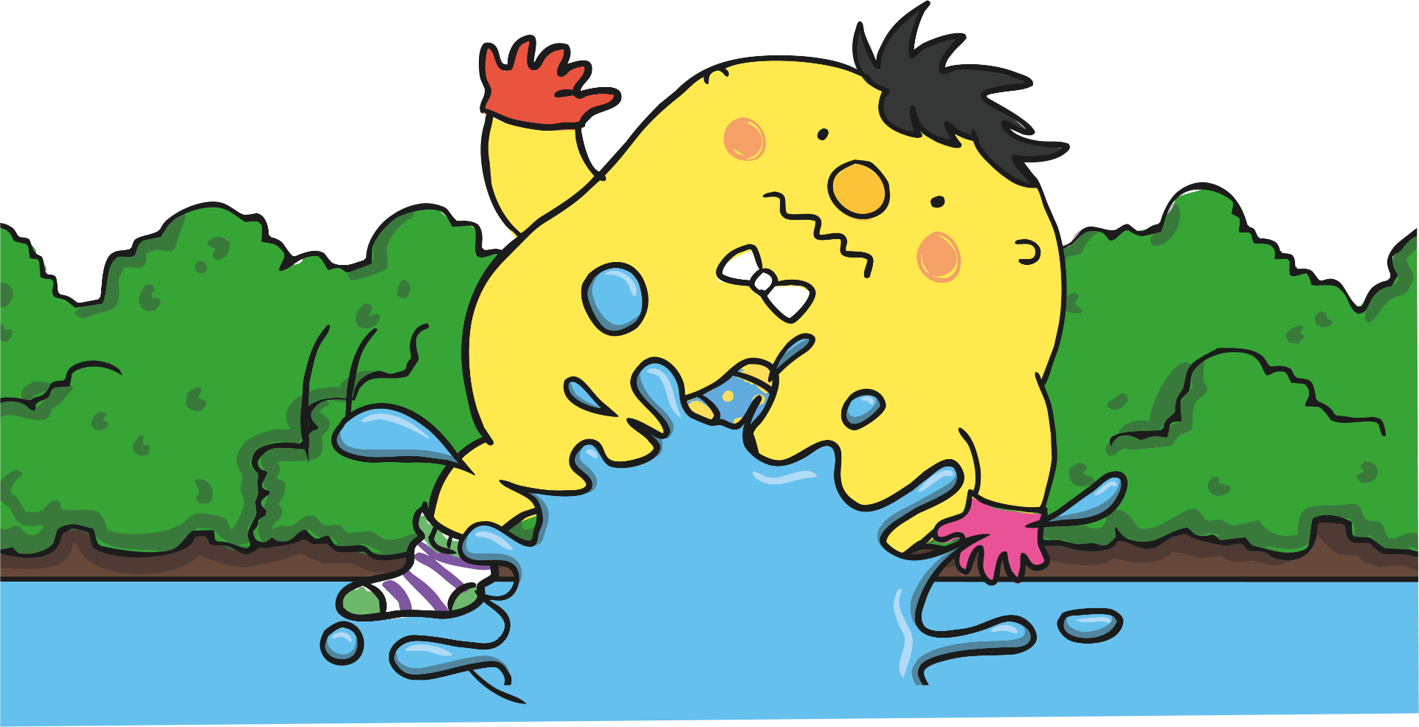
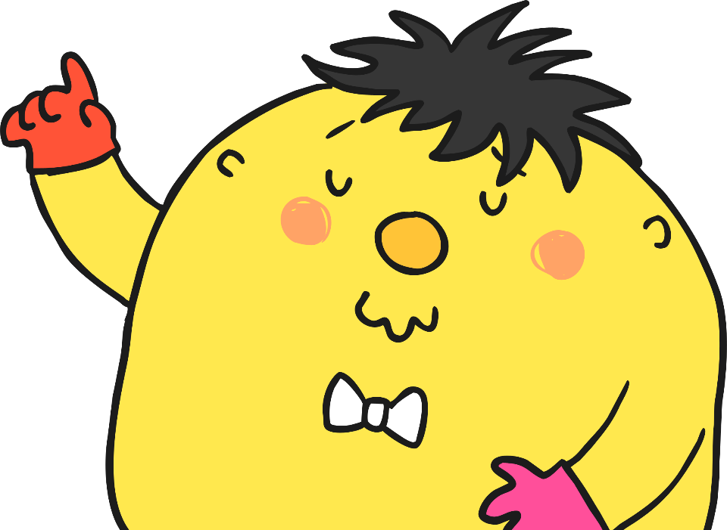
Start
1:00
1:00
0:59
0:58
0:57
0:56
0:55
0:54
0:53
0:52
0:51
0:50
0:49
0:48
0:47
0:46
0:45
0:44
0:43
0:42
0:41
0:40
0:39
0:38
0:37
0:36
0:35
0:34
0:33
0:32
0:31
0:30
0:29
0:28
0:27
0:26
0:25
0:24
0:23
0:22
0:21
0:20
0:19
0:18
0:17
0:16
0:15
0:14
0:13
0:12
0:11
0:10
0:09
0:08
0:07
0:06
0:05
0:04
0:03
0:02
0:01
Time’s up!
Clue: often looked for in quests and adventure stories.
Sorry! You have run out of time and Mr Whoops has slipped and fallen into the rapids!
The word was treasure!
Congratulations, you spelt the word correctly and helped Mr Whoops cross to the other side of the river safely!
Continue
Continue
r
i
m
s
z
r
a
treasure
j
u
s
o
r
l
i
Incorrect Letter!
Please wait five seconds
t
o
e
a
e
p
o
e
i
a
t
n
u
v
h

Slide 14
Start
1:00
1:00
0:59
0:58
0:57
0:56
0:55
0:54
0:53
0:52
0:51
0:50
0:49
0:48
0:47
0:46
0:45
0:44
0:43
0:42
0:41
0:40
0:39
0:38
0:37
0:36
0:35
0:34
0:33
0:32
0:31
0:30
0:29
0:28
0:27
0:26
0:25
0:24
0:23
0:22
0:21
0:20
0:19
0:18
0:17
0:16
0:15
0:14
0:13
0:12
0:11
0:10
0:09
0:08
0:07
0:06
0:05
0:04
0:03
0:02
0:01
Clue: to discover the exact size of something.
Time’s up!
Sorry! You have run out of time and Mr Whoops has slipped and fallen into the rapids!
The word was measure!
Congratulations, you spelt the word correctly and helped Mr Whoops cross to the other side of the river safely!
Continue
Continue
a
h
y
l
f
o
measure
e
f
t
o
w
l
Incorrect Letter!
Please wait five seconds
m
y
e
s
e
r
e
i
a
e
u
e
f

Slide 15
Start
1:00
1:00
0:59
0:58
0:57
0:56
0:55
0:54
0:53
0:52
0:51
0:50
0:49
0:48
0:47
0:46
0:45
0:44
0:43
0:42
0:41
0:40
0:39
0:38
0:37
0:36
0:35
0:34
0:33
0:32
0:31
0:30
0:29
0:28
0:27
0:26
0:25
0:24
0:23
0:22
0:21
0:20
0:19
0:18
0:17
0:16
0:15
0:14
0:13
0:12
0:11
0:10
0:09
0:08
0:07
0:06
0:05
0:04
0:03
0:02
0:01
Time’s up!
Clue: a pleasant or happy feeling.
Sorry! You have run out of time and Mr Whoops has slipped and fallen into the rapids!
The word was pleasure!
Congratulations, you spelt the word correctly and helped Mr Whoops cross to the other side of the river safely!
Continue
Continue
o
e
m
o
z
r
a
pleasure
j
u
s
s
r
l
f
Incorrect Letter!
Please wait five seconds
p
l
i
a
e
p
o
e
i
a
t
n
u
v
h

Slide 16
Clue: an area that has a barrier of some sort, often for animals.
Start
1:00
1:00
0:59
0:58
0:57
0:56
0:55
0:54
0:53
0:52
0:51
0:50
0:49
0:48
0:47
0:46
0:45
0:44
0:43
0:42
0:41
0:40
0:39
0:38
0:37
0:36
0:35
0:34
0:33
0:32
0:31
0:30
0:29
0:28
0:27
0:26
0:25
0:24
0:23
0:22
0:21
0:20
0:19
0:18
0:17
0:16
0:15
0:14
0:13
0:12
0:11
0:10
0:09
0:08
0:07
0:06
0:05
0:04
0:03
0:02
0:01
Time’s up!
Sorry! You have run out of time and Mr Whoops has slipped and fallen into the rapids!
The word was enclosure!
Congratulations, you spelt the word correctly and helped Mr Whoops cross to the other side of the river safely!
Continue
Continue
e
w
z
u
z
e
enclosure
o
m
a
f
s
o
r
l
r
n
Incorrect Letter!
Please wait five seconds
e
n
y
l
e
v
o
a
u
i
c
x
c
s
y
h
z

Slide 17
Start
1:00
1:00
0:59
0:58
0:57
0:56
0:55
0:54
0:53
0:52
0:51
0:50
0:49
0:48
0:47
0:46
0:45
0:44
0:43
0:42
0:41
0:40
0:39
0:38
0:37
0:36
0:35
0:34
0:33
0:32
0:31
0:30
0:29
0:28
0:27
0:26
0:25
0:24
0:23
0:22
0:21
0:20
0:19
0:18
0:17
0:16
0:15
0:14
0:13
0:12
0:11
0:10
0:09
0:08
0:07
0:06
0:05
0:04
0:03
0:02
0:01
Clue: the time when you are not at work or school.
Time’s up!
Sorry! You have run out of time and Mr Whoops has slipped and fallen into the rapids!
The word was leisure!
Congratulations, you spelt the word correctly and helped Mr Whoops cross to the other side of the river safely!
Continue
Continue
u
h
y
u
f
o
leisure
y
f
s
o
m
e
Incorrect Letter!
Please wait five seconds
l
e
i
t
e
r
l
i
a
e
l
e
f

Slide 18
Start
1:00
1:00
0:59
0:58
0:57
0:56
0:55
0:54
0:53
0:52
0:51
0:50
0:49
0:48
0:47
0:46
0:45
0:44
0:43
0:42
0:41
0:40
0:39
0:38
0:37
0:36
0:35
0:34
0:33
0:32
0:31
0:30
0:29
0:28
0:27
0:26
0:25
0:24
0:23
0:22
0:21
0:20
0:19
0:18
0:17
0:16
0:15
0:14
0:13
0:12
0:11
0:10
0:09
0:08
0:07
0:06
0:05
0:04
0:03
0:02
0:01
Time’s up!
Clue: the force you make when you press something.
Sorry! You have run out of time and Mr Whoops has slipped and fallen into the rapids!
The word was pressure!
Congratulations, you spelt the word correctly and helped Mr Whoops cross to the other side of the river safely!
Continue
Continue
o
i
m
o
z
r
a
pressure
j
e
z
s
r
l
i
Incorrect Letter!
Please wait five seconds
p
r
u
s
z
e
o
e
i
a
t
n
u
v
h

Slide 19
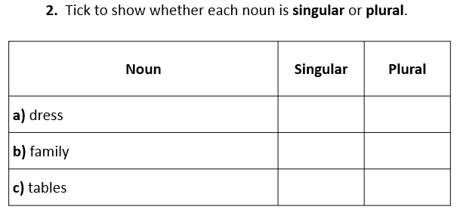
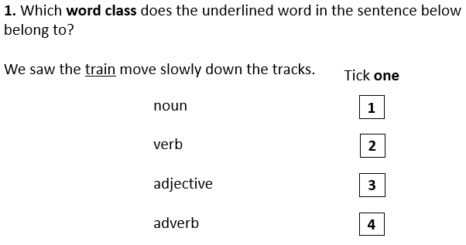
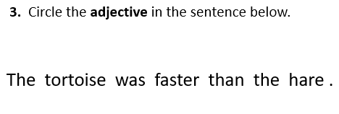
Monday 30th April
TBAT: use fronted adverbials.
3 in 3
Name the word classes of other words in question 3.

Slide 20
Monday 30th April
TBAT: use fronted adverbials.
Match the word to its definition.
Adverbial
Fronted adverbial
When an adverbial is used at the beginning of a sentence.
A word, phrase or clause that is used like an adverb to modify a verb or a clause.

Slide 21
Monday 30th April
TBAT: use fronted adverbials.
Different uses for fronted adverbials:

Slide 22
Monday 30th April
TBAT: use fronted adverbials.
Every fronted adverbial word, phrase or clause needs to be followed be a comma to separate it from the main clause of the sentence.
Where does the comma need to go in this sentence?
Slowly and carefully they released the juvenile badger back into the wild.
Does the fronted adverbial describe the time, frequency, manner, place or possibility of the action in the main clause?

Slide 23
Monday 30th April
TBAT: use fronted adverbials.
Talk partners
Place the comma in the sentence after the fronted adverbial.
On Tuesday Class 12 are visiting The Imperial War Museum.
Does the fronted adverbial describe the time, frequency, manner, place or possibility of the action in the main clause?

Slide 24
Fronted Adverbial Hunt
Can you spot the fronted adverbials in this piece of text? Do they describe the time, frequency, manner, place or possibility of the action in the main clause?
Against all the odds, Captain Curk got to his rocket before his oxygen supply ran out. Back in the safety of his shuttle, he removed his helmet and began to prepare for take-off. Suddenly, there was a loud crash at the shuttle door. The aliens must have caught up with him. Feeling intimidated, the captain quickly strapped himself into his seat as the door began to buckle. Almost certainly, the aliens would capture him if he didn’t leave this planet right away. With a trembling finger, he pressed the launch button...10, 9, 8, 7, 6, 5, 4, 3, 2, 1...BLAST OFF!
Seconds later, Curk was in the air but something was wrong. The fuel tank gauge showed a dangerously low level of fuel. The extra-terrestrial creatures must have caused it to leak. Sputtering noisily, the spacecraft started to stall. What was the captain going to do?
Against all the odds, Captain Curk got to his rocket before his oxygen supply ran out. Back in the safety of his shuttle, he removed his helmet and began to prepare for take-off. Suddenly, there was a loud crash at the shuttle door. The aliens must have caught up with him. Feeling intimidated, the captain quickly strapped himself into his seat as the door began to buckle. Almost certainly, the aliens would capture him if he didn’t leave this planet right away. With a trembling finger, he pressed
the launch button...10, 9, 8, 7, 6, 5, 4, 3, 2, 1...BLAST OFF!
Seconds later, Curk was in the air but something was wrong. The fuel
tank gauge showed a dangerously low level of fuel. The extra-terrestrial creatures must have caused it to leak. Sputtering noisily, the spacecraft started to stall. What was the captain going to do?

Slide 25
Monday 30th April
TBAT: use fronted adverbials.
_____________, the pupils walked home.
_______________, the students discussed their work in the library.
List whether the fronted adverbial describe the time, frequency, manner, place or possibility of the action in the main clause.

Slide 26
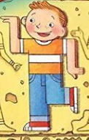
Monday 30th April
TBAT: use fronted adverbials.
Using fronted adverbials, write four sentences about what you have found out so far in our story of Flat Stanley.
Example: Early one morning, Stanley received a letter asking him to travel to Egypt.
Challenge
List whether your fronted adverbials are time, frequency, manner,
place or possibility.

Slide 27
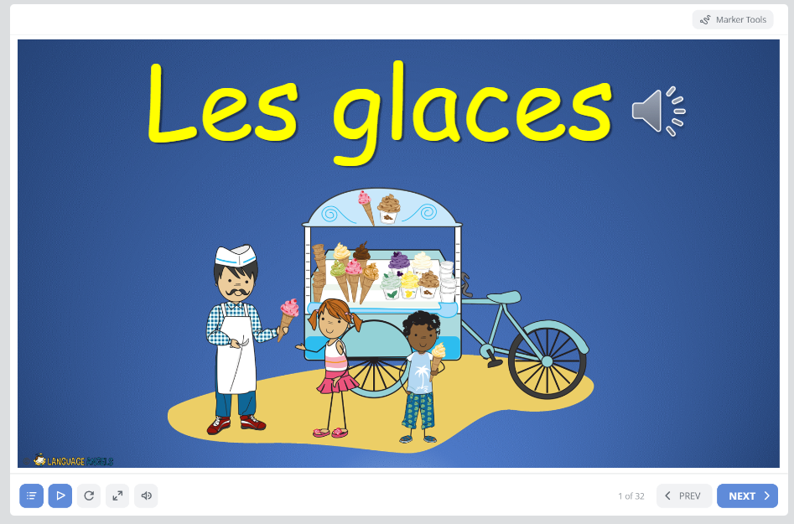
Mardi 30 Avril
TBAT: apply knowledge of 10 different ice cream flavours
Home (languageangels.com)
Unit – Ice Creams

Slide 28
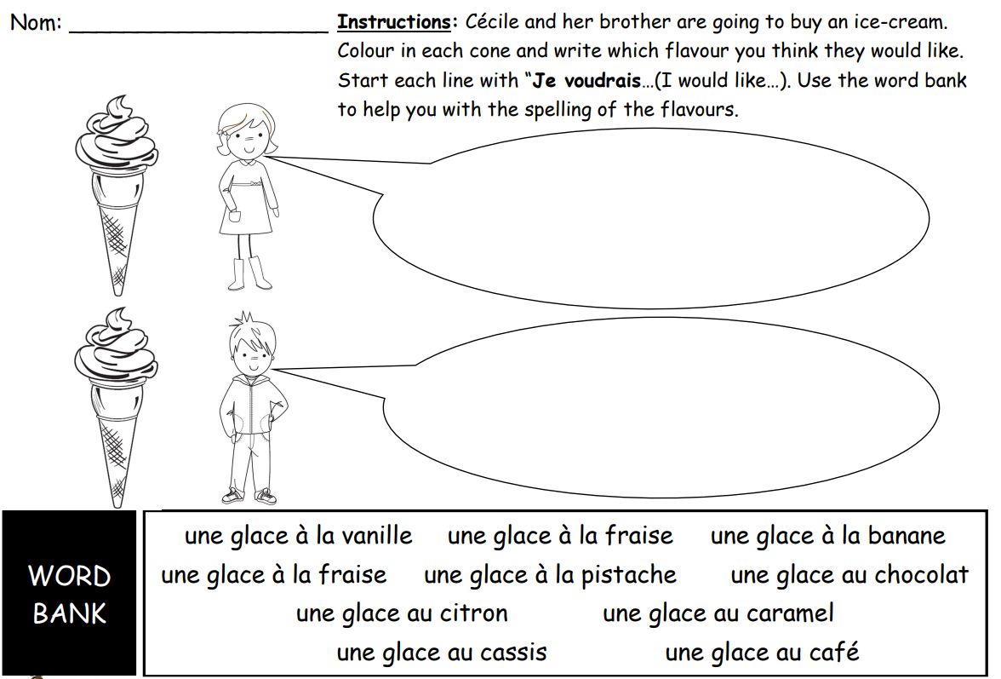
Mardi 30 Avril
TBAT: apply knowledge of 10 different ice cream flavours

Slide 29
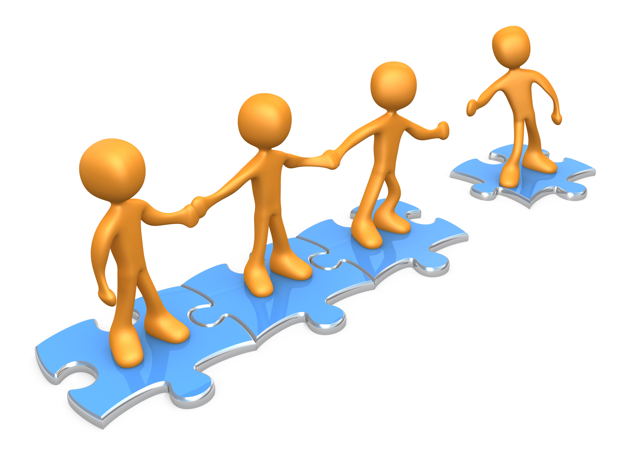
TBAT: track a ball that is not sent directly to me.
This half term in P.E will be Cricket and Balls Skills
- Changing for PE - Rules and expectations moving to PE - Move to the downstairs hall or outside Get Set 4 PE - KS2 OAA (getset4education.co.uk)

Slide 30
30.04.24
Q) What do our muscles do?
3 in 3
Do people with the longest leg jump furthest?
How would we find out if people with longer arms throw further?
Why are our bones important

Slide 31
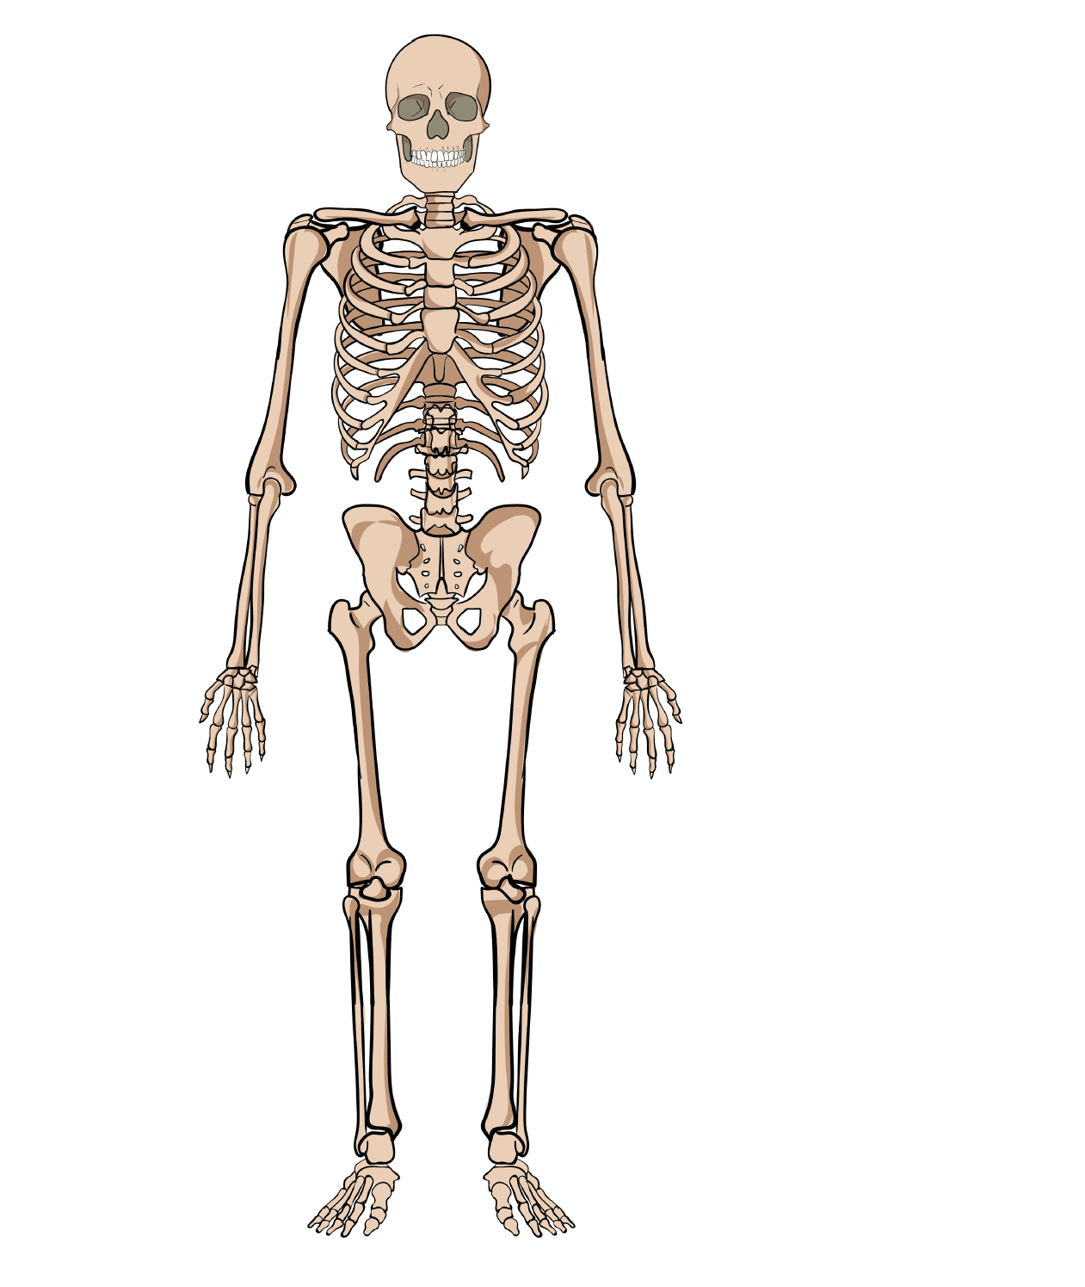
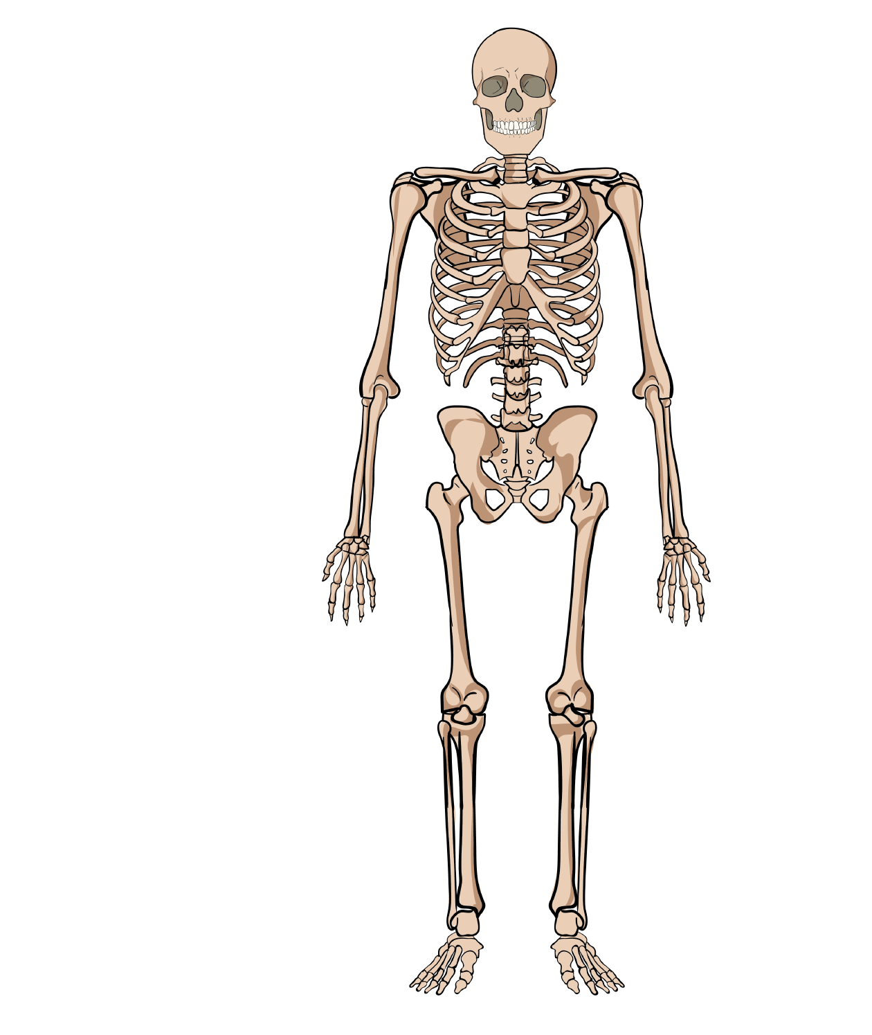
Bone Recap…
1
Who can name some of the different bones we have?

Slide 32
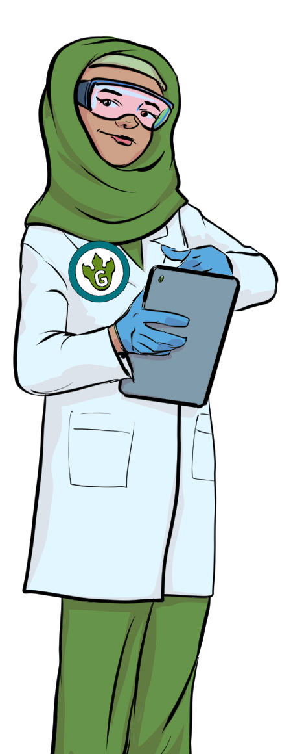
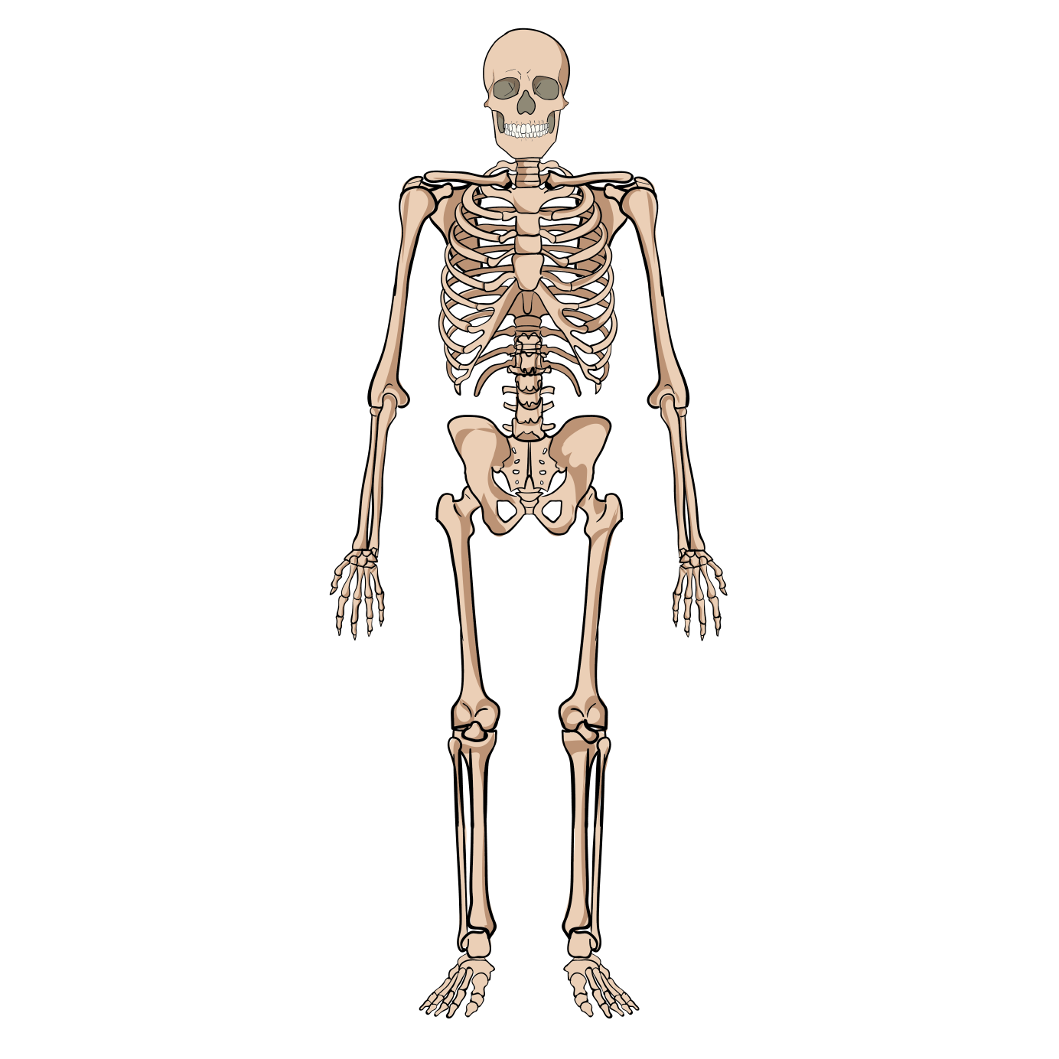
Bones
2
skull
collar bone
jaw
shoulder blade
rib cage
humerus
How many bones
did you remember?
spinal column
ulna
pelvis
radius
femur
hip
knee cap
fibula
tibia

Slide 33
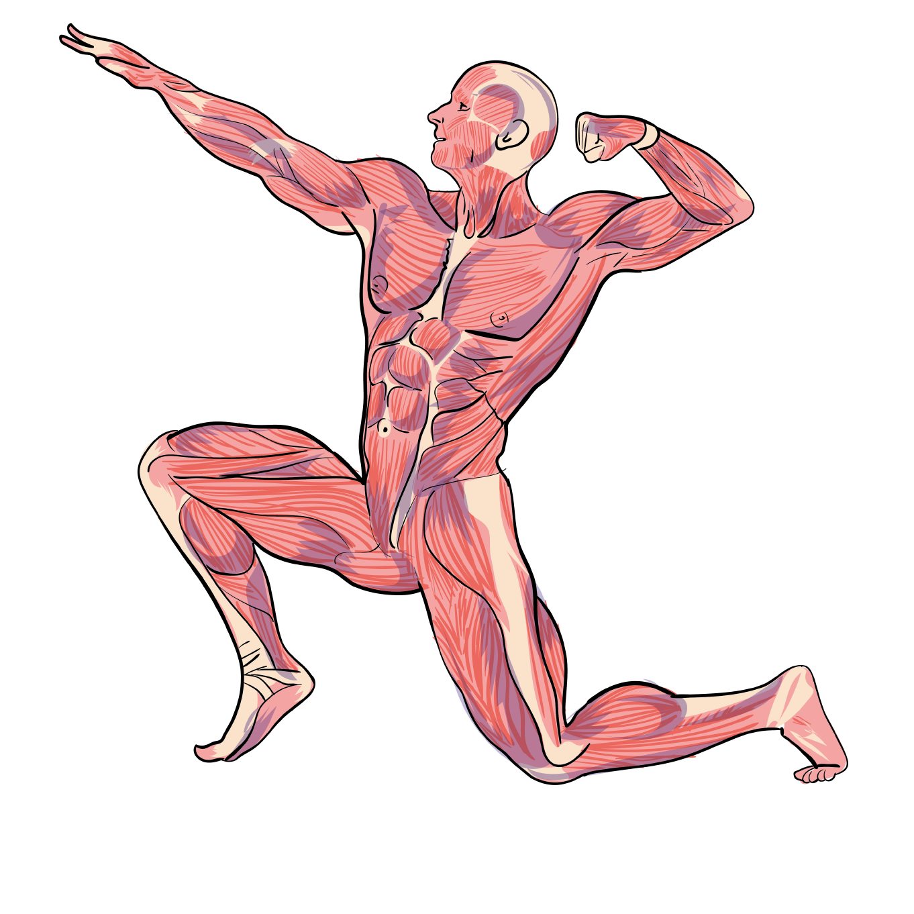
Muscles
3
Muscles have different jobs.
Muscles help pump blood around our bodies. Muscles help you lift things.
Muscles work with our bones to help us move.
Did you know?
We have over 600 muscles in our bodies!

Slide 34
Muscles
4
We have two types of muscle.
Voluntary muscles – these are muscles that we control. We move these muscles when we want to like the muscles in our arms and legs.
Involuntary muscles – these are muscles that move without us controlling them. Our brain tells these muscles what to do like our heart, the muscles in our eyelids and the muscles in our digestive system.

Slide 35
Muscles
5
Skeletons help support our bodies; without them, we would be floppy!
Muscles are attached to our bones and help us move. When we contract and relax our muscles they move
our skeleton.
Watch this short film to find out more about our muscles and our skeleton...
www.bbc.co.uk/education/clips/zy6chv4

Slide 36
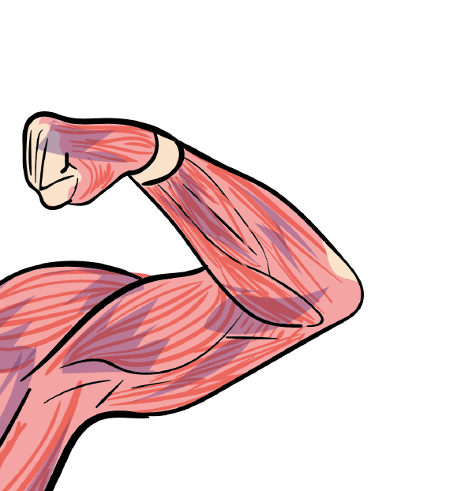
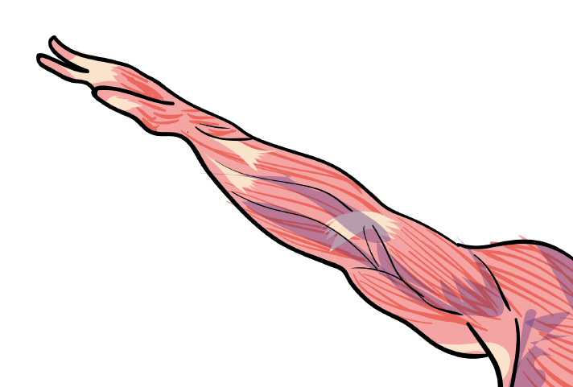
Muscles
6
When we stretch our muscles, they become longer and thinner.
When we contract our muscles, they become shorter.
biceps
biceps
triceps
triceps
To straighten our arm, our biceps relax and our triceps contract. This straightens our arm.
To bend our arm, our biceps contract and our triceps relax. This allows us to bend our arm at the elbow joint.

Slide 37
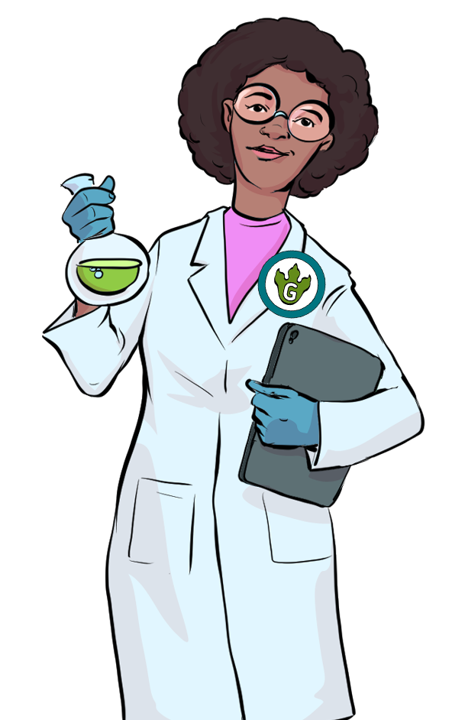
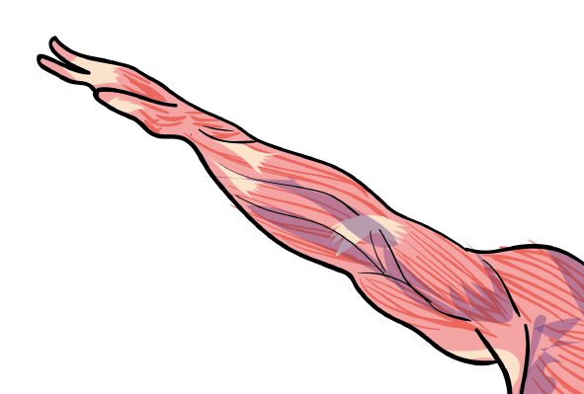
Independent Activity
8
You are now going to try this on your own arm muscles
You should then complete the activity attached.
biceps
Can you draw a diagram to explain how our triceps and biceps contract and relax?
triceps
biceps
triceps

Slide 38
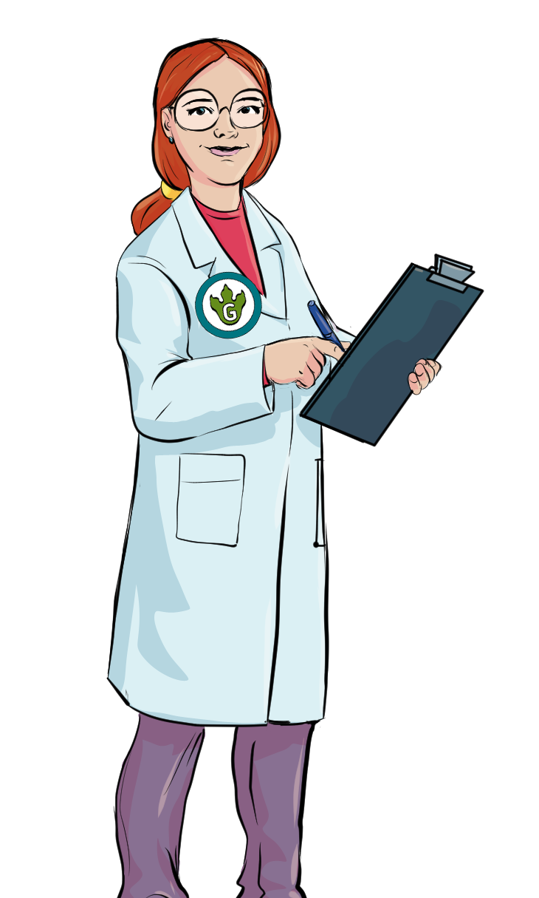
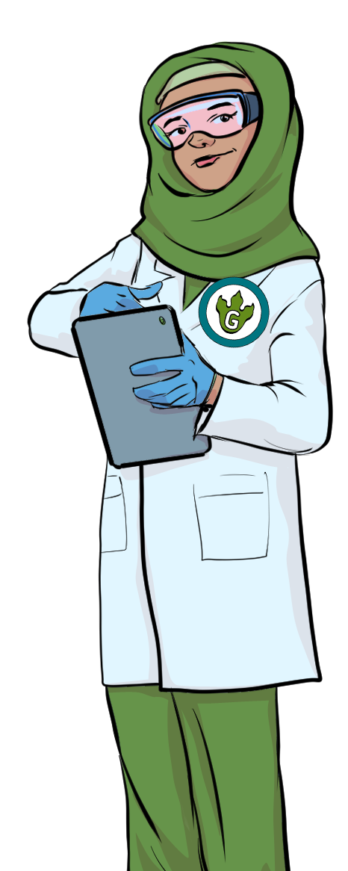
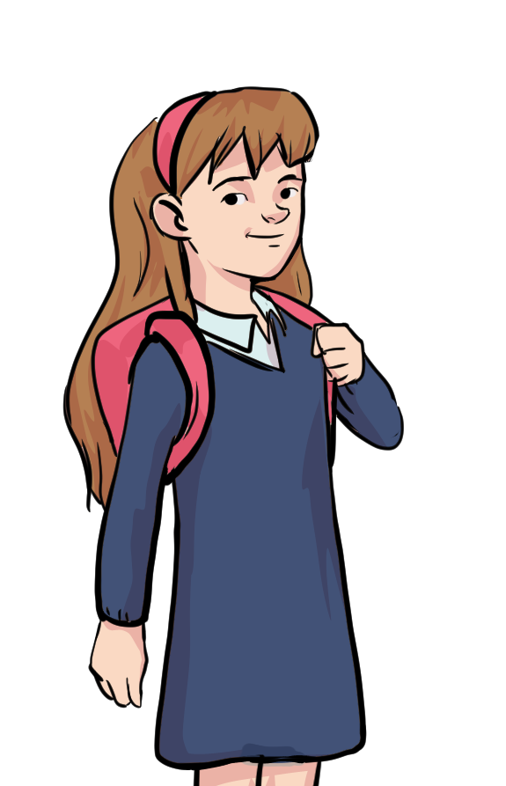
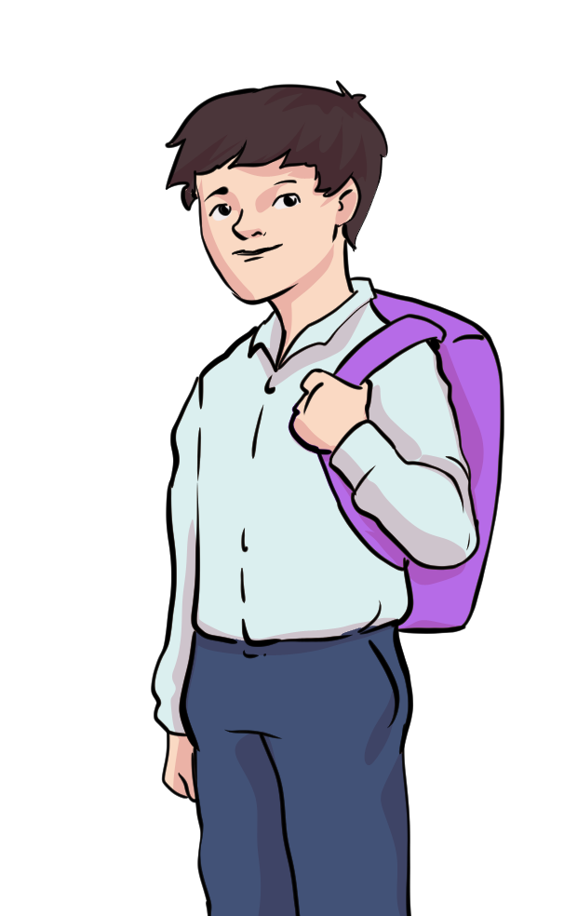
What did we find out?
9
Think about these questions and discuss them with your partner before feeding your ideas back to the class.
What did you most enjoy about this lesson?
Tell me one thing you have learnt.
Did you find anything difficult?

