Slide 1
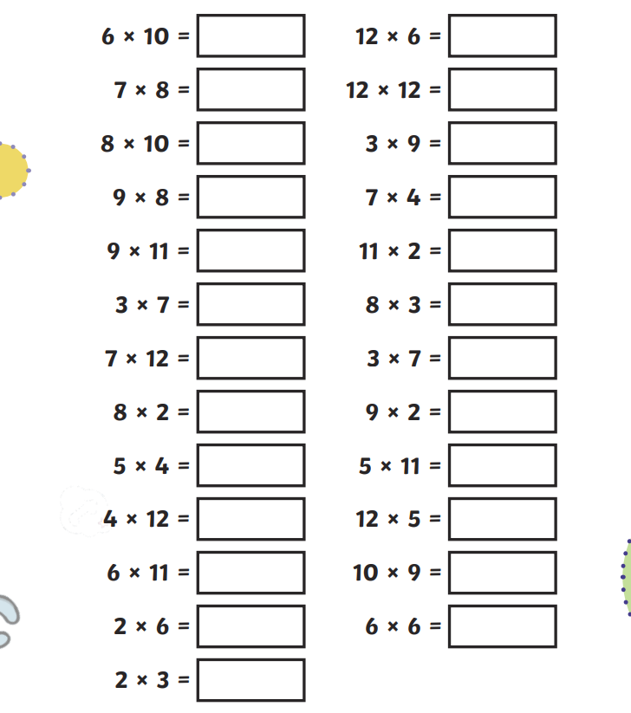
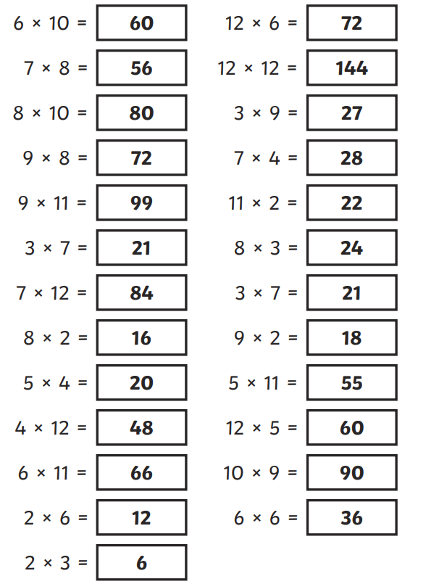
Monday 29th April Morning challenge
Check your answers:
Is it your day for TTRS?

Slide 2
29.04.24 TBAT: recognise and read Roman numerals to 100.
3 in 3
1. 4/8 + 7/8 =
2. 279 x 8 =
3. Three pieces of ribbon together measure 1 metre in length. One piece of ribbon is 14 cm long.
The next piece of ribbon is 29 cm long.
How long is the third piece of ribbon?

Slide 3
29.04.24 TBAT: recognise and read Roman numerals to 100.

Slide 4
29.04.24 TBAT: recognise and read Roman numerals to 100.

Slide 5
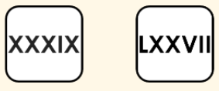
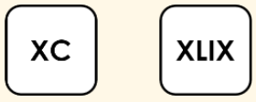
29.04.24 TBAT: recognise and read Roman numerals to 100.
Write these numbers as digits.

Slide 6
29.04.24 TBAT: recognise and read Roman numerals to 100.

Slide 7
29.04.24 TBAT: recognise and read Roman numerals to 100.

Slide 8
29.04.24 TBAT: recognise and read Roman numerals to 100.
Roman Numeral | Number | Words
 |  | three
 | 50
XLVIII
LXXXVII
 | 99
Order the following sets of Roman numerals from smallest to largest.

Slide 9
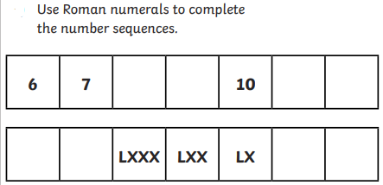
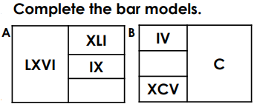
29.04.24 TBAT: recognise and read Roman numerals to 100.
Mastery Challenge with Greater Depth -
Challenge -
Mastery Challenge -

Slide 10
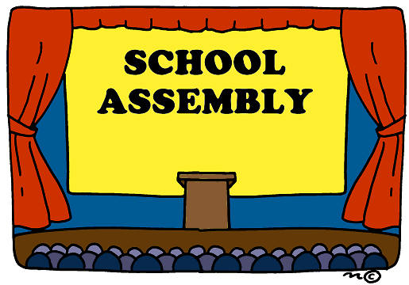
Monday 29th April

Slide 11
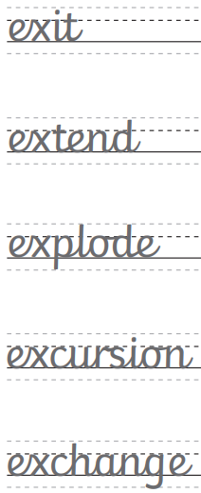
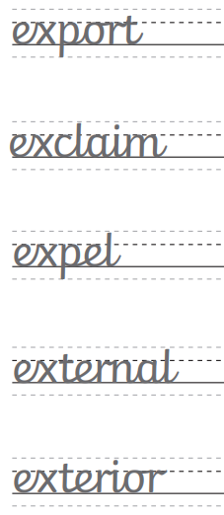
Monday 29th April TBAT: use horizontal and diagonal joins.
Can you find the definition of these words in the dictionary?

Slide 12
Monday 29th April TBAT: make inferences from the text. 3 in 3 1. Find and copy 3 items associated with the elements. 2. Why do you think Kukulcan hibernated during the dry season? 3. Which word is closest in meaning to reincarnation? Disappear Rebirth Degenerate

Slide 13
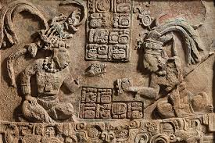
Monday 29th April TBAT: make inferences from the text. Words/phrases we will find in the text Milpas - produce crops of maize, beans, and squash. Nahs - a particular type of Maya building. Prowled - move about restlessly and stealthily, especially in search of prey. Carvings - an object or design carved from a hard material as an artistic work.

Slide 14
Monday 29th April TBAT: make inferences from the text. Multiple choice questions 1. What did the Maya see each morning to know that Kukulkan would come down? Moon Morning star Sunrise 2. How was Night Jaguar related to Kukulkan? Brothers Cousins Enemies 3. Which word is closest in meaning to fierce? Gentle Tame Ferocious

Slide 15
Monday 29th April TBAT: make inferences from the text. Inference questions 1. How can you tell that Night Jaguar is the opposite to Kukulkan? Give evidence to support your answer. 2. Do you think the Night Jaguar likes the Mayan people? Give reasons for your answer. 3. "Still, Night Jaguar guarded the city every night." What impression does the word still give? 4. How do you think Kukulkan feels about his brother? Why do you think that? 5. "As Night Jaguar rested, he smiled a secret grin." Why was it a secret grin?

Slide 16
Monday 29th April TBAT: make inferences from the text. Challenge "He believed the Gods should keep the best treasures in Paradise." What did Night Jaguar believe to be the best treasures and why did the Maya not deserve them?

Slide 17
Monday 29th April Q: What did the Ancient Maya believe and how did they worship? What would you find in an Ancient Maya city? Who were the people living in the Ancient Maya city? Challenge: Explain what is meant by a "social structure" - why have you presented this as a pyramid?

Slide 18
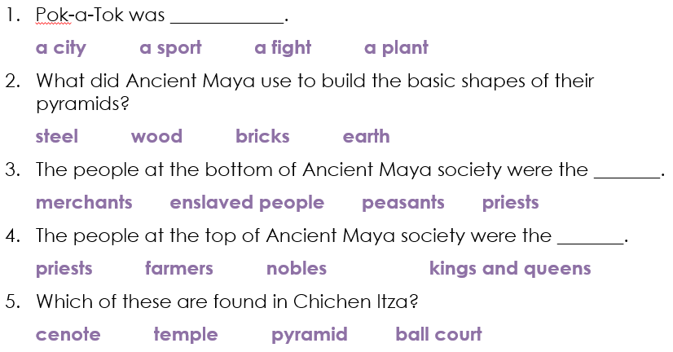
Monday 29th April Q: What did the Ancient Maya believe and how did they worship?

Slide 19
Lesson 3:
Knowledge quiz 3.2
Pok-a-Tok was ____________.
a city a sport a fight a plant
What did Ancient Maya use to build the basic shapes of their pyramids?
steel wood bricks earth
The people at the bottom of Ancient Maya society were the _______.
merchants enslaved people peasants priests
The people at the top of Ancient Maya society were the _______.
priests farmers nobles kings and queens
Which of these are found in Chichen Itza?
cenote temple pyramid ball court

Slide 20
Monday 29th April Q: What did the Ancient Maya believe and how did they worship? Key vocabulary: Ancestor - a person, typically one more remote than a grandparent, from whom one is descended.
Codices - an ancient manuscript text in book form.
Festival - a day or period of celebration, typically for religious reasons.
Myth - a traditional story, especially one concerning the early history of a people or explaining a natural or social phenomenon, and typically involving supernatural beings or events.
Religion - the belief in and worship of a superhuman power or powers, especially a God or gods.
Sacrifice - an act of slaughtering an animal or person or surrendering a possession as an offering to a deity.
Worship - any act that shows devotion or love for God.

Slide 21
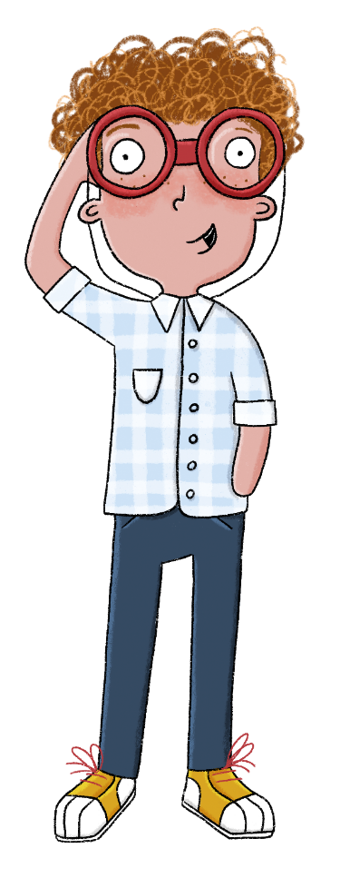
Lesson 3:
The key term for this lesson is
worship.
To worship is to show devotion to a person or a god.

Slide 22
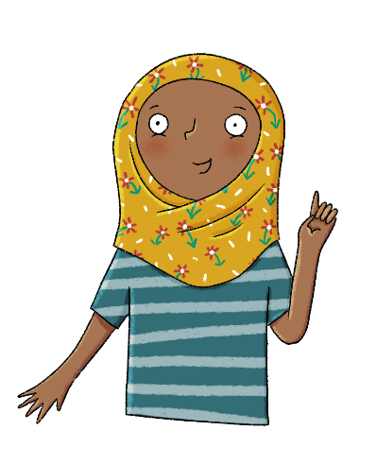
What did the Ancient Maya believe?
Lesson 3:
Religion was an important part of daily life for the Ancient Maya, who had many gods.
Temples were built in honour of the gods.
The people also worshipped the ruler and their ancestors.
The Ancient Maya had their own creation story.
ancestor
codices
festival
religion
sacrifice
worship

Slide 23
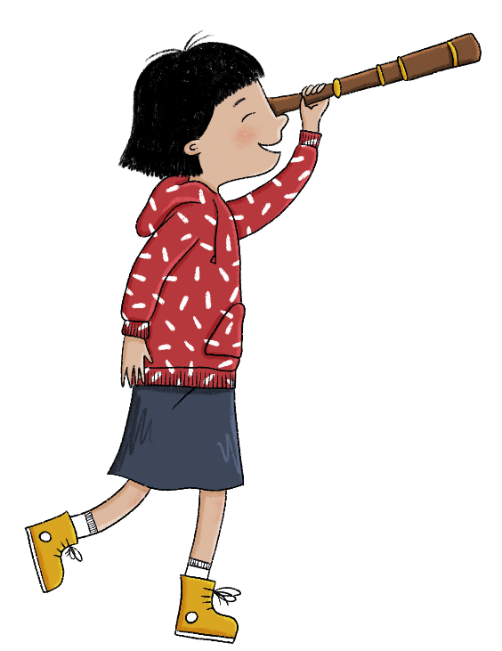
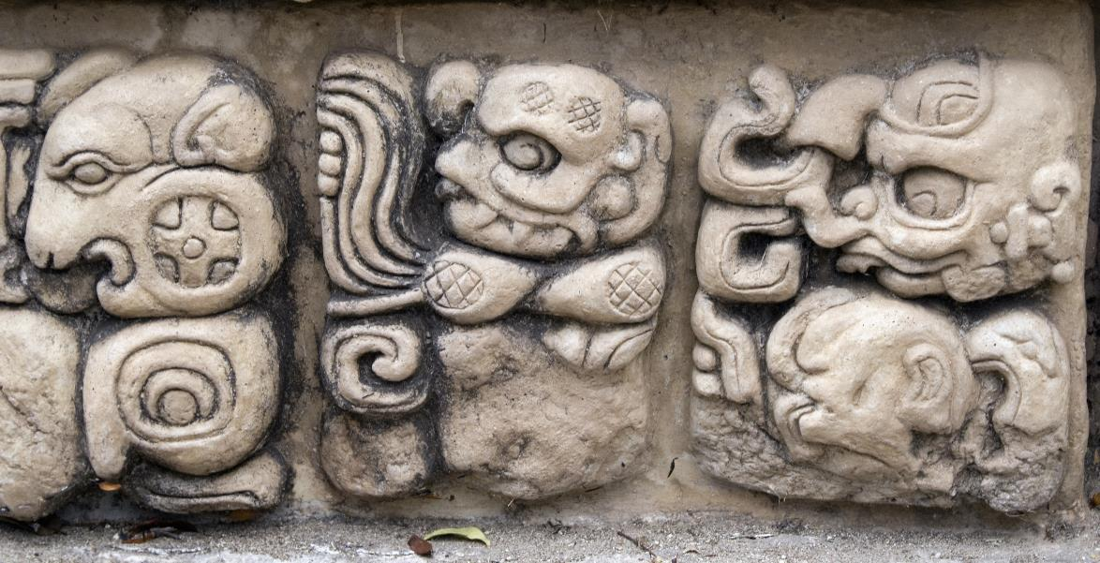
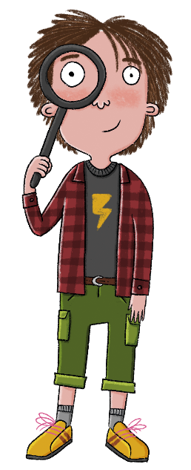
Lesson 3:
Do you think religion was important to the Ancient Maya?
Why do you think that?
Notes:
Talk task: Pupils discuss the questions ‘Do you think religion was important to the Ancient Maya?’ and ‘Why do you think that?’. Pupils should discuss that religion was very important to the Ancient Maya and that their lives often centred around their religion and gods. The centre of their city-states included pyramids that were monuments to their gods. Their carvings and codices had images of gods on them.

Slide 24
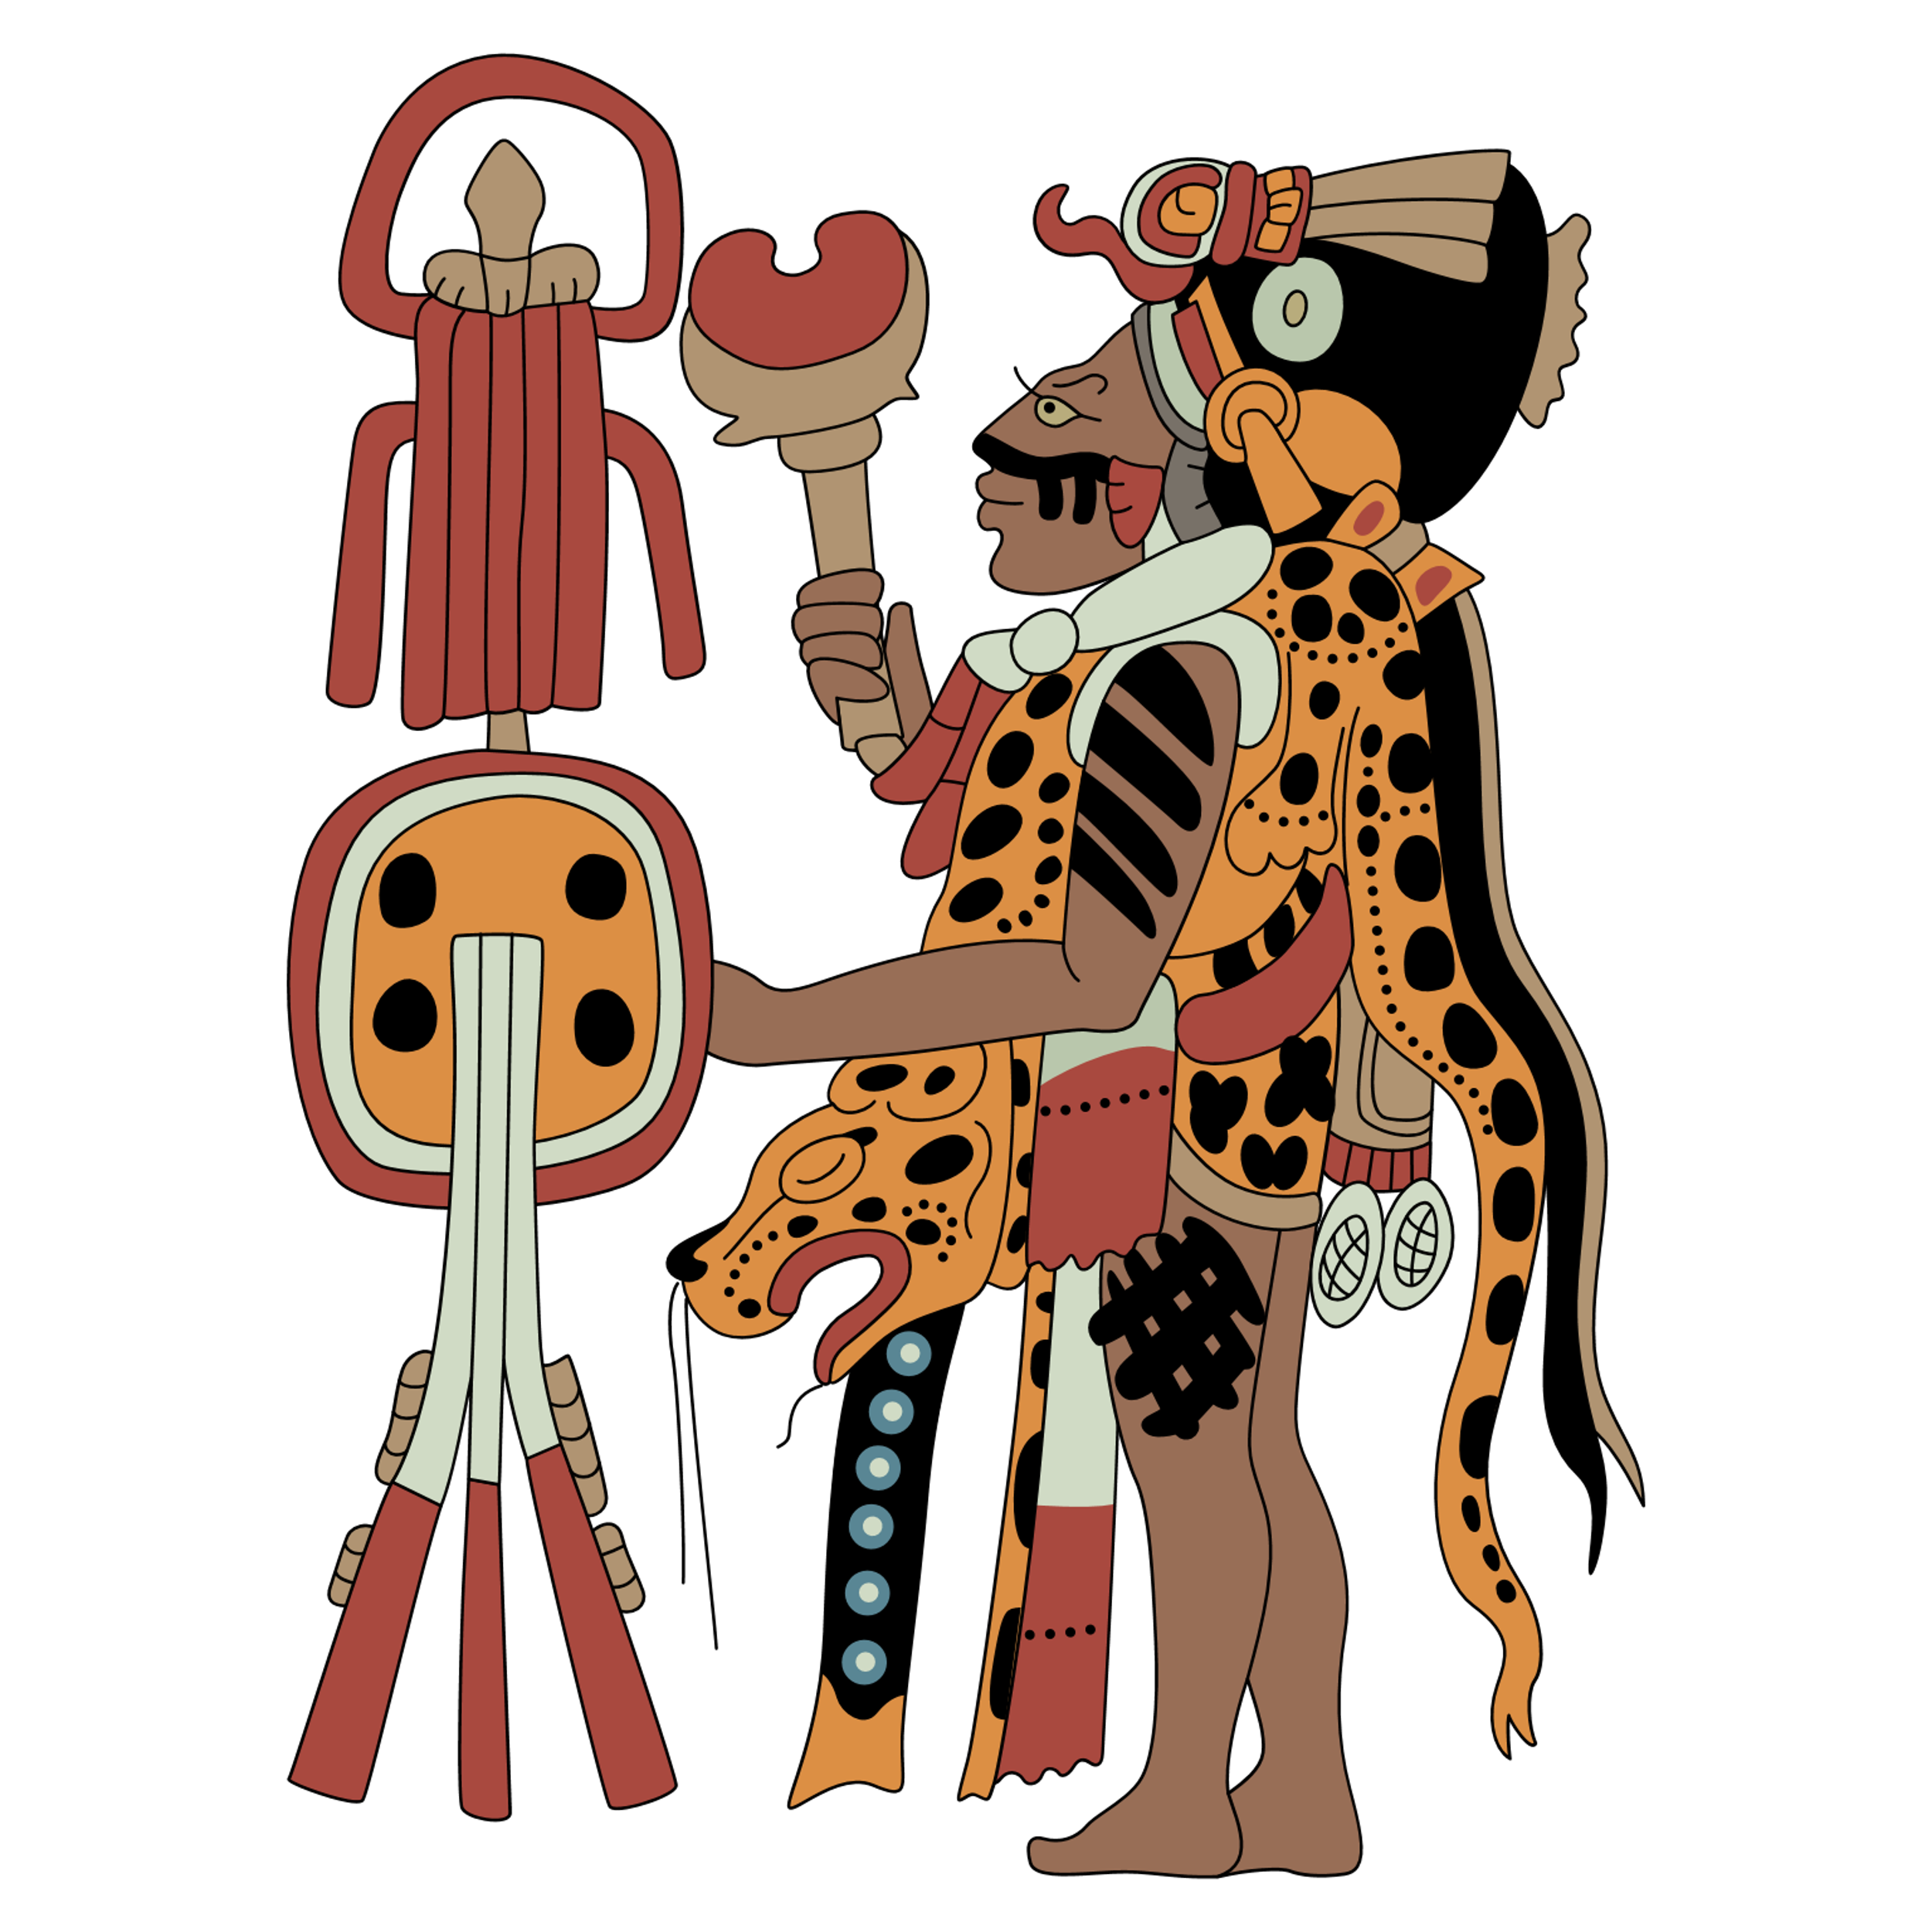
What do we know about Ancient Maya religion?
Lesson 3:
For the Ancient Maya, religion was an extremely important part of daily life.
All of the Ancient Maya were religious.
Notes:
Read: ‘What do we know about Ancient Maya religion?’ This section explains how important religion was to the Ancient Maya and the part it played in their lives. It also explains the role of the priests and who the Ancient Maya worshipped.

Slide 25
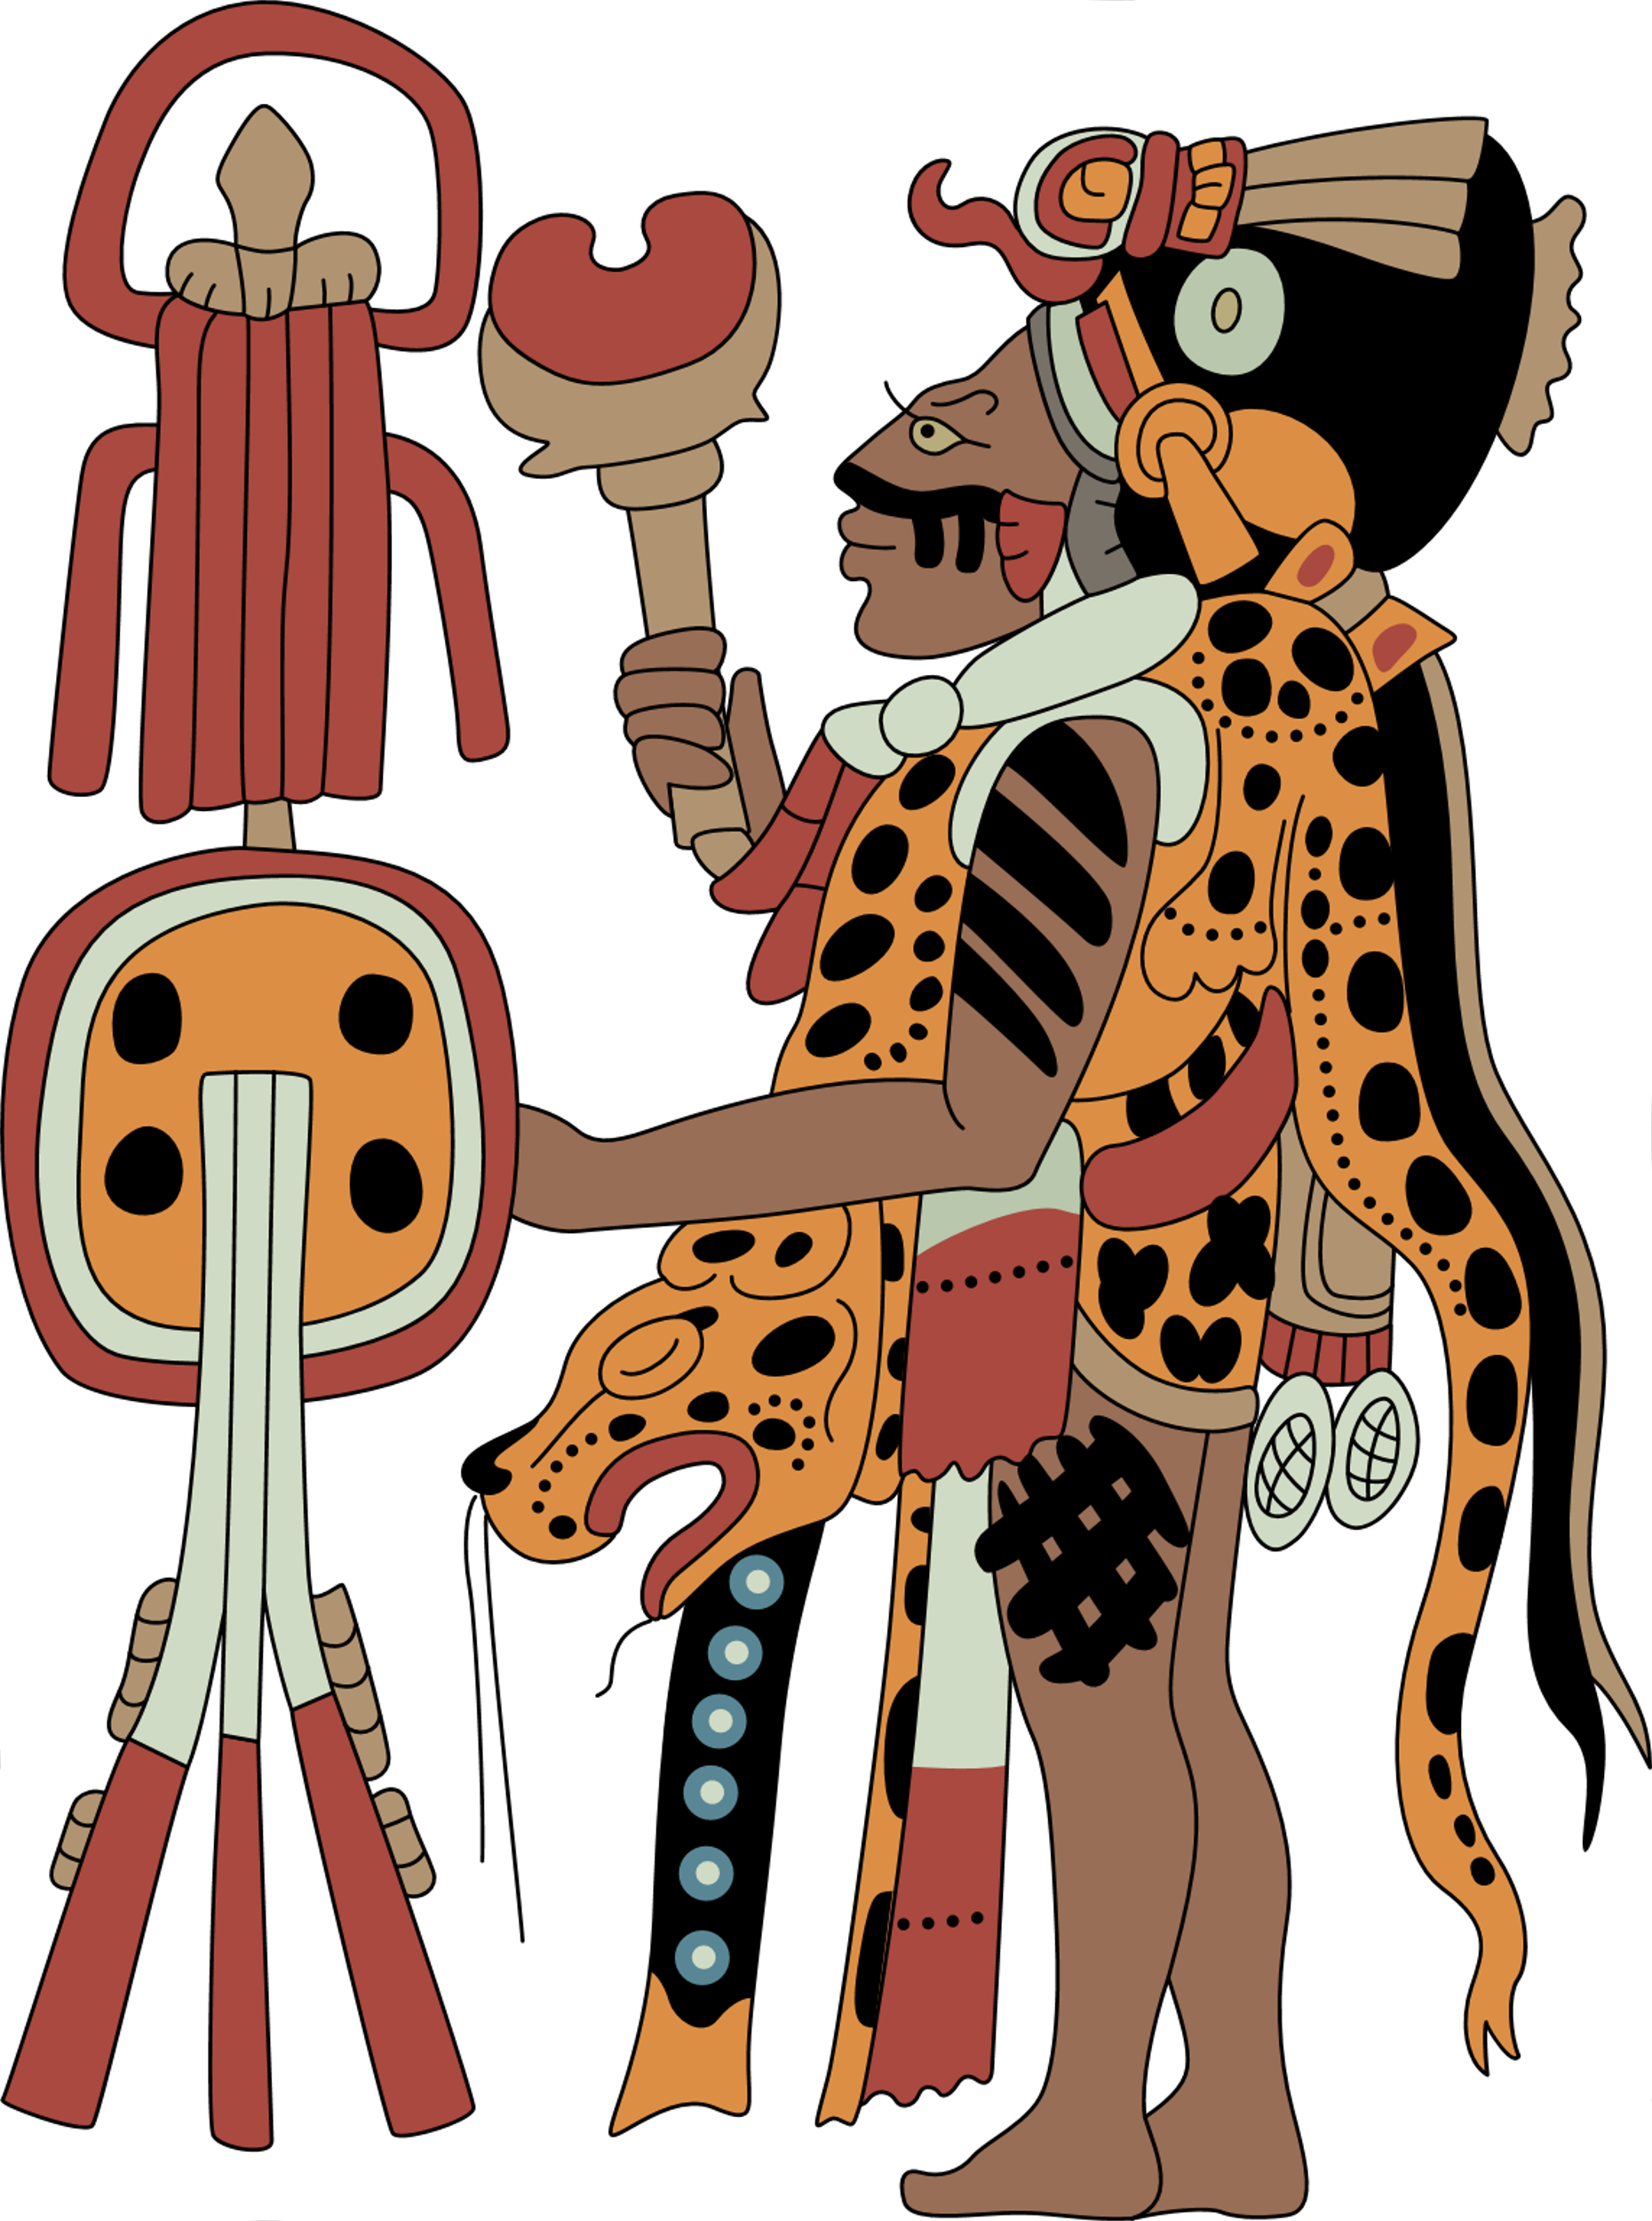
What do we know about Ancient Maya religion?
Lesson 3:
Specially trained priests lived and worked in the cities, where pyramids were built as monuments to worship the gods. The priests were responsible for religious ceremonies all through the year and each had strict rules for food, drink, dances, and music.

Slide 26
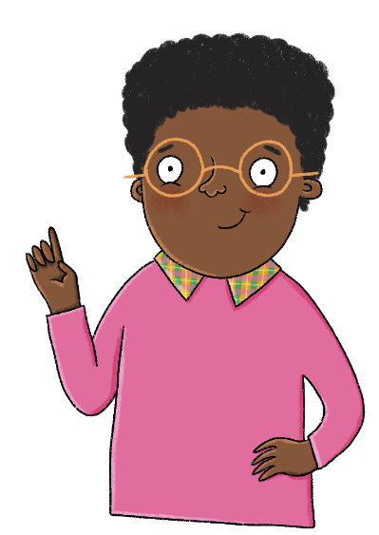
What do we know about Ancient Maya religion?
Lesson 3:
Ceremonies included:
Bloodletting, where a member of royalty’s blood was a sacrifice to the gods.
Saka, where the sacred drink Saka is offered to the gods to ask for good fortune and healthy crops.
Ya’axche’, which is one of the most sacred Mayan ceremonies and celebrates the connection between heaven, Earth, the Maya, and the underworld.
Different fire ceremonies, that lasted for hours, were common.
Sacrifice—there were also ceremonies involving animal and human sacrifice.

Slide 27
What do we know about Ancient Maya religion?
Lesson 3:
The priests were responsible for organising religious festivals for the people. They also told the people what they should do, when they should go hunting or plant crops, and who they should marry. The chief priest was the king or queen of the city-state.
We know about the Maya gods through carvings and Maya books known as codices.

Slide 28
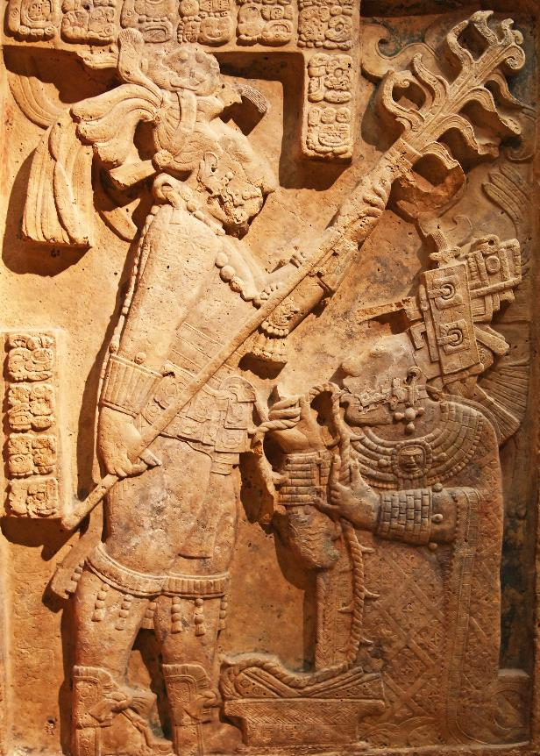
Look closely at this source. What else does this tell us about Maya beliefs?
Lesson 3:
Who?
Where?
What?
Why?
Notes:
Investigation: Pupils need to work together to analyse the source on the slide. They should discuss possible answers to the who, where, what, why question prompts and then come together as a whole class to discuss their initial thoughts. At this stage, share the following introductory information about the source:
This source is a lintel (piece of stone to provide strength above a door or opening) from Mesoamerica which depicts a Maya ritual. The ritual would have been carried out on the raised platform of a pyramid and people would have congregated to watch.
Pupils discuss the question prompts for a second time in pairs/groups. They should note their ideas in the boxes before coming back together as a whole class and discussing them. At this stage, show the answers slide. Were the pupils correct? Are they surprised? Pupils should complete each box with any extra information shared.

Slide 29
Look closely at this source. What else does this tell us about Maya beliefs?
Lesson 3:
Who?
A priest carrying out a ritual on the queen of a Maya city-state (Yaxchilian).
Where?
In or on a temple or pyramid during a blood-letting ceremony.
What?
Using a rope to cut her tongue for a blood-letting ritual.
Why?
To please the gods, to show and maintain power and status.

Slide 30
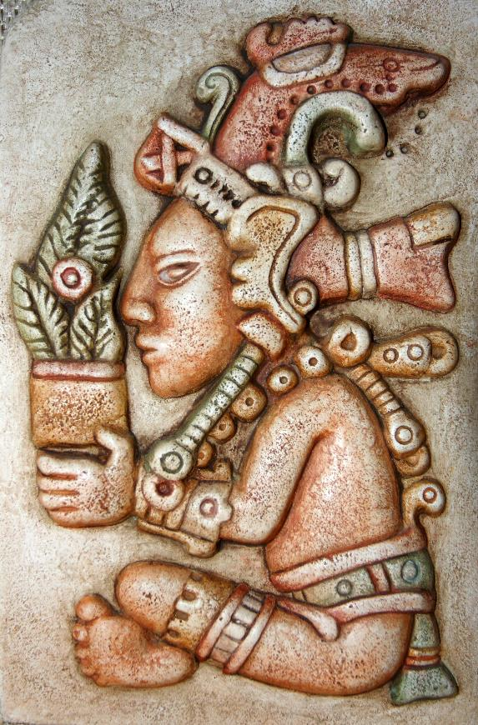
Who were the Ancient Maya gods?
Lesson 3:
As well as worshipping the king or queen, Maya people worshipped their ancestors and many gods.
These gods represented everything—water, rain, rivers, fire, the Sun, the moon, life, death, marriage, birth, and farming are just some examples.
Notes:
Read: ‘Who were the Ancient Maya gods?’ This section introduces the gods to pupils and sets them up for the next activity.

Slide 31
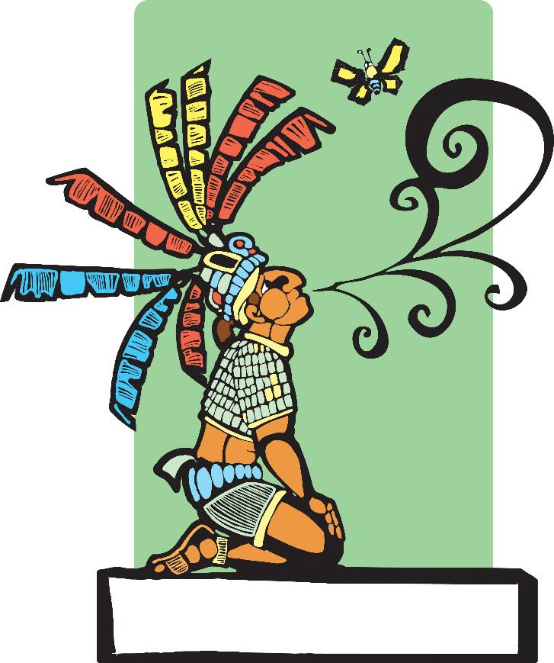
Who were the Ancient Maya gods?
Lesson 3:
Some gods represented more than one thing, and some represented the same thing.
The people worshipped them and would make sacrifices to them in order to please them or to ask for protection.

Slide 32
Who were the Ancient Maya gods?
Lesson 3:
Each of the Ancient Maya gods had a name. Archaeologists have not been able to discover all of them.
The Ancient Maya were great storytellers and had their own creation story. A creation story is a way of explaining how the world came to be and where the first people came from.

Slide 33
Research four of the Ancient Maya gods to complete the following table.
Lesson 3:
Name | Description
Notes:
Write: Pupils should work together to research four gods and complete the table of information. They could also use Additional resource: Maya Gods to add information to their tables. Answers for seven of the gods are provided on the following slides.

Slide 34
Research four of the Ancient Maya gods to complete the following table.
Lesson 3:
Name | Description
Itzamna | Itzamna is the creator and is one of the most important gods. He is lord of the heavens, day and night, and the inventor of books and writing.
Ek’Chuwah | Ek’Chuwah is the merchant god. He is responsible for looking after the merchants and trade. He is also the god of cacao.
K’inich Ajaw | K’inich Ajaw is also known as Kinich Ahau. He is the Maya Sun god who is believed to turn into a jaguar at night. He is also linked to warriors.

Slide 35
Research four of the Ancient Maya gods to complete the following table.
Lesson 3:
Name | Description
Chaac | Chaac is the god of rain and lightning. He has a lightning axe which he uses to strike the clouds. This creates thunder and rain.
Death god | The death gods are linked to death and the underworld. They live in Xibalba, which is the ‘place of fright’. Two death gods are Hun-Came and Vucub-Came.
Ix Chel | Ix Chel is the Maya god of the moon. She is also the god of healing, medicine, waters, and childbirth. Her name could also mean ‘Rainbow Lady’.
K’awiil | K’awiil is the god of royalty, lightning, serpents, and fertility. He protects royal family lines and looks over the coronation of new rulers.

Slide 36
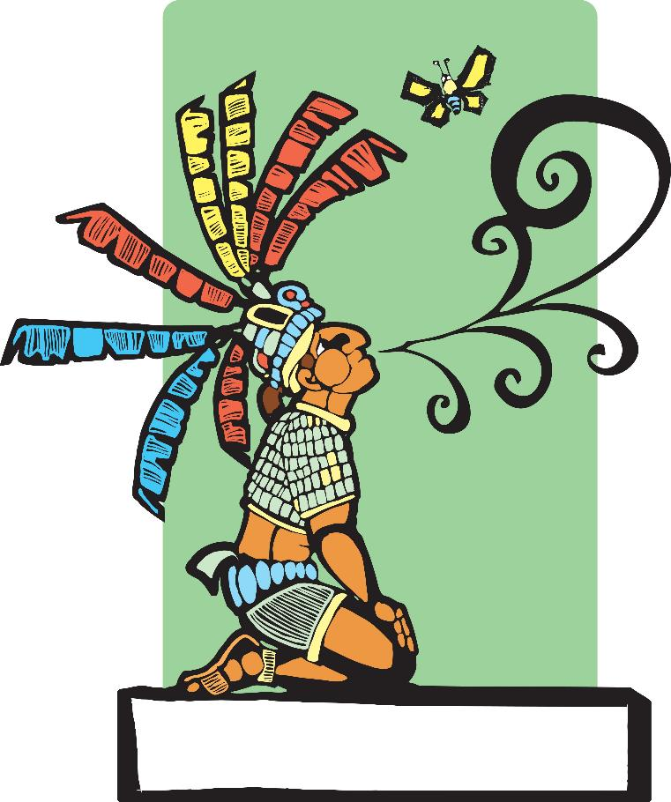
What was the Ancient Maya creation story?
Lesson 3:
The Ancient Maya were great storytellers and, like many other cultures, the Ancient Maya had their own creation story. A creation story is a way of explaining how the world came to be and where the first people came from.
Notes:
Read: ‘What was the Ancient Maya creation story?’ as an extension task, if time is available. (This section introduces the story, which is provided on the Additional resource: The creation story handout only.) Pupils could read the story in pairs before coming back together as a whole class to discuss. What do they learn from the story? What is interesting about it? What questions do they have about the story?

Slide 37
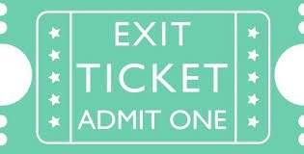
Monday 29th April Q: What did the Ancient Maya believe and how did they worship? Exit question 1. Name and describe one of the Gods the Mayans worshipped. 2. Who else did the Ancient Mayans worship? Challenge: Explain why the Mayan people offered sacrifices to their Gods.

Slide 38
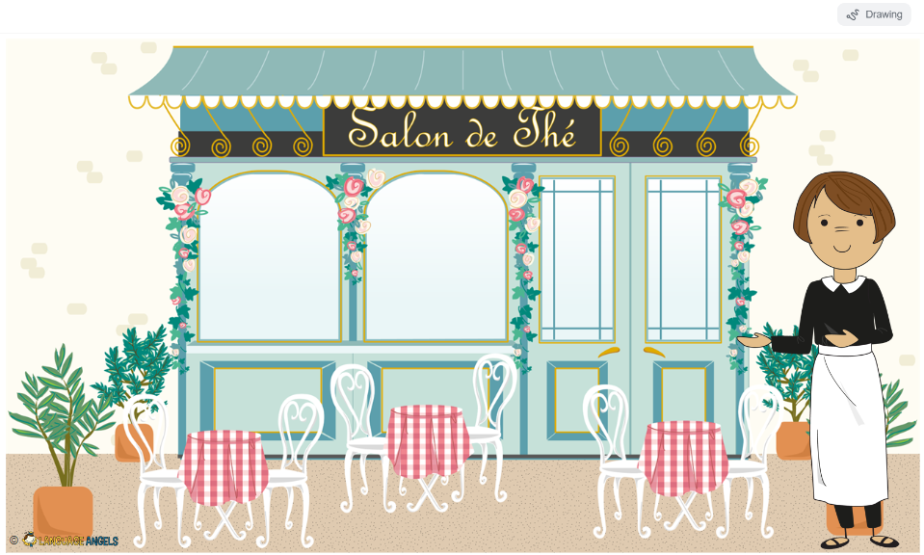
Lundi 29 Avril TBAT: order popular food and drink typically offered in a French cafe.
Dashboard (languageangels.com)

Slide 39
Lundi 29 Avril TBAT: order popular food and drink typically offered in a French cafe.
Challenge
Write a sentence asking to make an order one of the foods or drinks you have learnt.

